Slide 1


superstore
View in Power BI
Last data refresh:
11/02/2024 06:52:51 UTC
Downloaded at:
11/02/2024 07:10:24 UTC

Slide 2
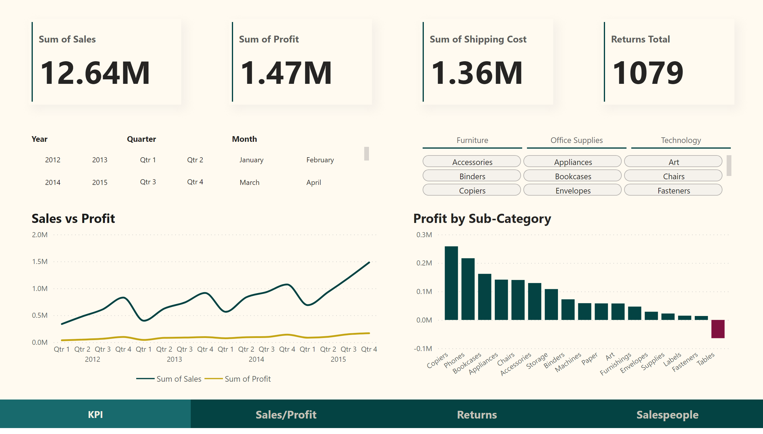
KPI
Notes:
Sales vs Profit
No alt text provided
advancedSlicerVisual
No alt text provided
advancedSlicerVisual
No alt text provided
cardVisual
No alt text provided
cardVisual
No alt text provided
cardVisual
No alt text provided
advancedSlicerVisual
No alt text provided
Month
No alt text provided
Profit by Sub-Category
No alt text provided
cardVisual
No alt text provided
pageNavigator
No alt text provided
Quarter
No alt text provided
advancedSlicerVisual
No alt text provided

Slide 3
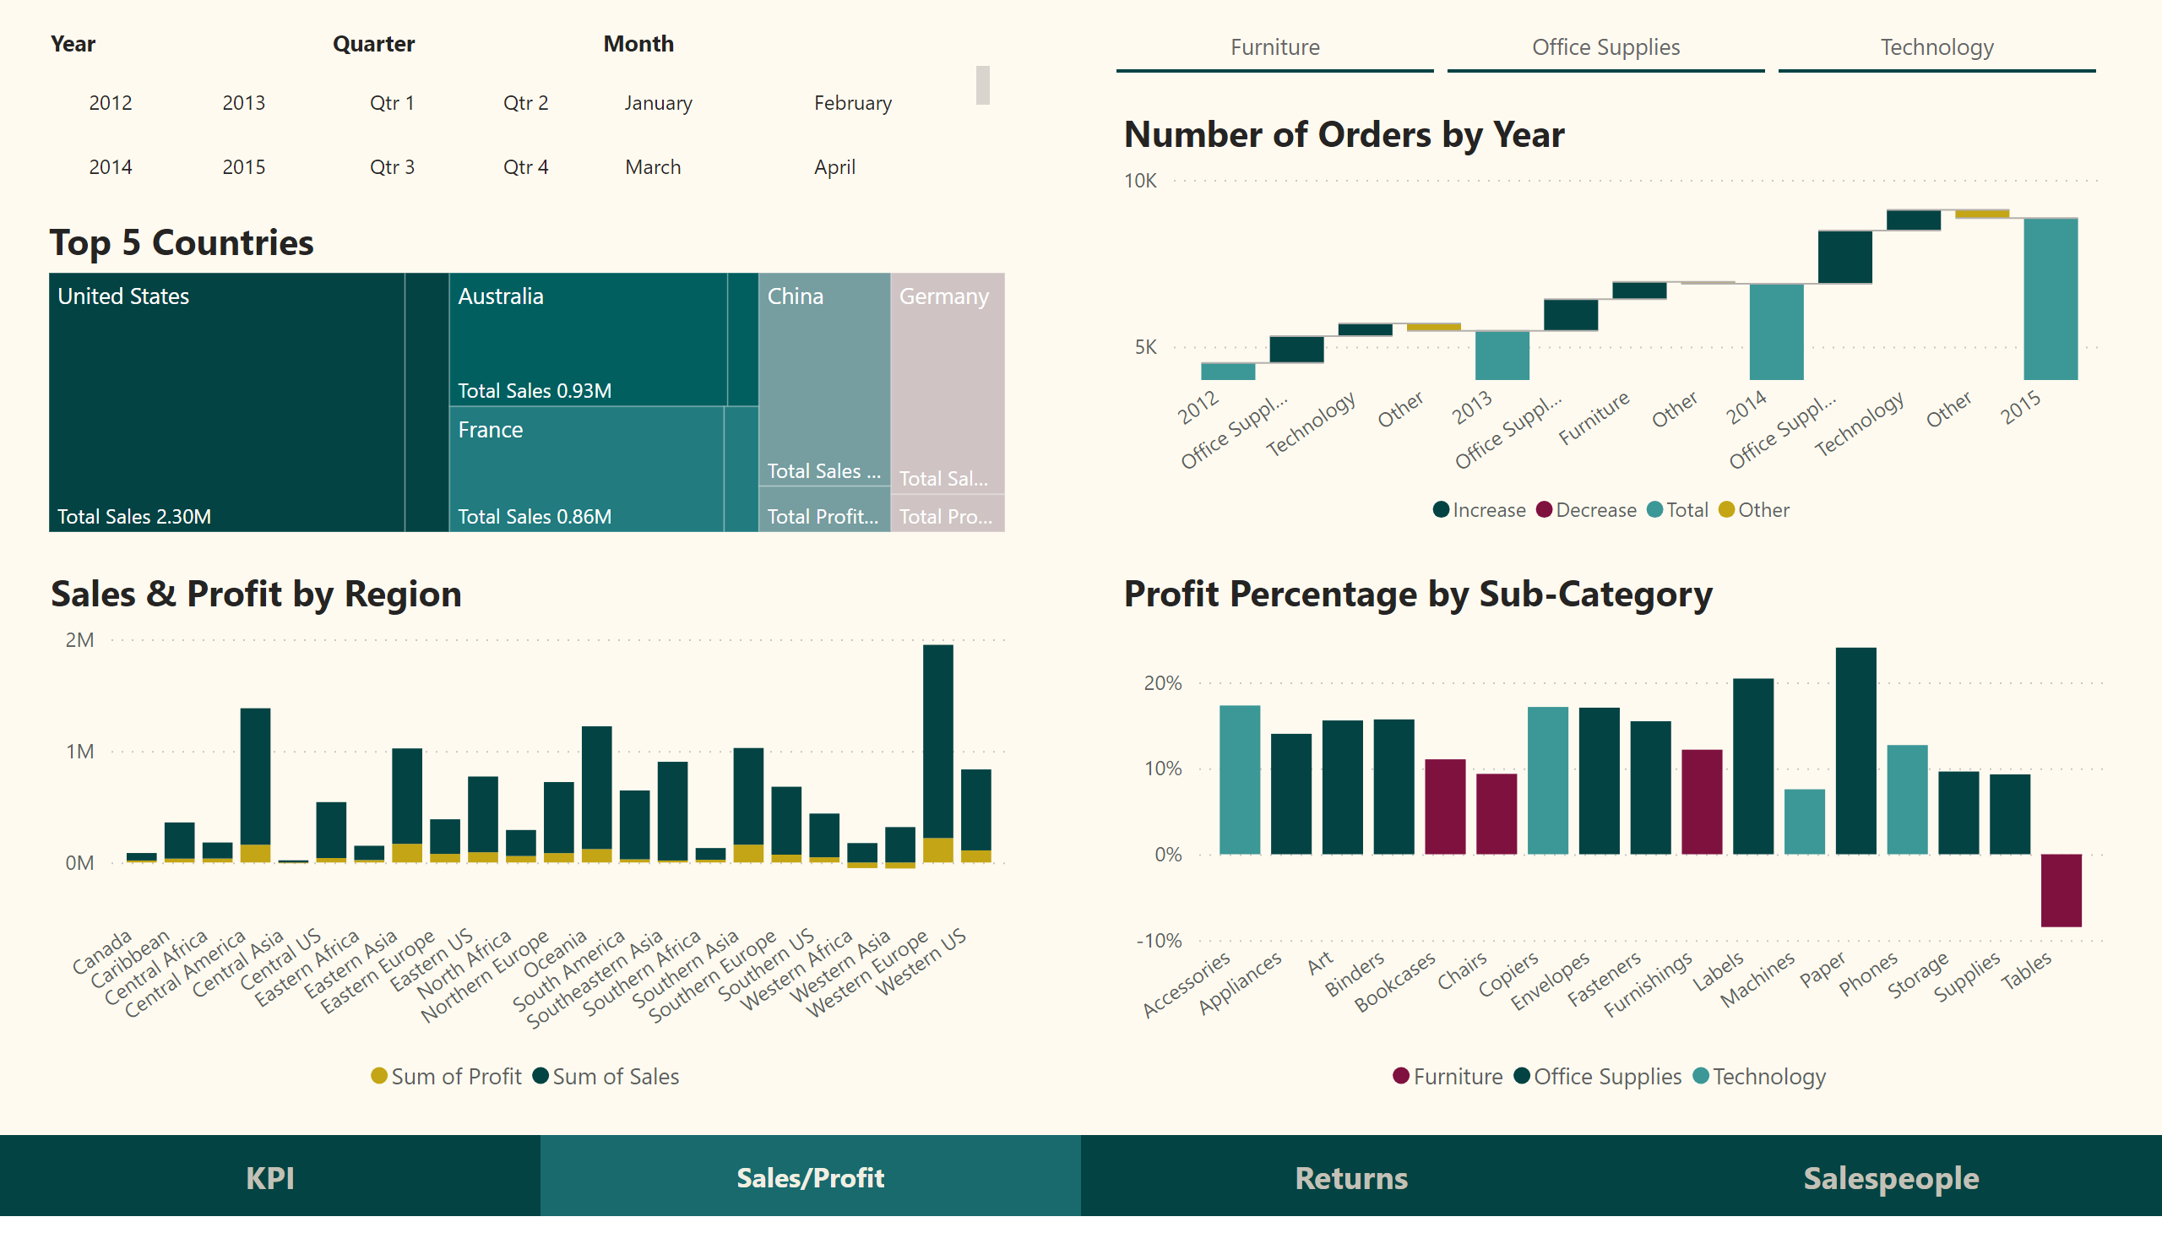
Sales/Profit
Notes:
pageNavigator
No alt text provided
Sales & Profit by Region
No alt text provided
advancedSlicerVisual
No alt text provided
Quarter
No alt text provided
Month
No alt text provided
Profit Percentage by Sub-Category
No alt text provided
advancedSlicerVisual
No alt text provided
Number of Orders by Year
No alt text provided
Top 5 Countries
No alt text provided

Slide 4
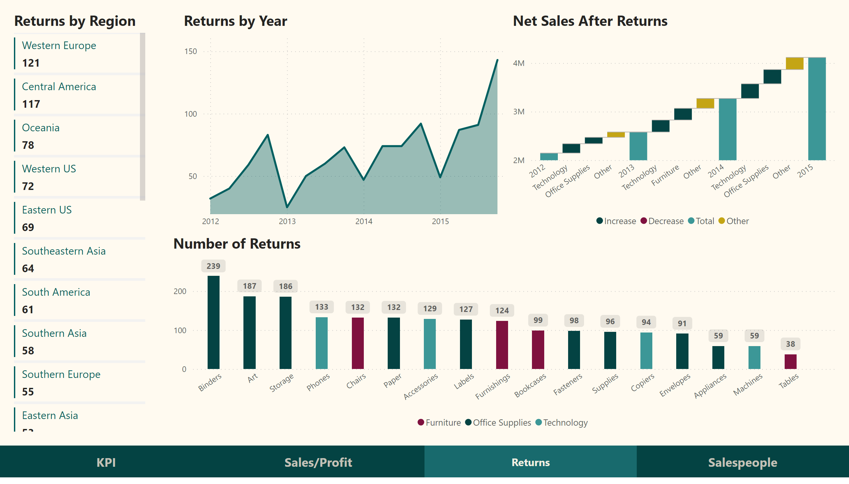
Returns
Notes:
pageNavigator
No alt text provided
Returns by Year
No alt text provided
Number of Returns
No alt text provided
Net Sales After Returns
No alt text provided
Returns by Region
No alt text provided

Slide 5
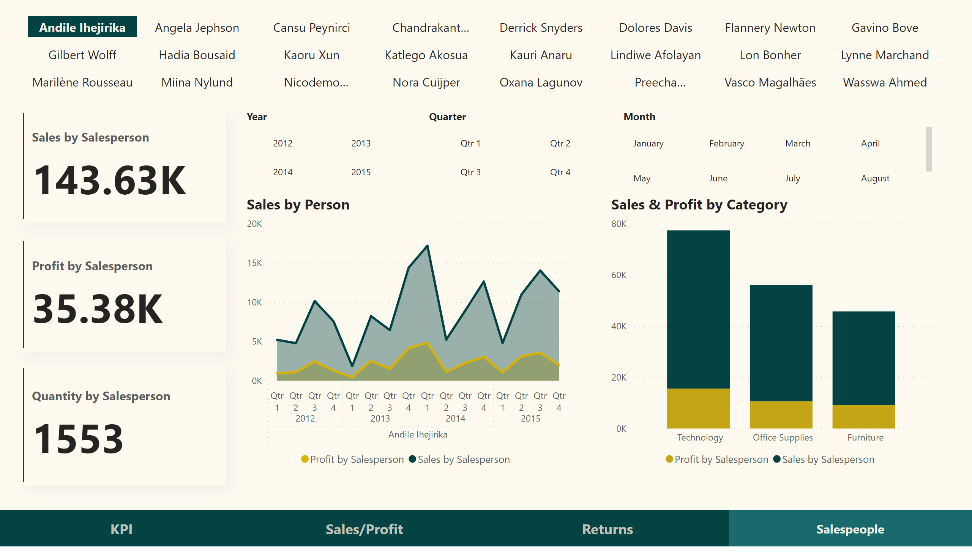
Salespeople
Notes:
Salespeople
No alt text provided
pageNavigator
No alt text provided
Sales by Person
No alt text provided
cardVisual
No alt text provided
cardVisual
No alt text provided
cardVisual
No alt text provided
advancedSlicerVisual
No alt text provided
Quarter
No alt text provided
Month
No alt text provided
Sales & Profit by Category
No alt text provided

