Slide 1

Big Matches
Little Errors
By Cuong Tran, Will Zhong, Gencer Mert, and Albert Ezem Osakwe
Notes:
Cuong

Slide 2
Why?
Academic, behavioral, and emotional benefits*
Self-esteem and trust*
*(Ben-Eliyahu & Goldner, 2021)
Notes:
Setup for the story; why do the analysis; Academic, behavioral, and emotional benefits*; Self-esteem and trust*
Cuong

Slide 3
Influential Factors for…
Match success
Closure reason
Match length
(Raposa et al., 2018)
Notes:
Cuong

Slide 4
Success Criteria: Either…
Still
Active
Long- lasting
Little’s Age
Closed
Successfully
Notes:
Setup for the story; why do the analysis;
Will

Slide 5
Closure Reasons
Unavailable
Incompatible
Moving
Time constraints
Personality mismatch
Lost interest
Unfit for participation
Scheduled
Policy violation
Unreasonable expectations
Successful
Little graduation
Notes:
Will; over 30 closure reasons; some were similar; truly were 4 categories

Slide 6
More Key Terms
Age Gap
Program Type
Small: <10 years
Large: ≥10 years
Community: Outdoors
Site: School
Notes:
Will

Slide 7
01
Match Length
Notes:
Bar chart, explain new groupings for closure reason

Slide 8
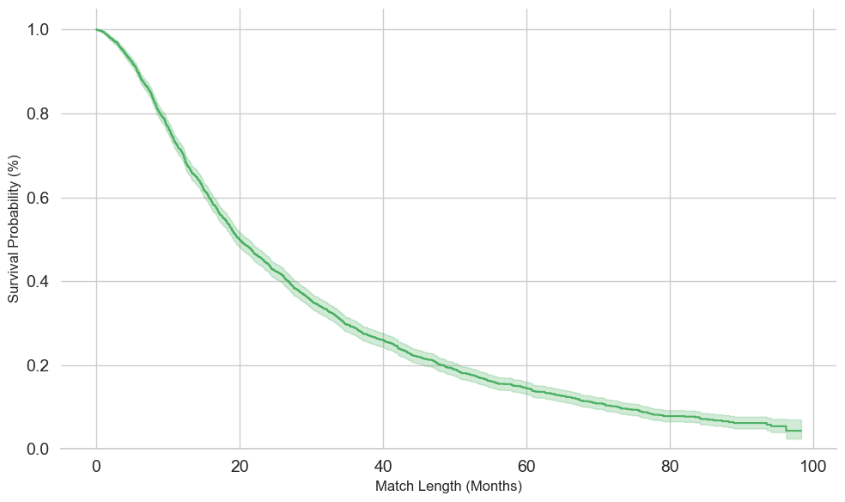
Survival Curve of Match Length
Median
Notes:
Match length- General Data Dist (Median); method of finding our criteria

Slide 9
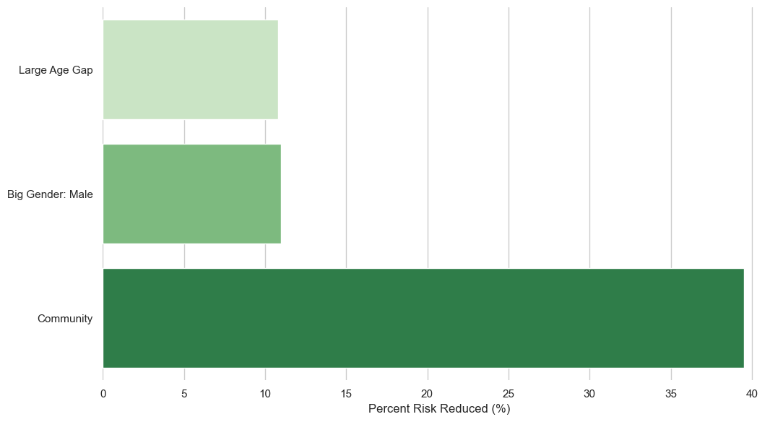
Feature Effects on Match Length
Notes:
Match Length Analysis; age gap; Will; cox regression; community biggest effect; program type split

Slide 10
02
Closure Reason
Notes:
Bar chart, explain new groupings for closure reason

Slide 11

Closure Reason
Lack of availability (55%)
Unfit for participation (26%)
Incompatible Match (12%)
Scheduled termination (7%)
Notes:
Bar chart, explain new groupings for closure reason
Scheduled Termination
"Child: Graduated"
"Successful match closure"
Match length > 20
Lack of Availability
Volunteer Health
"Volunteer: Health"
"Volunteer: Deceased"
Moved
Volunteer: Moved
"Volunteer: Moved within service area"
"Volunteer: Moved out of service area"
Child/Family: Moved
"Child/Family: Moved within service area"
"Child/Family: Moved out of service area"
Time constraint
"Volunteer: Time constraint"
"Child/Family: Time constraints"
Environment
School
"Volunteer: Changed workplace/school partnership"
"Child: Changed school/site"
"Child: Family structure changed"
"COVID impact"
Lack of Participation
Infraction of match rules/agency policies
"Volunteer: Infraction of match rules/agency policies"
"Child/Family: Infraction of match rules/agency policies"
Lost contact
Volunteer: Lost contact
"Volunteer: Lost contact with child/agency"
Low sample size (8)
"Volunteer: Lost contact with child/family"
"Volunteer: Lost contact with agency"
Child/Family: Lost contact
"Child/Family: Lost contact with volunteer/agency"
"Child/Family: Lost contact with volunteer"
"Child/Family: Lost contact with agency"
Agency
"Agency: Concern with Volunteer re: child safety"
Low sample size (1)
"Agency: Challenges with program/partnership"
"Changing Match Type"
Incompatible
Child Readiness
"Child: Lost interest"
"Child: Severity of challenges"
Personal Chemistry
"Child/Family: Feels incompatible with volunteer"
"Volunteer: Feels incompatible with child/family"
Unrealistic expectations
"Volunteer: Unrealistic expectations"
"Child/Family: Unrealistic expectations"

Slide 12
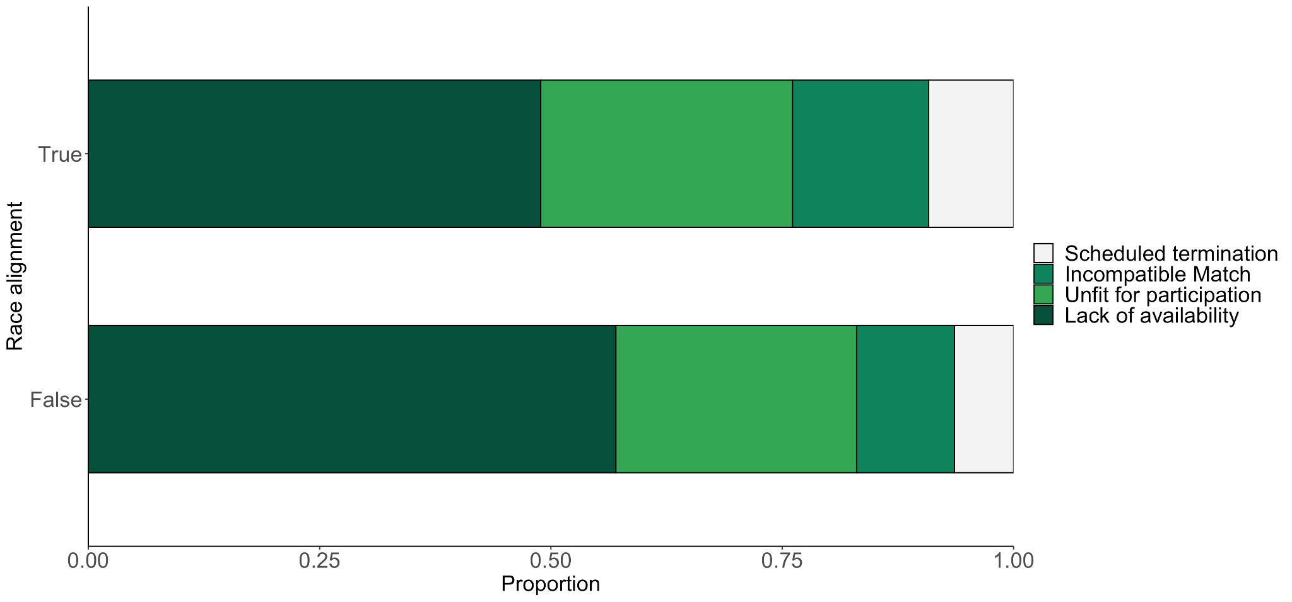
Closure Reason
(DuBois et al., 2018)
Notes:
Program type and closure reason, demographic and interest variables analyzed wrt closure reason
Not significant for Gender (blue is big is male)
Significant for Race Alignment (% increase?)

Slide 13
03
Successful Matches
Notes:
Graph of proportional effects of variables on match length

Slide 14
58%
58%
of all matches result in success!

Slide 15
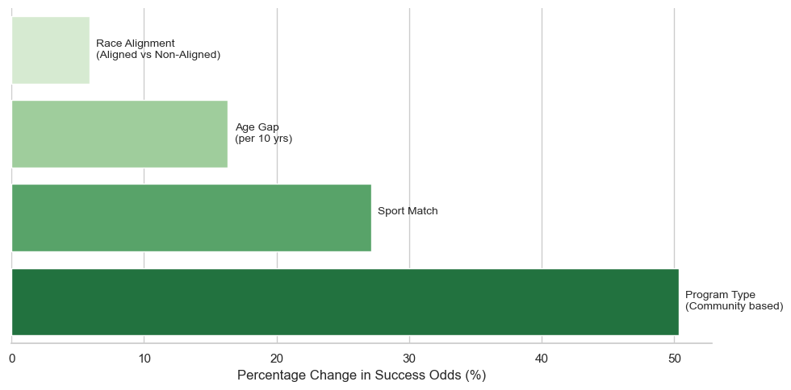
Feature Effects on Success
Notes:
Age Diff, Hobbies, Racial Alignment, Program Type

Slide 16
04
Conclusion
Notes:
Graph of proportional effects of variables on match length
Cuong

Slide 17
Suggestions
Go Out! All Out!
Big Bigs Little Littles
Racial Alignment
Community Bonding Sports in Shorts
Large Age Gaps Increased Longevity
Vital Cross Matching
Notes:
Will, Albert, Cuong, Gencer

Slide 18
Sources
DuBois, D. L., Herrera, C., & Rivera, J. (2018). Investigation of long-term effects of the Big Brothers Big Sisters community-based mentoring program: Final technical report for OJJDP. Office of Justice Programs’ National Criminal Justice Reference Service. https://www.ojp.gov/pdffiles1/ojjdp/grants/251521.pdf
Goldner, L., & Ben-Eliyahu, A. (2021). Unpacking Community-Based Youth Mentoring Relationships: An Integrative Review. International Journal of Environmental Research and Public Health, 18(11), 5666. https://doi.org/10.3390/ijerph18115666
Raposa, E. B., Ben‐Eliyahu, A., Olsho, L. E. W., & Rhodes, J. (2018). Birds of a feather: Is matching based on shared interests and characteristics associated with longer youth mentoring relationships? Journal of Community Psychology, 47(2), 385–397. https://doi.org/10.1002/jcop.22127

Slide 19
Thanks!

Slide 20
Suggestions
Go Out! All Out!
Big Bigs Little Littles
Racial Alignment
Community Bonding Sports in Shorts
Large Age Gaps Increased Longevity
Vital Cross Matching
Notes:
Cuong

