Slide 1






Dclab Final
第八組 陳昱仁 B06901190
楊欣哲 B06505021
傅敬倫 B06505011

Slide 2

01
Introduction
Outline
Theorem
02
Hardware implementation
03
Efficiency and Problems
04
Demo
05

Slide 3
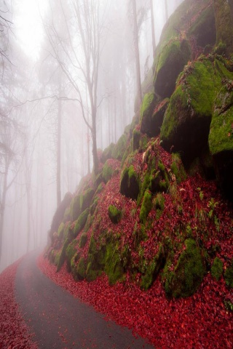
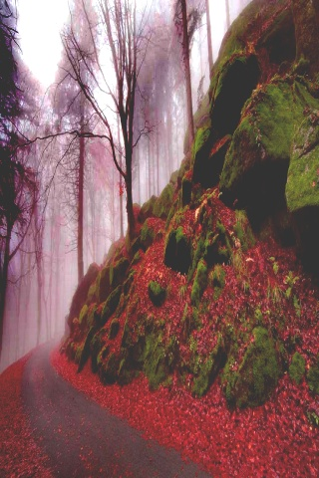
1
Motivation
Defog the picture(fog)

Slide 4

1
Dark channel prior
Dark Channel can be represented by :
$J^{dark}\left(x\right)=\min_{y∈Ω(x)}\left\{\min_{c∈r,g,b}\left(J^{c}(y)\right)\right\}$,
$\min_{y∈Ω(x)}is a min filter$ （we use blur）
Dark Channel Prior : In most fog-free photos, every pixels exist at least one channel has very low values$≈$ 0
${ J}^{dark}\left(x\right)→0$（fog-free photos)

Slide 5
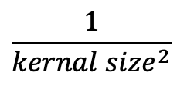
1
Blur filter
Use blur, and padding by a constant (we use 40)
Example:
40 | 40 | 40 | 40 | 40
40 | 1 | 2 | 3 | 40
40 | 4 | 5 | 6 | 40
40 | 7 | 8 | 9 | 40
40 | 40 | 40 | 40 | 40
1 | 1 | 1
1 | 1 | 1
1 | 1 | 1
1 | 2 | 3
4 | 5 | 6
7 | 8 | 9
$$\frac{1}{{kernal size}^{2}}$$
Filter
Picture (no padding)
Picture (padding)

Slide 6
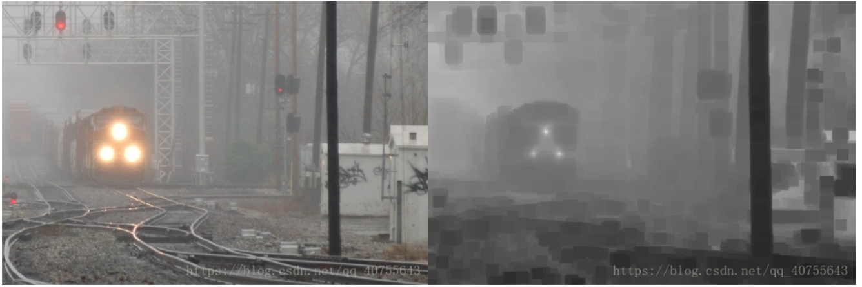
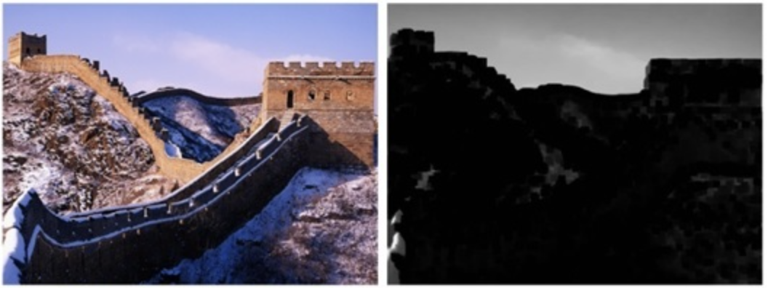
1
Dark channel prior
 | Original | Dark channel
Fog picture
No Fog picture

Slide 7

2
Theorem
Defog model : $I\left(x\right)=J\left(x\right)t\left(x\right)+A\left[1−t(x)\right]$
$I\left(x\right) is origin picture (including fog)$
$J\left(x\right) is defog picture (wanted)$
$t\left(x\right) is transmittance$
$A is atmospheric light$

Slide 8

2
Theorem
Computing $t\left(x\right)$
$I\left(x\right)=J\left(x\right)t\left(x\right)+A\left[1−t(x)\right]⋯(1)$
$\frac{I(x)}{A}=\frac{J\left(x\right)}{A}t\left(x\right)+\left[1−t(x)\right]⋯(2)$
$\min_{y∈Ω(x)}\left\{\min_{c∈r,g,b}\frac{I(x)}{A}\right\}=\min_{y∈Ω(x)}\left\{\min_{c∈r,g,b}\frac{J\left(x\right)}{A}t(x)\right\}+1−t\left(x\right)⋯\left(3\right)$
$$J\left(x\right) is defog picture,\min_{y∈Ω(x)}\left\{\min_{c∈r,g,b}\frac{J\left(x\right)}{A}t(x)\right\}→0$$
$∴t\left(x\right)=1−\min_{y∈Ω(x)}\left\{\min_{c∈r,g,b}\frac{I(x)}{A}\right\}$

Slide 9

2
Theorem
$I\left(x\right)=J\left(x\right)t\left(x\right)+A\left[1−t(x)\right]⋯(1)$
$t\left(x\right)=1−\min_{y∈Ω\left(x\right)}\left\{\min_{c∈r,g,b}\frac{I\left(x\right)}{A}\right\}⋯(2)$
Define $P^{dark}=\min_{c∈r,g,b}I\left(x\right)$
(2) can be written as : $t\left(x\right)=1−\min_{y∈Ω\left(x\right)}\frac{P^{dark}}{A}⋯(3)$
By (1)(3),
$$J\left(x\right)=\frac{I\left(x\right)−\min_{y∈Ω\left(x\right)}P^{dark}}{1−\min_{y∈Ω\left(x\right)}\frac{P^{dark}}{A}}$$

Slide 10
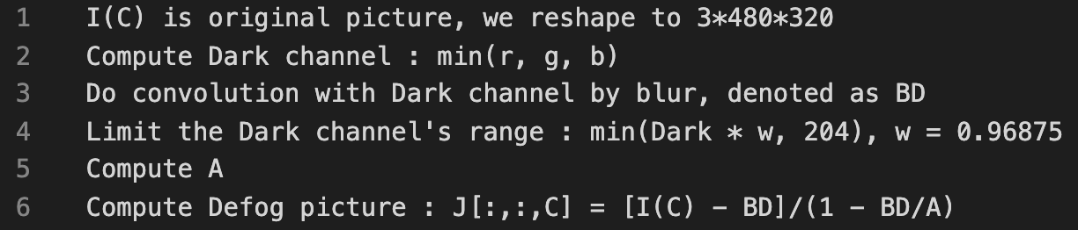
2
Algorithm

Slide 11


3
Block Diagram
SRAM
RS232 Controller
VGA Controller
CORE
Dark Channel
Blur Filter
MulDiv
PC
VGA
A Calculator

Slide 12
3
Dark Channel
Padding data
（0 or 20 or 40）
64
320
64
Dark data
63
480
63

Slide 13
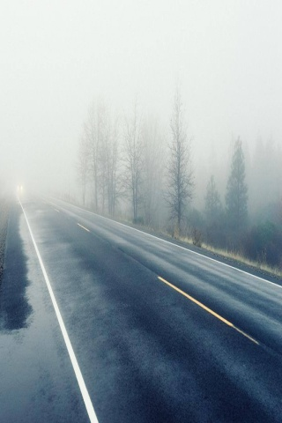
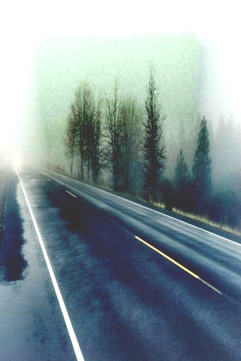
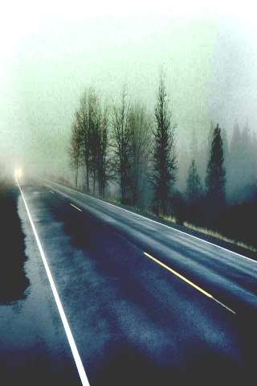
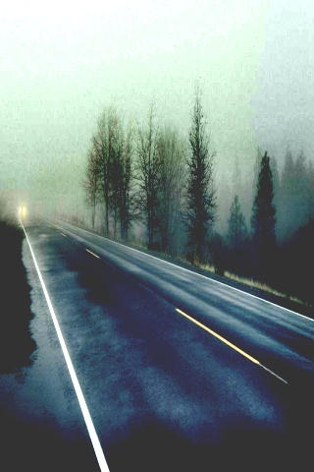
3
Padding
Original
Padding=0
Padding=20
Padding=40

Slide 14
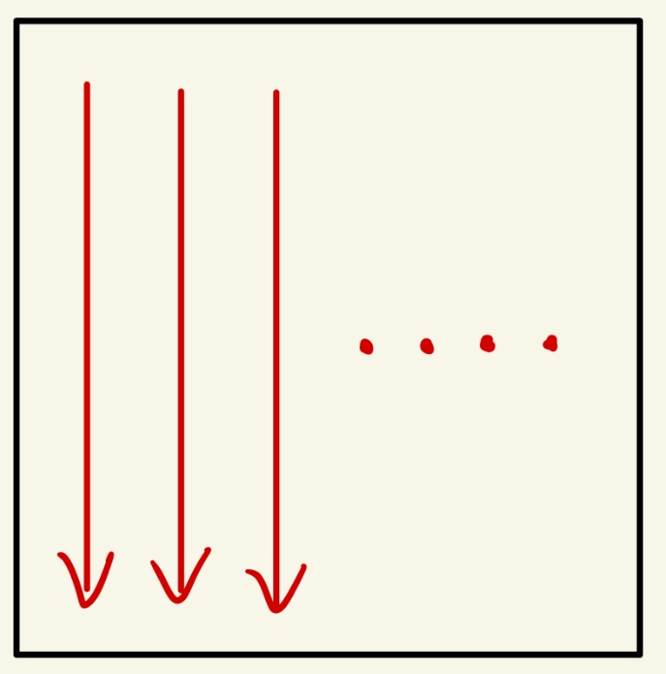
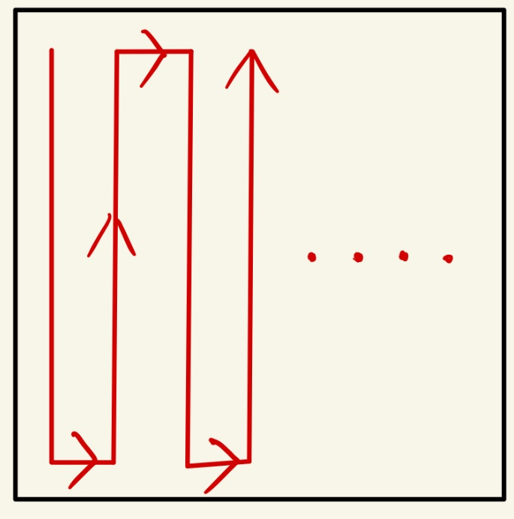
3
Blur
Input size : 480 * 320 ( Dark channel )
Filter size : 128 * 128
Best input data reuse :
kernel
kernel

Slide 15
4
Efficiency
Software（python）: 2.4s
Hardware :
Frequency : 75M
Image size : 480 * 320
Time : 0.5s
5x speed up

Slide 16
4
Problems
Rs232 spent too much time
Blur’s kernel size is too big（128*128）, which is bad for timing performance
Other padding methods may have better result

Slide 17
Demo

Slide 18
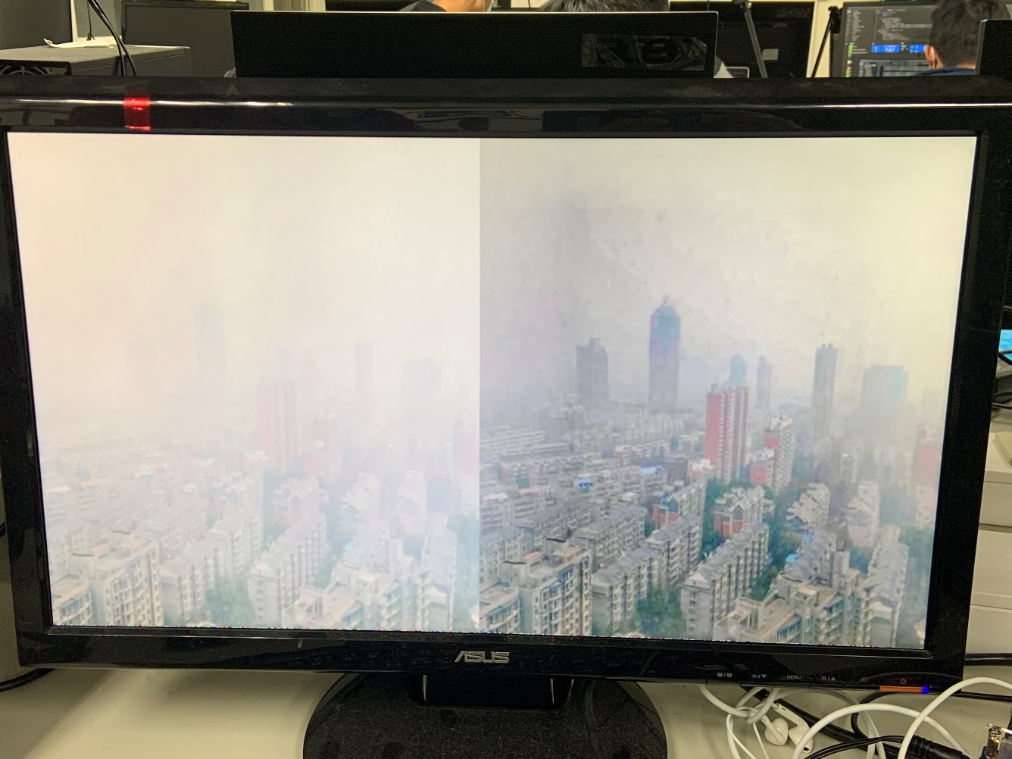
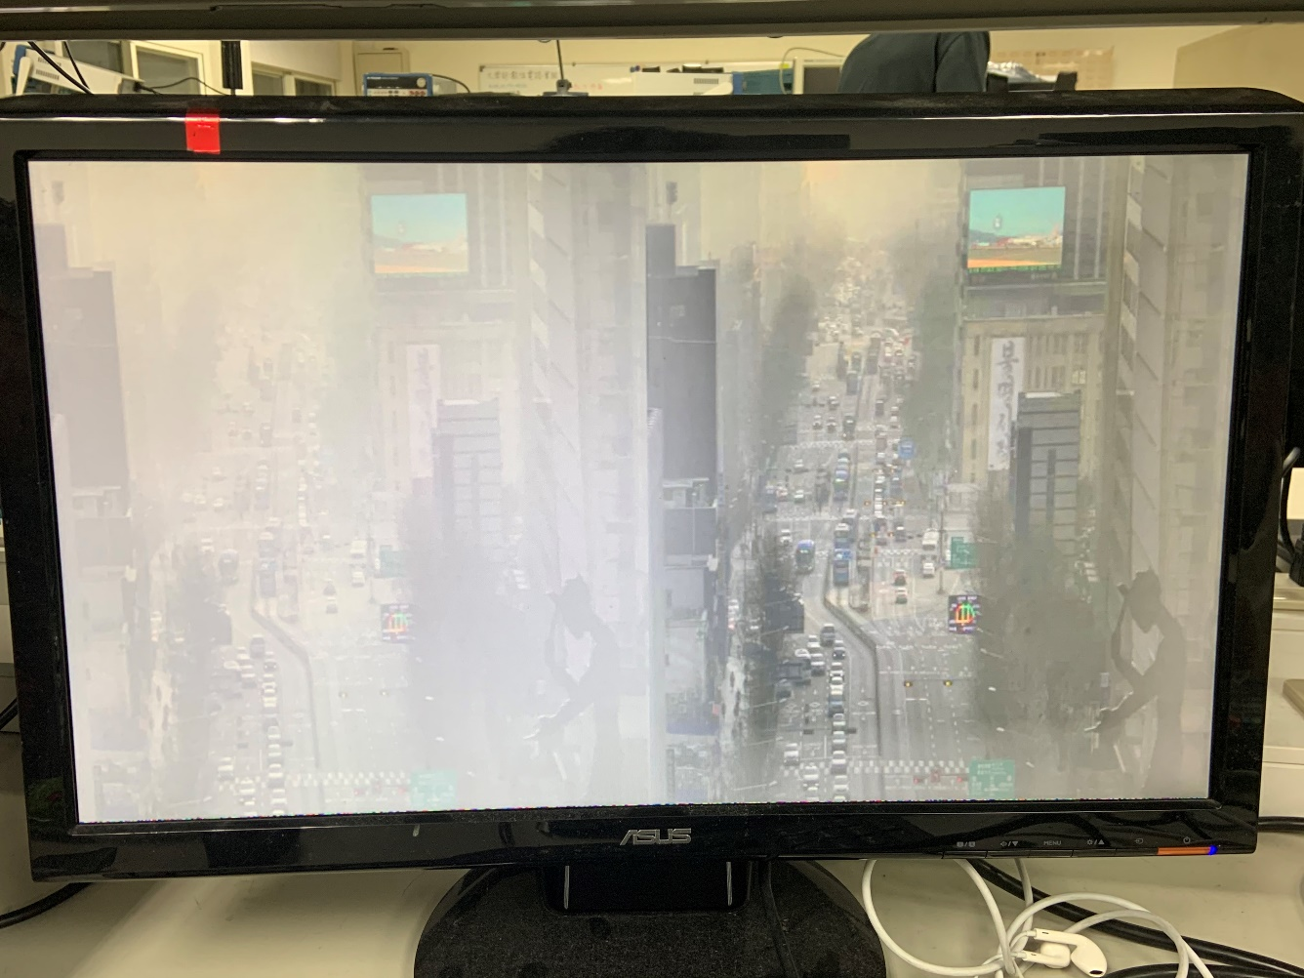
5
Demo

