Slide 1
Automatic State-Based
Test Generation Using
Genetic Algorithms

Slide 2
Introduction
-> Finite state machines (FSMs), or automata, are simple mathematical means of describing state diagrams.
-> It’s an abstract machine that can be in exactly one state of a finite number of states at any given time and in response to some inputs it can change to another state through a transition.
-> a FSM consists of a finite set of states Q, of which one is the designated initial state q1, and transitions between states labelled by symbols from a finite alphabet X
-> In the scope of this project we will use for illustrations the FSM model of a simplified Book class from a library system.

Slide 3
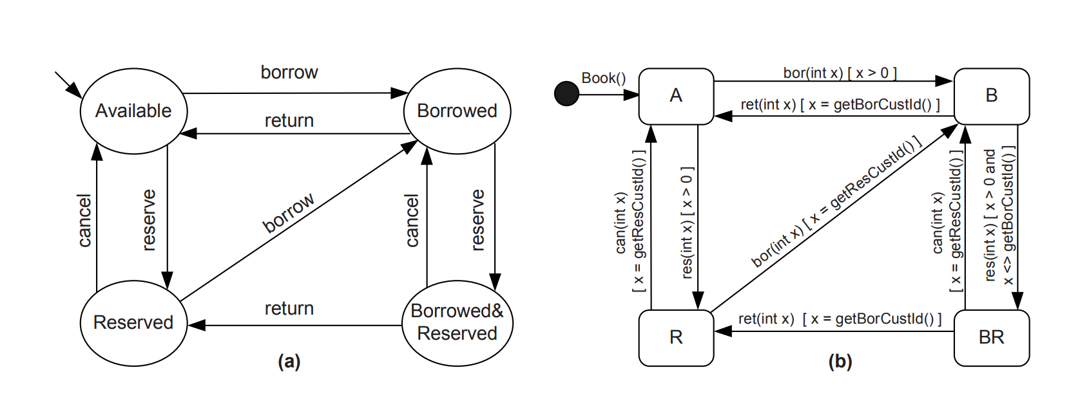
FSM
State machine diagram

Slide 4
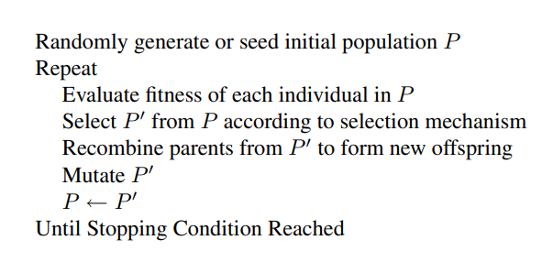
Genetic Algorithms
-> Genetic algorithms (GAs) are a particular class of evolutionary algorithms, that use techniques inspired from biology, such as selection, recombination (crossover) and mutation.
-> GAs are used for problems which cannot be solved using traditional techniques and for which an exhaustive search of the solution space is impractical

Slide 5
Test data generation strategy
-> The generation technique is based on the state diagram of the object under test and uses a genetic algorithm to search for the test data (input parameters) which satisfy some specified requirements
->The first step of the test generation is to obtain some valid paths in the state machine
->Once the state machine of the class is available (with guard conditions included in the transition labels), it is possible to automatically obtain test sequences that accomplish these criteria
-> The second step is finding, for each sequence, the input parameter values which trigger the methods in the sequence.
-> In order to illustrate our approach we will consider the present state machine representation of a Book class, having the transitions labelled with the method names, including their parameter list and guard conditions

Slide 6
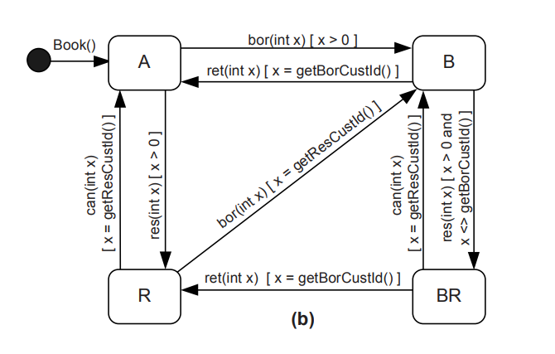

->The Book class has public getters for the customer which has reserved or borrowed the book: getResCustId() and getBorCustId()
-> The guards express conditions related to the the input parameters and/or the current ”memory” of the machine:
-> bor(x)[x = getResCustId()] transition from state R to state B
-> bor(x)[x <> getResCustId()] transition from R to R (corresponding to a forbidden usage of the method).
-> The derived constraints are:
x1, x2, x3, x4 > 0
x2 != x1, x3 = x1, x4 = x2
Example:

Slide 7
Chromosomes
-> Given a particular path in the state machine like:
-> and the corresponding constraints for each transition in the path, a chromosome (possible solution) is a list of input values, for example x = (x1, x2, x3, x4), corresponding to all parameters of the path methods (in the order they appear).
->If the sequence of method calls with parameter values from a chromosome X determines the transitions between the states specified by the path and validate the predicate of each transition, then x is a solution for the given path

Slide 8
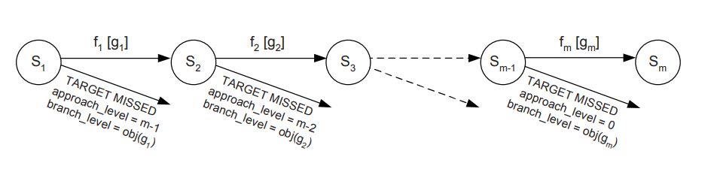
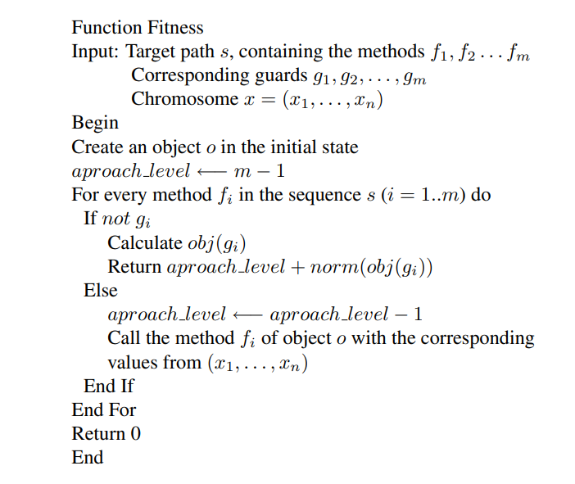
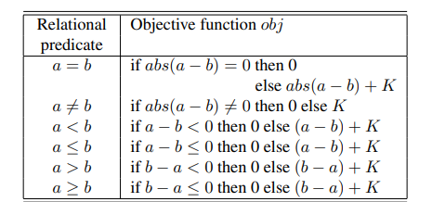
Fitness calculation
Tracey’s objective function for relational predicates.
The value K, K > 0, refers to a constant which is always added if the term is not true

Slide 9
Experiment
-> Selected 10 valid paths for which we generate valid input values
population size = 20, num_generations = 200, input_range = [-1000, 1000] , crossover_rate = 0.8, mutation_rate = 1/15, tournament_size = 5
-> Selection method: Tournament Selection
-> Crossover method: for (x1, x2, …, x7) genes of parent 1 and (y1, y2, …, y7 genes of parent 2, genes of child will be: Zi = α * (Xi - Yi) + Xi , where α = 0.2 and parent 1 is fitter
-> Mutation method: for every gene that gets to be mutated, we will update it with a random number from the input_range

Slide 10
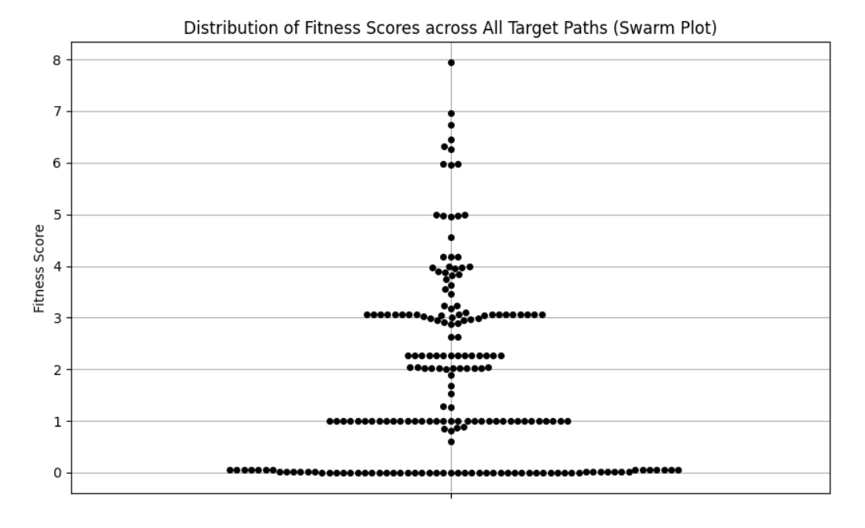
Results

Slide 11
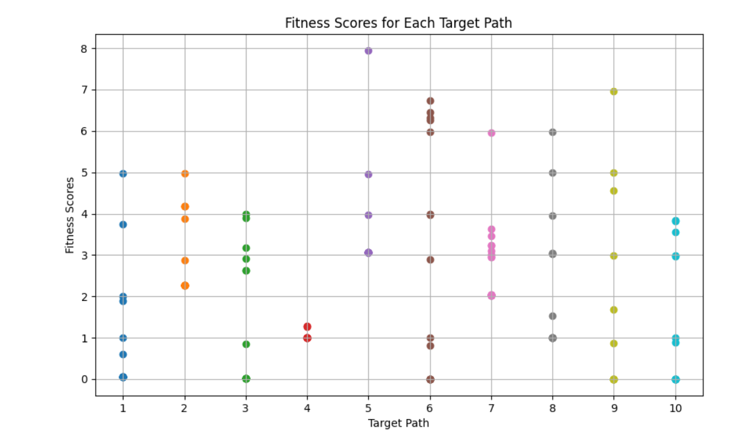
Results

Slide 12
The End
Bibliography: Raluca Lefticaru, Florentin Ipate: Automatic State-Based Test Generation Using Genetic Algorithms, in SYNASC, 188-195 (2007). http://www.ifsoft.ro/~florentin.ipate/publications/SYNASC%202007%20Automatic%20State-Based%20Test%20Generation%20Using%20Genetic%20Algorithms.pdf

