Slide 1
Relational and Non-Relational Data Living in Peace and Harmony
Polybase in SQL Server PDW 2012

Slide 2
Please silence cell phones

Slide 3
Agenda
Motivation – Why Polybase at all?
Concept of External Tables
Querying non-relational data in HDFS
Parallel data import from HDFS & data export into HDFS
Prerequisites & Configuration settings
Summary

Slide 4
Motivation – PDW & Hadoop Integration

Slide 5
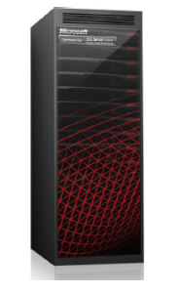


SQL Server PDW Appliance
Shared-Nothing Parallel DBSM
Scalable Solution
Standards based
Pre-packaged

Slide 6
Query Processing in SQL PDW (in a nutshell)
User data resides in compute nodes (distributed or replicated); control node obtains metadata
Leveraging SQL Server on control node as query processing aid
DSQL Plan may include DMS plan for moving data (e.g. for join-incompatible queries)
DSQL plan
Plan Injection
‘Optimizable query’
DMS op
(e.g. SELECT)
…
Control Node [Shell DB]
Compute Node 1
Compute Node 2
Compute Node n
Notes:
Search space = set of all execution plans for an input query
Produced serial plan of the SQL Server instance on control node is not enough/optimal as there is no knowledge about the distribution of data > join order may be different
if data sets are co-located

Slide 7



New World of Big Data
New emerging applications
generating massive amount of non-relational data
New challenges for advanced data analysis
techniques required to integrate relational with non-relational data
Social Apps
Sensor & RFID
Traditional schema-based DW applications
How to overcome the ‘Impedance Mismatch’?
Mobile Apps
Web Apps
Hadoop
RDBMS
Non-Relational data
Relational data

Slide 8
Project Polybase
Background
Close collaboration between Microsoft’s Jim Gray System Lab lead by database pioneer David DeWitt and PDW engineering group
High-level goals for V2
Seamless querying of non-relational data in Hadoop via regular T-SQL
Enhancing PDW query engine to process data coming from Hadoop
Parallelized data import from Hadoop & data export into Hadoop
Support of various Hadoop distributions – HDP 1.x on Windows Server, Hortonwork’s HDP 1.x on Linux, and Cloudera’s CHD4.0

Slide 9
Concept of External Tables

Slide 10
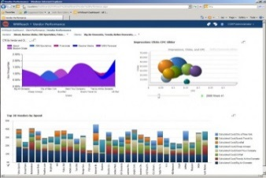

Polybase – Enhancing PDW query engine
Data Scientists BI Users DB Admins
Regular T-SQL
Results
Traditional schema-based DW applications
Social Apps
Sensor & RFID
External Table
Mobile Apps
Web Apps
Enhanced
PDW query engine
Hadoop
PDW V2
Non-relational data
Relational data

Slide 11
External Tables
Internal representation of data residing in Hadoop/HDFS
Only support of delimited text files
High-level permissions required for creating external tables
ADMINISTER BULK OPERATIONS & ALTER SCHEMA
Different than ‘regular SQL tables’ (e.g. no DML support …)
Introducing new T-SQL
CREATE EXTERNAL TABLE table_name ({<column_definition>} [,...n ])
{WITH (LOCATION =‘<URI>’,[FORMAT_OPTIONS = (<VALUES>)])}
[;]
1.
2.
3.
Indicates ‘External’ Table
Required location of Hadoop cluster and file
Optional Format Options associated with data import from HDFS

Slide 12
Format Options
<Format Options> :: = [,FIELD_TERMINATOR= ‘Value’], [,STRING_DELIMITER = ‘Value’], [,DATE_FORMAT = ‘Value’], [,REJECT_TYPE = ‘Value’], [,REJECT_VALUE = ‘Value’] [,REJECT_SAMPLE_VALUE = ‘Value’,], [USE_TYPE_DEFAULT = ‘Value’]
FIELD_TERMINATOR
to indicate a column delimiter
STRING_DELIMITER
to specify the delimiter for string data type fields
DATE_FORMAT
for specifying a particular date format
REJECT_TYPE
for specifying the type of rejection, either value or percentage
REJECT_SAMPLE_VALUE
for specifying the sample set – for reject type percentage
REJECT_VALUE
for specifying a particular value/threshold for rejected rows
USE_TYPE_DEFAULT
for specifying how missing entries in text files are treated

Slide 13

HDFS Bridge
Direct and parallelized HDFS access
Enhancing PDW’s Data Movement Service (DMS) to allow direct communication between HDFS data nodes and PDW compute nodes
Regular T-SQL
Results
Social Apps
Sensor & RFID
Traditional schema-based DW applications
External Table
Mobile Apps
Web Apps
Enhanced
PDW query engine
HDFS bridge
HDFS data nodes
PDW V2
Non-Relational data
Relational data

Slide 14
Underneath External Tables – HDFS bridge
Statistics generation (estimation) at ‘design time’
Estimation of row length & number of rows (file binding)
Calculation of blocks needed per compute node (split generation)
Parsing of the format options needed for import
File binding & split generation
CREATE EXTERNAL TABLE Statement
HDFS bridge process
Hadoop Name Node
Tabular view on hdfs://../employee.tbl
maintains metadata (file location, file size …)
part of DMS process
Parser process
Parsing of format options
part of ‘regular’ T-SQL parsing process

Slide 15
Summary – External Tables in PDW Query Lifecycle
Shell-only execution
No actual physical tables created on compute nodes
Control node obtains external table object
Shell table as any other with the statistic information & format options
SHELL-only plan
External Table Shell Object
No actual physical tables on compute nodes
CREATE EXTERNAL TABLE
…
Control Node [Shell DB]
Compute Node 1
Compute Node 2
Compute Node n
Hadoop Name Node

Slide 16
Querying non-relational data in HDFS via T-SQL

Slide 17
Querying non-relational data via T-SQL
Query data in HDFS and display results in table form (via external tables)
Join data from HDFS with relational PDW data
Running Example – Creating external table ‘ClickStream’:
CREATE EXTERNAL TABLE ClickStream(url varchar(50), event_date date, user_IP varchar(50)), WITH (LOCATION =‘hdfs://MyHadoop:5000/tpch1GB/employee.tbl’, FORMAT_OPTIONS (FIELD_TERMINATOR = '|'));
Query Examples
Text file in HDFS with | as field delimiter
1.
SELECT top 10 (url) FROM ClickStream where user_IP = ‘192.168.0.1’
Filter query against data in HDFS
2.
SELECT url.description FROM ClickStream cs, Url_Descr* url WHERE cs.url = url.name and cs.url=’www.cars.com’;
Join data from various files in HDFS (*Url_Descr is a second text file)
3.
SELECT user_name FROM ClickStream cs, User* u WHERE cs.user_IP = u.user_IP and cs.url=’www.microsoft.com’;
Join data from HDFS with data in PDW (*User is a distributed PDW table)

Slide 18





Querying non-relational data – HFDS bridge
Data gets imported (moved) ‘on-the-fly’ via parallel HDFS readers
Schema validation against stored external table shell objects
Data ‘lands’ in temporary tables (Q-tables) for processing
Data gets removed after results are returned to the client
Social Apps
Sensor & RFID
SELECT
Results
Traditional schema-based DW applications
Mobile Apps
Web Apps
External Table
Enhanced
PDW query engine
Parallel Importing
Parallel HDFS Reads
HDFS bridge
DMS Reader 1
DMS Reader N
HDFS data nodes
PDW V2
Non-Relational data
…
Relational data

Slide 19
Summary – Querying External Tables
DSQL plan with external DMS move
Plan Injection
SELECT FROM EXTERNAL TABLE
External Table Shell Object
Compute Node 1
…
Compute Node n
Control Node [Shell DB]
HFDS Readers
HFDS Readers
…
Hadoop Data Node 1
Hadoop Data Node n

Slide 20
Parallel Import of HDFS data & Export into HDFS

Slide 21

CTAS - Parallel data import from HDFS into PDW V2
Fully parallelized via CREATE TABLE AS SELECT (CTAS) with external tables as source table and PDW tables (either distributed or replicated) as destination
Example
CREATE TABLE ClickStream_PDW WITH DISTRIBUTION = HASH(url) AS SELECT url, event_date, user_IP FROM ClickStream
Retrieval of data in HDFS ‘on-the-fly’
Social Apps
Sensor & RFID
CTAS
Results
Traditional schema-based DW applications
Mobile Apps
Web Apps
External Table
Enhanced
PDW query engine
Parallel Importing
Parallel HDFS Reads
HDFS bridge
DMS Reader 1
DMS Reader N
HDFS data nodes
PDW V2
Non-Relational data
…
Relational data

Slide 22




CETAS - Parallel data export from PDW into HDFS
Fully parallelized via CREATE EXTERNAL TABLE AS SELECT (CETAS) with external tables as destination table and PDW tables as source
Example
CREATE EXTERNAL TABLE ClickStream WITH(LOCATION =‘hdfs://MyHadoop:5000/users/outputDir’,FORMAT_OPTIONS (FIELD_TERMINATOR = '|')) AS SELECT url, event_date, user_IP FROM ClickStream_PDW
Retrieval of PDW data
Social Apps
Sensor & RFID
CETAS
Results
Traditional schema-based DW applications
Mobile Apps
Web Apps
External Table
Enhanced
PDW query engine
Parallel HDFS Writes
Parallel Exporting
HDFS bridge
HDFS Writer 1
HDFS Writer N
PDW V2
HDFS data nodes
Non-relational data
…
Relational data

Slide 23
Functional Behavior – Export (CETAS)
For exporting relational PDW data into HDFS
Output folder/directory in HDFS may exist or not
On failure, cleaning up files within the directory, e.g. any files created in HDFS during CETAS (‘one-time best effort’)
Fast-fail mechanism in place for permission check (by creating an empty file)
Creation of files follows a unique naming convention {QueryID}_{YearMonthDay}_{HourMinutesSeconds}_{FileIndex}.txt
Example
CREATE EXTERNAL TABLE ClickStream WITH (LOCATION =‘hdfs://MyHadoop:5000/users/outputDir’, FORMAT_OPTIONS (FIELD_TERMINATOR = '|')) AS SELECT url, event_date,user_IP FROM ClickStream_PDW
1.
2.
Output directory in HDFS
PDW table (can be either distributed or replicated)

Slide 24
Round-Tripping via CETAS
Leveraging export functionality for round-tripping data coming from Hadoop
Parallelized import of data from HDFS
Joining data from HDFS with data in PDW
Parallelized export of data into Hadoop/HDFS
New external table created with results of the join
3.
Example
CREATE EXTERNAL TABLE ClickStream_UserAnalytics WITH (LOCATION =‘hdfs://MyHadoop:5000/users/outputDir’, FORMAT_OPTIONS (FIELD_TERMINATOR = '|')) AS SELECT user_name, user_location, event_date, user_IP FROM ClickStream c, User_PDW u where c.user_id = u.user_ID
2.
2.
1.
PDW data
Joining incoming data from HDFS with PDW data
External table referring to data in HDFS

Slide 25
Configuration & Prerequisites for enabling Polybase

Slide 26
Enabling Polybase functionality
1. Prerequisite – Java RunTime Environment
Downloading and installing Oracle’s JRE 1.6.x (> latest update version strongly recommended)
New setup action/installation routine to install JRE [setup.exe /action=InstallJre]
2. Enabling Polybase via sp_configure & Reconfigure
Introducing new attribute/parameter ‘Hadoop connectivity’
Four different configuration values {0; 1; 2; 3} :
exec sp_configure ‘Hadoop connectivity, 1’ > connectivity to HDP 1.1 on Windows Server
exec sp_configure ‘Hadoop connectivity, 2’ > connectivity to HDP 1.1 on Linux
exec sp_configure ‘Hadoop connectivity, 3’ > connectivity to CHD 4.0 on Linux
exec sp_configure ‘Hadoop connectivity, 0’ > disabling Polybase (default)
3. Execution of Reconfigure and restart of engine service needed
Aligning with SQL Server SMP behavior to persist system-wide configuration changes
Notes:
Decoupling setup/installation routine from enabling the actual functionality
Legal reasons why we cannot provide an appliance fully prepped before handing out to customer (violating appliance model)
Sp_configure to enable Polybase; 3 different supported Hadoop configurations/distributions
Underneath we are referring to the different jar files/Hadoop clients needed to connect to Hadoop
Hadoop 1.0 vs. Hadoop 2.0
Homogenous environment required; breaking changes; HDFS bridge not transparant against it

Slide 27
Summary

Slide 28
Polybase features in SQL Server PDW 2012
1.
Introducing concept of External Tables and full SQL query access to data in HDFS
Introducing HDFS bridge for direct & fully parallelized access of data in HDFS
Joining ‘on-the-fly’ PDW data with data from HDFS
Basic/Minimal Statistic Support for data coming from HDFS
Parallel import of data from HDFS in PDW tables for persistent storage (CTAS)
Parallel export of PDW data into HDFS including ‘round-tripping’ of data (CETAS)
Support for various Hadoop distributions
2.
3.
4.
5.
6.
7.

Slide 29
Related PASS Sessions & References
Polybase – SQL Server Website http://www.microsoft.com/en-us/sqlserver/solutions-technologies/data-warehousing/polybase.aspx
PDW Architecture Gets Real: Customer Implementations [SA-300-M] - Friday April 12, 10am-11am Speakers: Murshed Zaman and Brian Walker @ Sheraton 3
Online Advertising: Hybrid Approach to Large-Scale Data Analysis [DAV-303-M] – Friday April 12, 2:45pm-3:45pm Speakers: Dmitri Tchikatilov, Anna Skobodzinski, Trevor Attridge, Christian Bonilla @ Sheraton 3

Slide 30
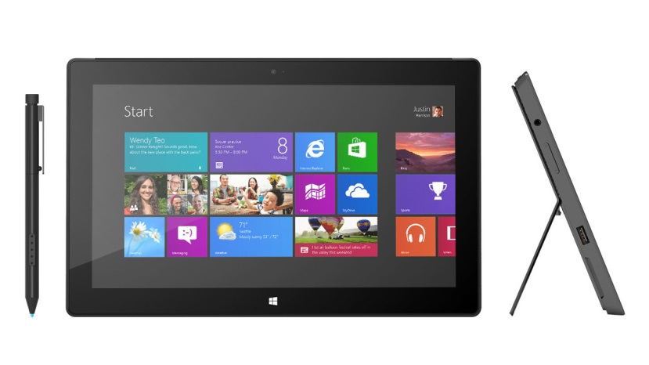
Win a Microsoft Surface Pro!
Complete an online SESSION EVALUATION to be entered into the draw.
Draw closes April 12, 11:59pm CT Winners will be announced on the PASS BA Conference website and on Twitter.
Go to passbaconference.com/evals or follow the QR code link displayed on session signage throughout the conference venue.
Your feedback is important and valuable. All feedback will be used to improve and select sessions for future events.

Slide 31


Thank you!
Diamond Sponsor
Platinum Sponsor

