Slide 1
The Cloud for Modern Business
Scott Guthrie
Executive Vice President
Cloud + Enterprise

Slide 2
Mobile-first
Cloud-first

Slide 3
Azure

Slide 4
Offline Operations
Remote Debug
Tag Expressions
Traffic Manager
Site to Site Virtual Network
Stop without Billing
Xamarin integration
Large Memory SKU
Hyper-V Recovery
SQL, SharePoint, BizTalk Images
HDInsight
Cloud Services SDK 2.0
Mercurial Deployment
Scheduler
Windows Phone Support
Distributed Cache
Partitioned Queues/Topics
AutoScale
Per Minute Billing
Dynamic Remote Desktop
Log Streaming
Android Support
IaaS
HTML 5/CORS
Active Directory
Custom Mobile API
IP and SNI SSL
Last 12
http Logs to Storage
BizTalk Services
IP/DDOS Protection
Hyper-V Disaster Recovery Support
Multi-Factor Auth
MSDN Dev/Test Integration
months
http Logs to Storage
Dynamic Remote Desktop
Storage Analytics
WebSockets
Delete Disks
AMQP Support
iOS Notification Support
VIP ACLs
New VM Gallery
PowerBI
Read-Only Secondary Storage
Queue Geo Replication
Mobile Services
Windows Server Backup
New Relic
Notification Hubs
Manage Azure in AD
Git Source Control
AD Directory Sync
Windows 8 Notification Support
AD Management Portal
CORS/JSON Storage Support
B2B/EDI and EAI Adapters
Point to Site
Software VPN
VOD Streaming + Encoding
Web Sites
Media Services
AutoScale/Monitoring
VS Online
Message Pump Programming Model
Import/Export Hard Drives

Slide 5
>10,000
New Azure customers a week
1,200,000
>30Trillion
SQL databases in Azure
Storage objects in Azure
350Million
>60%
Customers using higher level services
>2Million
Azure Active Directory users
>18Billion
Developers registered with Visual Studio Online
Azure Active Directory authentications/week

Slide 6
How we differentiate with Azure
Hyper-scale
Enterprise Grade
Hybrid

Slide 7

Azure footprint

Slide 8
19
Azure datacenter regions open for business this month
Azure footprint

Slide 9
Datacenter buildings are about one football field in size

Slide 10
…large enough to hold two jumbo jets

Slide 11
That’s up to 600,000 servers in each Azure region
And there are 16 buildings per region…

Slide 12
How we differentiate with Azure
Hyper-scale
Enterprise Grade
Hybrid

Slide 13
Leader in Gartner magic quadrants
Cloud Infrastructure as a Service
Enterprise Application Platform as a Service
Public Cloud Storage Services
x86 Server Virtualization
→
Microsoft only leader in all four magic quadrants

Slide 14
New D family of virtual machines
60% faster CPU
More memory
Local SSD storage

Slide 15

Announcing the G family
Largest Virtual Machines in the public cloud
G
Optimized for data workloads
Up to 32 CPU cores, 450 GB RAM, 6.5 TB local SSD
Latest generation Intel processor

Slide 16
Announcing premium storage
Up to 32 TB of storage per VM
>50,000 IOPS per VM
Less than 1ms read latency

Slide 17
How we differentiate with Azure
Hyper-scale
Enterprise Grade
Hybrid

Slide 18
Connect every on-premises server to the cloud
Azure
Storage
Backup
Disaster recovery
Identity
Networking
On-Premises Datacenter

Slide 19
How we differentiate with Azure
Hyper-scale
Enterprise Grade
Hybrid

Slide 20
Connecting ISVs + Startups with Enterprises

Slide 21
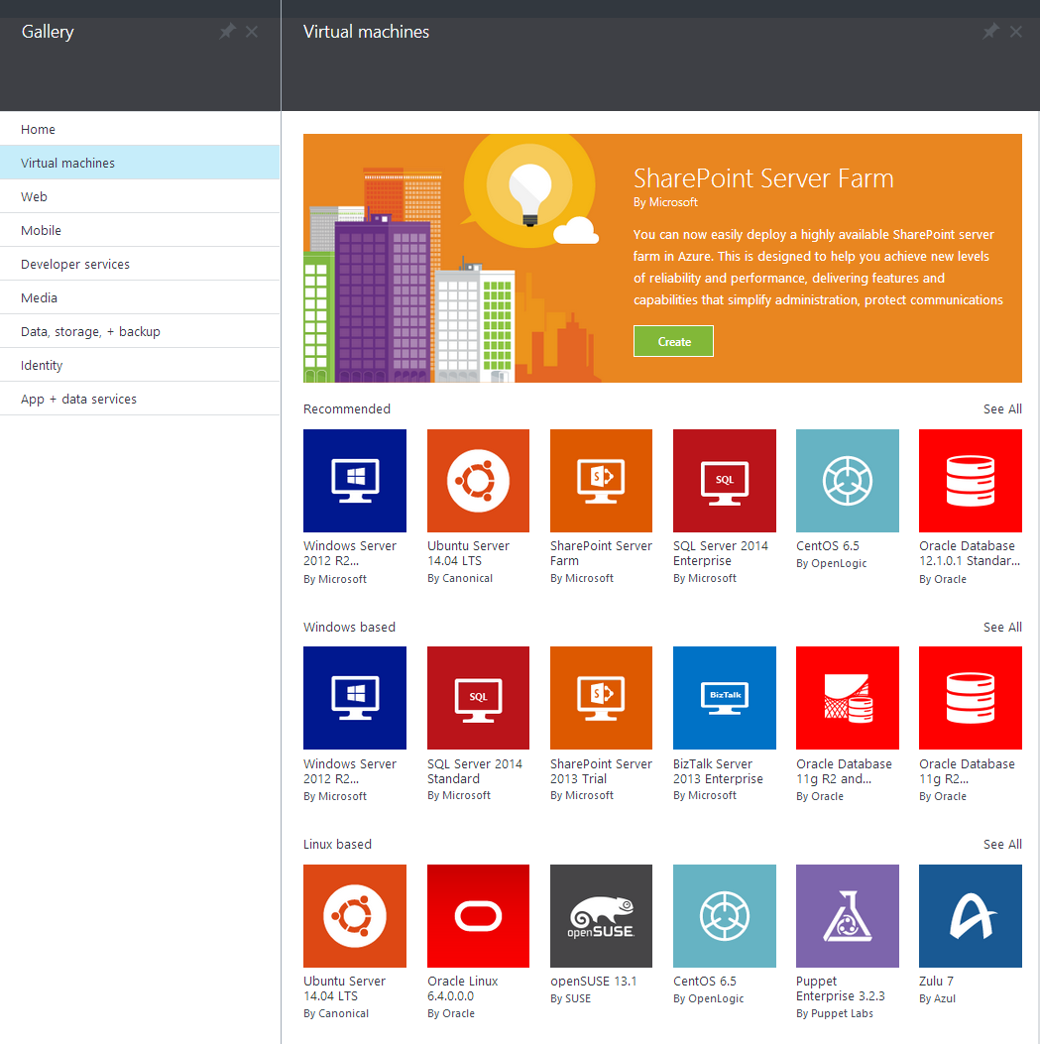
AnnouncingAzure Marketplace

Slide 22
Building Apps for Azure

Slide 23
Programming languages + tools
.NET, Visual Studio, TFS + Git, Java, NodeJS, PHP, Python, Ruby, C++
IaaS
PaaS
Microsoft Azure
Windows VMs
Linux VMs
Storage
Networking
Web
Mobile
Gaming
Cloud services
Data
Analytics
Media
Identity
Microsoft cloud infrastructure

Slide 24
Composing + Managing Apps using the Azure Resource Manager

Slide 25
Resource Groups
Enable application/solution management within Azure
Resource groups are containers that can contain multiple IaaS + PaaS resources (e.g. 3 VMs + 1 SQL DB)
Support lifecycle management with integrated Role Based Access Control
Support both imperative API and declarative JSON templates for deployment configuration
RESOU
R
CE G
R
OUP

Slide 26
Azure Resource Templates
My App
Azure Templates can:
Ensure Idempotency
Simplify Orchestration
Simplify Roll-back
Provide Cross-Resource Configuration and Update Support
Azure Templates are:
Source file, can be checked-in
Specifies resources and dependencies (VMs, WebSites, DBs) and connections (config, LB sets)
Support parametized input/output
Instantiation of repeatable config.
Configuration → Resource Group
[SQL CONFIG] VM (2x)
DEPENDS ON SQL
DEPENDS ON SQL
SQL - A
Website
Virtual
Machines
SQL
C
ONFIG

Slide 27
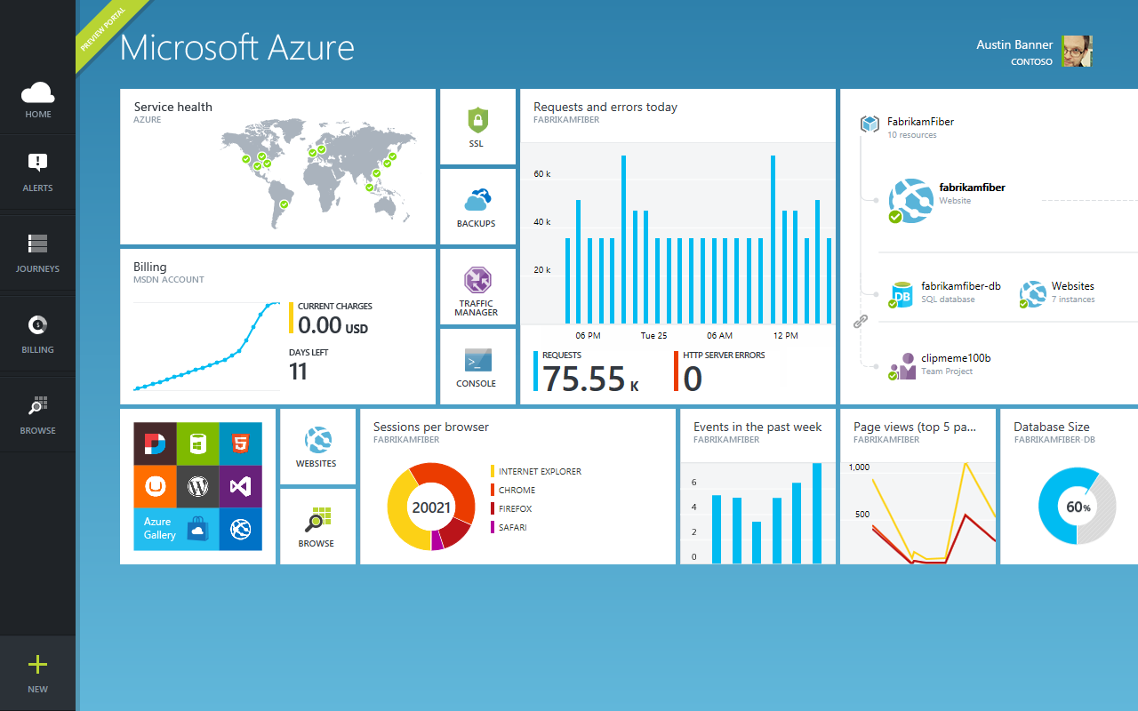
Azure Management Portal
Leverages resource groups to provide app management + monitoring views

Slide 28
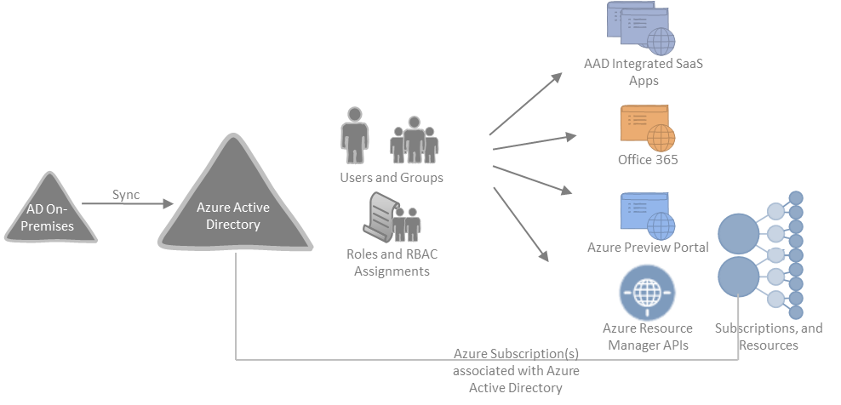
Azure Active Directory Identity control plane with integrated role based access control management

Slide 29
Consistent Management Layer with Windows Server
Consistent resource management, resource templates, management portal
Management Portal

Slide 30
Microsoft Azure
Programming languages + tools
.NET, Visual Studio, TFS + Git, Java, NodeJS, PHP, Python, Ruby, C++
IaaS
PaaS
Windows VMs
Linux VMs
Storage
Networking
Web
Mobile
Gaming
IoT
Data
Analytics
Media
Identity
Microsoft cloud infrastructure

Slide 31
Virtual Machines

Slide 32
Core IaaS Capabilities
Windows VMs
Linux VMs
Virtual Networking
Storage

Slide 33
IaaS Improvements this Fall
“D Series” of Virtual Machines
60% faster CPUs
Higher memory configurations
Local SSD storage
“G Series” of Virtual Machines
Latest Intel Haswell processors
Up to 32 CPU cores, 450GB RAM, 6.5TB Local SSD
Largest VMs in the cloud today
Premium Storage
Up to 32 TB of durable storage per VM
>50,000 disk IOPS, <1ms read latency

Slide 34
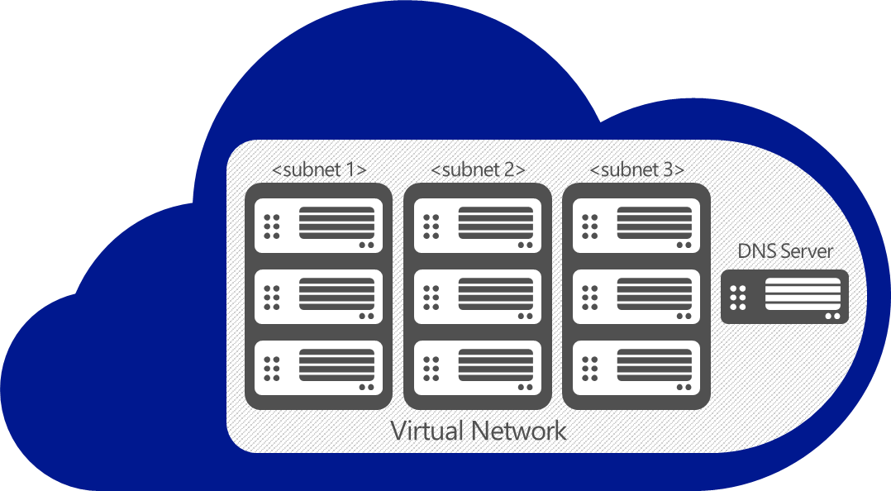

Hybrid Networking Support
Region to Region
Point-2-Site (SSL)
Site-2-Site (VPN)
Partners (ExpressRoute)
WAN
GW
On-premises
VPN

Slide 35

Configuring VM images

Slide 36
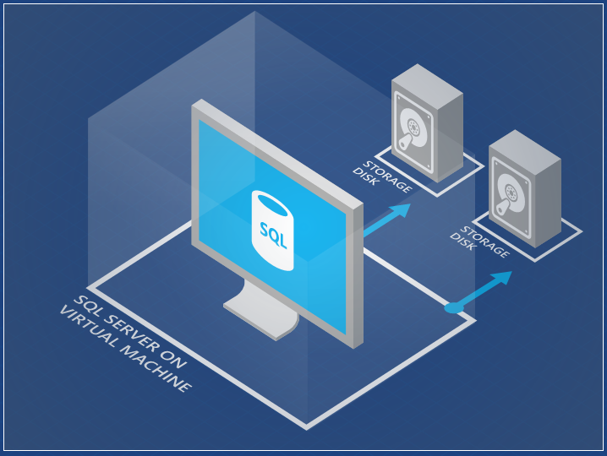
My DB Image
@ today
Capture VM images

Slide 37
My DB Image
@ today
Capture VM images

Slide 38
Virtual Machine configuration
→ Puppet
→ Chef
→ PowerShell and DSC

Slide 39

Virtual Machine management

Slide 40
Virtual Machine management

Slide 41
Demo: SharePoint Farm Creation

Slide 42
Microsoft Azure
Programming languages + tools
.NET, Visual Studio, TFS + Git, Java, NodeJS, PHP, Python, Ruby, C++
IaaS
PaaS
Windows VMs
Linux VMs
Storage
Networking
Web
Mobile
Gaming
IoT
Data
Analytics
Media
Identity
Microsoft cloud infrastructure

Slide 43
Web

Slide 44

Develop apps with…
.NET
Python
Node.js
Java
PHP

Slide 45
AutoScale

Slide 46
AutoScale

Slide 47
AutoScale

Slide 48
Staging

Slide 49
Staging

Slide 50
Staging

Slide 51
Staging

Slide 52
WebJobs

Slide 53
WebJobs

Slide 54
Intelligent customer routing with Traffic Manager
www.yourapp.com

Slide 55
Intelligent customer routing with Traffic Manager
www.yourapp.com

Slide 56
Demo: Websites in action

Slide 57
Microsoft Azure
Programming languages + tools
.NET, Visual Studio, TFS + Git, Java, NodeJS, PHP, Python, Ruby, C++
IaaS
PaaS
Windows VMs
Linux VMs
Storage
Networking
Web
Mobile
Gaming
IoT
Data
Analytics
Media
Identity
Microsoft cloud infrastructure

Slide 58
Mobile

Slide 59
Develop backends with…
.NET
Node.js

Slide 60
Flexible Data

Slide 61
Broadcast Notifications

Slide 62
Now supports Active Directory

Slide 63
Office 365 APIs

Slide 64
API Management Service
→ Throttle, rate limit and quota Web APIs
→ Gain analytics on how APIs are being used and by whom
→ Secure APIs using OAuth or key-based access
→ Track the health of APIs and quickly identify errors
→ Easily expose developer portal for APIs

Slide 65
Demo: Mobile in Action

Slide 66
Data

Slide 67
New
99.99% SLA
SQL
500 GB
SQL

Slide 68
DELETE FROM
Sales.SalesPersonQuotaHistory; GO
SQL
Self service restore

Slide 69
SQL
Self service restore

Slide 70
SQL
SQL
Self service restore

Slide 71
Active geo replication
Read Only
Read/Write
Read/Write

Slide 72
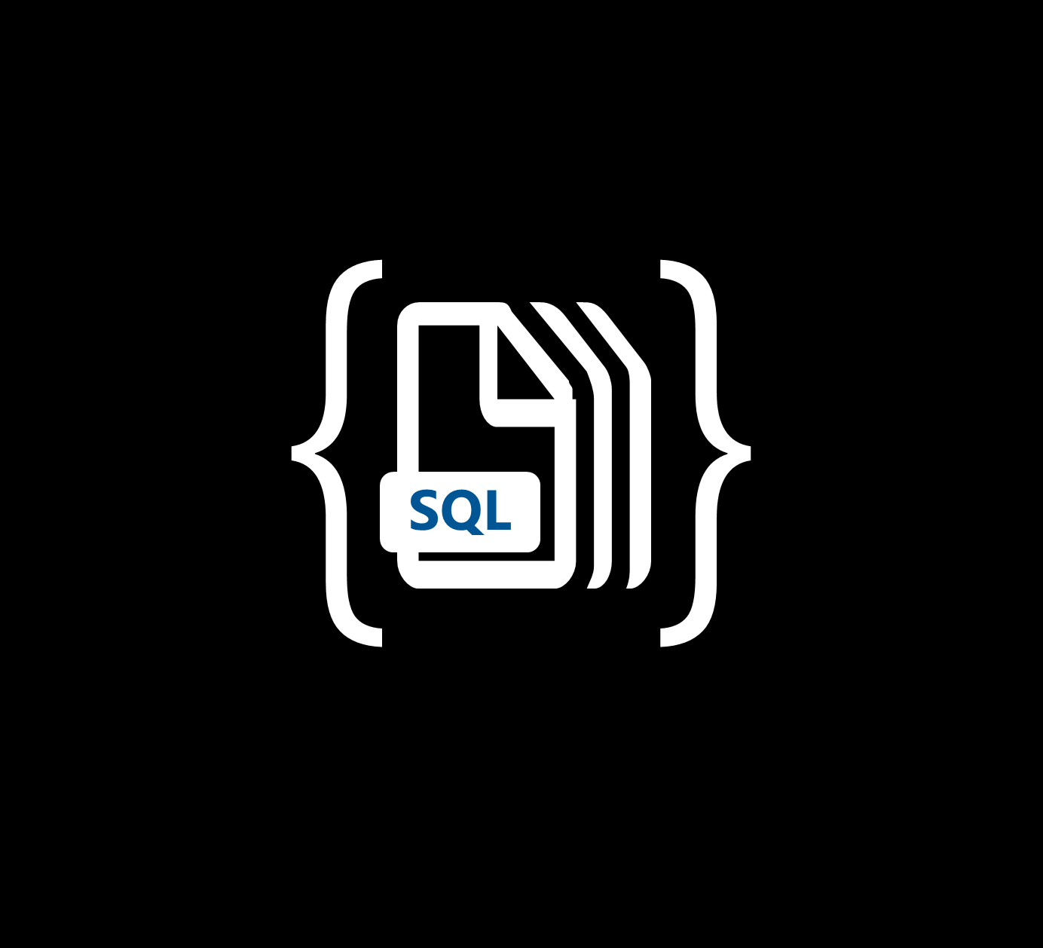



Azure DocumentDB
Fully-managed, highly-scalable, NoSQL document database service
query over schema-free JSON
multi-document
transactions
tunable, high performance
designed
cloud first

Slide 73
Demo: DocDB in Action

Slide 74
Additional Data Services
→ Search (Search as a Service)
→ HDInsight (Hadoop as a Service)
→ Machine Learning (Predictive Analytics as a Service)
→ More coming soon ☺

Slide 75
Programming languages + tools
.NET, Visual Studio, TFS + Git, Java, NodeJS, PHP, Python, Ruby, C++
IaaS
PaaS
Microsoft Azure
Windows VMs
Linux VMs
Storage
Networking
Web
Mobile
Gaming
IoT
Data
Analytics
Media
Identity
Microsoft cloud infrastructure

