Slide 1
RECYCLING
PLEASE NOTE:
This PowerPoint is intended to be remodeled for the purposes of SlideFest.

Slide 2

According to the Environmental Protection Agency, in 2009 Americans produced about
243 million tons of trash.

Slide 3
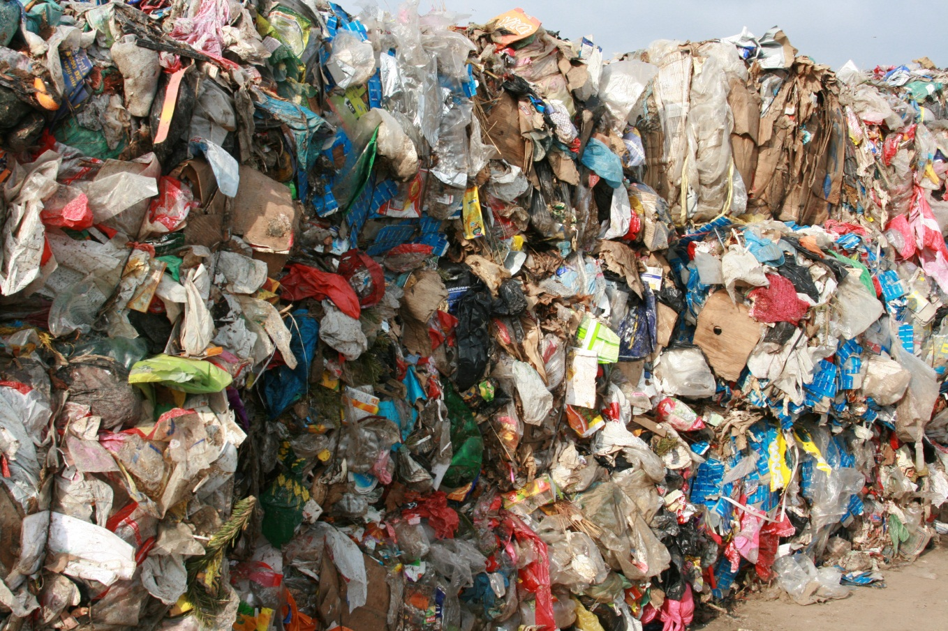
That’s an average of about 4.3 pounds of waste per person per day!

Slide 4
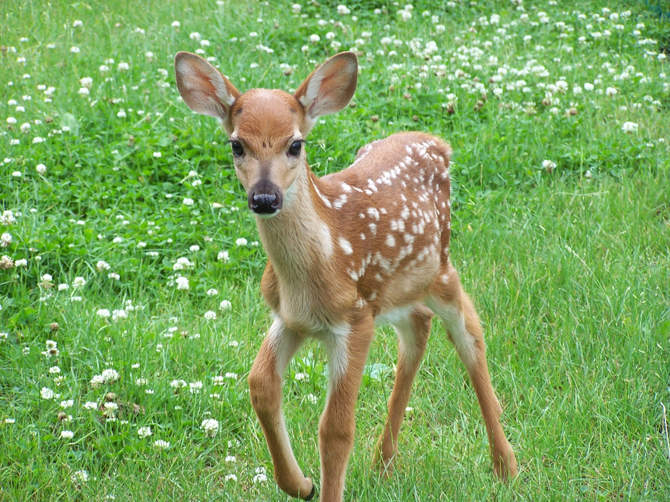
It’s important that we all do our part to save the environment.

Slide 5

Recycling is something we all have the power to do to save
Mother Earth.

Slide 6

Kids & adults can recycle.

Slide 7
So,
what exactly can you recycle?

Slide 8

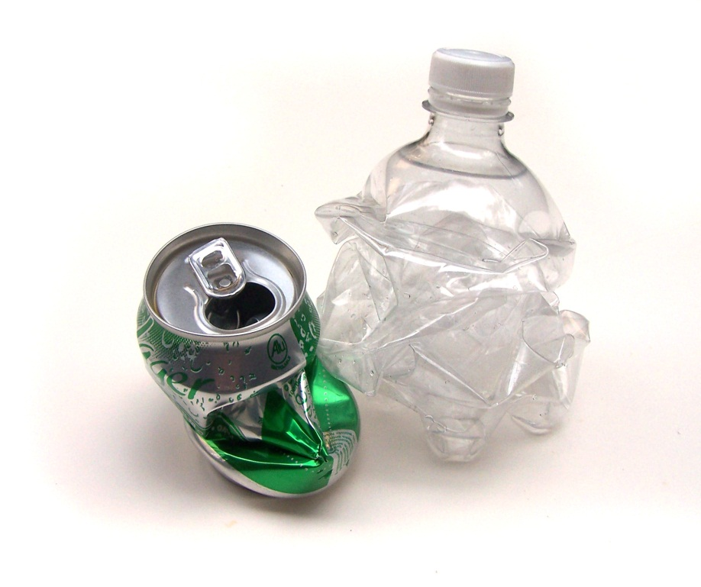
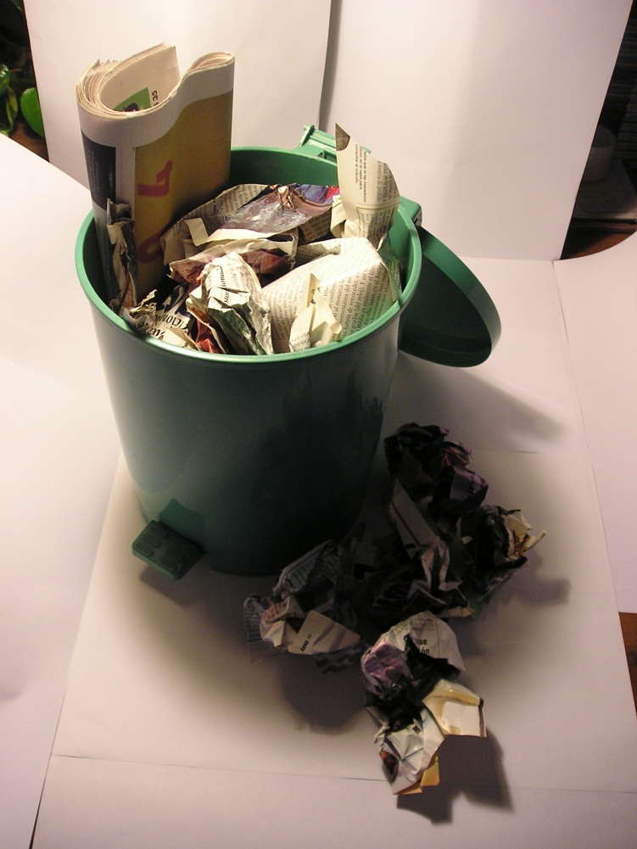
Aluminum & Plastic
Newspapers
All these items can be recycled
!!!!!!!!!!!!!!!!!!!!

Slide 9

Other items that can be recycled include:
Magazines
Junk mail
Glass soda bottles
Glass pasta jars
Soup cans
Coffee cans
Shampoo bottles
Cardboard boxes
Wrapping paper
Wine bottles
Jam jars
Clean aluminum foil
Outdated maps
Paper towel tubes
Tissue boxes
Empty cereal boxes
Cracked drinking glasses

Slide 10
So find the nearest recycling bin
&
start recycling today!

