Slide 1
https://www.monsterenergy.com/it-it/

Slide 2
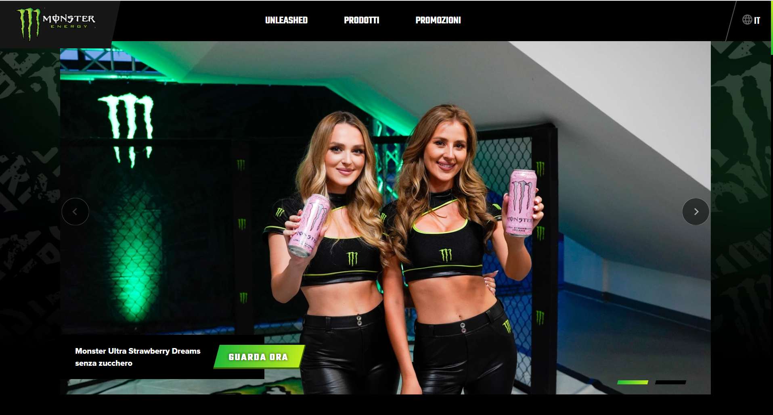

Slide 3
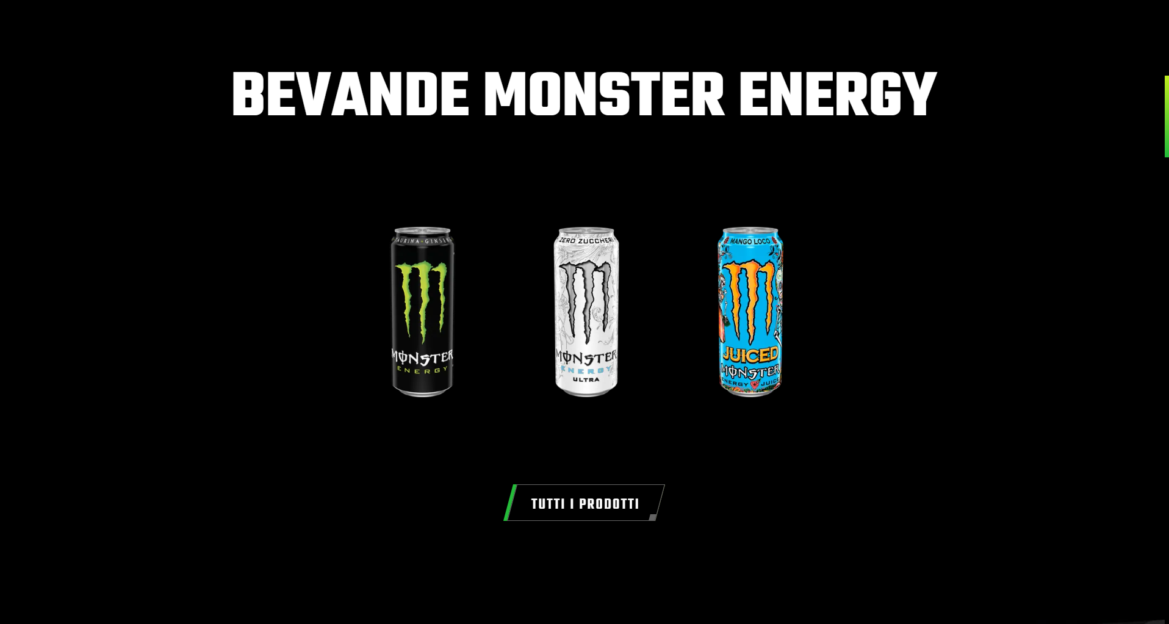

Slide 4
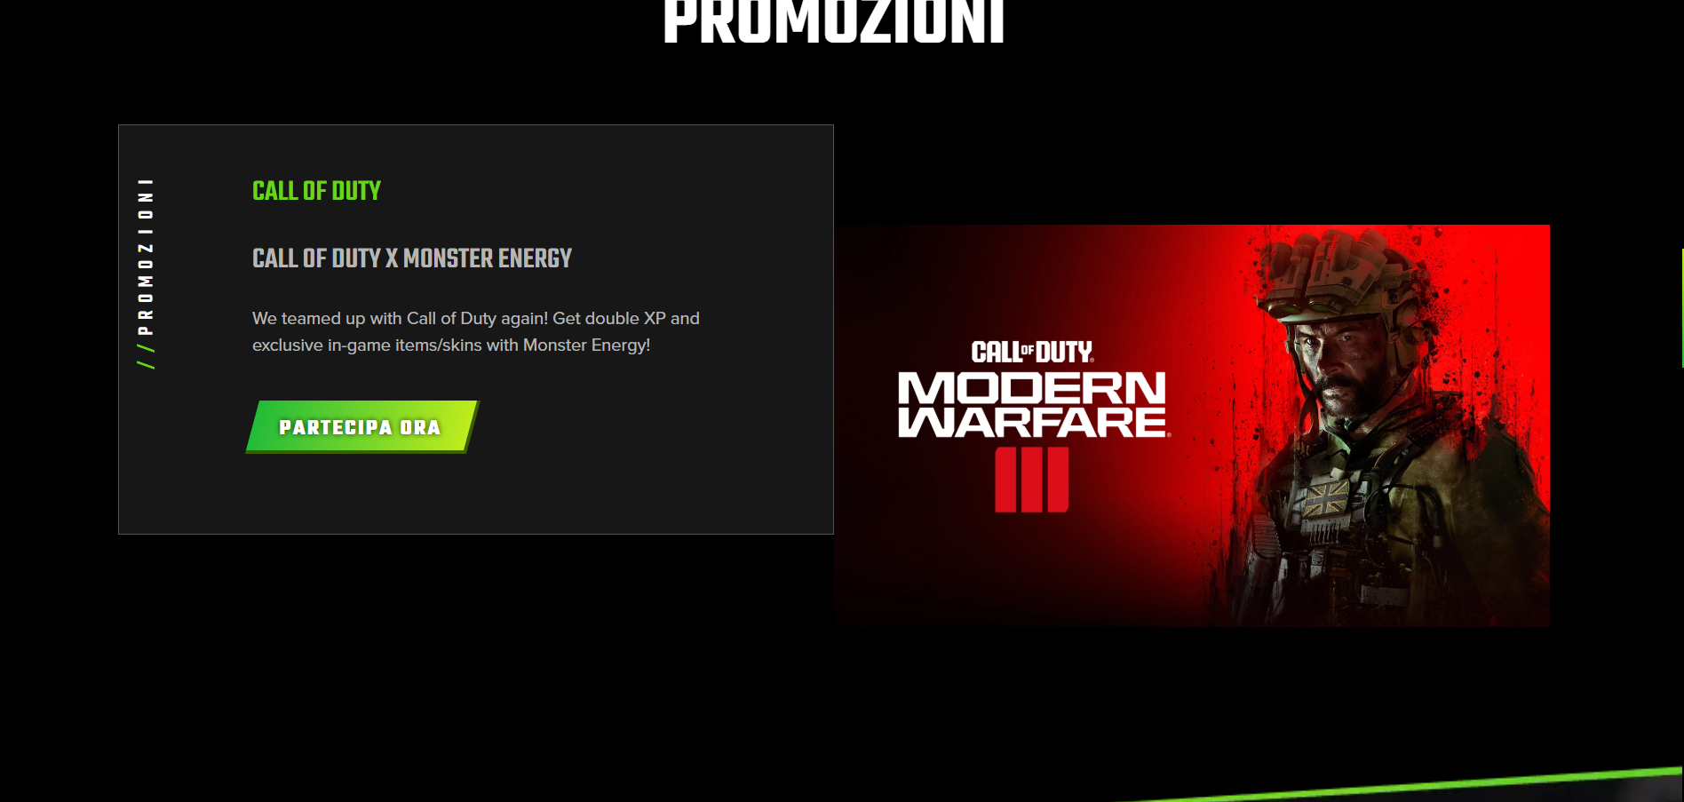

Slide 5
