Slide 1
Case Study Project – Video Game Categories
Albert Kurbanov

Slide 2
Overview
Background: Only 23% of buyers use genre filter to find games of interest. Instead, 71% of buyers use advanced filters.
Task: Identify new genres (No more than 5, unless there is a concrete reason to do so) that will improve the users’ experience in finding new products.
Business Focus: Improve user experience which should improve customer retention and could possibly increase the amount of sales in the future with repeat buyers.
Business Metric: New genres, no more than 5. Future metrics would include returning customers (Account tracking), and A/B testing for time spent on website to make a purchase.
Method: Unsupervised machine learning task that needs to separate the data into a number of segments. The best choice for this task would be K-Means clustering.

Slide 3
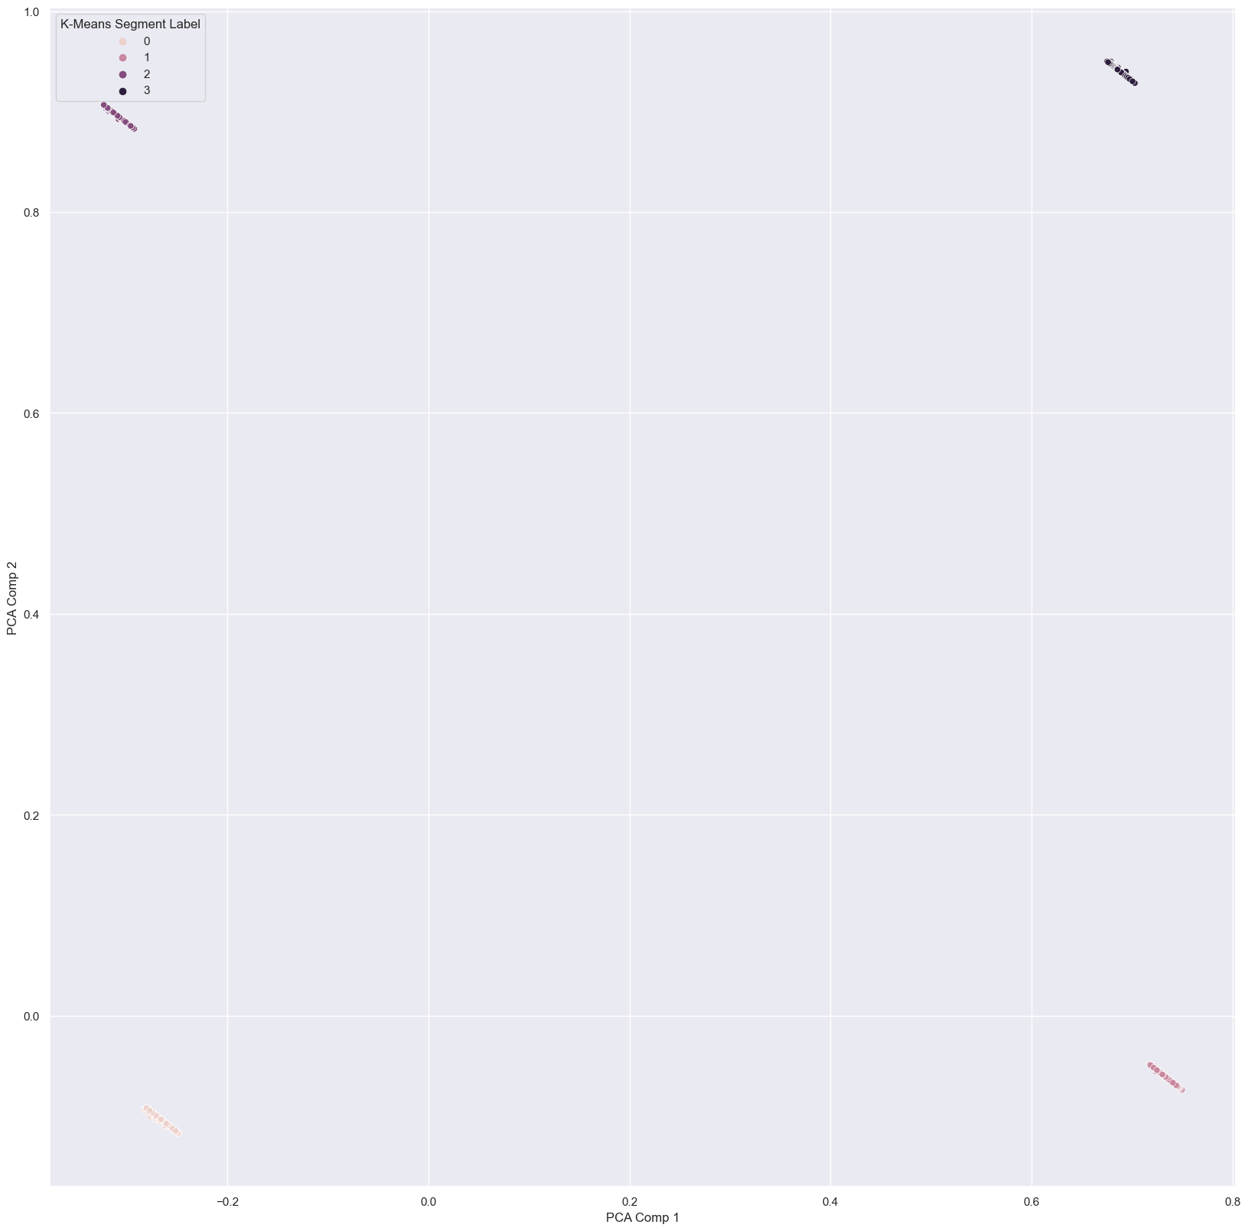
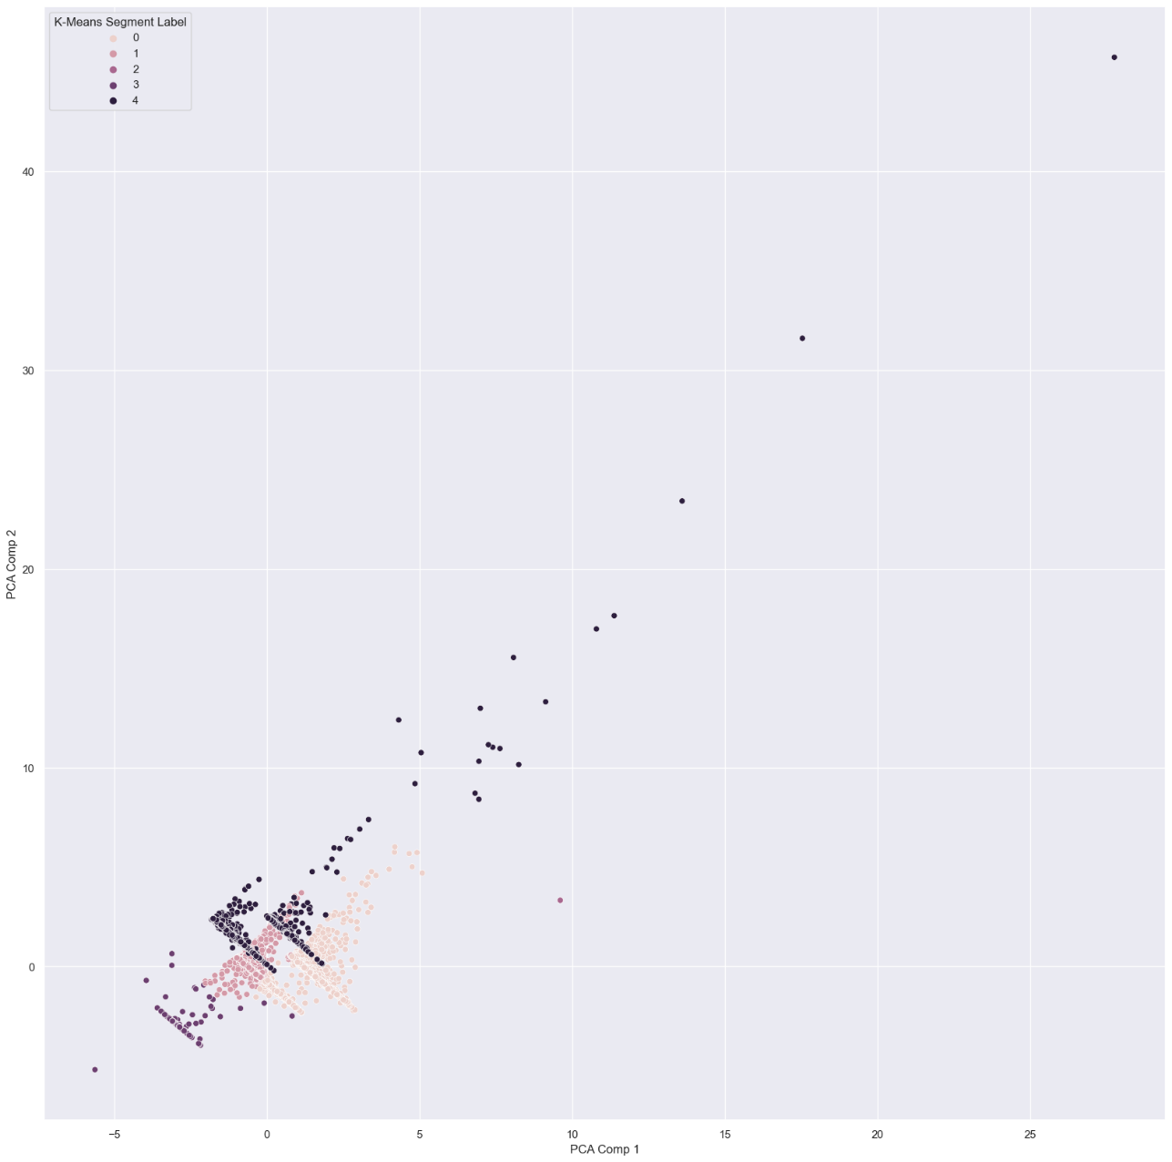




Method
K-Means with MinMaxScaler
K-Means with StandardScaler

Slide 4
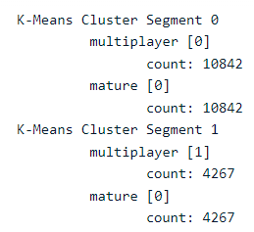
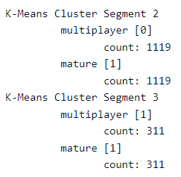
K-Means with MinMaxScaler
Identified Multiplayer and Mature games as the most important factor for separation.

Slide 5
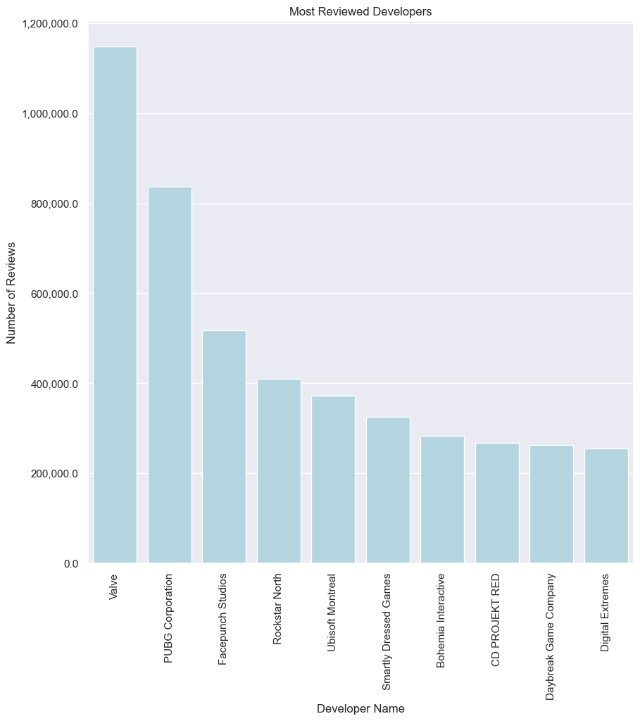
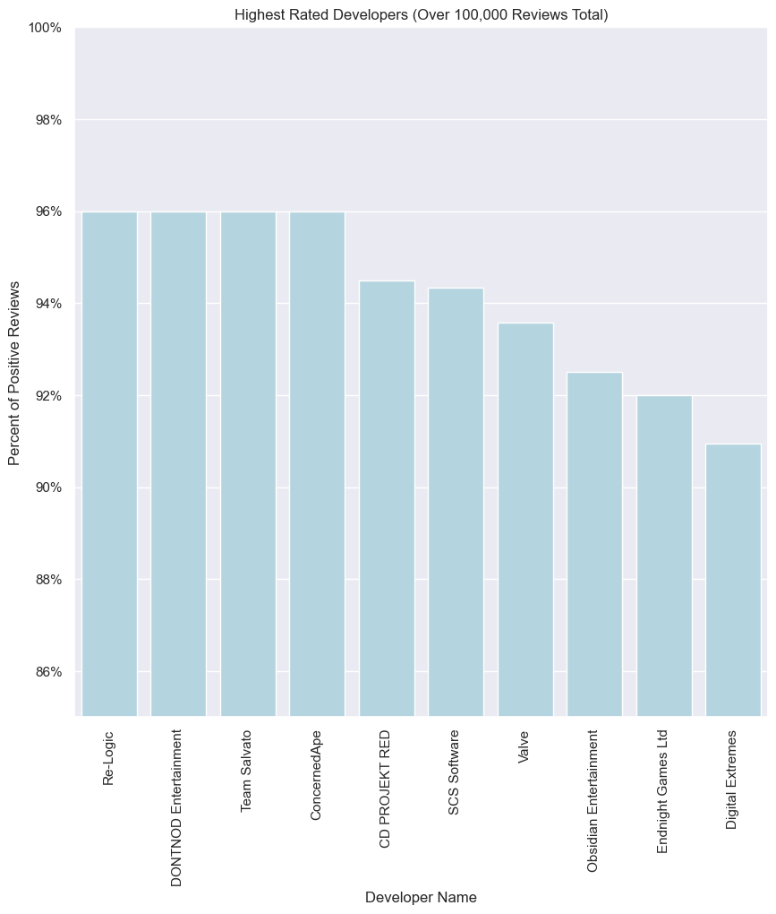
Additional findings - Developers

Slide 6
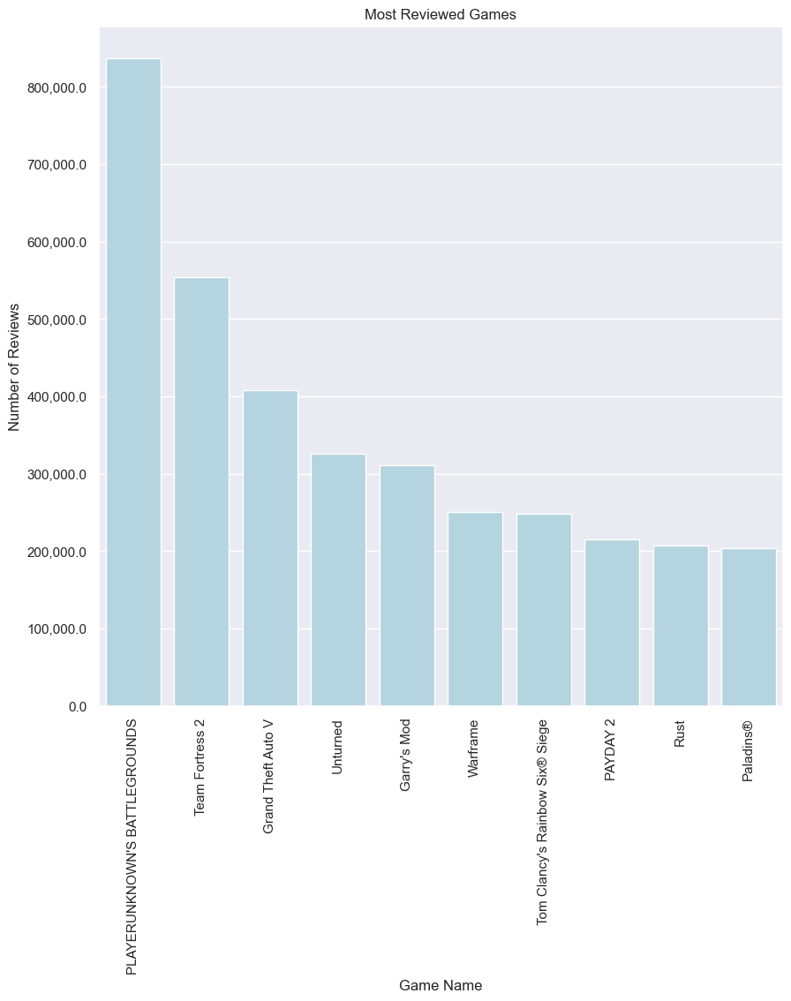
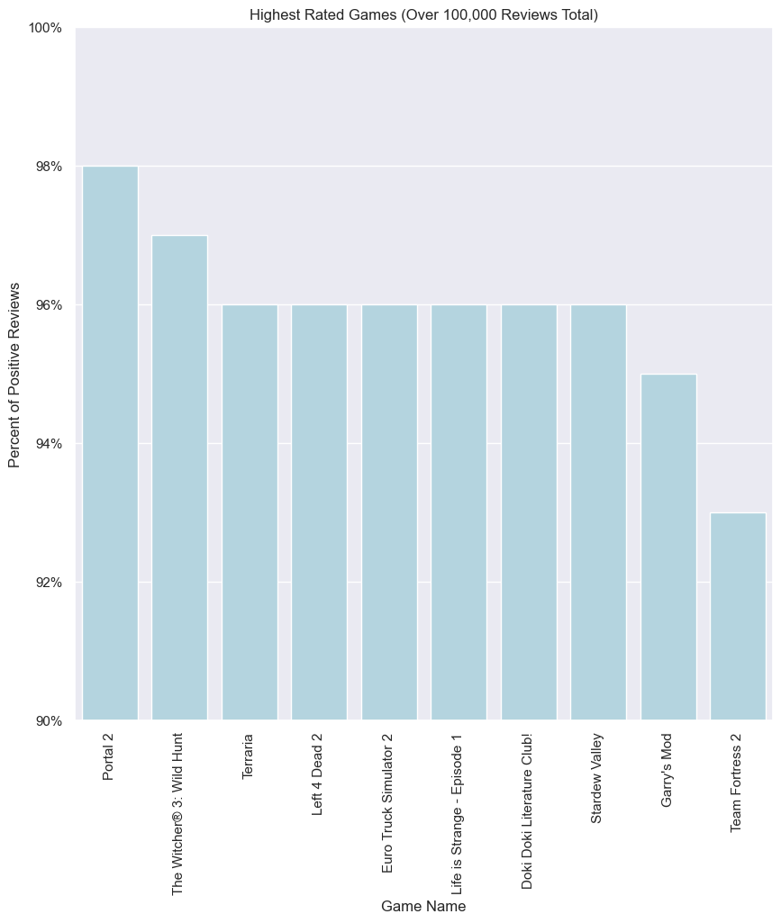
Additional findings - Games

Slide 7
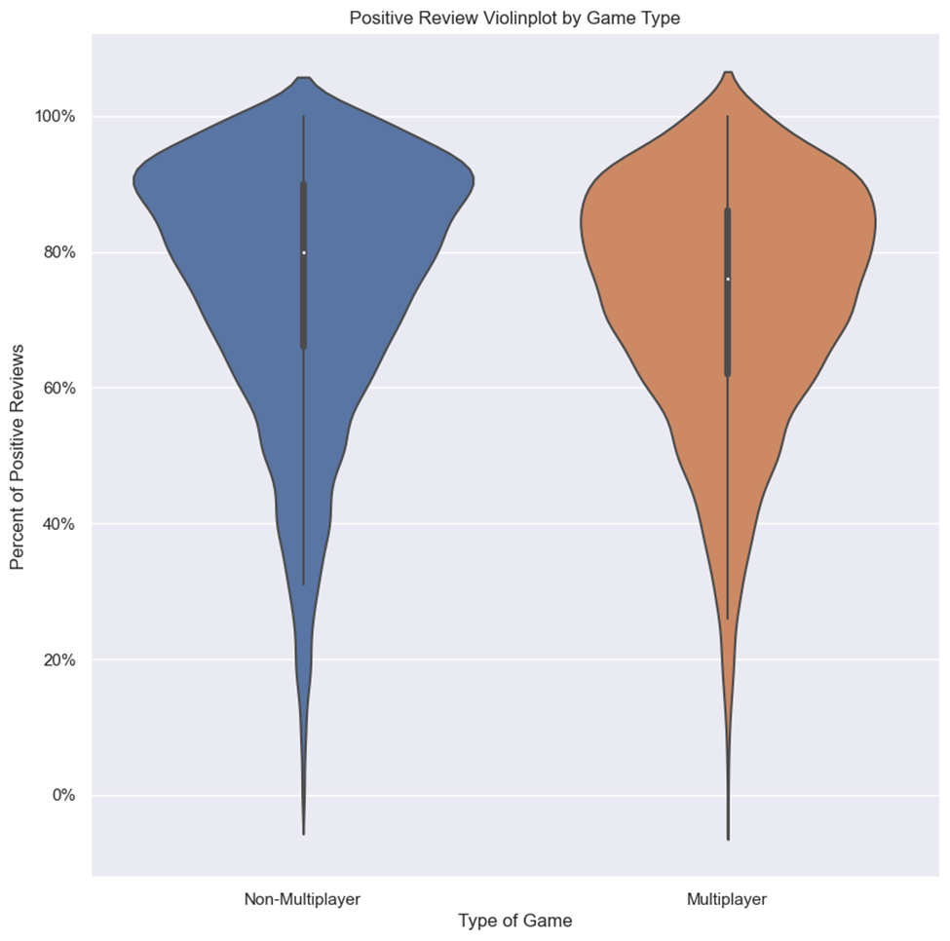
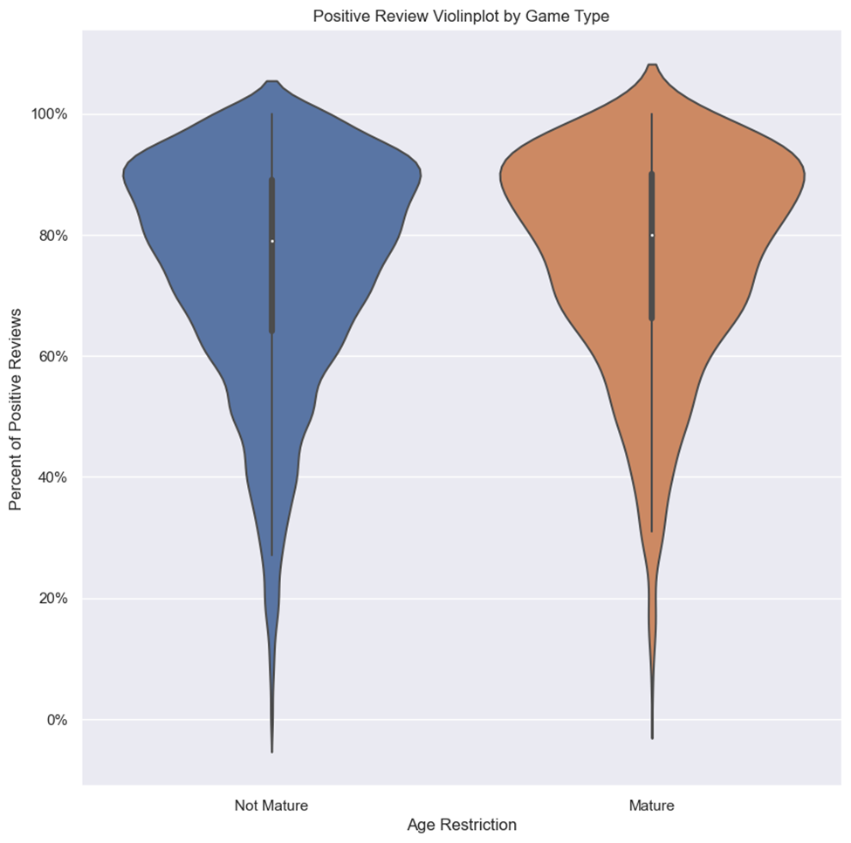
Percent of Positive Reviews by Multiplayer and Age

Slide 8
Summary
Add Mature and Multiplayer genre’s to the filters.
Add top charts to website based on games and developers.
Restrict the use of blanks when entering new data into databases.
Need more data - Better quality filters can be generated if genre information and sales data was provided.

Slide 9
Going Forward
Improve data collection technique.
Promote account creation for customers – to track sales. With enough data a recommendation engine can be created(users who bought X also bought Y).
Measure amount of time spent on the website (from homepage to sale) for future A/B testing and measuring whether new features play a significant role in user experience/sales.

