Slide 1
LSE-Grillo Earthquake Detection Challenge
General Approach
Model Selection
Tuning Parameters
Team 1
Linhan He, Albert Kong, Zhuofei Li, Wenlin Irene Zheng

Slide 2
General Framework – Dual Model Approach
General Approach
Model Selection
Tuning Parameters
Model 1: Determine whether there is a p-wave in the trace
Model 2: Determine which window is most likely to contain the p-wave

Slide 3
Features Considered
General Approach
Model Selection
Tuning Parameters
Long-Term Rolling Average (50 Samples)
Short-Term Rolling Average (25 Samples)
Long-Term Rolling Variance (50 Samples)
Short-Term Rolling Variance (25 Samples)
Trace Values
Magnitude of Trace Values

Slide 4
Models Considered
General Approach
Model Selection
Tuning Parameters
CNN LSTM
Signal model to identify p-wave
Location model to find start point of p-wave
Input
CNN Model
LSTM Model
Dense
Output

Slide 5
Tuning Parameters
General Approach
Model Selection
Tuning Parameters
Window Size (for Model 2)
Window Step Size (for Model 2)
Probability Threshold for Model 1 (S-Prob) – Used in Detector Script
Probability Threshold for Model 2 (P-Prob) – Used in Detector Script

Slide 6
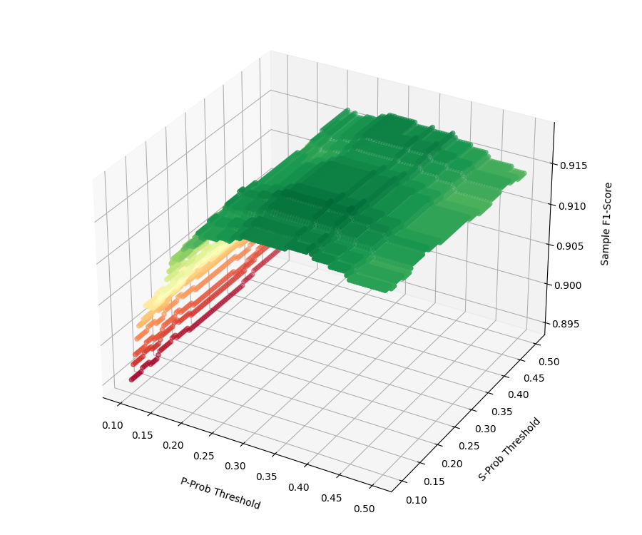
Optimizing Model
General Approach
Model Selection
Tuning Parameters
Limit Window Size to be no more than 2x acceptable error (0.5 sec)
Maximize Sample F1-Score based on varying P-Prob and S-Prob

Slide 7
Q&A
General Approach
Model Selection
Tuning Parameters

