Slide 1
LSE-Grillo Earthquake Detection Challenge
General Approach
Model Selection
Tuning Parameters
Team 1
Linhan He, Albert Kong, Zhuofei Li, Wenlin Irene Zheng

Slide 2
General Framework – Dual Model Approach
General Approach
Model Selection
Tuning Parameters
Model 1: Determine whether there is a p-wave in the trace
Model 2: Determine which window is most likely to contain the p-wave

Slide 3
Features Considered
General Approach
Model Selection
Tuning Parameters
Long-Term Rolling Average (50 Samples)
Short-Term Rolling Average (25 Samples)
Long-Term Rolling Variance (50 Samples)
Short-Term Rolling Variance (25 Samples)
Trace Values
Magnitude of Trace Values
Notes:
Thanks Irene!
When building the model, we also wanted to include some features beyond the trace values themselves. From the traces, we decided to derive a few rolling statistics that may provide better indicators of the presence of a p-wave. These included rolling averages and variances of different sample sizes as well as the ratios of the short-term to long-term statistics.
When we were originally looking at all three traces, we had also considered the total magnitude of the acceleration. We kept the magnitude in our final model (so for a single trace, it would just be the absolute value) so that if it were to intake the entire stream rather than an individual trace, it can also be handled with very few adjustments.
Next, I'll pass it off to Zofie who will walk you through the structure of the model itself

Slide 4
Models Considered
General Approach
Model Selection
Tuning Parameters
CNN LSTM
Signal model to identify p-wave
Location model to find start point of p-wave
Input
CNN Model
LSTM Model
Dense
Output

Slide 5
Tuning Parameters
General Approach
Model Selection
Tuning Parameters
Window Size (for Model 2)
Window Step Size (for Model 2)
Probability Threshold for Model 1 (S-Prob) – Used in Detector Script
Probability Threshold for Model 2 (P-Prob) – Used in Detector Script
Notes:
After we landed on a model, we worked on optimizing various parameters for the chosen model as well as the interpretation of the results.
For model 2, which is where we cut the trace into smaller segments, our primary levers were the size of the segments as well as the increment at which we would cut each segment.
For our interpretation, we had two different thresholding parameters which determined whether or not the results of the models warranted the flagging of a p-wave. By varying this parameter, we would be able optimize the number of false positives and false negatives produced by the model.

Slide 6
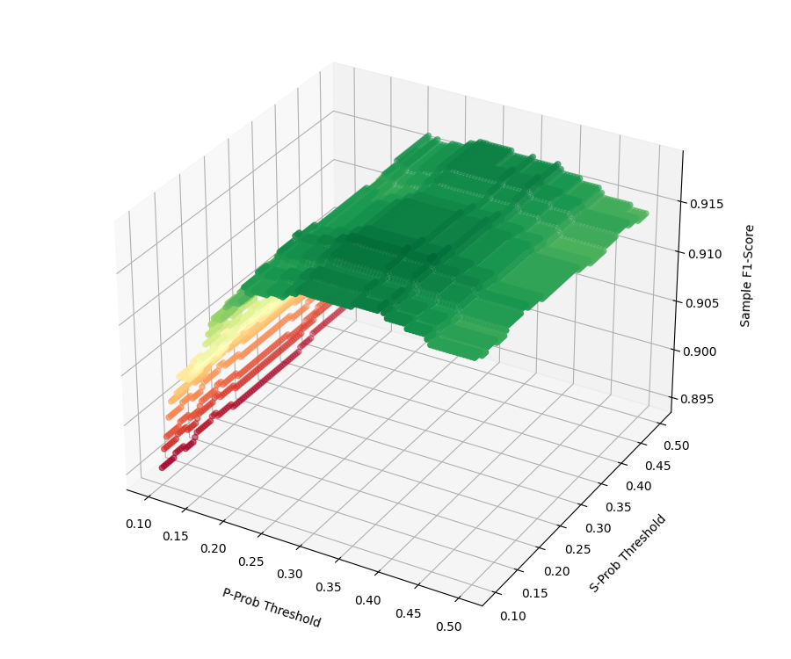
Optimizing Model
General Approach
Model Selection
Tuning Parameters
Limit Window Size to be no more than 2x acceptable error (0.5 sec)
Maximize Sample F1-Score based on varying P-Prob and S-Prob
Notes:
Through trying multiple values, we found that the best results calculated by our detection algorithm came from for window size that were no longer than 2 times the acceptable error (i.e., 2 times half a second).
We then varied the thresholding parameters between 0.1 and 0.5 and based on a select sample of traces, we found the combination that yielded the highest sample F-1 Score. (0.35 for P-Prob and 0.2 for S-Prob)
From these chosen parameters as well as a few other restrictions based on the detection criteria, we could then translate the identified window into the UTCDateTime object expected.

Slide 7
Thank You
General Approach
Model Selection
Tuning Parameters

