Slide 1

Harmonized censuses: research prospects
Jan Kok
CedaR symposium, March 1, 2013

Slide 2
Contents
A look from family history/historical demography
Popular and scholarly perceptions of the census
Research challenges in historical demography: how can the census help?
Netherlands
Global

Slide 3
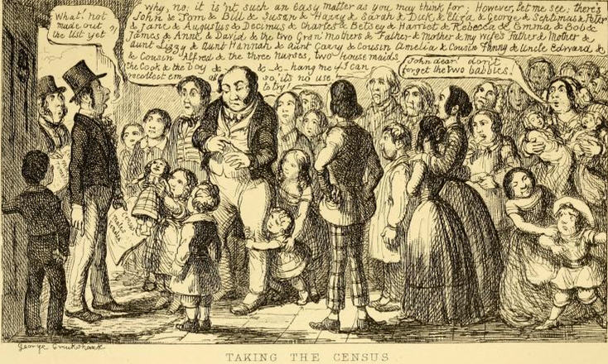
Popular perceptions of the census- George Cruikshank 1851

Slide 4
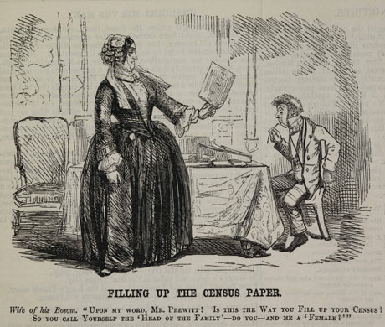

Slide 5
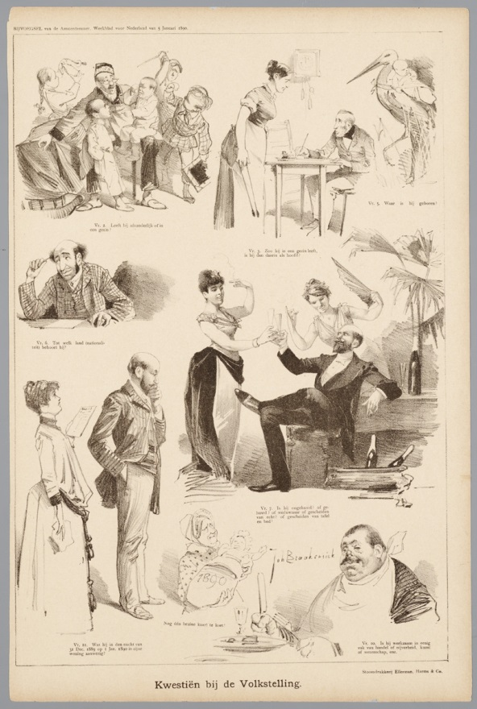
Does he live alone or in a family?
Is he the head of the family?
What is his nationality?
Is he unmarried, married, widowed, divorced?
Was he present in the house on the night of 31 December 1889??

Slide 6
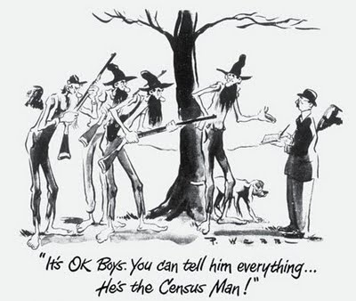
Censustakers portrayed as weak and gullible men
Census as ‘Big Brother’

Slide 7
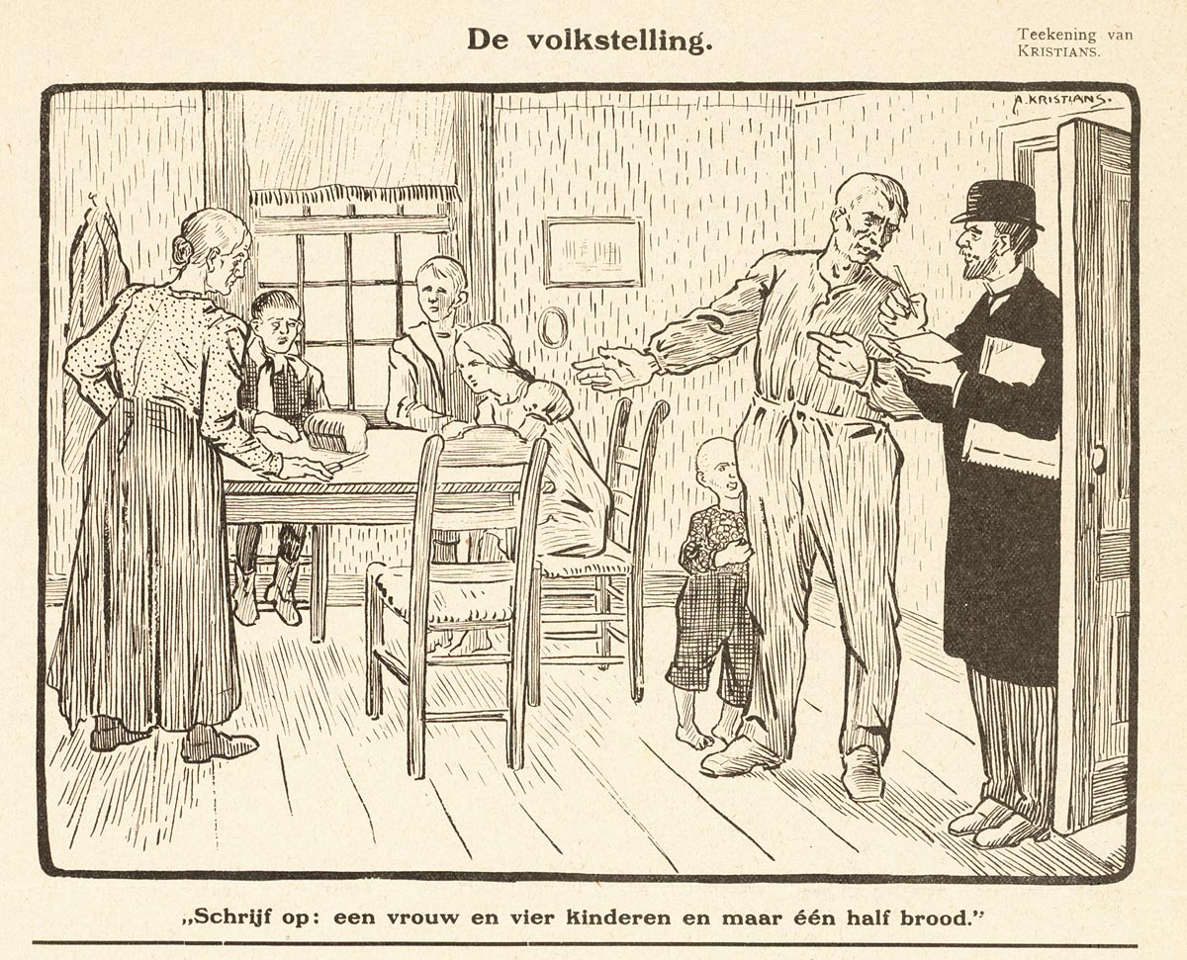
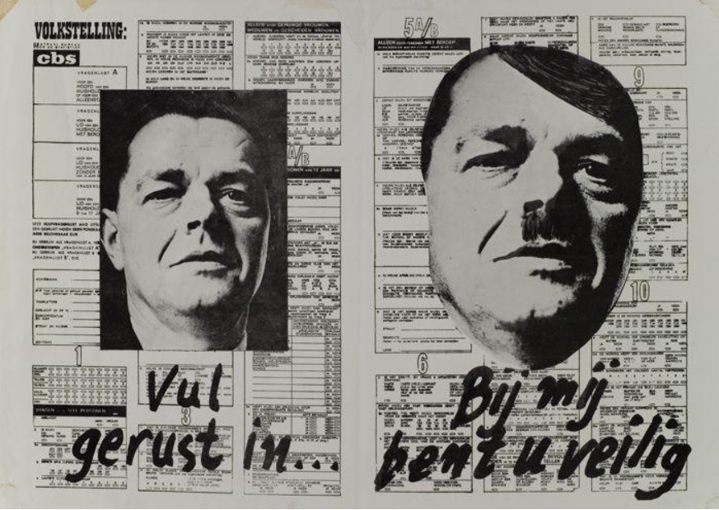
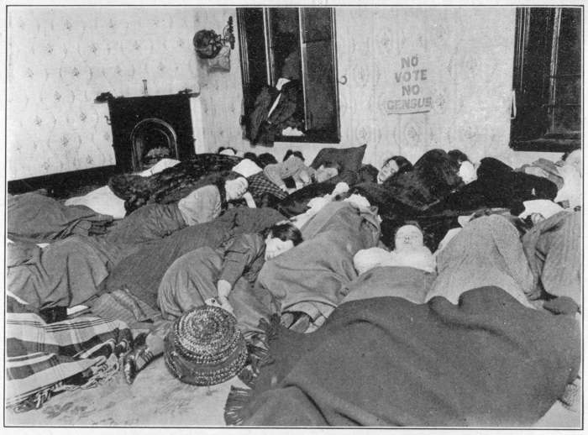
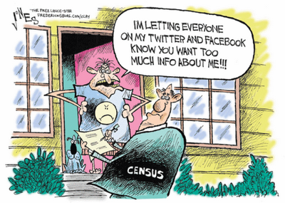

Slide 8
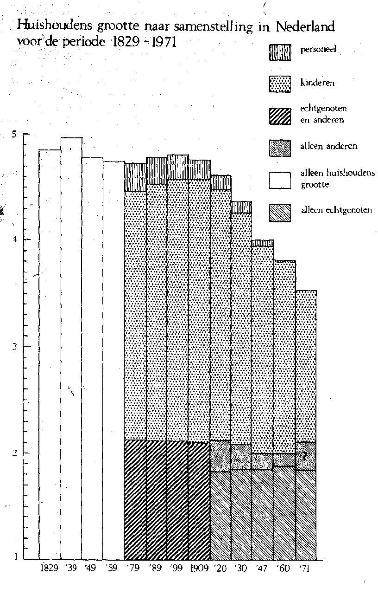
Scholarly misgivings
Census lags behind social reality (e.g. cohabitation)
Census does not capture
social complexity
(e.g. households)
Misreporting understudied
Categories and questions
change (too) often

Slide 9
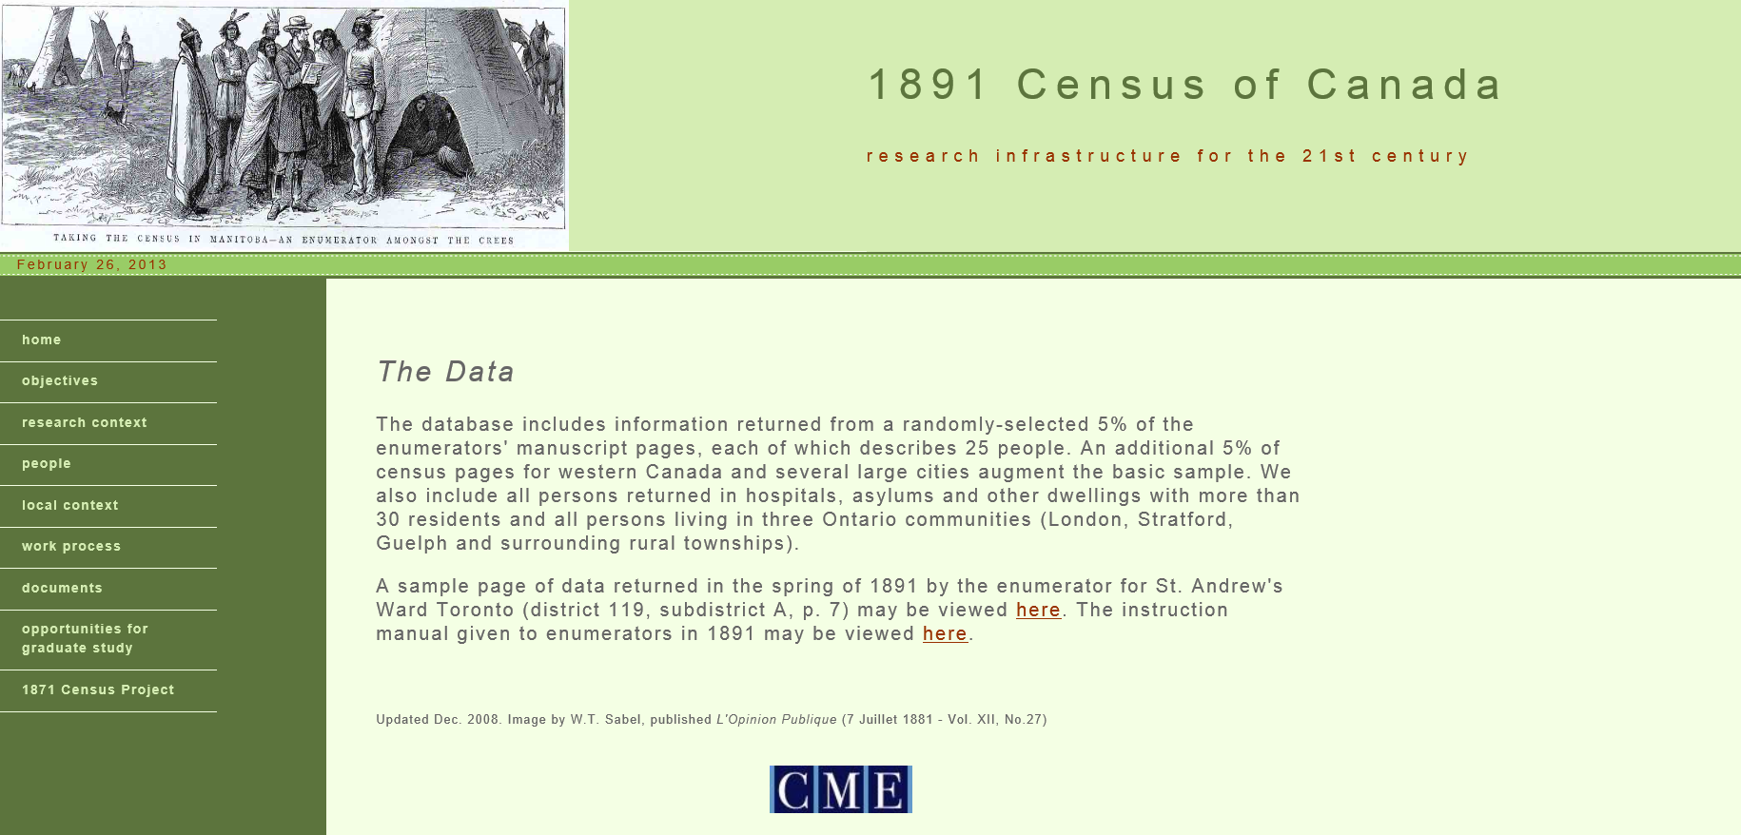

Slide 10

Research challenges
(…) the breach between the demographer and the census was complete… Is the role of censuses for historical demographers … over? The census seems to have become less en vogue as a source of demographic research.

Slide 11
Research challenges
Completing demographic history of the Netherlands
Understanding demographic processes
Understanding global trends

Slide 12
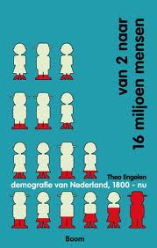
Demographic history of the Netherlands
Relation demographic to socio-economic change
From provinces to regional clusters

Slide 13
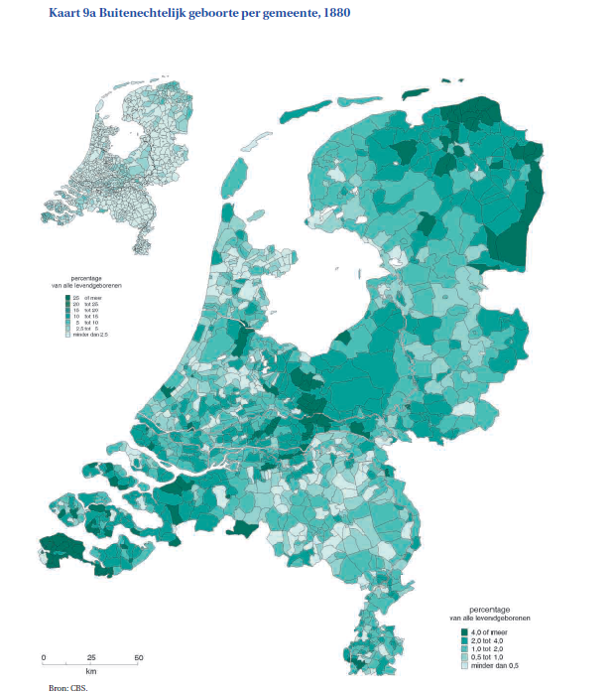
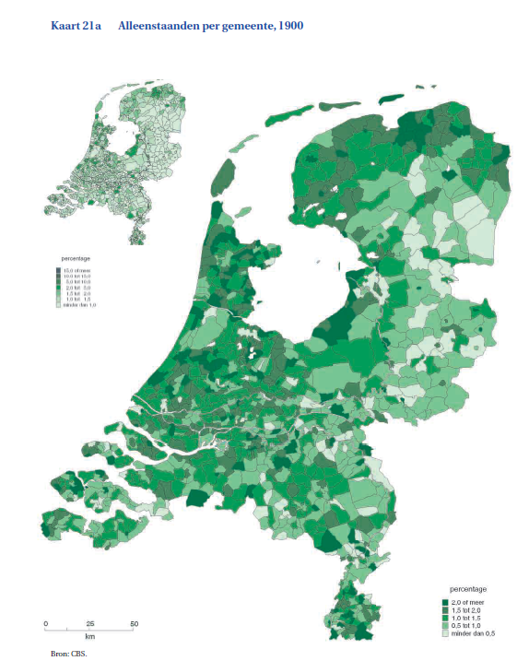

Slide 14
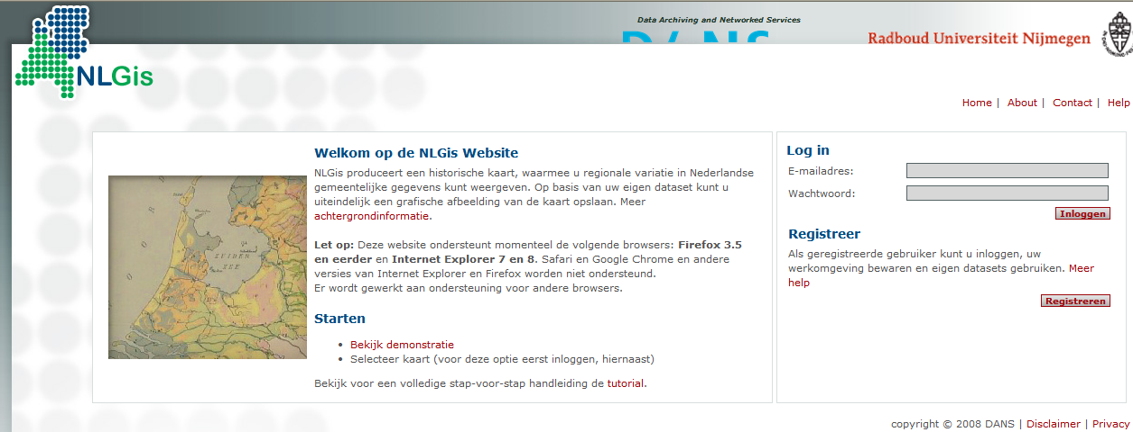
Infrastructural wish: Reboot the Gis-tool!

Slide 15
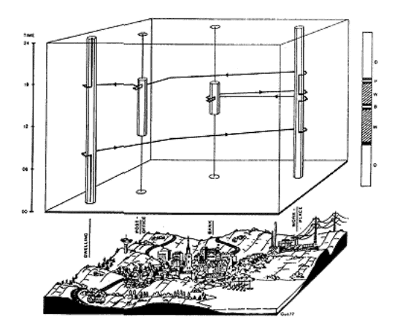
Understanding demographic processes
By adding more context to life courses
e.g.
Chance and timing of marriage
Marriage market conditions
(sex ratios and religion in area
around place of residence)
Likelihood of outmigration
Employment opportunities within
commuting distance

Slide 16
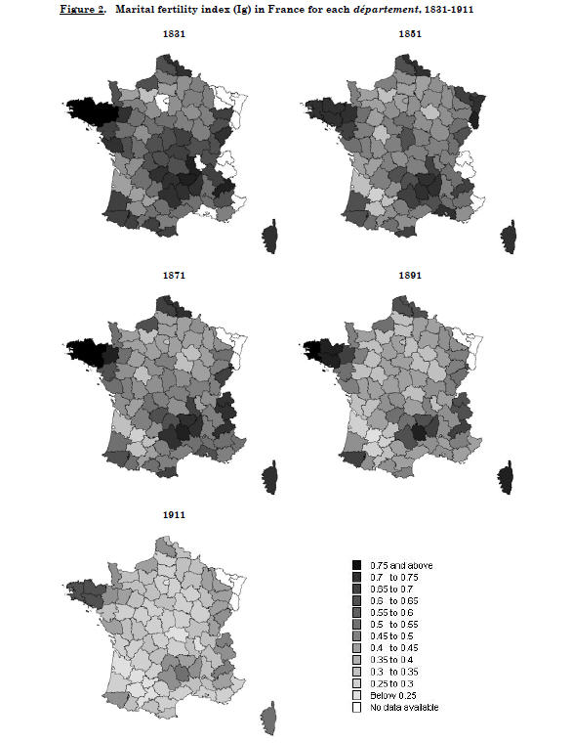
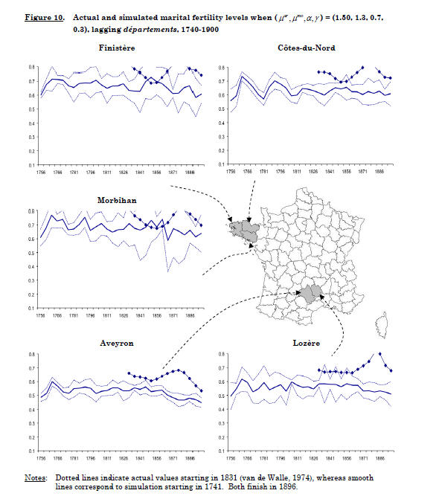
ABM: simulations to bridge micro-macro gap

Slide 17
Infrastructural wish: integrated community level variables
Census
Hofstee data and HED
Causes-of –death by municipality
Infrastructure and communication
Reports of municipalities/provinces

Slide 18
Global trends: revolution in the family
Postponement of marriaged&first birth
Increase in single living
Increase in cohabitation and extramarital births

Slide 19
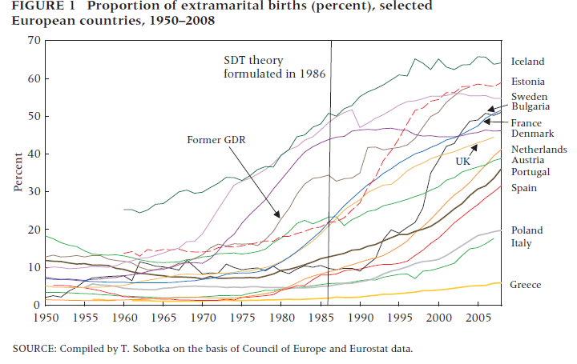

Slide 20
Global trends: revolution in the family
Postponement of marriaged&first birth
Increase in single living
Increase in cohabitation and extramarital births
Increase in divorce
Fertility below replacement
Decline kin co-residence
Need for a long term perspective on changes in family roles, household composition

Slide 21
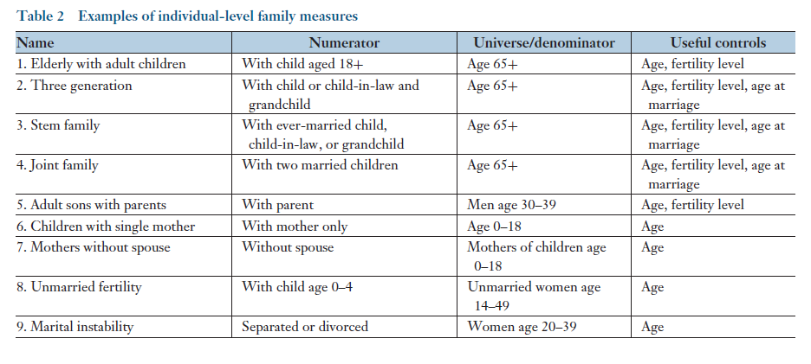
Ruggles 2012

Slide 22
Quantifying patriarchy
‘Non-elderly’ variables’
Patrilinearity: the proportion of wife’s relatives within household
Elderly (65+) focused variables
Patrilocality: the ratio of elderly with married daughters to those with married sons within household
Neolocality: ever married heads as % of ever married (men 20-29)
Nuptiality: male SMAM
Female autonomy: age-specific share of unrelated secondary individuals among women 15-34
Lateral extension: the proportion of the elderly coresiding with at least one lateral relative
Joint residence: proportion of the elderly living with at least two married children
Male domination: proportion of household heads among elderly women
Seniority: percent elderly in households headed by a man of a younger generation
Density of kin: the number of co-resident kin of an elderly person
Old age loneliness: share of elderly living either alone, with spouse only, or with non-kin
Szoltysek and Gruber 2012

Slide 23
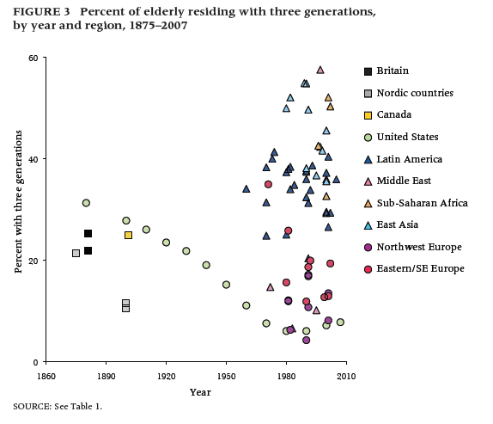
Ruggles 2009

Slide 24
Convergence toward small families-Scandinavian model?
Because of economic and demographic trends?
Because the spread of individualism in inevitable?
Or lasting differences- not detectable through co-residence (e.g. longevity Southern Europe)

Slide 25
Infrastructural wish: harmonizing across countries
Reconstruct 1% sample?

Slide 26
Summing up
Lots of use for properly documented and harmonized census variables
Preferably in interactive tools (incl GIS)
Enriched with other meso-level data
Ready-made for international comparisons

