Slide 1





DATA2SeMANTICS meets CENSUS2SEmantics CEDAR MINI-symposium/ 1-3-2013
Gerben de Vries
-group, University of Amsterdam

Slide 2
The PROJECT
Partners
VU University Amsterdam & University of Amsterdam
Elsevier, DANS & Philips
Two main use-cases
Enriching medical guidelines (Elsevier & Philips)
Census (DANS)

Slide 3
Project AIMS
Semantify (scientific) data
Data:
experimental datasets,
papers,
tables,
figures
Semantics:
links between datasets,
links to vocabularies/ontologies,
provenance trail
additional facts

Slide 4
PLAN for TODAY
Overview of the project by the workpackages: linking, provenance, scientific modeling, ranking, machine learning, complexity
WP aim
Current research
Application to E-Humanities
Notes:
Different levels of detail in the applicability, but each workpackage has something

Slide 5
WP4 - Information Publication, Integration and Enhancement
Methods, tools and strategies for:
Publishing information in an accessible, machine interpretable form
Integrating different types of information papers, spreadsheets, datasets, images, vocabularies
Enhancing information by providing
Annotations on contents and structure
Linking across different information sources
Mappings between alternative vocabularies
Notes:
Linking, linking, linking. Adding, adding, adding. Using relatively ‘dumb’ strategies

Slide 6

WP4 – PROV-O-MAticTM
Provenance tracing over shell & Python scripts
Software Carpentry Bootcamp
Notes:
Tool to automatically track the provenance of research pipelines, to make us all better researchers.

Slide 7
WP4 – LightWEight annotation
Annotation of structure of Clinical Guidelines
Trace from recommendation to underlying evidence
Notes:
Manual annotation

Slide 8
Link data and metadata in Figshare.com to LOD Cloud, ORCID, DBLP, Elsevier LDR
Extract references from PDF, and obtain DOI
Publish enriched metadata as RDF
Notes:
Linkitup is a tool to link stuff in figshare to other stuff and publish it back into figshare

Slide 9
WP4 – E-HUMANITIES APPLications
Integrate Linkitup with DANS EASY
Requirement: new API to EASY
Integrate TabLinker in Linkitup
Enrich and publish Census data from CEDAR as RDF
Elaborate on Annotation Work to represent
Alternate, possibly conflicting annotations
… perhaps even reason across these contexts (Szymon Klarman’s PhD thesis)
Notes:
Most concrete applications for DANS

Slide 10
WP5 – PROVENANCE RECONSTRUCTION
Data provenance is the history of a data item
Who, when, how was the data item created?
Which operations were performed on it?
The goal of WP5 is to reconstruct a plausible provenance for documents in a shared folder based on available evidence
In other words, we are trying to reconstruct a timeline of events and relationships between data
Notes:
Provenance for a shared documents folder

Slide 11
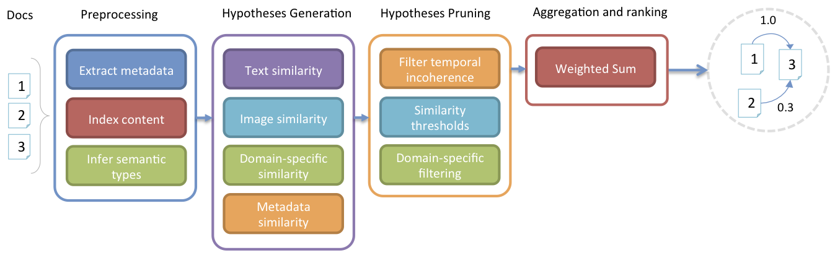
WP5 – HOW?
We propose a pipeline that collects evidence, generates hypotheses and ranks them by plausibility
First prototype based on similarity measures:
Good performance on test dataset:
Collection of biomedical publications
Notes:
Prototype based on a bunch of similarities

Slide 12
WP5 – E-HUMANITIES APPLICATIONS
The CEDAR dataset contains several versions of Excel sheets, PDFs and images related to census data
Moreover, there are books and other publications that describe and analyze these data
e.g. Twee eeuwen Nederland geteld
We can apply our provenance reconstruction pipeline to:
Reconstruct the relationships between the Excel sheets and the publications/books that talk about them
Infer semantic relationships between different versions of a sheet or different sheets (connection with WP6)
Notes:
Provenance reconstruction on the census files, relatively straightforward

Slide 13

WP6 - Understanding the scientific modeling process
Conceptual model
Computational model
Results
Problem
Publication
Notes:
Er ligt belangrijke wetenschappelijke kennis over onderzoeksprojecten opgesloten in computational models (in onze case study zijn dat de spreadsheets): welke concepten zijn belangrijk en hoe hangen deze samen, hoe worden resultaten berekend. Deze kennis is vaak niet toegankelijk voor anderen dan de ontwikkelaars. Wij willen het modelleer proces begrijpen en transparanter maken.

Slide 14
WP6 - Case study on Dutch Energy System in 2050
Computational model consisting of :
10s of spreadsheets
100s of tables
100s of concepts
1000s of formulas
Example, part of spreadsheet table:
 |  | Geothermal heating | Solar boiler | Hybrid heater
CO2 emission | Mton/PJ | 0.01 | 0 | 0.01
Roof area | Mm2 | 0 | 0.40 | 0
Geothermal energy | PJ | 0.80 | 0 | 0
Methane gas | PJ | 0.20 | 0 | =M12/$H$39
Notes:
Onze case study gaat over een spreadsheet model dat gebruikt wordt om de NL regering te adviseren over energie beleid. We hebben de spreadsheets deels handmatig, deels automatisch geanalyseerd.

Slide 15
WP6 - Which concepts are included and how are they related?
Manual anlysis of concepts in spreadsheets
Built
environment
Supplies
hasSupplies
hasTechnology
Public
buildings
New
houses
Roof
area
Methane
gas
…
…
Technology
Hybrid
heater
Solar
boiler
Notes:
We hebben handmatig een ontologie gereconstrueerd van een paar spreadsheets. De opbouw/opmaak van de tabellen in spreadsheets geeft veel informatie over de aard en relaties van de gebruikte concepten.

Slide 16
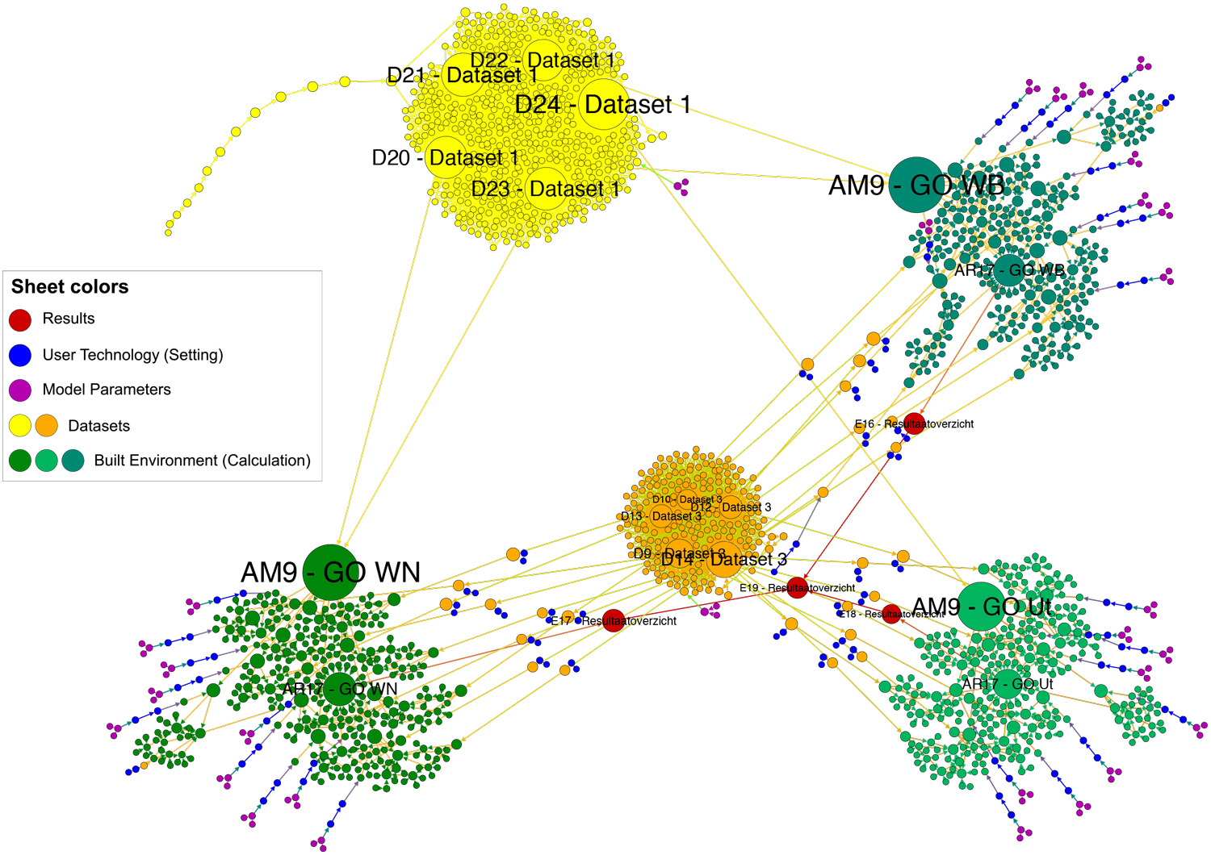
WP6 - How are results calculated (1)?
Automatic analyis of workflow in spreadsheets
Notes:
We hebben automatisch de afhankelijkheden tussen spreadsheet cellen in kaart gebracht door de formules na te lopen. Het plaatje laat zien hoe een van de model resultaten (broeikasgassen uitgestoten door gebouwde omgeving) wordt berekend uit 1800 ! andere spreadsheetcellen. Netwerk analyse laat zien welke cellen een belangrijke positie hebben in het netwerk en dus belangrijke variabelen zijn in de calculation workflow.

Slide 17
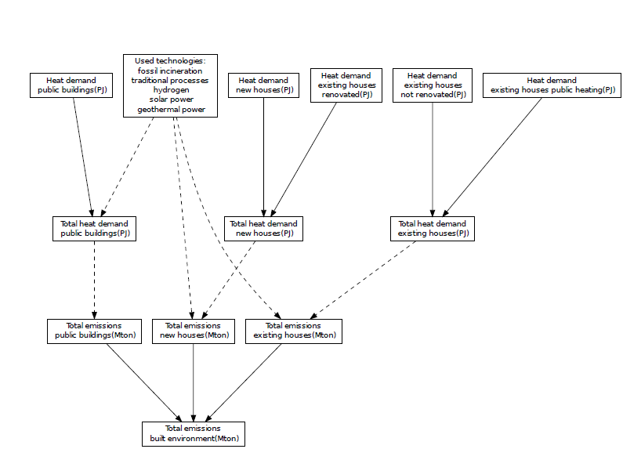
WP6 - How are results calculated (2)?
Manual reconstruction of workflow in spreadsheets
Notes:
De netwerk graaf van het vorige plaatje laat alleen de spreadsheet cellen zien, niet wat deze voorstellen. We hebben de belangrijkste variabelen genomen en handmatig bijbehorende labels opgezocht in de spreadsheets; zo konden we een versimpeld workflow schema reconstrueren.

Slide 18
WP6 – E-HUMANITIES APPLICATIONS
We could do the same for the CEDAR spreadsheets as we are planning to do for our energy use case:
Semi-automatically recognizing concepts and relations from within the CEDAR spreadsheets and relating them in an ontology
There are many publications describing the census data. These could be linked to the spreadsheets through the constructed ontology.

Slide 19
WP3 - RANKING
Main topic: Ranking Linked Data
Ranking is used for linked data replication
How do you know the original dataset changed?
What are good measure for selecting a partial replica?
What is the optimal unit of change?
Notes:
Optimal unit of change: when we’ve created a replica of a graph, how do we sync any changes between both? Using hashes (e.g. rsync style), or triples, or copy the same graph again, or a combination of these?

Slide 20
WP3 – Current Work
Subgraph selection for large-scale (~750 million triples) graphs
Use of big-data solutions (pig, hadoop)
How can we induce relevant subgraphs using rankings in our graph (i.e. using generic graph properties)
Notes:
How to select subgraphs for very large graphs in general. How to use rankings to induce relevant subgraphs.

Slide 21
WP3 - E-Humanities Applications
Replication for annotation purposes
Selecting a subgraph to add annotations to Such a subgraph would be similar to a DB ‘view’
Keeping the subgraph consistent with other annotations or changes in the original dataset
Merging the annotations back to the original graph
Notes:
Selection of subgraph might be useful for offline purposes: annotating the census spreadsheets locally, without needing to copy the complete rdf to your computer.

Slide 22
WP2 – InTEGRATION PLATFORM & ML modules
Provide the necessary plumbing to connect the different modules of the WPs
Machine learning modules for data enrichment
Learn from RDF to enrich RDF
Notes:
Two tasks

Slide 23
WP2 – LEARNING FROM GRaphs
Predict property Y for nodes of class X in an RDF graph Z
How?
Extract subgraphs, compute kernel, train classifier
Using Graph kernels + Support Vector Machines
Person
is a
person22
author
affiliation
paper54
group34
authoredBy
person11
Notes:
Learning from graphs, with a complementary approach to WP1

Slide 24
WP2 – Current WORK
What graph kernel to use
Different ways to express similarities between graphs
Computational complexity
How to handle numerical and string nodes
Link prediction
Link between node of class X and node of class Y?
Scaling up to large RDF graphs, together with WP3
Can we use it for ranking in WP3?
Notes:
Lots of things to investigate

Slide 25
WP2 – E-HUMANITIES APPLICATIONS
Flexible machine learning method for RDF graphs to do
Property prediction, link prediction, clustering, outlier detection
Provide help with harmonization on the RDF representation of the Census data?
Clustering of nodes in the RDF graph
Find similar professions in the Census?
Notes:
Machine learning can be applied in all kinds of settings, these are just examples.

Slide 26
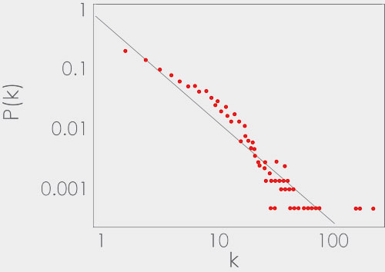
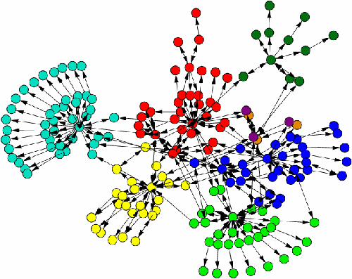
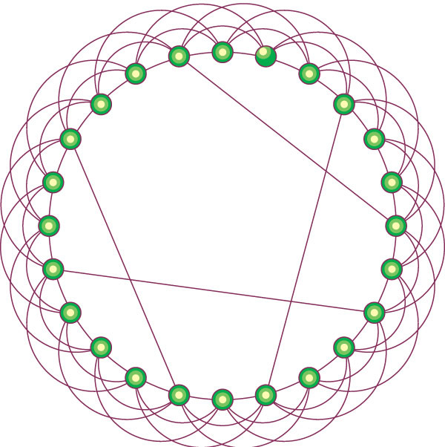
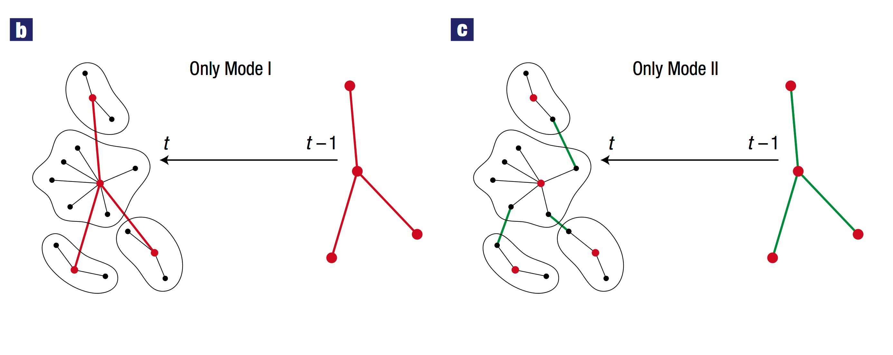
WP1 – COMPLEX NETwORKS
scale free networks
fractal networks
small world networks
Notes:
Complexity of data, large networks such as rdf graphs

Slide 27
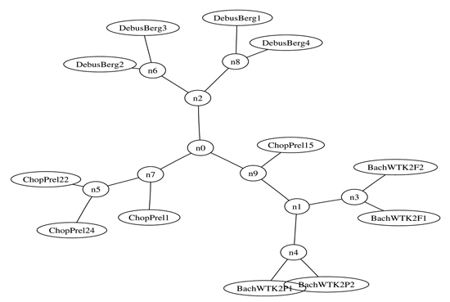
WP1 – Learning by Compression
Compression = Learning
Finding structure in data (learning) allows you to compress it. Compressing data means finding structure
Just using ZIP is enough:
Notes:
One method to estimate complexity is by compression, which you can also use for learning.
Example is a clustering of musical pieces by compression their midi files.

Slide 28
WP1 – Learning by Compression
Domain knowledge?
Put it in your compressor
Graph compressors for RDF:
Frequent subgraphs
Iterated Graph clustering
Graph grammars
Minimum spanning tree
Notes:
Compression for RDF graphs.

Slide 29
WP1 – GRAPH GRAMMARS
S
S
A
B
A
C
S
A
C
B
B
A
A
A
A
A
C
B
A
a
a
B
b
a
c
C
c
b
Notes:
CFG grammar as in language but for graphs

Slide 30
WP1 – Graph simplification
Simple Complete
has temp
has temp
patient
37 ºC
patient
temp
37
ºC

Slide 31
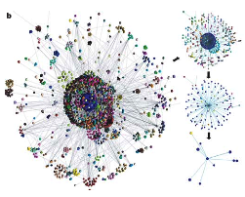
WP1 – graph visualization
S
A grammatical parse provides a leveled view of the graph, hiding the complexity that makes graphs difficult to visualize.
A
C
B
A
A
C
B
a
a
c
b
Notes:
Next to using it for compression, might be useful for visualization

Slide 32
WP1 – E-humanities APPLications
Data: Social networks, co-author networks, correspondence networks, trade networks, semantic networks, etc.
Compression: Author detection/analysis:
How well does Marlowe compress under a model for Shakespeare?
Graph complexity: Determine node function and similarity
Find Democratic and Republican politicians with the same function within their context
Graph modeling: Statistics on graphs, finding outliers, etc.
Graph grammars: Multi-resolution analysis: from broad clusters, to low level interactions.
Notes:
Tons of e-humanities applications

Slide 33
Concluding REmarks
Each workpackage has something for E-humanities
In different stages of development
www.data2semantics.org
For updates and who does what!

Slide 34
Questions
?

