Slide 1


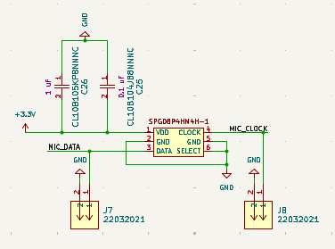

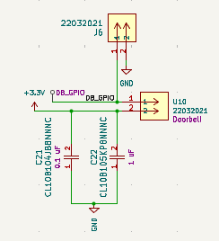
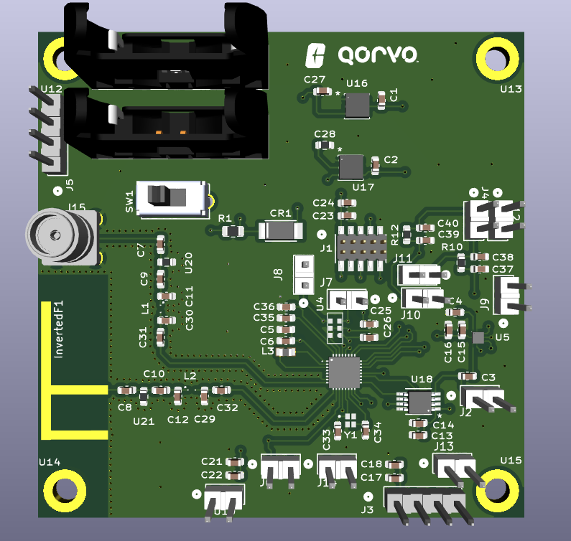
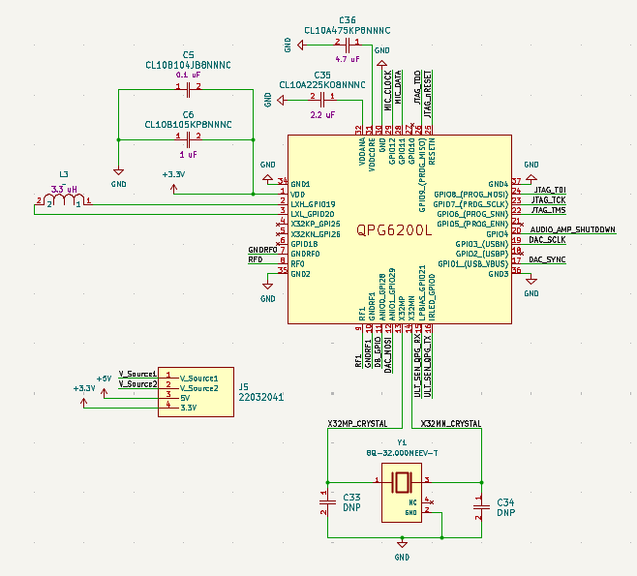
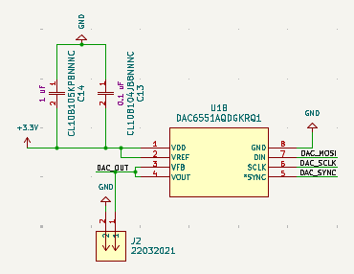
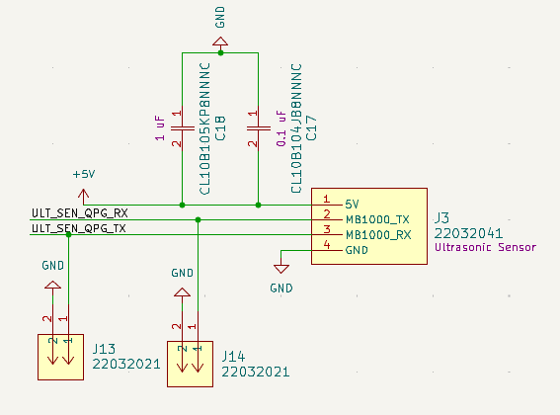
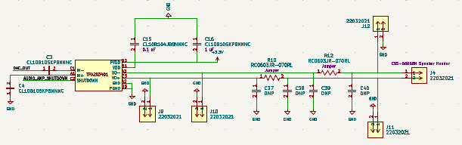
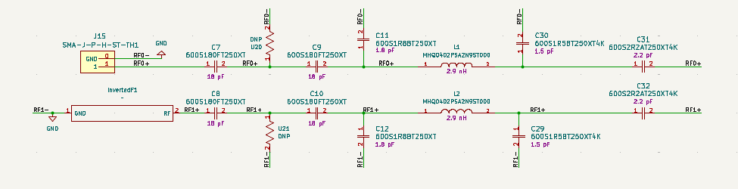
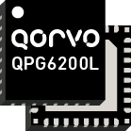
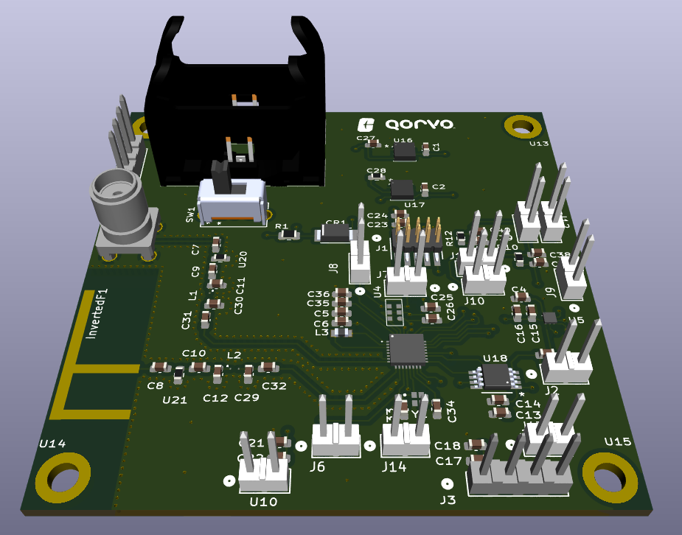
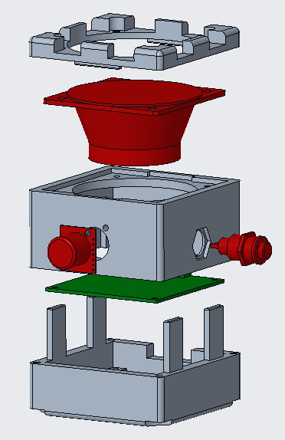
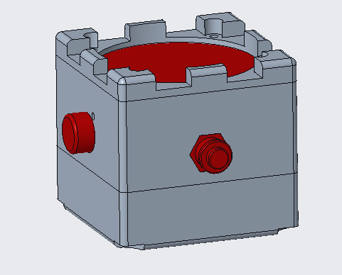



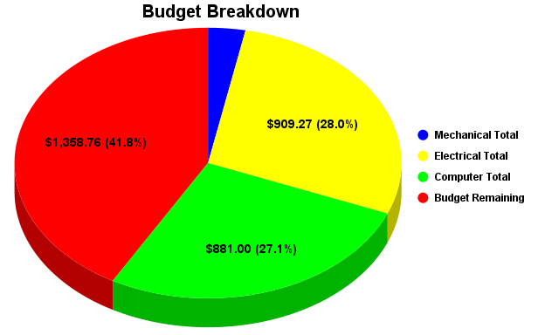
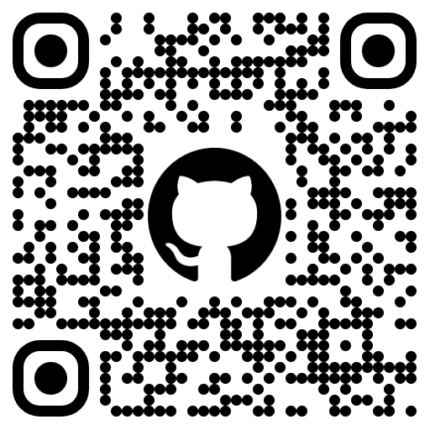
QORVO_RADIO2
Senior Design I - Fall 2025
Industry Supporters: Jed Sander | David Kegley | Nathan Whitt | Daisy Vazquez | Faculty Mentors: Prof. Nabila (Nan) BouSaba | Dr. Fareena Saqib
Team Members: Luke Matthews [lmatth23@charlotte.edu] | Kenneth Le [kle26@charlotte.edu] | Abdul Bah [abah2@charlotte.edu] | Alberto Hernandez [aherna86@charlotte.edu] | Ethan Hartman [ehartma6@charlotte.edu]
Objective
Design, develop, and replicate a device with multiple protocols and peripherals.
Can communicate through a mesh network to promote RF research at UNCC.
PCB
PCB Schematic
Why these Peripherals
PDM will capture voice via a digital MEMS microphone
SPI will drive a speaker and amplifier for audio playback
Analog detects push button presses to trigger doorbell events
UART interfaces with an ultrasonic sensor for motion detection and alerts
Requirements
Two or more unique Protocols
Three or more unique peripherals
2.4GHz - 2.5GHz ISM Band
3”x3”x3” enclosure
0.5 lbs
QPG6200L SoC
Battery life greater than week
Top View
Mechanical Enclosure Design
CAD Model
Main SoC
Implementation Plan (SDII)
Remeasure extrusions and manufacture enclosure. (1/12/2026)
Assemble the initial replicated PCB to design specifications. (1/19/2026)
Program initial replicated remote devices. (1/26/2026)
Conduct rigorous testing to verify compliance with operational specifications. (3/1/2026)
Deliver fully functional remote devices that communicate through mesh network. (4/24/2026)
Side View
Protocols Selected
Budget
$3,250 Total Budget
$1,891.24 Spent
$74.44 Per Device
IoT Block Diagram
Start
Send a command
Gateway receives command through Wi-Fi AP/direct connection
Convert to BLE format & send
Yes
Uses BLE?
No
Convert to Zigbee format & send
Yes
Transmit audio?
No
Yes
Activate lights?
No
Peripherals Selected
PDM 🗣️🎙️
SPI 🔊
Analog🚪🔔
UART 🕺
Speaker & Mic receives GATT command
Doorbell receives GATT command
Lighting System receives On/Off cluster command
Movement Detector senses motion
Future Usage (After SDII)
Serve as an interactive educational tool to promote RF research
at UNC Charlotte and Qorvo’s
technological advancements.
Output Speaker Audio
Trigger chime event
Activate
LED lights
Send light signal
Gateway receives status & sends it to tablet
Update tablet with device responses
End
GitHub

