Slide 1
MO601 – Project 4 LISC Learning Instruction Semantics from Code Generators
093311 – Alberto Arruda de Oliveira

Slide 2
LISC Objective
Automated modeling of instruction semantics
Compilers: Intermediate Language -> Assembly Code
GCC, LLVM, etc.
LISC:
Learn from code generators
Automatically extract semantics
Test extracted semantics

Slide 3
Project 4 Objective
Reproduce the completeness experiment (Table 4) of reference [1]
Project 3 Objective
Evaluate the instruction lifting performance of LISC
Is the performance reported by [1] accurate?
How does the program size affects lifting performance?
Does the automata used impacts lifting performance?
[1] Niranjan Hasabnis and R. Sekar. 2016. Lifting Assembly to Intermediate Representation: A Novel Approach Leveraging Compilers. In
Proceedings of the Twenty-First International Conference on Architectural Support for Programming Languages and Operating Systems (ASPLOS '16).
ACM, New York, NY, USA, 311-324.

Slide 4
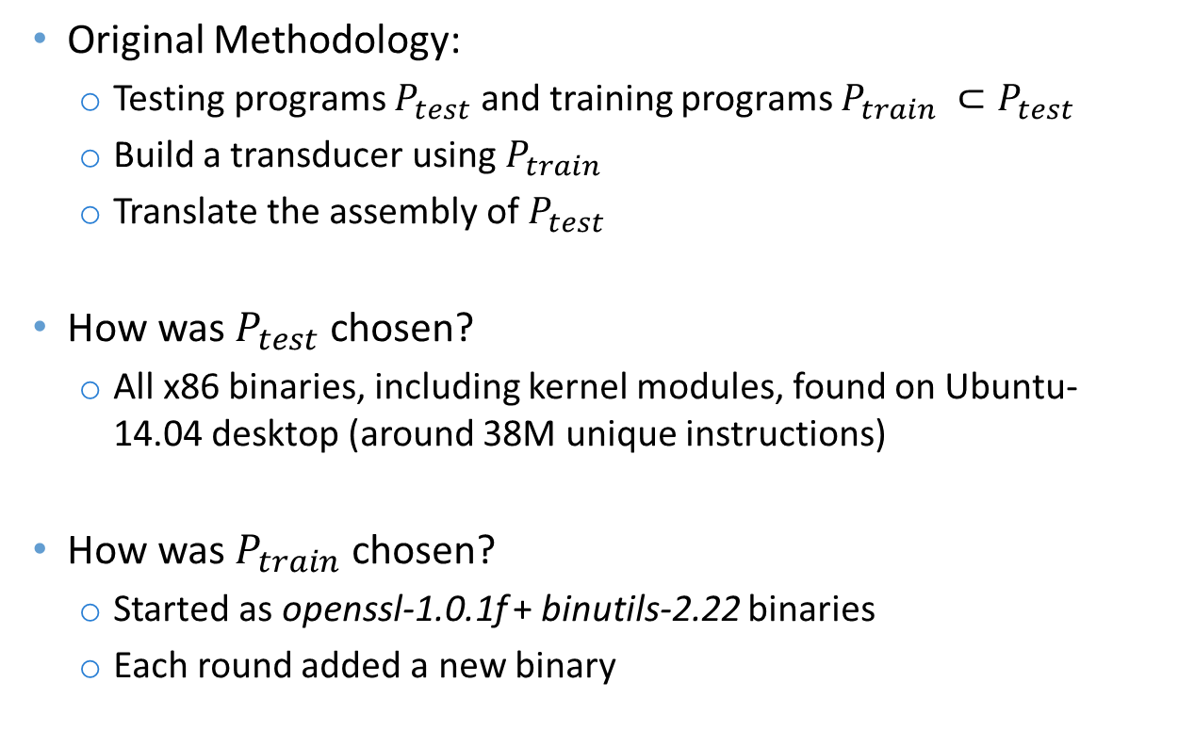
LISC Evaluation Completeness
Original Methodology:
Testing programs $P_{test}$ and training programs $P_{train} ⊂P_{test}$
Build a transducer using $P_{train}$
Translate the assembly of $P_{test}$
How was $P_{test}$ chosen?
All x86 binaries, including kernel modules, found on Ubuntu-14.04 desktop (around 38M unique instructions)
How was $P_{train}$ chosen?
Started as openssl-1.0.1f + binutils-2.22 binaries
Each round added a new binary

Slide 5
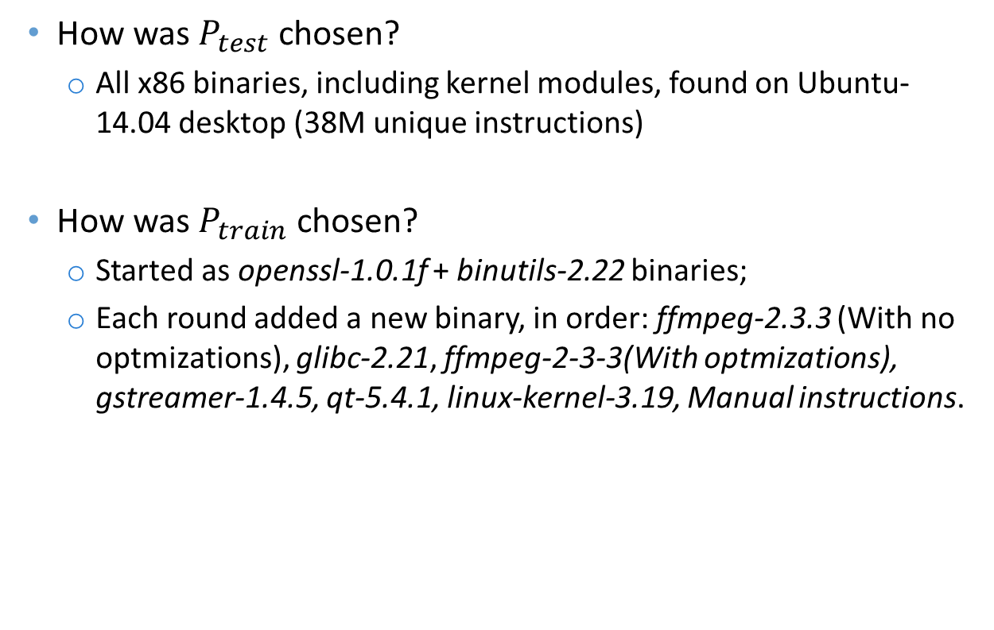
LISC Evaluation Completeness
How was $P_{test}$ chosen?
All x86 binaries, including kernel modules, found on Ubuntu-14.04 desktop (38M unique instructions)
How was $P_{train}$ chosen?
Started as openssl-1.0.1f + binutils-2.22 binaries;
Each round added a new binary, in order: ffmpeg-2.3.3 (With no optmizations), glibc-2.21, ffmpeg-2-3-3(With optmizations), gstreamer-1.4.5, qt-5.4.1, linux-kernel-3.19, Manual instructions.

Slide 6
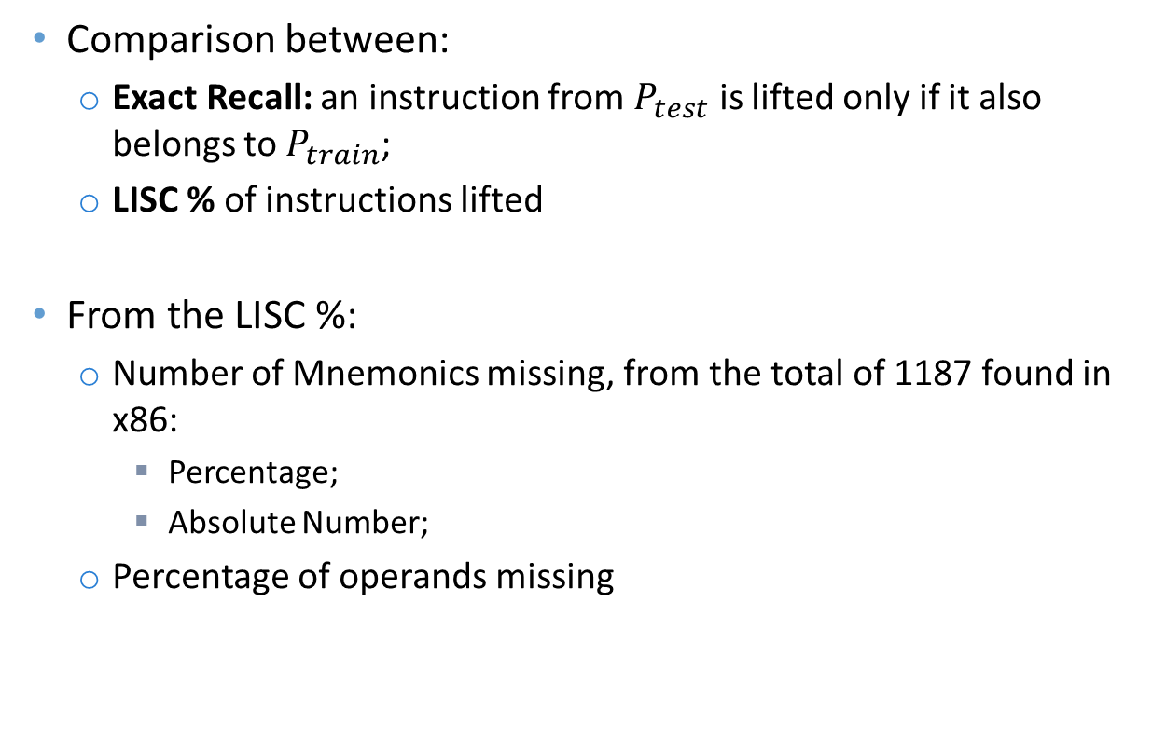
LISC Evaluation Completeness Metrics
Comparison between:
Exact Recall: an instruction from $P_{test}$ is lifted only if it also belongs to $P_{train}$;
LISC % of instructions lifted
From the LISC %:
Number of Mnemonics missing, from the total of 1187 found in x86:
Percentage;
Absolute Number;
Percentage of operands missing

Slide 7
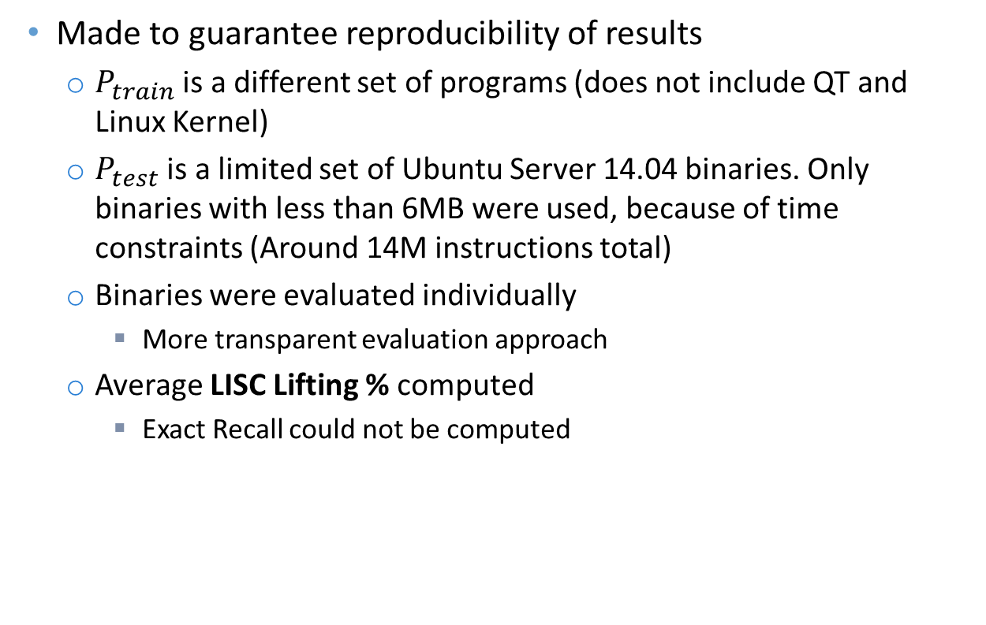
LISC Evaluation Completeness Methodology Changes
Made to guarantee reproducibility of results
$P_{train}$ is a different set of programs (does not include QT and Linux Kernel)
$P_{test}$ is a limited set of Ubuntu Server 14.04 binaries. Only binaries with less than 6MB were used, because of time constraints (Around 14M instructions total)
Binaries were evaluated individually
More transparent evaluation approach
Average LISC Lifting % computed
Exact Recall could not be computed

Slide 8
LISC Evaluation Completeness Original Results
P_train | % Instructions Lifted |  | LISC (%) |  | Missing Mnemonics (Absolute)
 | Exact Recall | LISC | Missing Mnemonics | Missing Operands
openssl-1.0.1f + binutils-2.22 | 63.72 | 98.46 | 1.05 | 0.49 | 464
+ffmpeg-2.3.3 (Non Opt) | 68.21 | 98.74 | 1.03 | 0.23 | 377
+glibc-2.21 | 68.74 | 98.8 | 1.01 | 0.19 | 346
+ffmpeg-2.3.3 (Opt) | 69.07 | 98.89 | 0.88 | 0.23 | 303
+gstreamer-1.4.5 | 71.07 | 99.1 | 0.79 | 0.11 | 221
+qt-5.4.1 | 72.45 | 99.21 | 0.69 | 0.09 | 161
+linuxkern-3.19 | 73.97 | 99.49 | 0.44 | 0.07 | 49
+Manual | 74.04 | 100 | 0 | 0 | 0

Slide 9
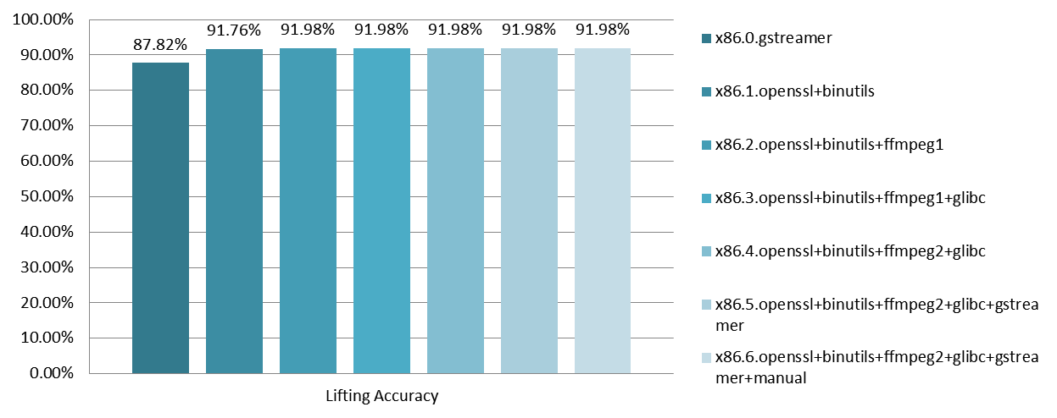
LISC Evaluation Completeness New Results

Slide 10
LISC Evaluation Completeness Discussion
Huge difference between Original and New results, even in comparable experiments
Over 10 percentual points in some cases
New methodology is more ‘fair’, by not excluding duplicates
Most complementary automatas do not change the final results at all
Ldconfig results were very low.

Slide 11
LISC Evaluation Performance Evaluation
Performance reporting in the original paper was lacking
Only graphically reports automata creation time
Biggest burden in performance is binary lifting
Liner algorithm with program size
The authors argue 8h total to lift around 38M instructions, a fifth of which is to dump programs
Very different results observed in practice
Significantly smaller number of instructions took around 13h only to lift

Slide 12
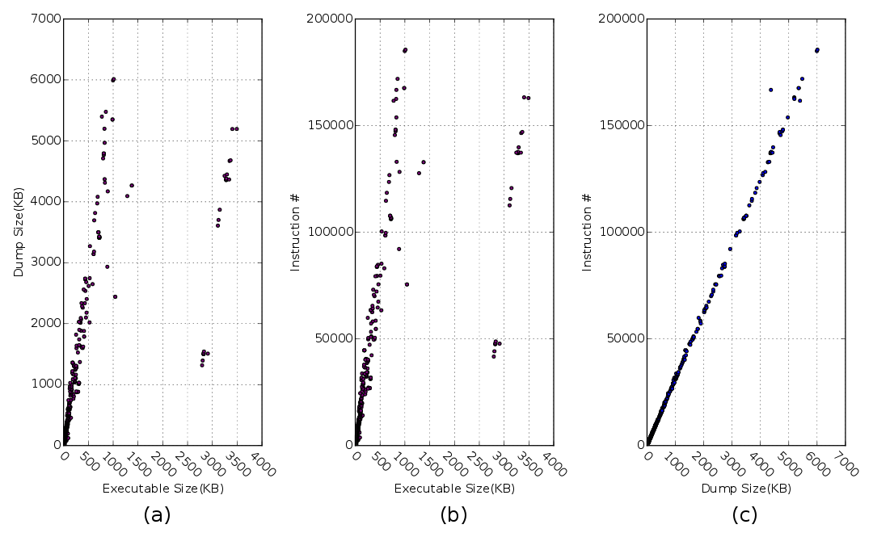
LISC Evaluation Executable dumping

Slide 13
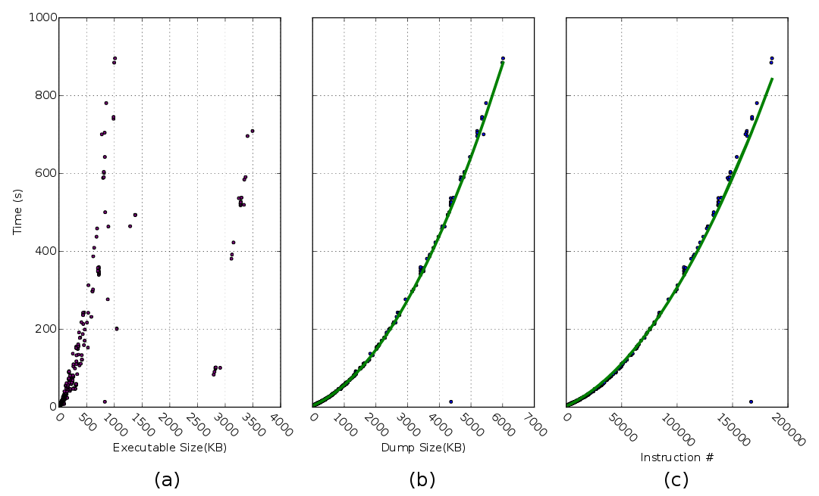
LISC Evaluation Lifting Time Growth

Slide 14
LISC Evaluation Performance Evaluation
The authors argued linear growth, while I obtained a clear quadratic growth
Around 13 hours to lift around 900
Not all executables could be lifted in a feasible time
Ldconfig is the sole outlier
Also had the absolute worst lifting results
Although it has some particularities, like highest number of nops, no pattern could be found in its dump to explain this fact

Slide 15
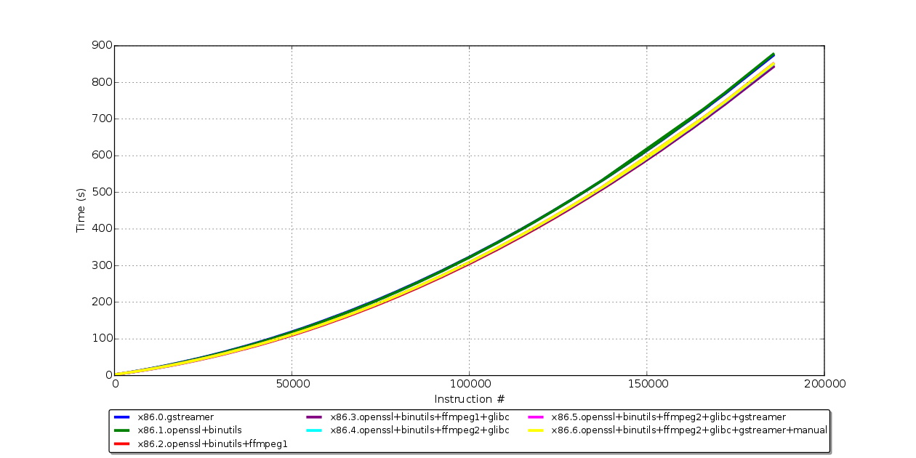
LISC Evaluation Automata Impact on Performance

Slide 16
LISC Evaluation Automata Impact on Performance
Another performance question not explored by the authors
Bigger automatas in some cases actually decrease the lifting time
Overall, all the results were very similar

Slide 17
LISC Evaluation Conclusions
The framework and instructions provided by the authors were not sufficient for complete reproduction of results
Several discrepancies between results reported in the paper and my own
Performance experiments reported are very incomplete
Focused on the aspect that is the least burden to time

Slide 18
THANK YOU!

