Slide 1
MO601 – Project 3 LISC Learning Instruction Semantics from Code Generators
093311 – Alberto Arruda de Oliveira

Slide 2
Overview
Binary analysis and instrumentation
Program monitoring (Valgrind, Pin)
Virtualization
Malware Analysis
Etc.
Modeling of instruction Semantics
Translation of assembly to intermediate language representation
Requires previously existing models, created manually
Limited Support of new architectures

Slide 3
LISC Objective
Automated modeling of instruction semantics
Compilers: Intermediate Language -> Assembly Code
GCC, LLVM, etc.
LISC:
Learn from code generators
Automatically extract semantics
Test extracted semantics

Slide 4
LISC Benefits
Automated instruction semantics modeling
Machine Learning Approach
Reduce manual efforts
Broaden Architecture Support
Architecture Neutrality
Code Generators
Well tested compiler code
Among the most tested code

Slide 5
Project 3 Objective
Test LISC in a already used architecture of choice
x86, ARM, AVR
Reproduce at least one of LISC’s evaluation approaches:
Completeness
Architecture-Neutrality
Performance
Correctness

Slide 6
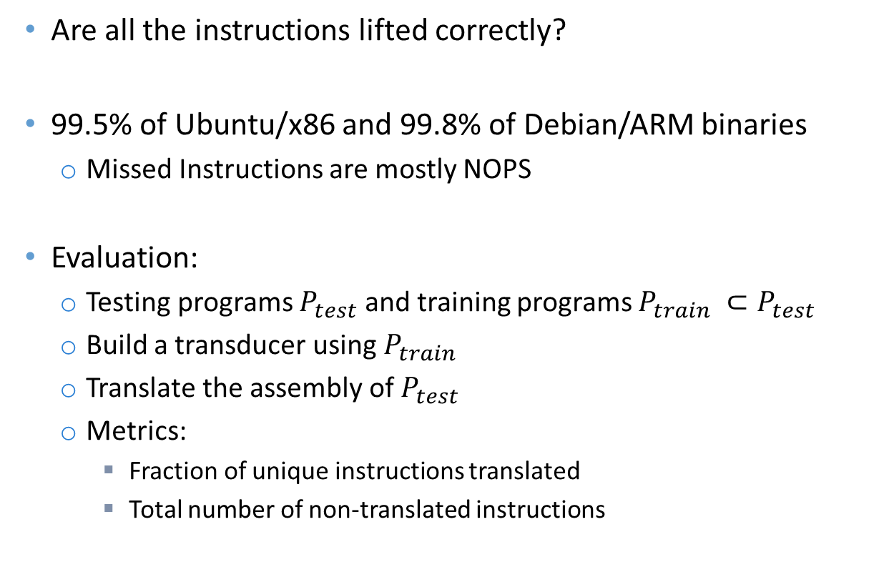
LISC Evaluation Completeness
Are all the instructions lifted correctly?
99.5% of Ubuntu/x86 and 99.8% of Debian/ARM binaries
Missed Instructions are mostly NOPS
Evaluation:
Testing programs $P_{test}$ and training programs $P_{train} ⊂P_{test}$
Build a transducer using $P_{train}$
Translate the assembly of $P_{test}$
Metrics:
Fraction of unique instructions translated
Total number of non-translated instructions

Slide 7
LISC Evaluation Architecture Neutrality
Can the system be easily adapted to a new architecture?
9 person-hours to support ARM and 3 person-hours to support AVR
Evaluation:
Code that is architecture specific
Project 4: Support a new architecture!

Slide 8
LISC Evaluation Performance
How long does training/testing takes?
10 minutes training
1.4GB of code generator logs
4830 transducer states
Lifting binaries from Ubuntu/x86 and Debian/ARM archiectures (around 100M instructions): around 8 hours
Linear-time algorithm for lifting binaries

Slide 9
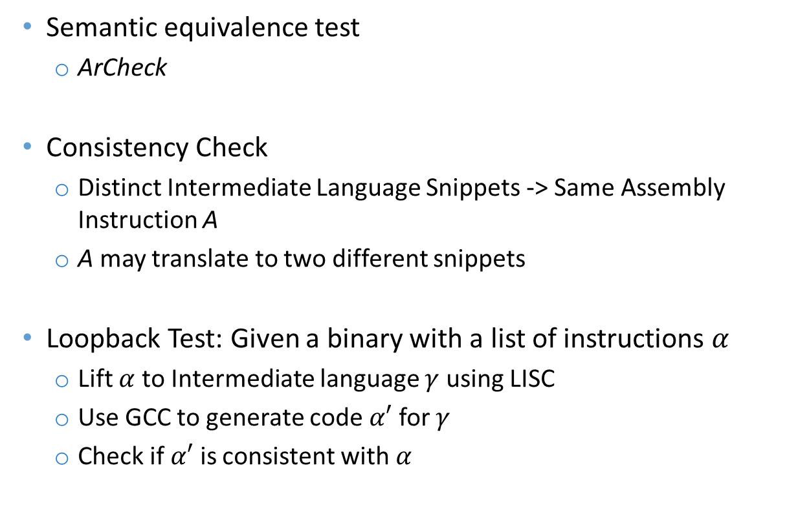
LISC Evaluation Correctness
Semantic equivalence test
ArCheck
Consistency Check
Distinct Intermediate Language Snippets -> Same Assembly Instruction A
A may translate to two different snippets
Loopback Test: Given a binary with a list of instructions $α$
Lift $α$ to Intermediate language $γ$ using LISC
Use GCC to generate code $α′$ for $γ$
Check if $α′$ is consistent with $α$

Slide 10
Project 4 Possible Ideas
New check of architecture neutrality
Generate language model for a non-supported architecture
Alternative machine learning technique
Can a different approach to training and testing be employed?
Evaluation Flaws
Is there some aspect of current evaluation that fails to cover possible scenarios?

Slide 11
THANK YOU!

