Slide 1

Generalizing Path-Relinking for a Simulation-Optimization Problem in Hydroinformatics
Author&speaker: | Andrea Peano
Author: | Maddalena Nonato
Author: | Prof. Marco Gavanelli

Slide 2
Outline:
Intensification strategies
The path-relinking (from the literature)
A generalization of path-relinking (we propose)
A simulation-optimization application
Experiments & Results
Conclusions & Future works

Slide 3
Combinatorial/Constrained Optimization Problem
search space
Enveloped Search Space
☺
☺

Slide 4
Enveloped Search Space
Local optimum
Local optimum

Slide 5
Mixing the (good) features from two good solutions (local optima) likely yield a better solution
Sounds like an evolutionary concept…
Local optimum
A₁
B₂
Local optimum
A
B
A₂
B₁
Exploit
Existing
Knowledge

Slide 6
Sampling / Optimization
Intensification

Slide 7
Online
Offline
O $I
O !I
O
O
O
O
O
I
I
I
I
I
Diversification
Convergence metrics
Many I runs
Post-Optimization
Effectiveness depends on the input population
Many O runs

Slide 8
Metaheuristics
GA, LS, GRASP…
??

Slide 9
Path-relinking
First introduced in "Fundamentals of scatter search and path relinking" by Glover et al., 2000
Iteratively
transforms an initial solution ( ) into a guiding solutions ( )
At each step assigns "one" feature of g to i
i
g
A
8
11
15
13
10
F
11
15
13
10
8
L
15
13
10
8
11
D
13
10
8
11
15
13
10
8
11
15
Z
A
F
L
D
Z

Slide 10
Path-relinking
First introduced in "Fundamentals of scatter search and path relinking" by Glover et al., 2000
Iteratively
transforms an initial solution ( ) into a guiding solutions ( )
At each step assigns "one" feature of g to i
i
g
A
8
11
15
13
10
F
11
15
13
10
8
L
15
13
10
8
11
D
13
10
8
11
15
13
10
8
11
15
Z
A
F
L
D
Z
s¹

Slide 11
Path-relinking
First introduced in "Fundamentals of scatter search and path relinking" by Glover et al., 2000
Iteratively
transforms an initial solution ( ) into a guiding solutions ( )
At each step assigns "one" feature of g to i
i
A
8
11
D
13
g
10
8
11
D
13
10
8
11
D
13
10
8
11
D
Z
10
8
11
15
13
10
8
11
D
13
A
F
L
D
Z
s¹

Slide 12
Path-relinking
First introduced in "Fundamentals of scatter search and path relinking" by Glover et al., 2000
Iteratively
transforms an initial solution ( ) into a guiding solutions ( )
At each step assigns "one" feature of g to i
i
A
8
11
D
13
g
10
8
11
15
13
10
8
11
D
13
A
F
L
D
Z
s¹
s²

Slide 13
Path-relinking
First introduced in "Fundamentals of scatter search and path relinking" by Glover et al., 2000
Iteratively
transforms an initial solution ( ) into a guiding solutions ( )
At each step assigns "one" feature of g to i
i
g
A
8
L
D
13
A
8
11
D
13
10
8
11
15
13
10
8
11
D
13
A
F
L
D
Z
s¹
s²
s³

Slide 14
Path-relinking
First introduced in "Fundamentals of scatter search and path relinking" by Glover et al., 2000
Iteratively
transforms an initial solution ( ) into a guiding solutions ( )
At each step assigns "one" feature of g to i
i
g
A
8
L
D
13
A
8
L
D
Z
A
8
11
D
13
10
8
11
15
13
10
8
11
D
13
A
F
L
D
Z
s¹
s²
s³
s⁴

Slide 15
Path-relinking
First introduced in "Fundamentals of scatter search and path relinking" by Glover et al., 2000
Iteratively
transforms an initial solution ( ) into a guiding solutions ( )
At each step assigns "one" feature of g to i
i
g
s¹
s²
s³
s⁴
s^{k} are intermediate steps of a path connecting i to g
Path-relinking explores one (or more) of the possible paths connecting i to g

Slide 16
best=PR(i,g)
i
g
s¹
s²
s³
s⁴
WARNING!
Paths are exponential, so it is important to make good choices during the exploration
→
implement good strategies!

Slide 17
best=PR(i,g)
i
g
s¹
s²
s³
s⁴
STRATEGIES:
Neighbourhood exploration (deterministic/randomized, partial/complete)
Move selection (best improvement, first improvement)
Path exploration (1/2 direction, entirely/partially, 1/2+ paths, termination condition)
Many variants in Ribeiro et al. 2012: Path-relinking intensification methods for stochastic local search algorithms

Slide 18

O
?????????????????
best=PR(i,g)
Many LOs are passed to the path-relinking
Reference set: rs

Slide 19
Common implementation
While "new <i,g> available"
Select a pair <i,g> in rs
best=PR(i,g)
Update rs
LOG:
Select <i,g₁>
Explore <i,g₁>
Select <i,g₂>
Explore <i,g₂>: NEW BEST!
Select <i,g₃>
Explore <i,g₃>: NEW BEST!
FINISH!
g2
i
Path-relinking is
SEQUENTIAL AND ATOMIC!!
g1
g3

Slide 20
Facts:
Classical applications:
no limit in the number of explored solutions →
all <i,g> in rs are explored
Simulation-Optimization:
strict limit (we have 500) →
rs cannot be fully explored
Path-relinking is blind and consumes simulations
How to make path-relinking more "frugal", i.e., aware and reactive wrt the acquired knowledge?

Slide 21
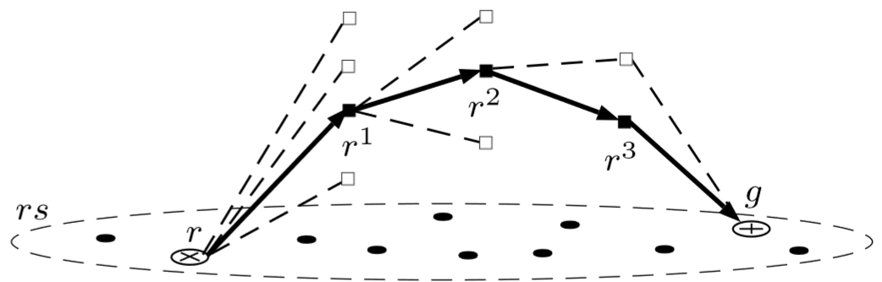
Building blocks of path-relinking
(see Ribeiro et al., 2012)
The reference set:
Filtering
<i,g> selection
Updating (new solutions are added into rs)
Solution representation (affect all the other below)
Exploration strategies:
Neighbourhood exploration (random, entirely, partially…)
Move selection (randomized, greedy, first improvement…)
Path exploration (direction, both direction, entirely, partially, one path, more paths, termination condition)

Slide 22
Generalizing path-relinking
Step 1: re-modelling the concept of path-relinking
Global / inter-path strategies
<i,g> selection strategy
Atomic exploration of <i,g>
rs management
Main loop’s termination condition
<i,g>
Local / intra-path strategies
Neighbourhood exploration
Move selection
Path exploration
Path’s termination condition

Slide 23
Generalizing path-relinking
Step 2: considering more than one <i,g> to be "open" (N_{pr}=[1,|rs|²])
(creating an active knowledge base…)
Global / inter-path strategies
N_{pr}=4
Star 1
a
g₁
<a,g>₁
Local / intra-path strategies
<a,g>
Local / intra-path strategies
Local / intra-path strategies
<a,g₃>
g₃
g₂
Star 2
Local / intra-path strategies
g₄
<g₂,g₄>

Slide 24
Generalizing path-relinking
Step 3: splitting the <i,g> search in quantum (preemptive)
Step 4: moving control from intra-path to inter-path (triggering)
Step 5: define priority function (quality driven, …)
Global / inter-path strategies
LOG:
Trigger
Trigger
Trigger: NEW BEST!
Trigger
Trigger: NEW BEST!
Trigger: NEW BEST!
Trigger: NEW BEST!
Trigger
FINISH!
Es.
|quantum|=neighbourhood
Priority = continue if best found
<a,g>₁
Local / intra-path strategies
<a,g>
Local / intra-path strategies
Local / intra-path strategies
<a,g₃>

Slide 25
Generalizing path-relinking
Step 3: splitting the <i,g> search in quantum (preemptive)
Step 4: moving control from intra-path to inter-path (triggering)
Step 5: define priority function (quality driven, …)
Global / inter-path strategies
Es.
|quantum|=solution
Priority = continue if best found
<a,g>₁
Local / intra-path strategies
<a,g>
Local / intra-path strategies
Local / intra-path strategies
<a,g₃>

Slide 26
Limited number of evaluations: 24
Simulation-Optimization
LOG:
Trigger
Trigger
Trigger: NEW BEST!
Trigger
Trigger: NEW BEST!
Trigger
Trigger: NEW BEST!
Trigger: NEW BEST!
FINISH!
LOG:
Trigger
Trigger
Trigger: NEW BEST!
Trigger
Trigger: NEW BEST!
Trigger: NEW BEST!
Trigger: NEW BEST!
Trigger
FINISH!
|quantum|=path
|quantum|=neighbourhood
14
24
12
15
3
8
24
22
5
19

Slide 27
Generalizing path-relinking
The final shape
rs management
<i,g> knowledge based selection
Preemptive exploration of <i,g>
Priority function for quantum selection
INPUT: Quantum size
INPUT: Number of open pairs
Path exploration
Main termination condition
Path’s termination condition
Global / inter-path strategies
<i,g>
Local / intra-path strategies
Neighbourhood exploration
Move selection

Slide 28
Generalizing path-relinking
Why a generalization?
|quantum|
Known variants of path-relinking
path
multipath
truncated
Concurrent-prioritized
path-relinking
neighbourhood
Huge mainly unexplored
territory
solution
N_{pr}
Priority functions??
1

Slide 29
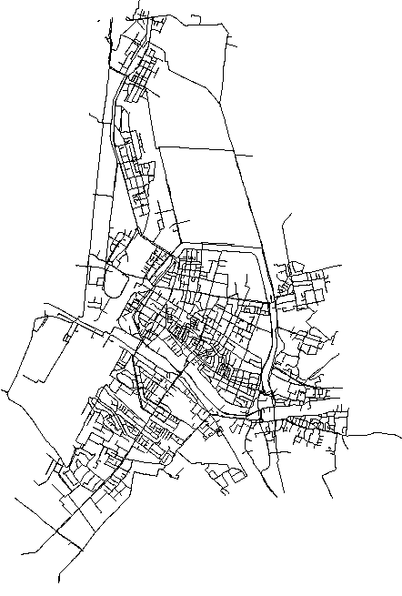
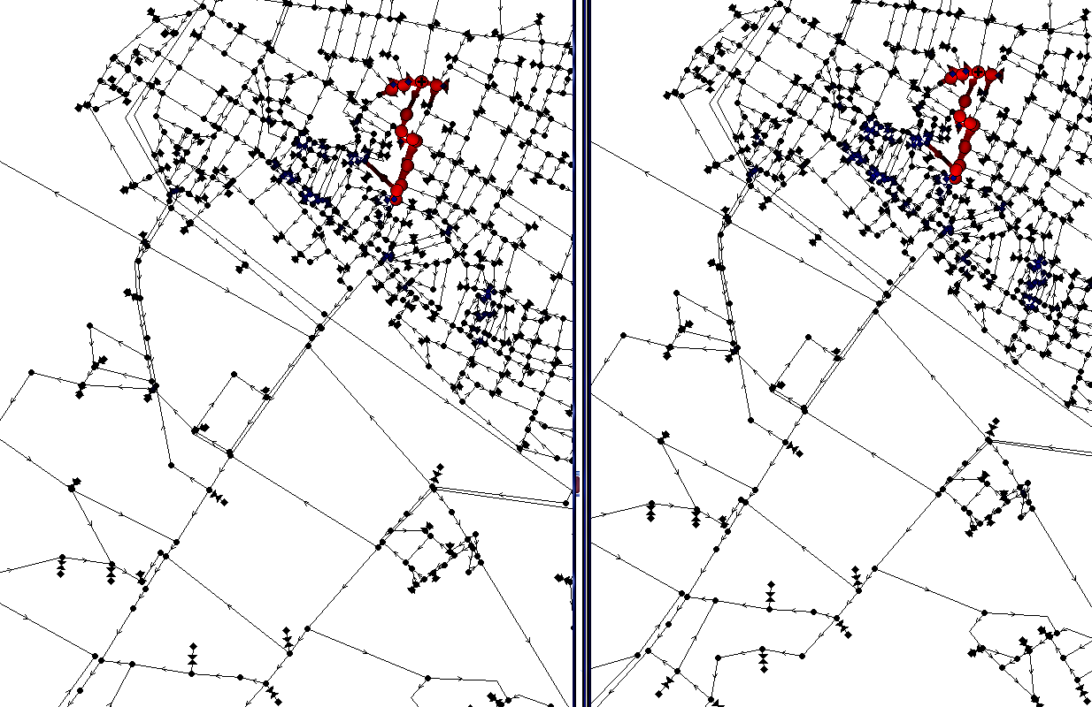
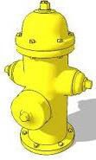
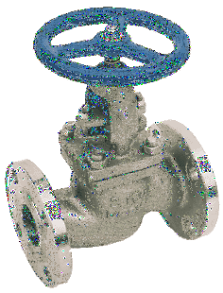
Injection of contaminant within the hydraulic network. Contaminant spreading…
Hydraulic simulations
No reaction Device activation
01h

Slide 30
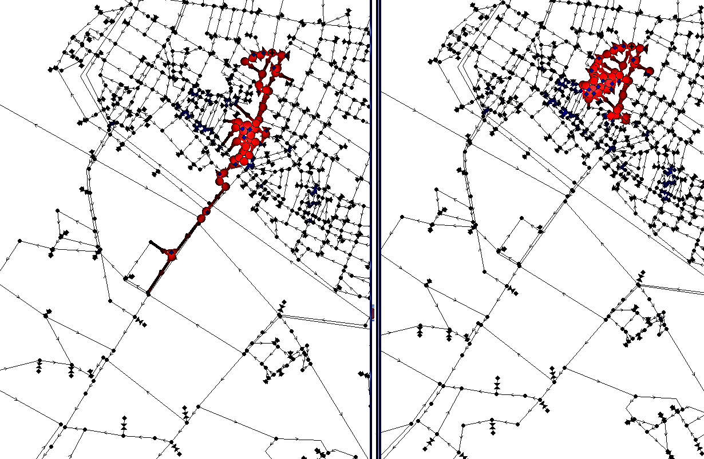
Injection of contaminant within the hydraulic network. Contaminant spreading…
Hydraulic simulations
No reaction Device activation
03h

Slide 31

Simulation-Optimization: Response to contamination events
Device | Time
V1 | ∞
V2 | ∞
V3 | ∞
H1 | ∞
H2 | ∞
… | …
Hydraulic Simulator
̴5 seconds
Volume of contaminated water consumed by users – 80’000 litres
MAX 500 EVALUATIONS
Device | Time
V1 | 4’
V2 | 7’
V3 | 23’
H1 | 18’
H2 | 12’
… | …
Hydraulic Simulator
̴5 seconds
Volume of contaminated water consumed by users – 47’000 litres

Slide 32
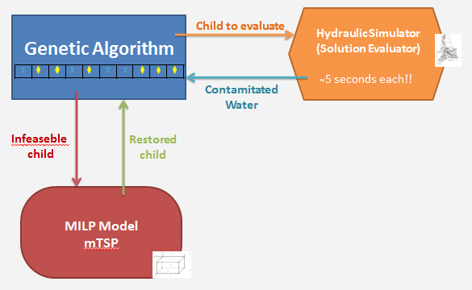
Previous work:
Genetic Algorithms EVOCOP 2012 + Journal of AI 2013
Path-relinking
very preliminary results at IFORS 2014
first stable results Ph.D. Thesis, March 2015
stable results at AI*IA 2015 in September (best application paper)
extended results published in the journal “Intelligenza Artificiale”
PATH RELINKING

Slide 33
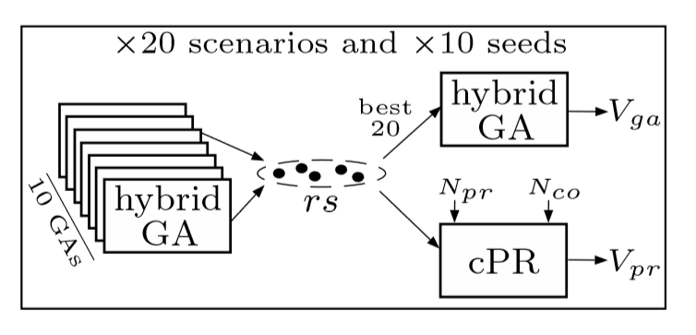
Experiments
Δ = best(rs) - Vx

Slide 34
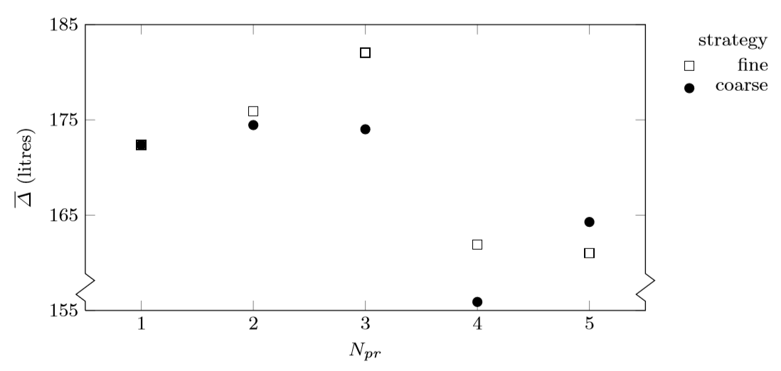
Results
|quantum|
Solution
Neighbour.

Slide 35
Conclusions
It’s a generalization of path-relinking because it collapses to existing versions when:
N_{pr}=1
|quantum|=path
(e.g., truncated path-relinking is N_{pr}=1 & |quantum|<path)
This framework can exploit the active knowledge to drive the search
Existing knowledge can be updated and analyzed any time (between quantums)
priority=f(active knowledge)
Priority ≡ concurrency
Concurrent path-relinking more effective in simulation-optimization
N_{pr}>1 ≡ (more) active knowledge
|quantum|<path ≡ many more decision checkpoints
(kill unpromising pairs basing on knowledge reasoning…)
(exploit new bests ASAP)

Slide 36
Future works
Investigate other opportunities this framework gives
Test it on the standard benchmarks for path-relinking
Any other ideas?
Thank you for your attention
Q&A?

