Slide 1
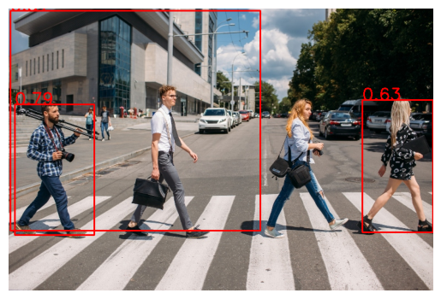
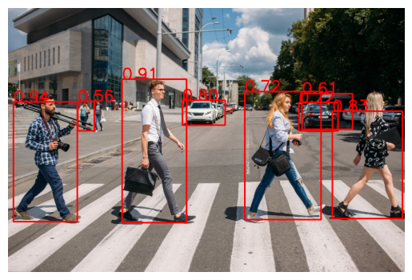
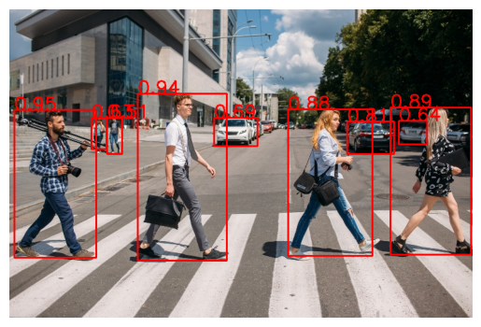
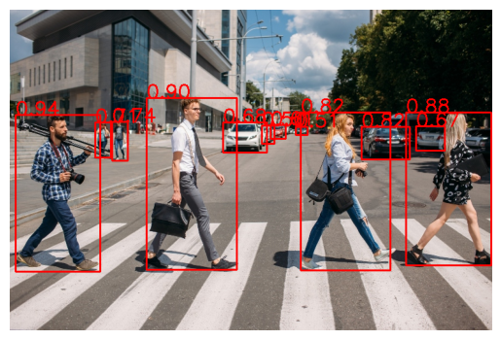
Validation with Different Resolutions
1
2
64px
128px
1. Bad detection @64px
2. Foreground objects @128px
(not perfect boxes)
3. Foregr. + backgr. objects @256px
(almost perfect boxes)
4. Foregr. + backgr. + further
objects @ 512px
(almost perfect boxes)
3
4
256px
512px

Slide 2
Experiments
train mode | model | top1-acc | iteration | batch-size
supervised | SimpleViT | 0.7285 | 399 | 22
meta-p.l. | SimpleViT

Slide 3
Thank you for listening.

