Slide 1
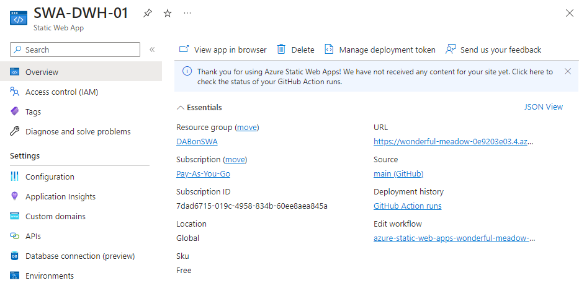

Slide 2
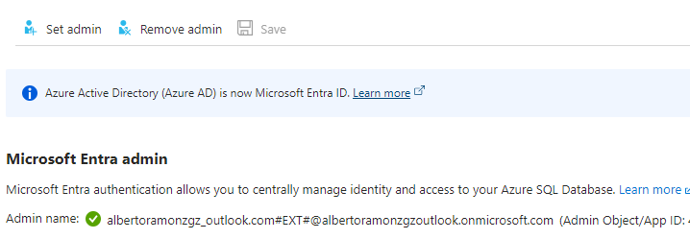

Slide 3
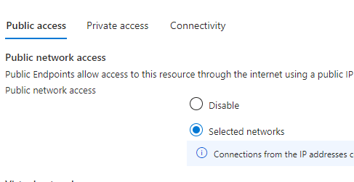

Slide 4
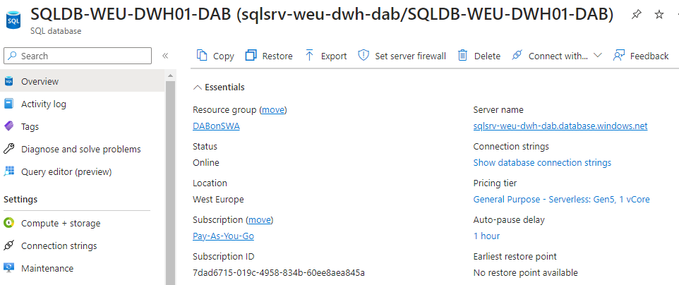

Slide 5
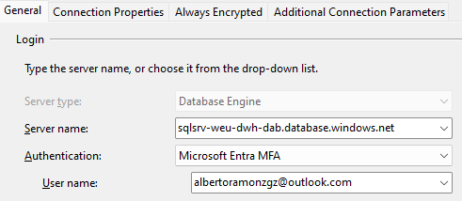
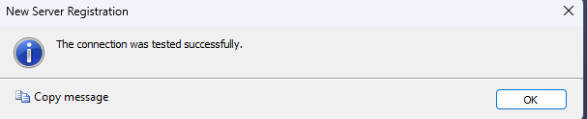

Slide 6
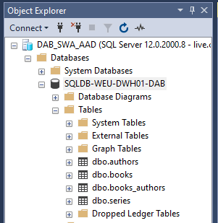

Slide 7


Slide 8


Slide 9
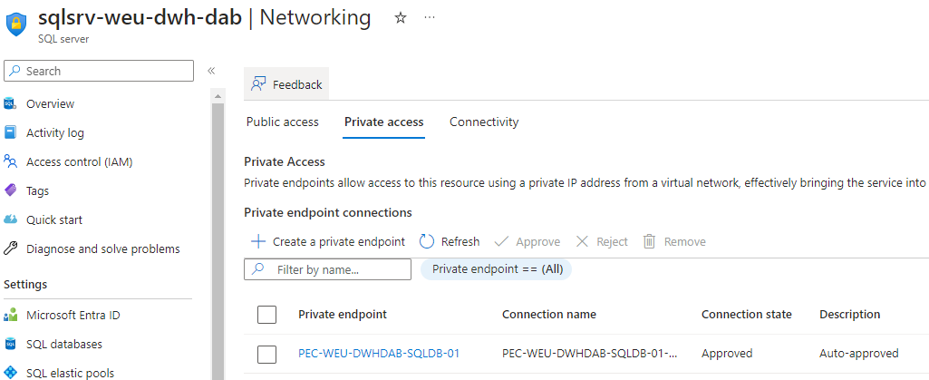

Slide 10
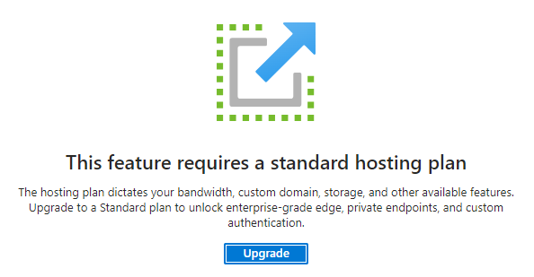

Slide 11
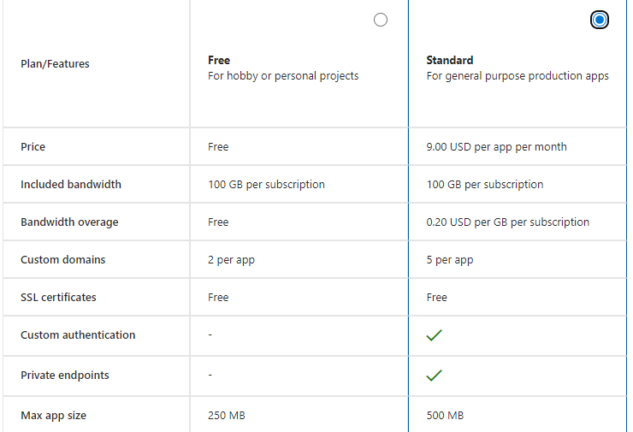

Slide 12
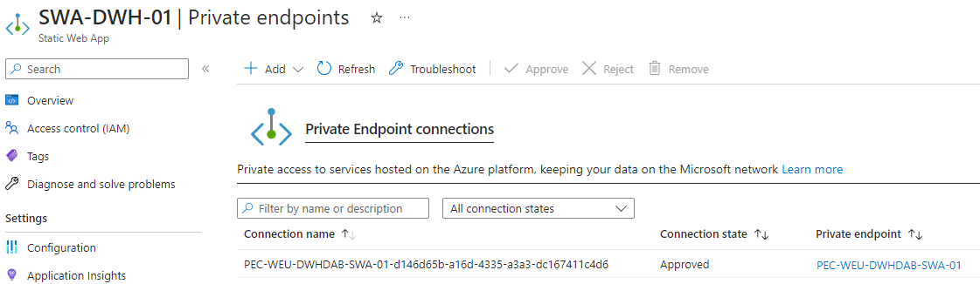

Slide 13
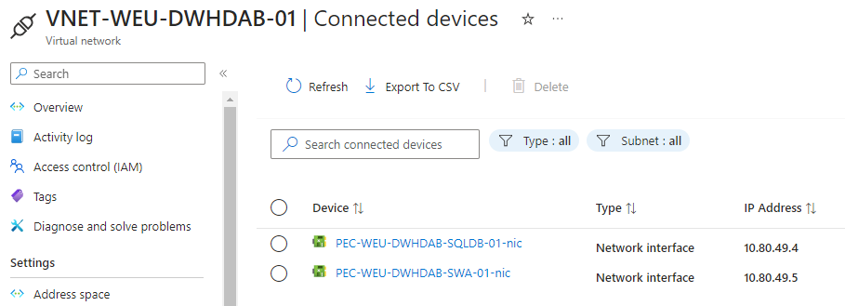

Slide 14
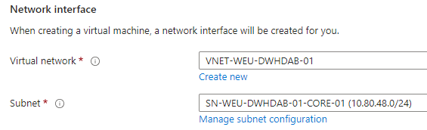

Slide 15
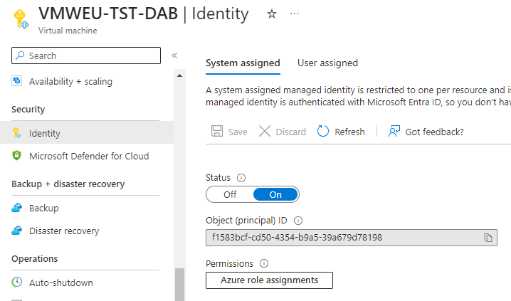

Slide 19
Diagrams

Slide 20
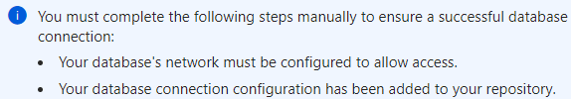







authentication

Slide 21




VNET-WEU-DWHDAB-01
(10.80.48.0/20)
SN-WEU-DWHDAB-01-CORE-01
(10.80.48.0/24)
SN-WEU-DWHDAB-01-PLINK-01
(10.80.49.0/24)
SWA-DWH-01
SWA-DWH-01
Sqlsrv-weu-dwh-dab
(SQLDB-WEU-DWH01-DAB)
(PEC-WEU-DWHDAB-SQLDB-01)
(PEC-WEU-DWHDAB-SWA-01)

Slide 22
VNET-WEU-DWHDAB-01
(10.80.48.0/20)
SN-WEU-DWHDAB-01-CORE-01
(10.80.48.0/24)
VMWEU-TST-DAB
(10.80.48.4)
SN-WEU-DWHDAB-01-PLINK-01
(10.80.49.0/24)
SWA-DWH-01
SWA-DWH-01
Sqlsrv-weu-dwh-dab
(SQLDB-WEU-DWH01-DAB)
(PEC-WEU-DWHDAB-SQLDB-01)
(PEC-WEU-DWHDAB-SWA-01)

