Slide 1
Memory Cache
Architetture dei sistemi digitali

Slide 2
What is a Cache

Slide 3
What is a cache
Cache: a hiding place to put something for future use
  First usage of the term in computers denoted specifically the small memory between the processor and the main memory
Nowadays, cache denotes any storage that takes advantage of locality
  e.g., browser cache, DNS cache
Recall the library example
  The cache is your table where you store the books to later examine

Slide 4
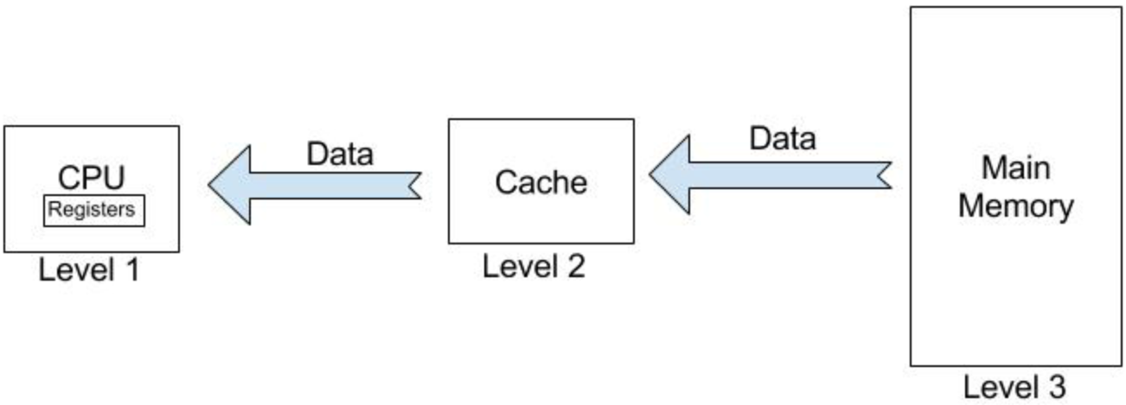
What is a cache
The cache settles in the middle between CPU and memory
  The cache can contain a subset of the data in the main memory
  It is faster than the RAM
Average Memory Time = h × C + (1-h) × M
hit ratio cache time memory time

Slide 5
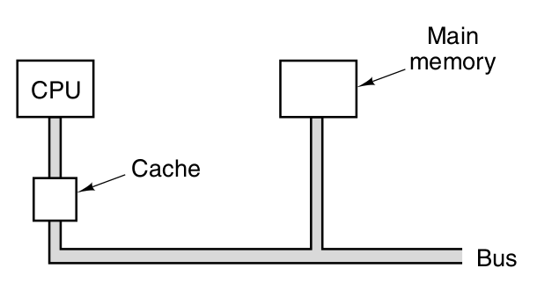
What is a cache
Hit Ratio in the order of 0.9
  Measured experimentally
  Depends on which data is present in the cache
  The cache controllers decides the policy

Slide 6
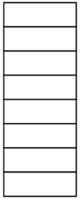
What is a cache
A cache is a piece of fast memory
  Implemented with SRAM
  Organized in lines
  Each line contains a certain number of bytes
    E.g., 32B
Line, e.g., 32B
#Lines

Slide 7
Locality principle
  Temporal locality (locality in time): if an item is referenced, it will tend to be referenced again soon.
  Spatial locality (locality in space): if an item is referenced, items whose addresses are close by will tend to be referenced soon.

Slide 8

Locality principle
A guy is doing some research about some topic. Needs to:
  Take a book from shelf (long walk)
  Read some part
  Put back the book on shelf (long walk)
A cache is a table where to put useful books

Slide 9
Direct Mapping Cache

Slide 10
Operation
The cache settles in the middle between CPU and memory
The cache can contain a subset of the data in the main memory, called block
Each cell of the cache stores a Line (= 4Bytes = 32bits)
Questions:
  How do we know if a data item is in the cache?
  If it is, how do we find it?

Slide 11
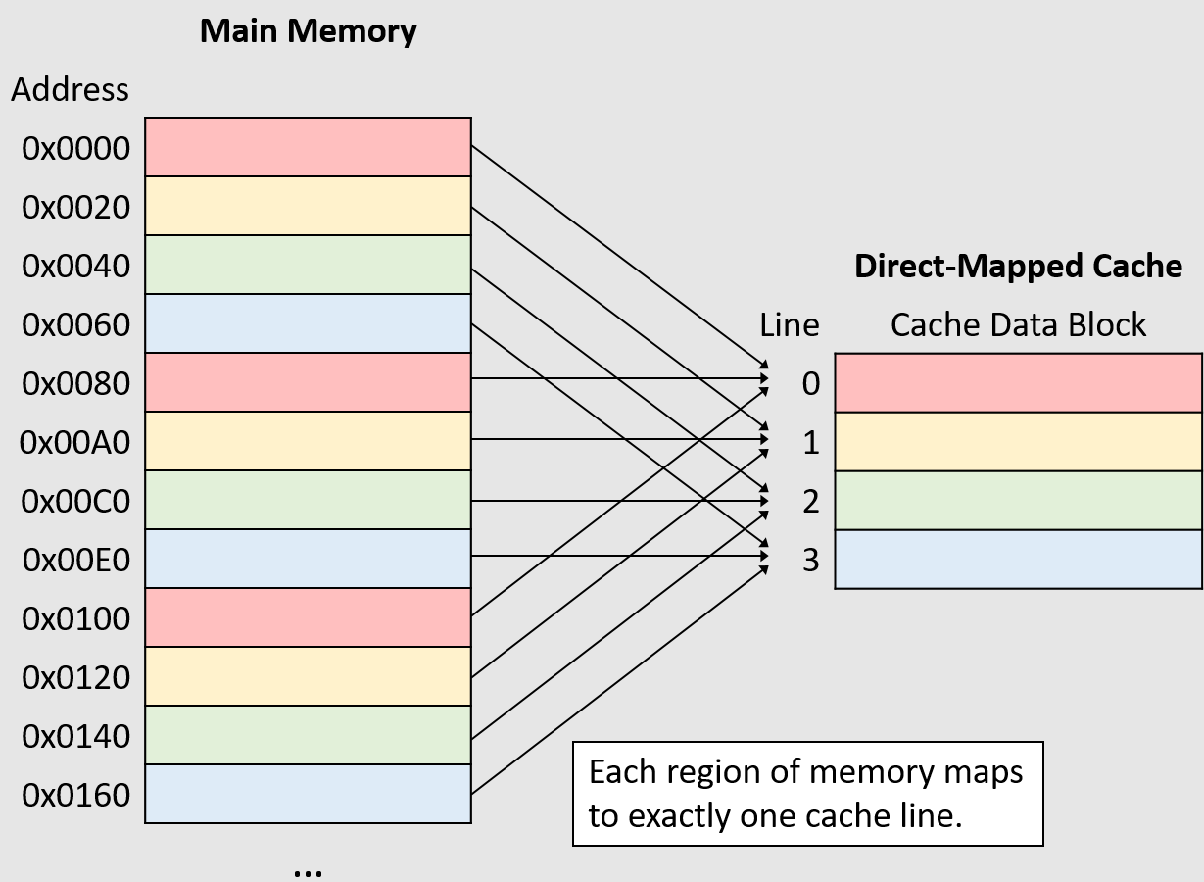
Operation
In a direct mapping cache
  Each block can go in exactly one line in the cache
  It is straightforward to find the word if it is in the cache.
  The simplest way to assign a location in the cache for each word in memory is to assign the cache location based on the address of the word in memory.

Slide 12
Algorithm
Consider a cache containing C cells (each of a Word)
Given a block address A, how to find its location L on the cache
L = A % C
Where % is the modulo operation

Slide 13
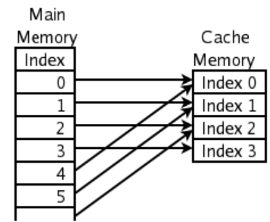
Example
C = 4 The cache can contain 4 blocks
Cache line 0 can contain:
  Block 0, 4, 8, 12, 16, …
...or…
If Block 4 is in the cache
  it can be only in in Cache 0

Slide 14
Cache line
The cache line size is always a power of 2
Effect :
Example: cache line size is 32B, address on 16bit
Address
# Block
Offset
Address: 16bit
# Block: 11 bit
Offset: 5bit

Slide 15
L is always power of two
The number of lines L is power of 2
The modulo operation ( L = A % C ) is simply using the least significant bits of the block address
Example:
L=4, Line size = 32B, addresses on 16bit
Address
# Block
Offset
Tag
#Cache line
Address: 16bit
# Block: 11bit
Offset: 5bit
Tag: 9bit
#Cache line: 2bit

Slide 16
The Tag
  Each cache location can hold multiple memory blocks
  How do the Cache Controller know which one?
  The tag field identifies it!
    The tag needs contains the upper portion of the address, corresponding to the bits that are not used as an index into the cache.
    The lower bits are implicit, given the cell number

Slide 17
Validity Bit
  A way to recognize that a cache line does not have valid information.
    when a processor starts up, the cache does not have good data, and the tag fields will be meaningless.
    we need to know that the tag should be ignored for such entries
  Validity Bit: If the bit is not set, there cannot be a match for this block.

Slide 18
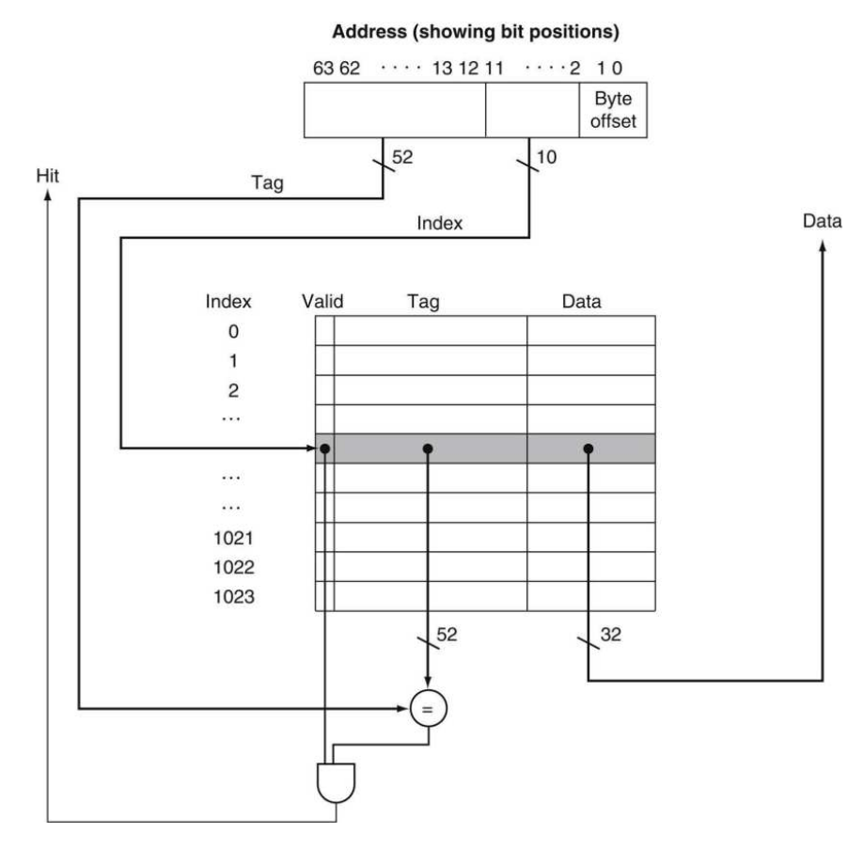
Overview

Slide 19
Cache controller steps
  Divide the address in Tag, #Cache line and Offset
  Find line number:
    #Cache Line identifies it
  Get if that cache line contains that memory line or not:
    Compare the cache tag with the address tag
    Yes: Cache HIT!
    No: Cache MISS!
Address
# Block
Offset
Tag
#Cache line

Slide 20
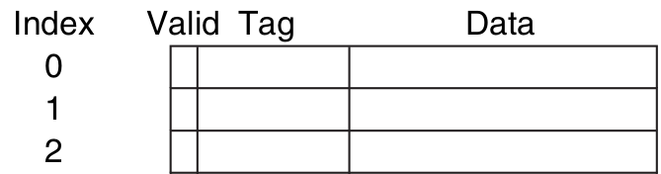
Summary
  A Direct Mapping cache is collection of L entries
    L is typically a power of two
  Each block in the memory is mapped to one and only one of the cache lines
    Using the modulo operation
    Which means using the least significant bits of the block address
  Each entry contains:
    The line = the data
    The tag: indicates which of the different memory blocks is contained, among those that are mapped there
    A validity bit: tells whether the data is valid.

Slide 21
Limitations
If a line is in the cache, can be in a single location
  #Cache Line = #Block % Cache Size
  Simple!
  No flexibility
  A program can incur several cache miss
Example: Cache size: 4 lines
  Accesses: 1, 5, 1, 9, 5, 1, 1
  Always Cache Miss!
Address
# Block
Offset
Tag
#Cache line

Slide 22
Example 1
The cache contains 8 blocks, each of 1 Byte
  L = 8 = 2^3
Block Addresses on 5 bits
  The three least significant bits are used to map an address to a cache cell
  The two most significant address bits are the tag
0 1 1 0 1
Tag Index
Offset is 0 Bytes!

Slide 23
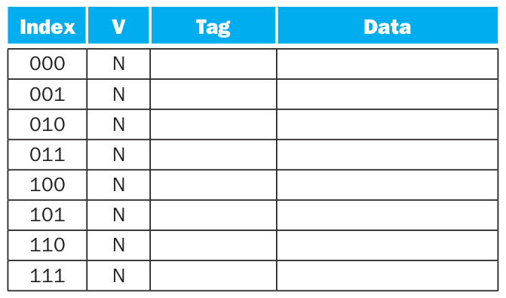
Example 1
  Initial state

Slide 24
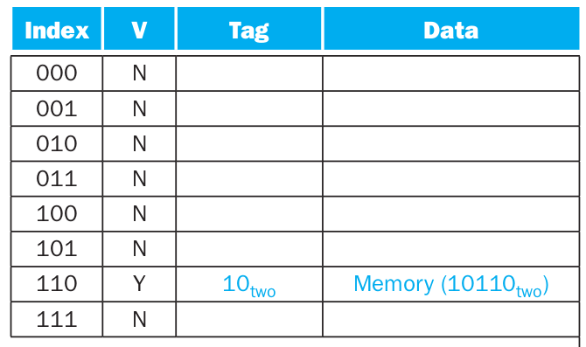
Example 1
  After accessing address 10110

Slide 25
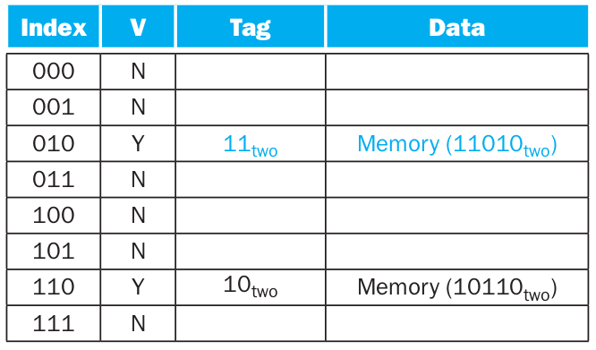
Example 1
  After accessing address 11010

Slide 26
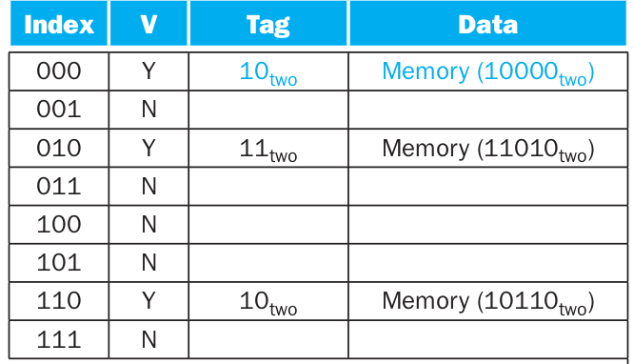
Example 1
  After accessing address 10000

Slide 27
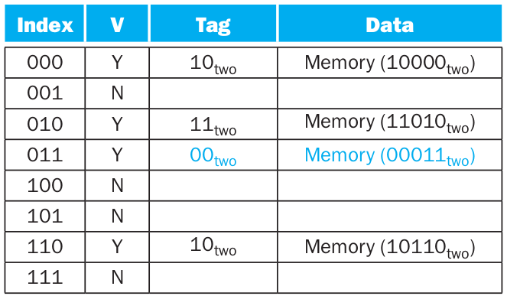
Example 1
  After accessing address 00011

Slide 28
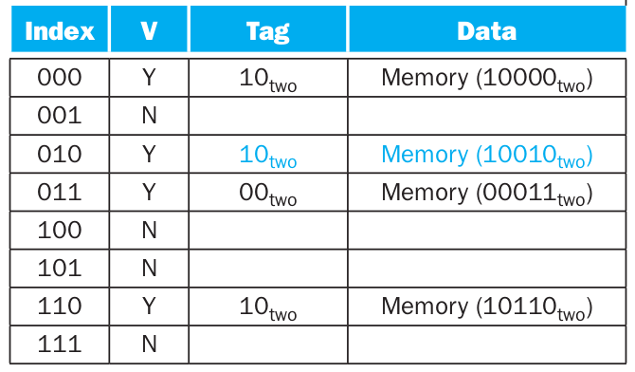
Example 1
  After accessing address 10010

Slide 29
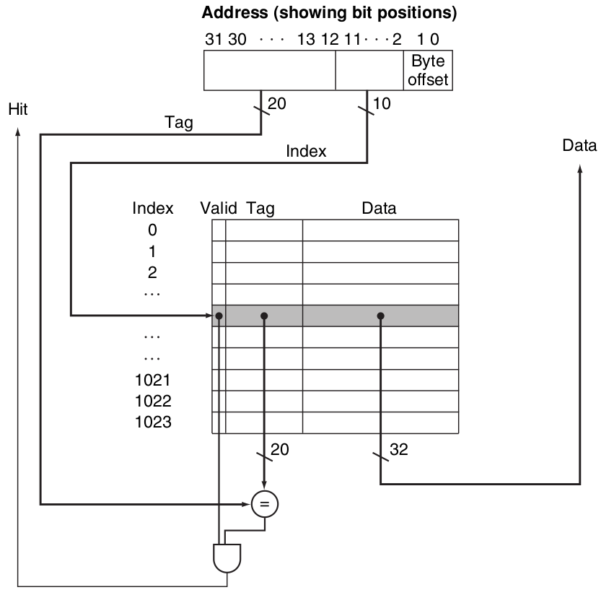
Example 2
The cache is configured as follows
  #Lines = 1024 = 2^10
  Each line contains a Word = 4 Bytes
Addresses on 32 bits
  The 2 least significant bits identify a byte inside a word
  The 10 next significant bits are used to map an address to a cache cell
  The 20 most significant bits are the tag

Slide 30
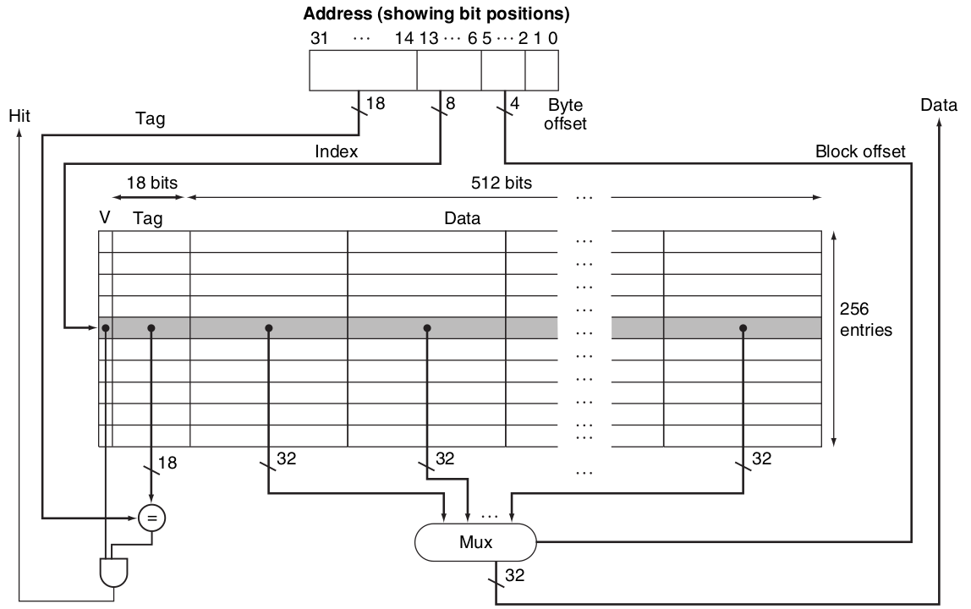
Intrinsity FastMATH
2x cache: data, instructions
  Addresses on 32 bits
  Each word is 4=22 bytes
  Each cache lines holds 16= 24 words
  The cache has 256=28 lines
  The tag is 232-2+4+8==218 bits
Performance - Miss rate:
  instruction: 0.4%
  data: 11.4%
  combined: 3.2%
Why is the instruction miss rate much lower?

Slide 31
Exercize
  For a main memory of 4 GB and a cache with 1024 blocks of 4 words each
    Compute the tag size in bits
    Compute the ratio between actual data stored in the cache and overall cache size
  Repeat for a main memory of 4 GB and a cache with 1024 blocks of 16 words each
1 word is 4 bytes

Slide 32
Exercize
For a main memory of 256 byte, where an initially empty cache with 4 blocks of 1 word each, and the reads 10, 11, 13, 20, 21, 22, 10, 20, 21 (decimal addresses)
  Show the cache content after the 3rd request
  Compute the hit rate
Hint: use decimal notation for block contents

Slide 33
Tuning the line size
Consider a cache containing 1M = 220 Bytes
  We can have each line holding 2²=4 words of 2²=4 bytes
    The cache has 2¹⁶ lines of 2²⁺²=16 Bytes
  We can also have each line holding 2⁸=256 words of 2²=4 bytes
    The cache has 2¹² lines of 2⁸⁺²=1024 Bytes
Consider that
  Larger blocks exploit spatial locality to lower miss rates
    However, spatial locality among the words in a block decreases with a very large block
    Moreover, the cost of a miss increases, as more data must be retrieved from memory!
  How to find the good tradeoff?

Slide 34
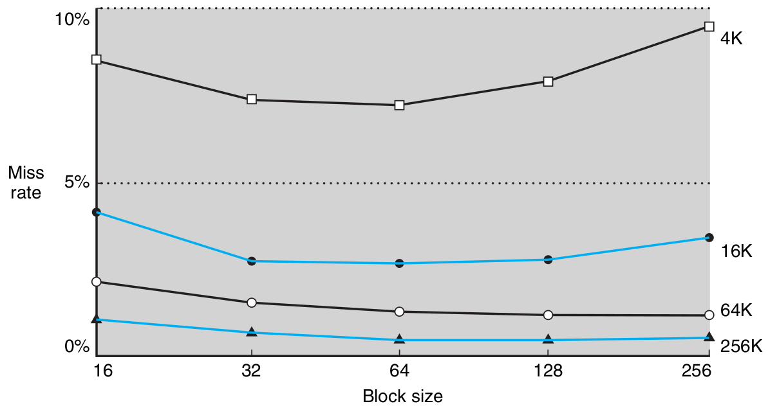
Tuning the line size
Miss rate versus block size.
Note that the miss rate actually goes up if the block size is too large relative to the cache size. Each line represents a cache of different size.

Slide 35
Some definitions
  Block: The minimum unit of information that can be either present or not present in a cache
    It is a certain number of Words, e.g., 8
    A Word is the natural unit of data used by a particular processor design
      In ARM and RISC-V is 4 Bytes = 32 bits
  Hit Rate: The fraction of memory accesses found in a level of the memory hierarchy.
  Miss Rate: The fraction of memory accesses not found in a level of the memory hierarchy. It is 1-Hit Rate
  Hit Time: The time required to access a level of the memory hierarchy, including the time needed to determine whether the access is a hit or a miss.
  Miss penalty: The time required to fetch a block into a level of the memory hierarchy from the lower level, including the time to access the block, transmit it from one level to the other, insert it in the level that experienced the miss, and then pass the block to the requestor.

Slide 36
Cache Performance

Slide 37
How to measure cache performance
The CPU spends time in
  Executing instructions
  Waiting for the memory
    When a memory access causes a miss
    These CPU cycles are memory-stall cycles
CPU Time = ( Cycles for Execution +
Memory Stall Cycles ) × Clock time

Slide 38
Stalls
We can divide the memory stall cycles in:
  Stalls in read
  Stalls in write
Memory Stall Cycles = Read Stall Cycles +
Write Stall Cycles

Slide 39
Stall Frequency
The amount of read and write cycles depends on the hit/miss ratio of the cache
For Read operations
Read Stall Cycles = Reads × Read Miss Rate ×
Read Miss Penalty
For Write operations (in case of Write Through with Write buffer)
Write Stall Cycles = Writes × Write Miss Rate ×
Write Miss Penalty
+ Write buffer stalls
  For Write-back, every write causes a write to the memory

Slide 40
Stall Frequency
Read and Write miss penalties are often the same
  They require a memory access
We can summarize the above formula with
Stall Cycles = Memory Accesses × Miss Rate ×
Miss Penalty
We can also formulate it as:
Stall Cycles = Instructions × Memory Accesses / Instruction
× Miss Penalty

Slide 41
Example
  Instruction Miss Rate: 2%
  Data Miss Rate: 4%
  CPI (Clock Cycles per Instruction): 2
  Miss Penalty: 100 cycles
  Load/Store frequency: 36% of instructions

Slide 42
Example
Step 1: Compute the stalls per instruction
Instruction Stall Cycles = I × Instruction Hit Ratio × Miss Penalty
= I × 2% × 100
= I × 2
Data Stall Cycles = I × Load Store Freq × Data Hit Ratio × Miss Penalty
= I × 36% × 4% × 100
= I × 1.44
We can sum them:
Total Stall Cycles = I × (2 + 1.44) = I × 3.44

Slide 43
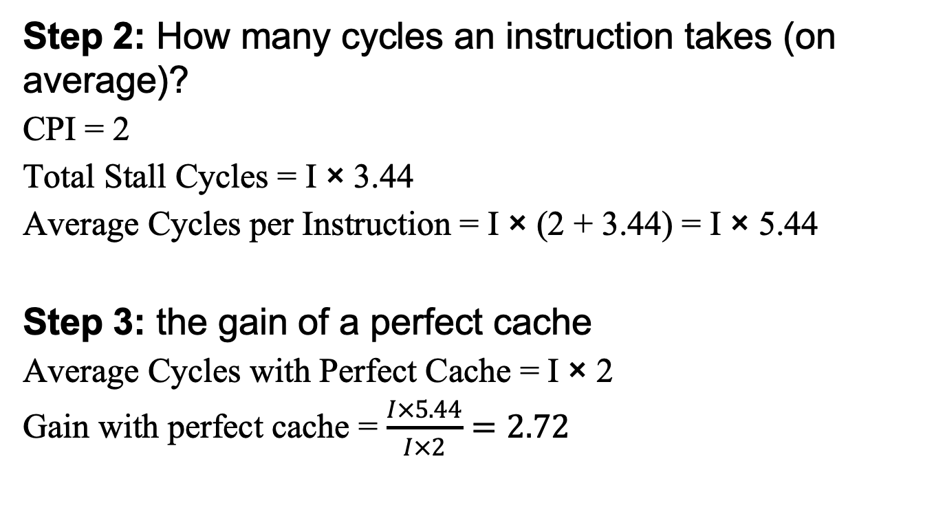
Example
Step 2: How many cycles an instruction takes (on average)?
CPI = 2
Total Stall Cycles = I × 3.44
Average Cycles per Instruction = I × (2 + 3.44) = I × 5.44
Step 3: the gain of a perfect cache
Average Cycles with Perfect Cache = I × 2
Gain with perfect cache = $\frac{I×5.44}{I×2}=2.72$

Slide 44
Associative Mapping Cache

Slide 45
How to improve cache performance
Two main strategies to improve cache performance
  More flexible cache placement: Associative caching
  Cascading caches: multi-level cache

Slide 46
Direct Mapping Limitations
With the traditional direct mapping cache, each block of the memory can be contained in a single cache line
  The index bytes determine the cache line
This approach is not flexible
  Example: two frequently accessed memory cells are mapped to the same cache line
  They are continuously read and written from/to the memory

Slide 47
The associative cache
The cache controller can put a memory block in any cache line
  Maximum flexibility
How it understands if a line is in cache?
  Must scan all lines!
  Or have a comparator for each line
Address
# Block
Offset
Tag
#Cache line

Slide 48
The associative cache
Example: cache line of 16B
Cache lines: 128
Addresses on 20bit
Cache
Data: 16Byte
= 128bit
Tag: 16bit
Address: 20bit
# Block: 16 bit
Offset: 4bit
128
lines
Tag: 16bit
#Cache line: 0bit

Slide 49
The associative cache
Algorithm of the Cache controller:
  Divide the address in offset and tag (no cache line)
  Scan the cache to find if there is an entry with the given tag
Scan is a problem
  To slow to scan all the cache for every access
Improving the scan scan:
  Each cache line has a circuit comparator to scan in parallel
  Too Expensive!
Never used in practice!

Slide 50
Set Associative Mapping Cache

Slide 51
Set associative cache
Intermediate between Direct Mapping and Set associative
  Cache lines are grouped in sets of k lines
  If a memory block is in the cache can be only in one set
  In any of the k lines
    Must run k comparisons

Slide 52
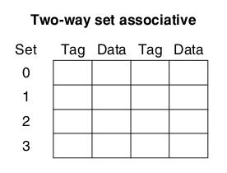
Set associative cache
  Example: a two-way associative cache. The cache has 8 locations
  Each set has 2 locations
  There are 4 sets

Slide 53
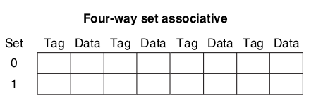
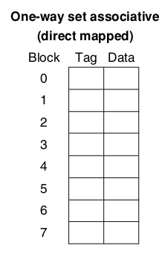
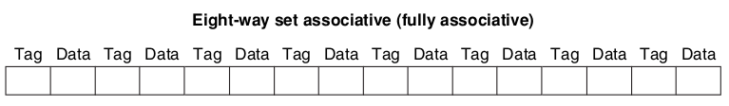
Set associative cache
Can decide the level of associativity of the cache
  Here, we suppose to keep the total size of the cache unvaried

Slide 54
Algorithm
The cache controller must:
  Divide the address in Tag, #Cache Set, offset
  If the line is in the cache in one of the k lines in the set #Cache line
  Scan all the k lines of set #Cache Set
    If one line has the given tag: Cache Hit!
    Otherwise: Cache Miss!
Address
# Block
Offset
Tag
#Cache set

Slide 55
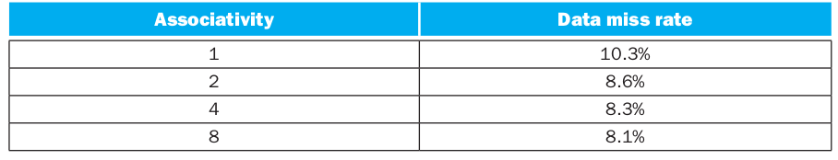
Performance
  With associative caches the miss rate typically decreases
Miss rate vs Cache Associativity level
(Intrinsity FastMATH processor)

Slide 56
Example 1
Cache
  A cache can hold 256 lines
  Each line is 32 Bytes
  Lines are grouped in sets of 4
  Memory is 4GB
Data: 32Byte
256bit
Tag: 21bit
64
sets
4 lines per set
Address: 32bit
# Block: 27bit
Offset: 5bit
Tag: 21bit
#Cache set: 6bit

Slide 57
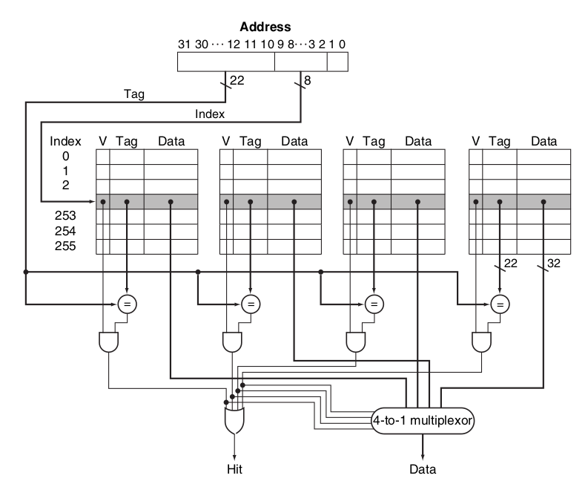
Design
The design is more complicated!
  A memory block can go in more than one location
  When accessing the cache
    It is necessary to search if the block is in the cache
    Comparing the Tag field in the cache with the searched one
    It requires N comparison, where N is the associativity level
  Cache avoid making this search sequentially, but use comparators in parallel

Slide 58
Associativity Level
How the bits for tag and index vary
  Increasing the level of associativity
  Keeping the same cache size
  A block is a word (=4Bytes)
  Addresses on 16 bit
Direct Mapping – 1-way associative cache
Tag | Index | Offset
11 bit | 3 bit | 2 bit
2-way associative cache
Tag | Index | Offset
12 bit | 2 bit | 2 bit
4-way associative cache
Tag | Index | Offset
13 bit | 1 bit | 2 bit
Fully Associative (8-way) associative cache
Tag | Index | Offset
14 bit | 0 bit | 2 bit

Slide 59
Example 2
Let’s consider three caches with four blocks:
  A direct mapping cache
  A 2-way associative cache
  A fully associative (4-way) associative cache
Question: What happens when accessing memory blocks 0, 8, 0, 6, 8

Slide 60
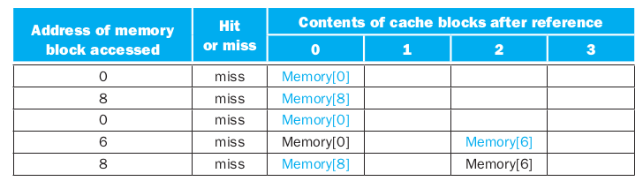
Example 2
In case of Direct Mapping
5 Accesses:
  5 Misses
  0 Hits
Time

Slide 61
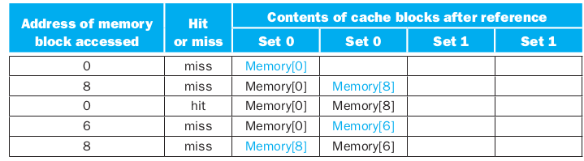
Example 2
In case of Two-Way associative cache
5 Accesses:
  4 Misses
  1 Hit
Time

Slide 62
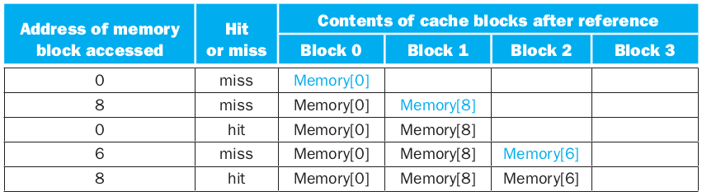
Example 2
In case of Full (Four-way) Associative cache
5 Accesses:
  3 Misses
  2 Hit
Time

Slide 63
Which block to replace?
In a direct mapping cache, in case of miss:
  If the cache entry holds another block, it is erased
In associative caches:
  If all entries are full, one must choose which block to erase
Should I replace 0 or 8?

Slide 64
Which block to replace? /2
Typical approach:
  Least recently used (LRU): the block replaced is the one that has been unused for the longest time
  It requires additional bits per block, to keep track of the access order
    Two-way associative cache: 1 bit
    Four-way associative cache: 2 bit
    …
Other approaches:
  FIFO: cheaper than LRU, stupid
  Random: simple and effective
  Least Frequently Used would be the best one. Too complicated

Slide 65
Cache and Reading

Slide 66
CPU operation when reading
When the CPU wants to read a memory cell
  In case of Hit: it reads directly from the cache
  In case of Miss: two possible approaches
    Standard approach:
      The cache controller loads the memory block in a cache line
      The CPU operates on the cache line
      Easy to implement, but slower
        The cache operates with the concept of line
        Must cache controller reads entirely a memory block
    Load Through approach
      The CPU reads immediately from the memory
      Thereafter, the cache controller reads the block from the memory and loads it in a cache line
      Faster, more expensive to implemenent

Slide 67
Cache and Writing

Slide 68
Cache and Writing
  So far, we considered only reads from cache/memory
  Writing poses some additional challenges
  If cache and memory are not aligned, they can be inconsistent
  Various approaches to solve the problem

Slide 69
Cache and Writing
Approach 1 - Write Through: when writing on the cache, the CPU also writes on the memory
  Slow, but data are always consistent
  Very simple design
  Not best performance
Possible improvement:
  Use a write buffer: A write buff er stores the data while it is waiting to be written to memory
    The processor writes data in the cache and in the write buffer and can continue execution
    If the write buffer is full when the processor reaches a write, the processor must stall until there is an empty position in the write buffer.

Slide 70
Cache and Writing
Approach 2 - Write Back
  The processor writes the data only on the cache
  For each cache line, there is a Dirty Bit flag, which indicates if the block was modified
    The data are stored on the memory only when the cache line is replaced and the dirty bit is set
  Improves performance but cache and memory can be inconsistent

Slide 71
Cache Coherence in case of multiple CPU

Slide 72
Cache Coherence in case of multiple CPU
Modern architectures have multiple CPU/Cores
  Each has its local cache
  How can caches be coherent?
Important:
  Even Write Through does not solve!
  CPU1 writes (in cache and mem)
  But CPU2 had the block in cache
  In CPU2 cache it is not updated!

Slide 73
Cache Coherence in case of multiple CPU
Solution
  Validity bit: on each line. If it is kept up to date across cores, can solve the issue. When the line is not valid, the entry is threated like a miss
  Options:
    Bus watching or snooping: the cache observes the bus. If a block it has in memory is updated by another core, the cache set it is as invalid
    Portions of non-cacheable memory: if a memory location is shared between cores, put in a portion which is not loaded in cache
    Advanced protocols: cores exchange messages to invalidate/update cache content
      Various approaches: MESI, MOESI

Slide 74
Multiple Cache Levels

Slide 75
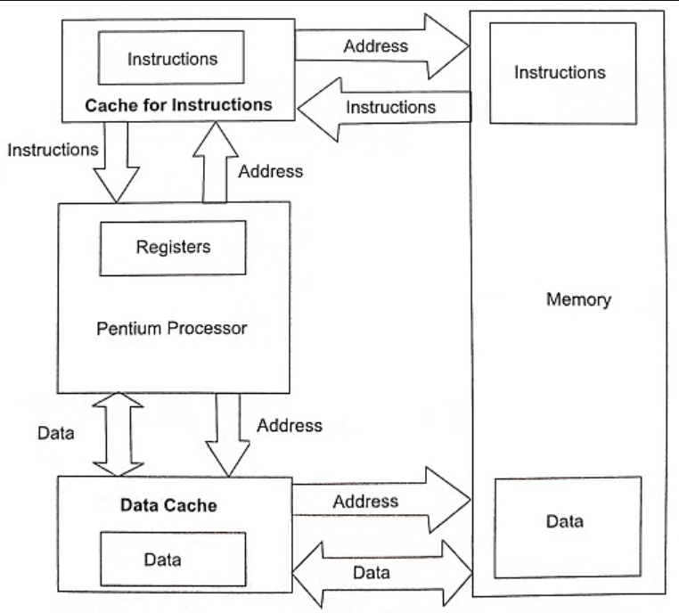
Data and Instruction cache
Can have separate cache for Instructions and Data
  Similar to the Harvard architecture
  Improvements in Hit Rate
    Data and instructions never in conflict

Slide 76
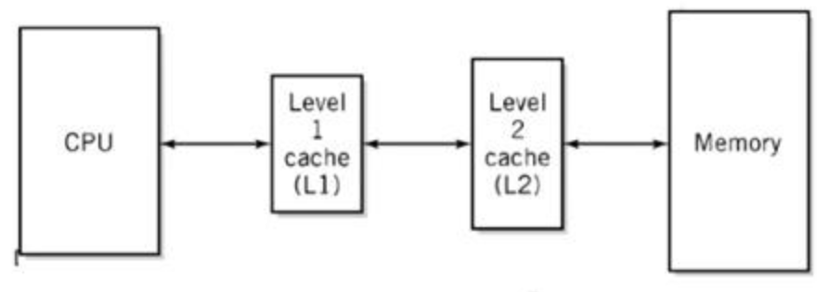
Cascading caches: Multi-level cache
Classical (old-style) architecture
Now, processors typically have at least two levels of caches

Slide 77
Cascading caches: Multi-level cache
Operation of two-level cache:
  Look for the data in the first-level cache (the closest to the CPU)
  If miss, look in the second-level cache
  If miss, get the data from the memory
The second-level cache is typically in the same chip of the CPU
  Access time and size intermediate between first-level cache and memory

Slide 78
Example
  CPI (clock per instruction): 1 clock
  CPU frequency: 4GHz
  Memory time: 100ns
  Miss rate: 2%
  Access to the cache: 1 clock
Question: if I add a second-level cache with access time 5ns which reduces miss rate to 0.5%, how faster is the CPU?

Slide 79
Example
With one level of cache:
Average CPI (including memory access) =
= CPI + Miss Rate × Miss Penalty
= 1 + 2/100 × 400
= 9 cycles
Memory time is 100ns which is 400 clocks at 4GHz

Slide 80
Example
With two levels of cache:
Average CPI =
= CPI + Primary stalls + Secondary stalls per instruction
= 1 + 2/100 × 20 + 0.5/100 × 400
= 3.4 cycles
Second-level cache time is 5ns which is 20 clocks at 4GHz

Slide 81
Example
Gain:
The performance gain with the secondary cache is:
9/3.4 = 2.6
The second-level cache entails large performance benefits!

Slide 82
Cascading caches: Multi-level cache
When having two levels of cache:
  The first level is typically very small and fast
    Often smaller block size
    More granularity
  The second level is much larger
    Larger block size
    Higher associativity
    The goal is to reduce as much as possible the misses

Slide 83
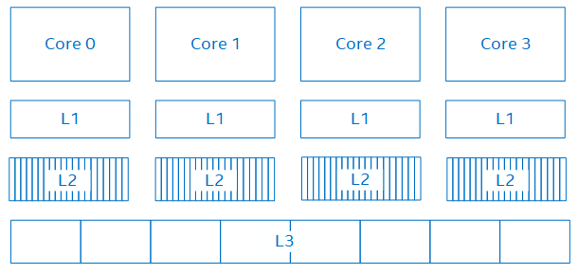
The cache in the current CPUs
Typical Architecture:
  The L1 and L2 cache are per-core
  L3 is shared

Slide 84
The cache in the current CPUs
The cache size is between few KByte to some Mbyte
Up to three levels of cache
Examples:
  Intel Core i3-2312M – a cheap processor
    2 cores – 4 threads
    3 cache levels
      Level 1 cache size: 2 x 32 KB 8-way set associative instruction caches
      2 x 32 KB 8-way set associative data caches
      Level 2 cache size: 2 x 256 KB 8-way set associative caches
      Level 3 cache size: 3 MB 12-way set associative shared cache
  Intel Xeon 6140 - a performing server processor
    18 cores - 36 threads
    3 cache levels
      Level 1 cache size: 18 x 32 KB 8-way set associative instruction caches
      18 x 32 KB 8-way set associative data caches
      Level 2 cache size: 18 x 1 MB 16-way set associative caches
      Level 3 cache size: 24.75 MB 11-way set associative non-inclusive shared cache

