Slide 1
Car Racing v2
Solved using PID and DQN

Slide 2
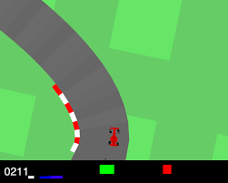
Problem definition
In this environment, the agent (a car) needs to learn how to navigate a racing track. The observation space typically includes pixel images from the car's perspective, and the action space consists of continuous actions like steering, acceleration, and braking.
The generated track is random every episode. Some indicators are shown at the bottom of the window along with the state RGB buffer. From left to right: true speed, four ABS sensors, steering wheel position, and gyroscope.

Slide 3
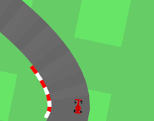
State space
State: 84 x 84 RGB image
Actions: (steering, acceleration, braking)
All real numbers between -1 and 1 or 0 and 1. No measurement unit

Slide 4
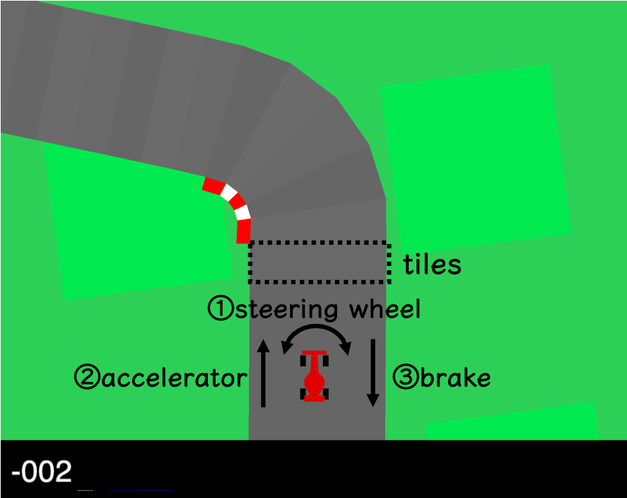
Reward
The reward is -0.1 every frame and +1000/N for every track tile visited, where N is the total number of tiles in the track.
For example, if you have finished in 732 frames, your reward is 1000 - 0.1*732 = 926.8 points.

Slide 5
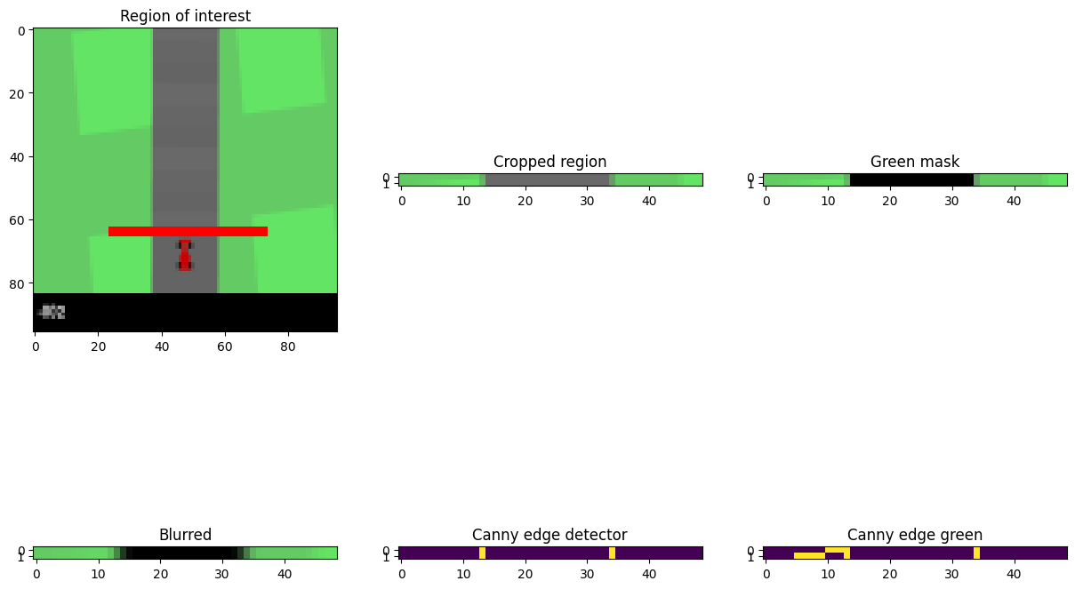
PID design

Slide 6
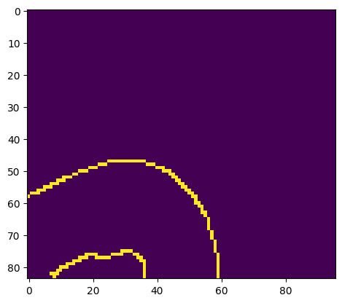

PID problems
Sharp corners don’t have left/right boundaries
If only one of the two is visible, then steer in the opposite direction
After a turn the car might resonate
When the error is too high apply braking, so the PID will put the car back on track
In this case I will also touch the proportional gain so it will steer faster to the middle of the track

Slide 7

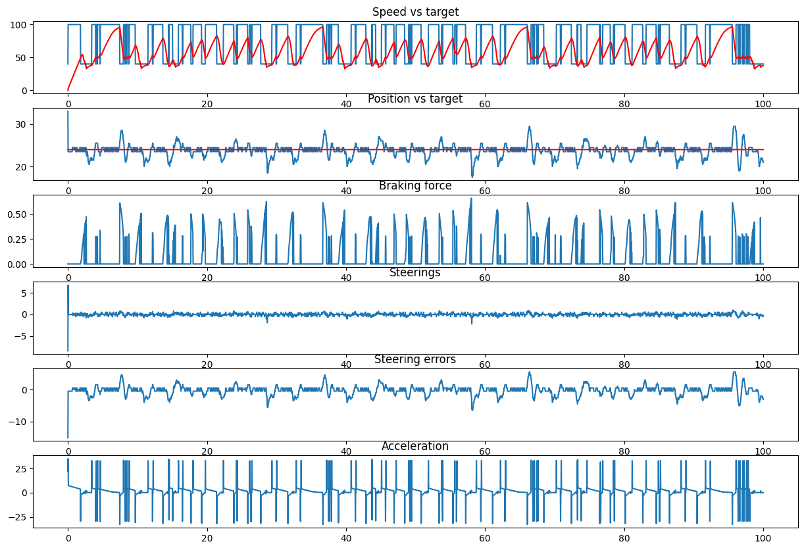
PID performance

Slide 8
What is DQN
Q-learning with function approximation, but the function is a neural network
The neural network is trained using experience replay

Slide 9
DQN action
(steering, acceleration, braking)
Acceleration is 1 and 0, braking always 0
Steering can be: (-1, 0, 1)
Using OHE, the output is a 3 elements vector

Slide 10
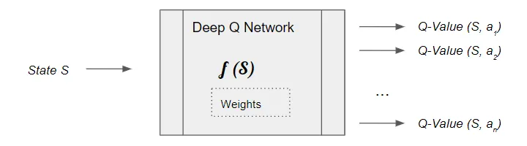
DQN architecture
CNN based on LeNet
Input is shaped 3x84x84. The three frames are at different time steps

Slide 11
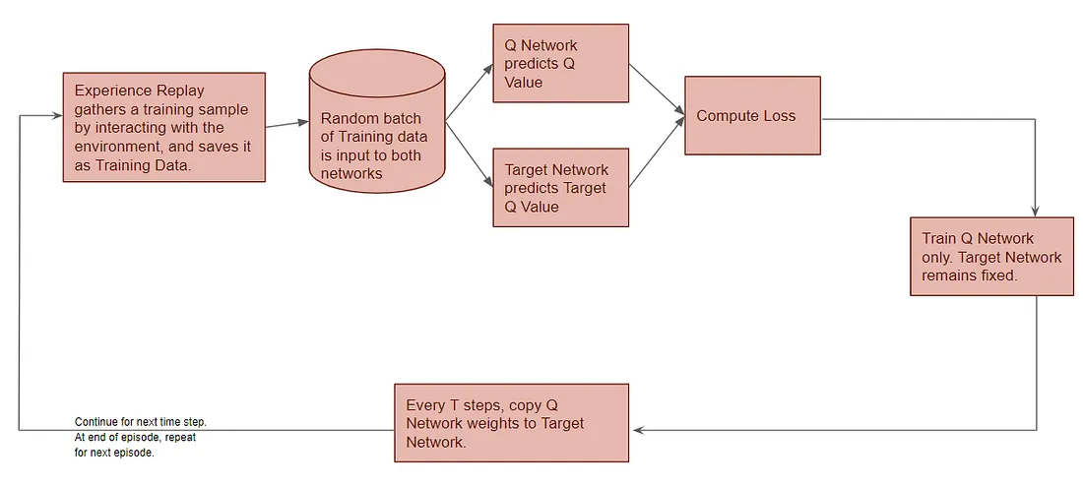
DQN steps for training

Slide 12
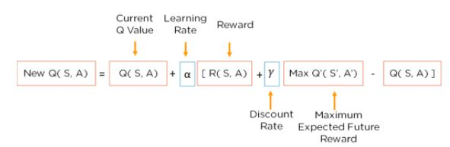
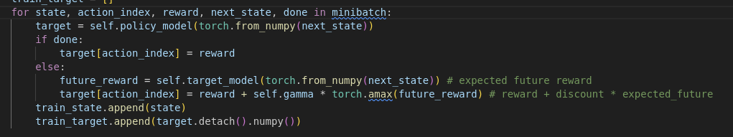
DQN structure compared to Q-learning

Slide 13
DQN structure compared to Q-learning

Slide 14
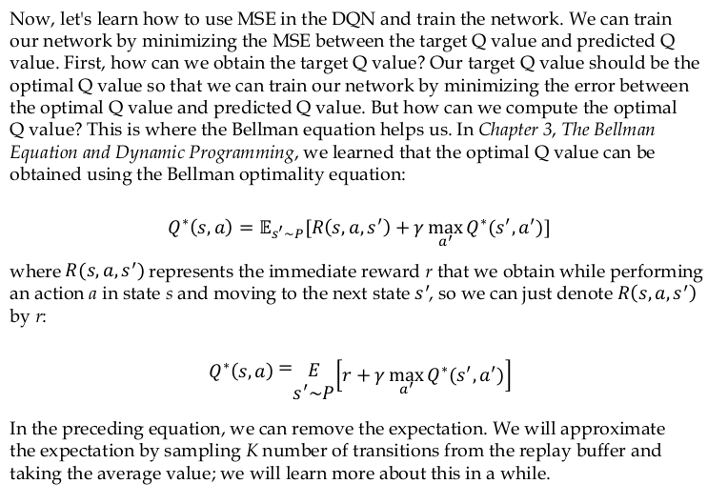
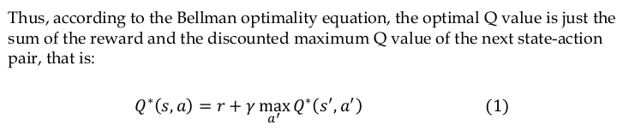
Proof

Slide 15
Mini batches creation
64 experiences will be stored and replayed
The target model is updated every 5 iterations

Slide 16
Episode termination
After 2000 steps
After 25 times I get a negative reward
Off-track
Completing the second round

Slide 17
Problem of DQN
2e6 iterations would be needed
1e3 iterations take 4hrs to complete on my laptop

Slide 18
Approach
Collect a dataset using PID
Train the neural network using the dataset
Apply RL on the pre-trained neural network

Slide 19
Results
After just 100 iterations RL was able to have a sufficiently good performance
When the car goes out of track, it’s able to steer back in (PID would not be able to do this)
Live demo

