Slide 1
Virtual Memory
Architetture dei sistemi digitali

Slide 2
Idea of Virtual Memory

Slide 3
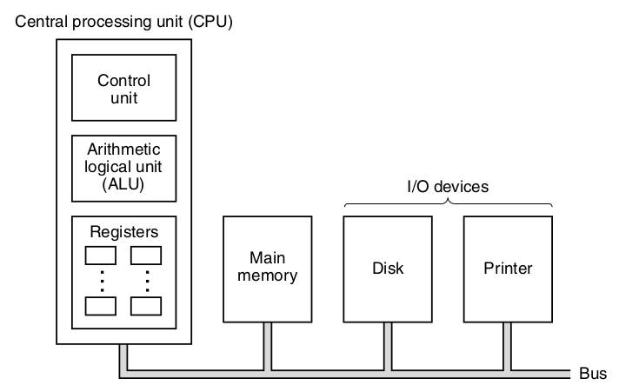
What is Virtual Memory
In systems with an OS, in the main memory there are user programs and data used in a moment
  The other programs and data are in the disk
  The disk is slow
  The OS must be smart to load in the memory what the user needs

Slide 4
What is Virtual Memory
Virtual Memory is a system to keep in the main memory only the needed parts
  Concept similar to cache
  Managed by a cooperation between Hardware and Software (the OS)
Almost all CPU-based system use Virtual Memory
  Simple systems do NOT use it

Slide 5
Operation of Virtual Memory

Slide 6

Operation
  The CPU thinks it has a large Virtual Memory
  The Physical Memory is actually smaller
  The CPU emits Virtual Addresses
  A Memory Management Unit translates them into Physical Addresses

Slide 7

Operation
  The memory is divided in fixed-size blocks called Pages
    Similar to the Cache Line concept
  The MMU keeps a Memory Address Table (MAT) or Page Table that maps pages from the Virtual Memory to the Physical Memory
Page Table
Or Memory Address Table

Slide 8
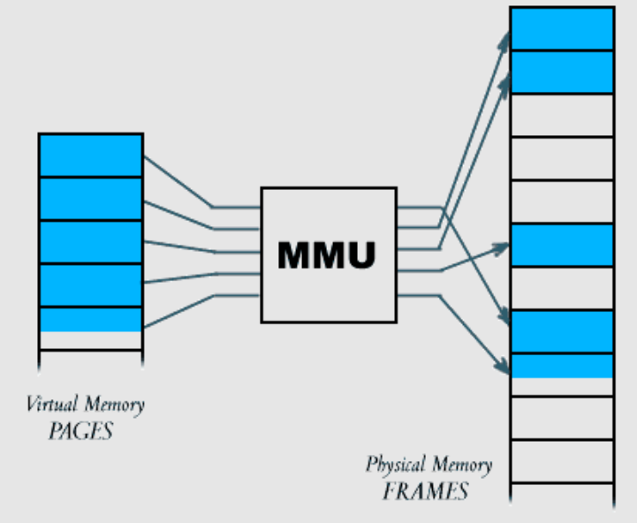
Operation
  The VM is larger than PM
    Cannot fit!
  There can be a miss, called Page Fault
    The MMU calls the OS that handles it
  The MMU is programmed by the SO
  Hit ratio is in the order of 99.9%

Slide 9
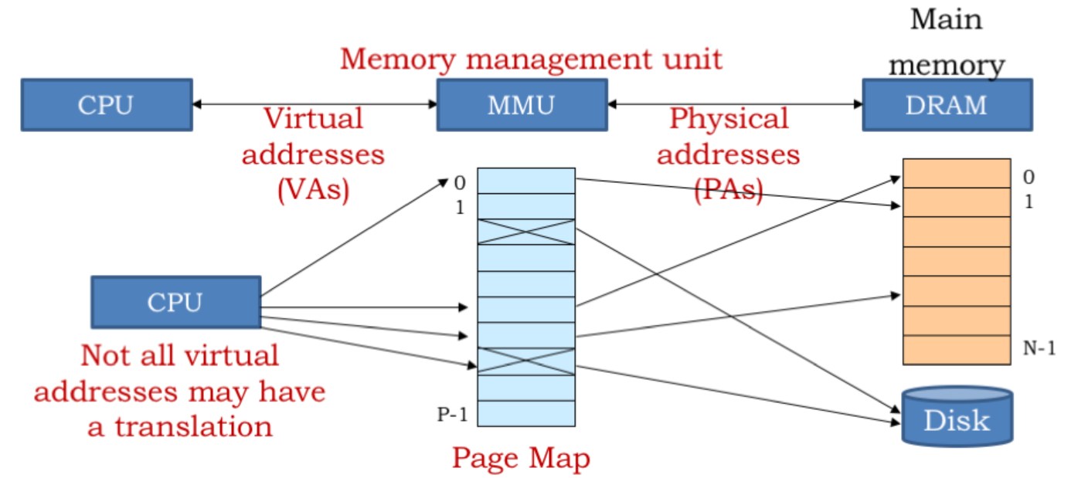
Operation

Slide 10
Benefits
A program can virtually use more memory than available
  Virtual memory space much larger than physical
  Makes it portable in system with different memory size
It is fundamental multi-processing systems:
  The Operating System loads into memory only the used programs
  The processes can share the Virtual address space
  The processes cannot access other’s memory

Slide 11
Example
The CPU sees a VM of 128GB
  37 bit of Virtual Address (also called Logical Addresses)
The Physical Memory is 1GB
  30 bit of Physical Address
37 bit
30 bit
Page Table
Or Memory Address Table

Slide 12
Memory Address Table

Slide 13
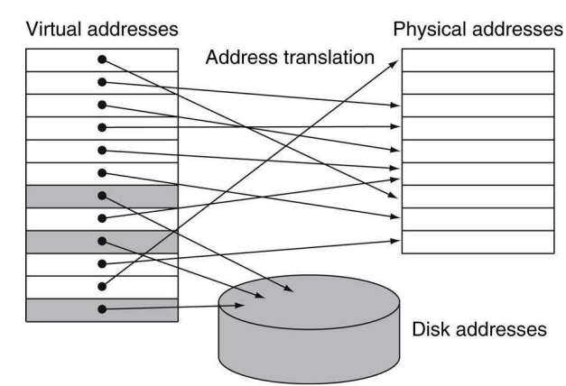
Memory Address Table
The MAT maps page numbers to their physical location
A page could not be loaded into memory
  The MAT indicates this (gray blocks in figure)

Slide 14
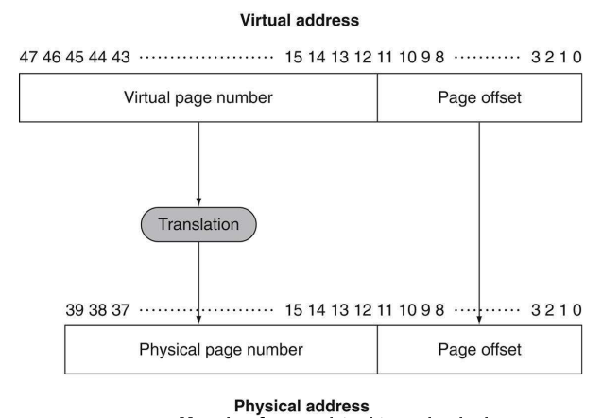
Translation
  The virtual address is divided in page offset bits and page number
  The MMU, using the MAT, translates the page number
  The physical address has the same offset but has a the physical location of the page in the high bits
  The size of the two address is different
    Physical < Virtual

Slide 15
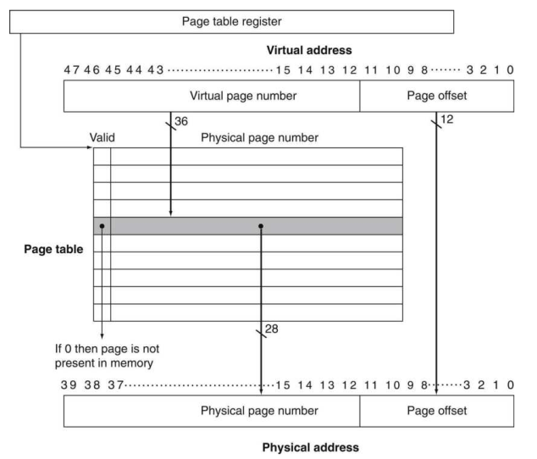
Translation
The page number is used as an index to access the MAT by the MMU

Slide 16
Example of a small MAT
Example:
  Virtual Memory of 65KB
    Virtual Addresses on 16bit
  Physical Memory of 4KB
    Physical addresses on 11bit
  Page size: 1KB
16 bit
12 bit
64 Entries (for each Virtual Page)
Page Table
Or Memory Address Table
Virtual Address: 16bit
Virt. Page Number: 6bit
Page Offset: 10bit
2bit of Phys. Page Number
Physical Address: 10bit
Phys. Page Number: 2bit
Page Offset: 10bit

Slide 17
Example of large MAT
Example:
Virtual Memory of 4GB
  Virtual Addresses on 32bit
Physical Memory of 1GB
  Physical addresses on 30bit
Page size: 1KB
16 bit
12 bit
2²²
Entries
Page Table
Or Memory Address Table
Virtual Address: 16bit
Virt. Page Number: 22bit
Page Offset: 10bit
20bit of Phys. Page Number
Physical Address: 10bit
Large!
Phys. Page Number: 20bit
Page Offset: 10bit

Slide 18
Performance penalty
Problem
  For each memory access, the MMU needs to access the MAT
  For each memory access, there is an additional memory access
  Memory performance decrease with VM

Slide 19
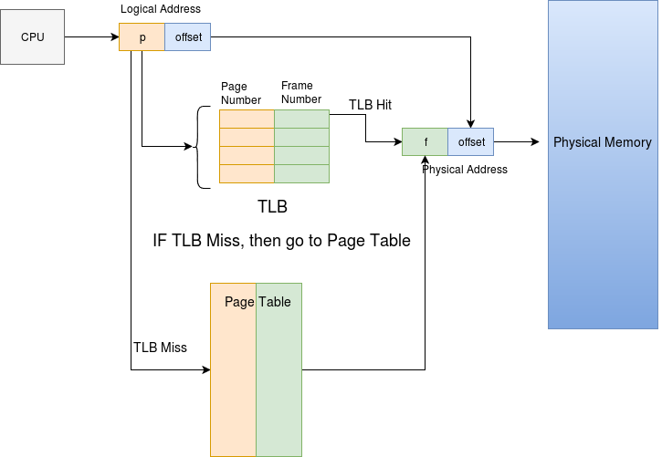
Transaction Look Aside Buffer
The MMU contains the most used MAT lines in the TLB
  The TLB is a «cache» of the MAT
When the MMU has to translate an address:
  Checks if the line in in the TLB
  Otherwise accesses the MAT
This speeds up the MMU
  Often prevents from an extra memory access to get the MAT entry

Slide 20
Example of very large MAT
Example:
Virtual Addresses on 48bit
  It’s often the case
Physical addresses on 36bit
  Physical Memory of 64GB
Page size: 4KB
16 bit
12 bit
Page Table
Or Memory Address Table
2³⁶
Entries
24bit = 3B of Phys. Page Number
Virtual Address: 48bit
Virt. Page Number: 36bit
Page Offset: 12bit
MAT Size = 3B*2³⁶
= 192GB
Cannot fit memory!
Physical Address: 36bit
Phys. Page Number: 24bit
Page Offset: 12bit

Slide 21
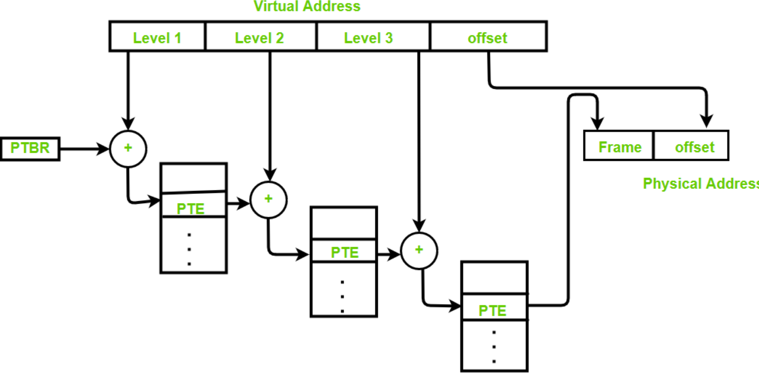
Techniques to handle large MAT
Sometimes the MAT does not fit even in the main memory
Solutions:
  Limit register:
    CPU and software start consuming low addresses
    The MAT is truncated at the «limit register»
    Sometimes more than one limit register
  Multilevel MAT:
    Smart
    More complex
    Requires more memory accesses

Slide 22
Virtual Memory and Processes

Slide 23
Operating Systems
  Nowadays, most systems run an Operating System
  An Operating System is a software that:
    Allow many program to execute on the system at the same time
    Regulate the access to the system resource by the programs
    The fundamental component of the operating system is the Kernel
  Popular operating systems: Linux, Windows, MacOS
  A program in execution is called a Process
    Process access the CPU in a time-sharing fashion
    The Kernel schedules the processes on the CPU, so that each process uses the CPU for a fixed amount of time
  Process, Operating System and Virtual Memory are very connected topics

Slide 24
Processes and OS
  All programs operate on the Virtual Memory
  This allows the program:
    To have the illusion of being the only program in execution
    To be independent from the actual physical memory installed on the system
    To address more memory than the available one
  Virtual Memory allows multi-processing
    Each process has its own virtual address space
    So that a process cannot access (and corrupt) the memory of other processes
    Each process has its own MAT

Slide 25
How the Virtual Memory protects processes
  Each process has its address space
    Big as the whole virtual memory
    Cannot access memory of other processes
  Modern CPUs have two modes of operation:
    Kernel mode: the CPU instruction executed in this mode
      Can R/W the MAT
      Can access I/O devices
    User mode: the CPU instruction executed in this mode:
      Can only use the MAT
      Must use a System Call to access any I/O functionality (screen, keyboard, etc.)

Slide 26
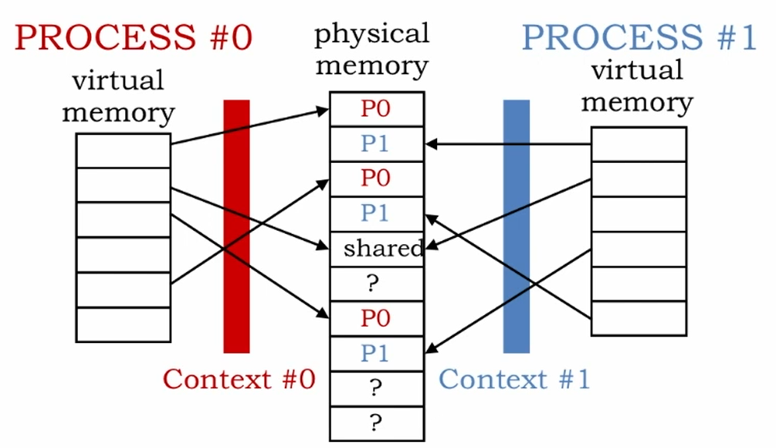
OS and processes
  When the OS starts a new process (upon user’s request)
    Creates a new MAT for the process
  Then, the process is scheduled, and will access the CPU in a turn with the other processes
  When a new process is scheduled (i.e., starts executing on the CPU), the corresponding MAT must be set in the MMU
    This is done by the kernel by setting the corresponding “Base Address” in the MMU base register

Slide 27
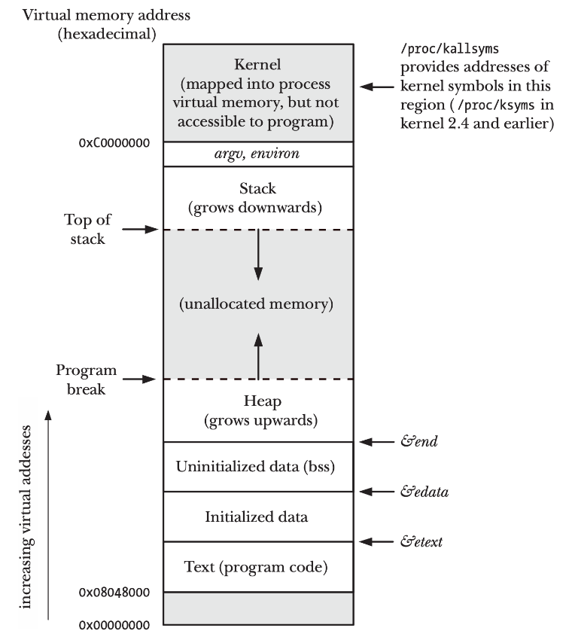
Memory Layout in Unix-like OSes
  The Virtual Address space is not entirely used
    The MAT is truncated in two points
  By convention:
    Program code, global variables and heap are on the bottom addresses
    The stack uses to top addresses

Slide 28
Minor and Major Page Fault
  Page Fault can be classified in two types:
  Minor Fault: does not require disk access
    A process starts using a new Virtual Page
    The OS finds a free space in the physical memory
    The OS just updates the MAT for that process
    Very fast process
  Major fault: requires disk access
    A process accesses a new Virtual Page or a Virtual Page previously swapped on disk
    There is no free space in the Physical Memory
    The OS chooses a page to swap on disk
    The new page is put in the freed space

Slide 29
Overall architecture

Slide 30
Overall architecture
  The MMU operates before the cache
  The cache operates on physical addresses
Virtual Addresses
Physical Addresses
CPU
MMU
CACHE
Main Memory
Disk
Data Bus

Slide 31
Virtual Memory vs Cache
Similarities
  Locality Principle
  Work between a fast and small memory and a slow and large one
Differences
  Cache: Virtual Memory
  Access time: 5:1 1000:1
  Hit ratio: 0.9 0.999
  Management: HW HW and SW
  Block size: 4-32 B 1-64 kB
  Writing: W. Back/Through Write Back

