Slide 1
Car Racing
Solving it with PID and DQN

Slide 2
Problem definition
In this environment, the agent (a car) needs to learn how to navigate a racing track. The observation space typically includes pixel images from the car's perspective, and the action space consists of continuous actions like steering, acceleration, and braking.
The generated track is random every episode. Some indicators are shown at the bottom of the window along with the state RGB buffer. From left to right: true speed, four ABS sensors, steering wheel position, and gyroscope.

Slide 3
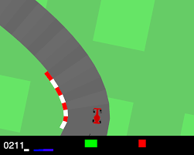
State, actions and reward
State: 84 x 84 RGB image
Actions: (steering, acceleration, braking)
  All real numbers
Rewards: the reward is -0.1 every frame and +1000/N for every track tile visited, where N is the total number of tiles visited in the track

Slide 4
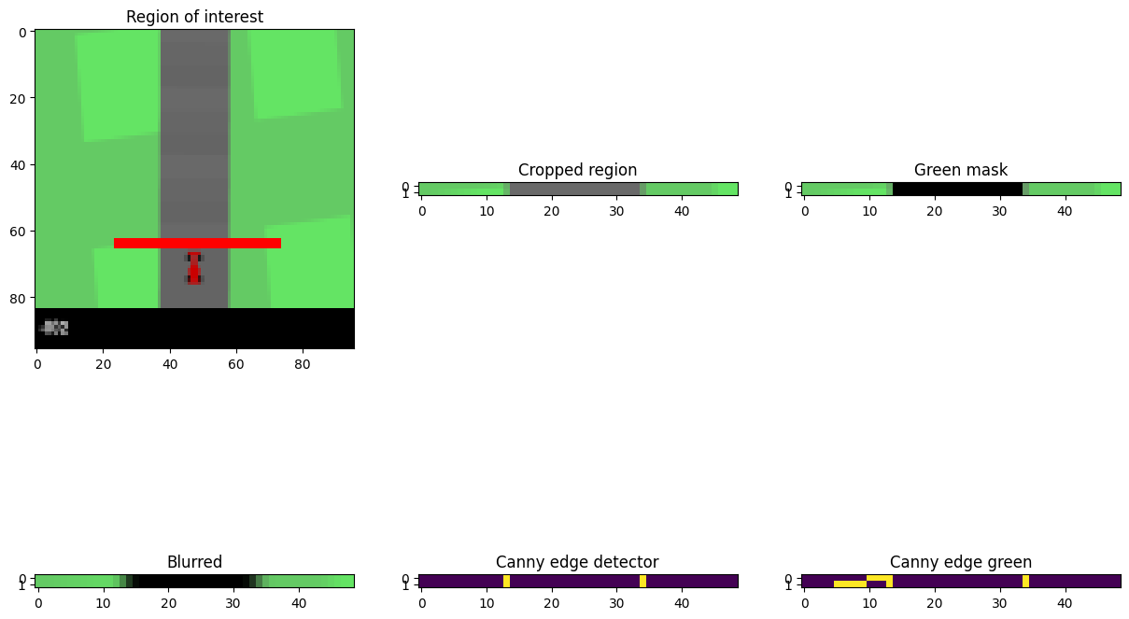
PID design

Slide 5
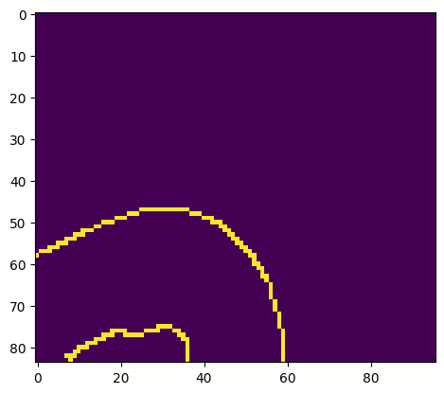
PID problems
- Sharp corners don’t have left/right boundaries
- If only one of the two is visible, then steer in the opposite direction
- After a turn the car might resonate
- When the error is too high apply braking, so the PID will put the car back on track

Slide 6
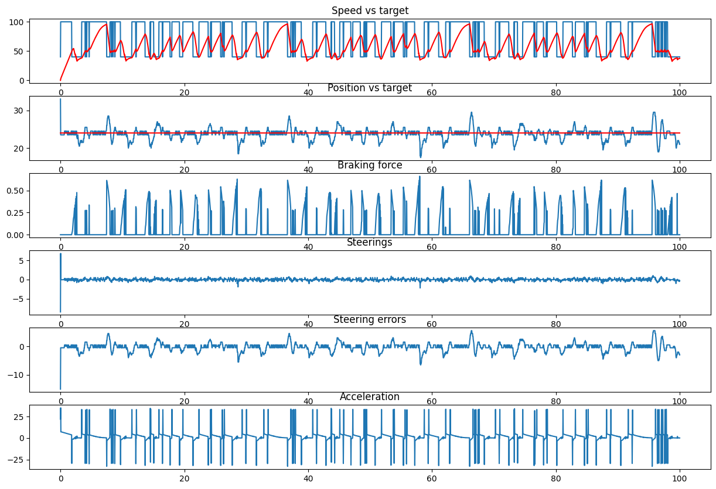
PID performance

Slide 7
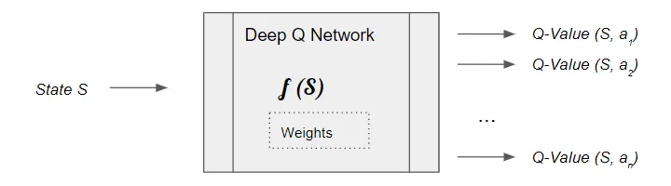
DQN
CNN based on LeNet
Input has 3 channels, which are frames at different time steps

Slide 8
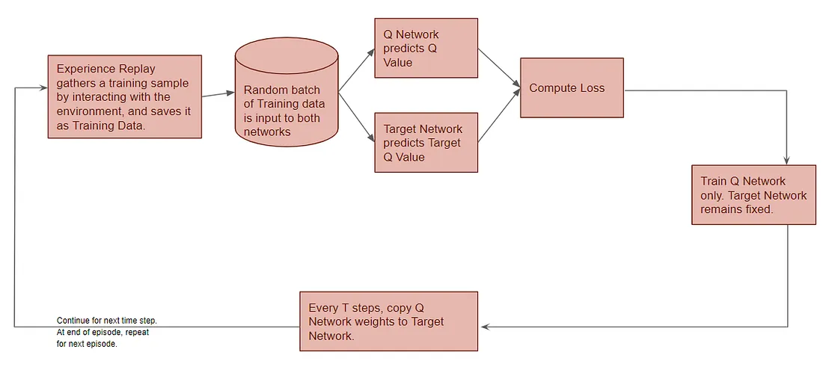
DQN architecture

Slide 9
Experience replay
An action will be chosen and performed for 3 steps
64 experiences will be stored and replayed
The target model is updated every 5 iterations

Slide 10
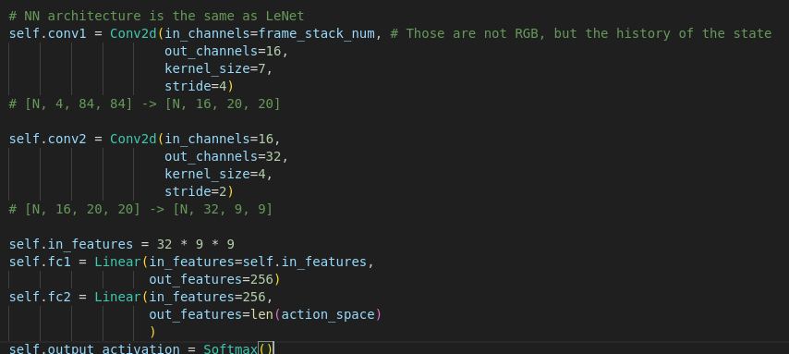
Neural network architecture
Loss: RMSProp and ADAM, but the performance was basically unchanged
Output activation function: Softmax or ReLU didn’t impact the performance

Slide 11
Problems encountered with DQN
The car is always steering to the same direction
10e6 epochs would be needed to get a decent performance
1000 epochs take 4 hours on my laptop

Slide 12
Approach
Gather a synthetic dataset using PID to control the car
Train the neural network on the dataset
Apply reinforcement learning on the pre-trained network

Slide 13
Results

