Slide 1

Tagging with word embeddings
Explore the use of Word Embeddings for tagging.
Two models: Logistic Regression and Multilayer Perceptron.
Word embeddings computed using word2Vec tool.
Ancora corpus.

Slide 2
Vectors
Embeddings of length 300.
Classification items like, <k-1>, <k>, <k+1>
Convolution trick for constant memory.
  Turn W into a 3D tensor, rely on broadcasting 2D matrix to 3D tensor during convolution.
~10000 missing words.
Dataset split: 70% train, 10% validation, 20 test.

Slide 3
Convolution trick
padding
x
embedding
length
nº of
classes
window length
Achieve constant memory use.
Re-arrange W.
Broadcast input window along red dimension of kernel.
padding

Slide 4
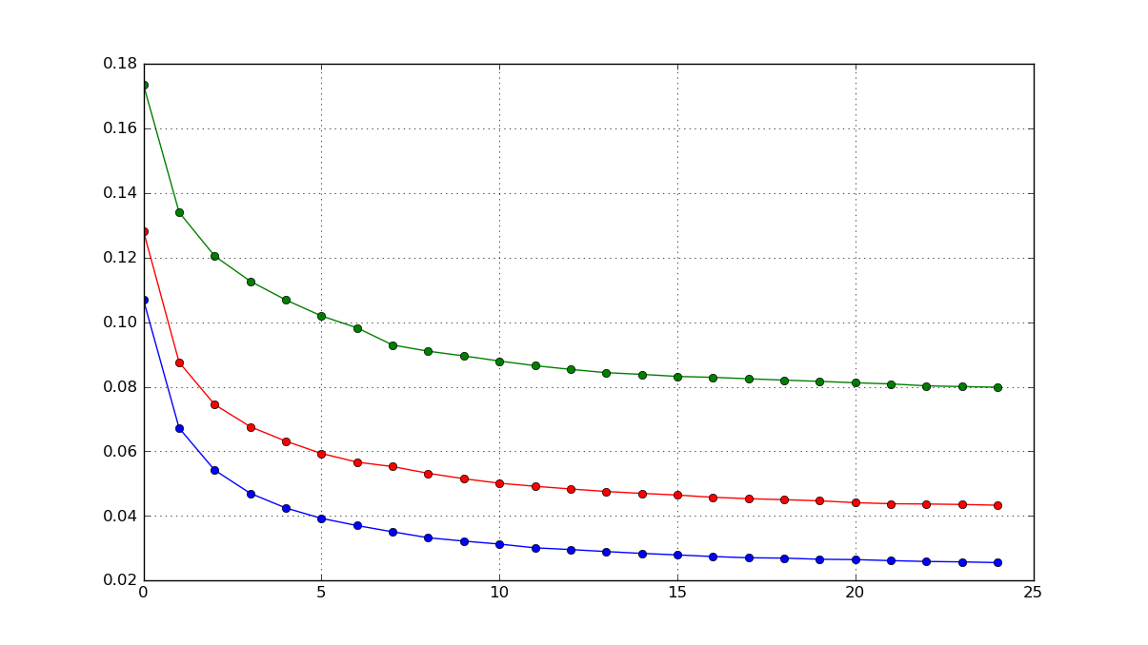
Missing embeddings
Map every missing word to the same random vector.
Map every missing word to a different vector each.
Map every missing word to a “special” vector according to tag.
Note: validation error data for 1:1 logreg, 25 epochs.

Slide 5
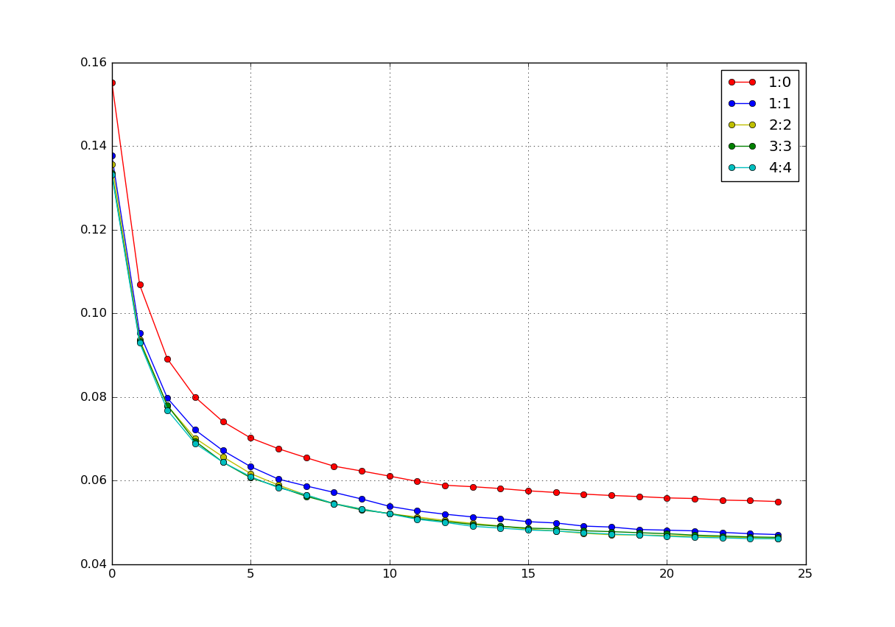
Logistic Regression
Window comparison
Choosing 2:2 running for 45 epochs, yields a validation performance of 4.195%, with test performance 3.939%

Slide 6

Logistic Regression
For an input x, a weight matrix W, and bias b
The model’s prediction is the class whose probability is maximal,

Slide 7
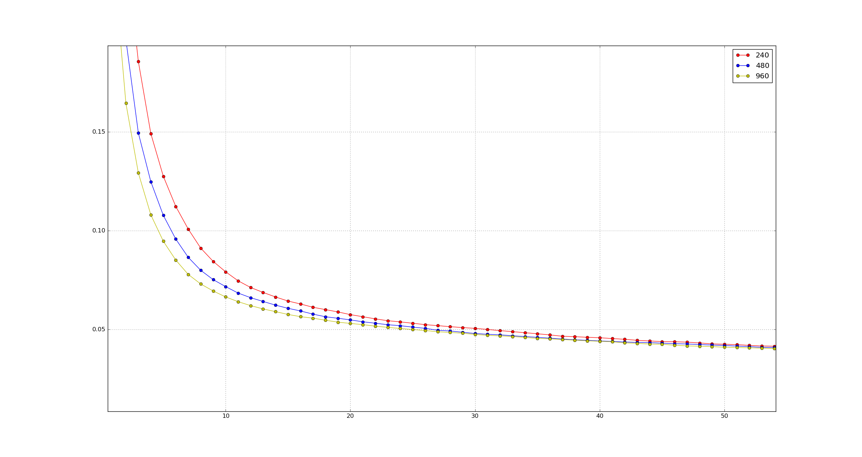
Neural Network
Error for different number of hidden units

Slide 8
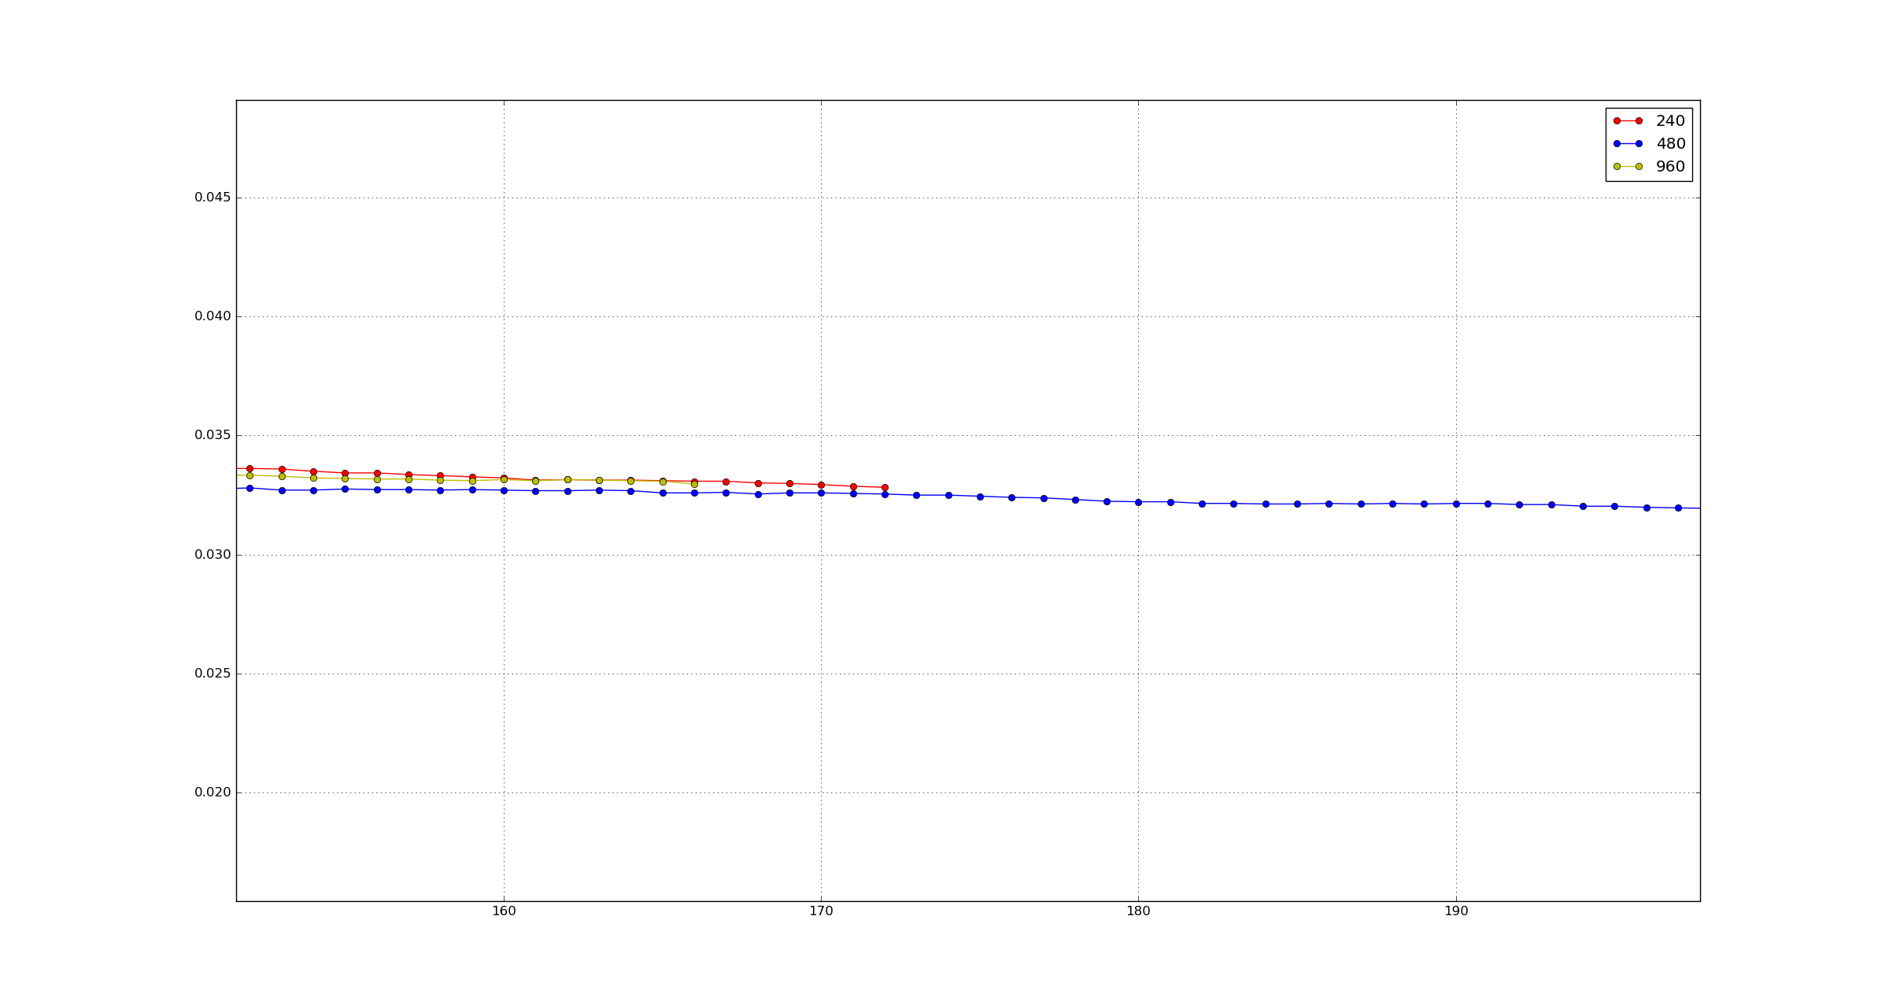
Neural Network
3,2 % error for 480 hidden units

