Slide 1
Bioinformatics CNN project 3.7 Growing DeepTree
Alberto Benincasa [251415]
Chiara Penaglia [246289]
MarcoMorandi[253488]

Slide 2
The aim:
Create a Growing DeepTree able to catalogue different histological samples.

Slide 3


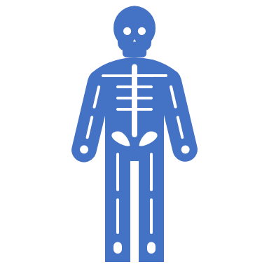
In particular an histological samples are a pieces of human tissue, obtained via a surgical operation.
Adenocarcinoma, tumour (AC)
Healthy tissue, normal colonic glands (H).
Serrated Adenoma, precursive lesion of cancer that may turn into it (Serr).
Tubular adenoma, precursive lesion of cancer that may turn into it (T).
Villous Adenoma, precursive lesion of cancer that may turn into it (V).

Slide 4
HOW IT WORKS:
Images + Labels
Others
Class 0
Dataset
Level 0
Others
Class 1
Others
Class 2
Class 4
Class 3
Level 1
Level 2
Level 3
The group images a Tree where at each level a network learns to distinguish a Class from the other set

Slide 5
Set
All Classes minus AC
AC
THE NETWORK:
The numeber of networks are the number of the classes in the original dataset minus one, because in the last step OTHERS is formed by only one class, so there will not be an other level
Others
One of the five input classes, it is a leaf

Slide 6
A vector called Tree is instanzieted and in each cell a trained CNN is stored.
CNN 1
CNN 2
CNN 3
CNN4
TREE [ 4 ]

Slide 7
OLD DATASET + EXTRA CLASS
OLD DATASET
EXTRA CLASS
LEVEL 0
Dataset – Class 0
Class 0
LEVEL 1
When an extra class is added, an extra net able to distinguish the extra class from the old dataset.
An the new net is stored in the first position of the vector, and the other nets are shifted
EXTRA CNN
CNN1
CNN2
CNN3
CNN4

Slide 8
SPEAKING ABOUT CODE...

Slide 9
STEPS:
TRAINING CIFAR10
TEST WITH CIFAR10
TRAINING NEW DATASET
TEST NEW DATASET

Slide 10
Before starts working with the net, the group choses a class to save
Take as input the traisent_gold and it drops a class from the trainingset, and stores in a dictionary images and label
newclassadd = dropElements(trainset_gold)
In order to create a tree, a loop is defined and all the CNN are trained and at the end they are stored in a vector, and passed to the test function.

Slide 11
As the set is changed during each cycle, two functions are called that manage data/labels and overwrite the old trainset.
DatasetBalancing()
At each cycle class that are already analyzed are dropped from the set. It selects a class that will be the leaf, the other will become a unique class. This function also balacing the two classes.
ToDict()
This function take the cifar10 set and reduce the number of elemnts from 10 to 4. The four elements are transformed in a dictionary
trainset.data, trainset.targets = datasetBalancing(toDict(trainset_gold), j)

Slide 12
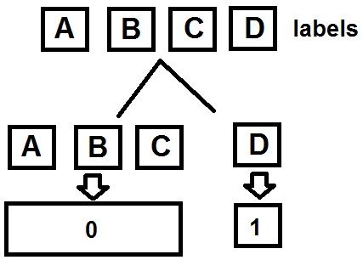
ReturnValues()
As the classes are mergerd to create the class others, the labels of the classes must be united and the label is renamed

Slide 13
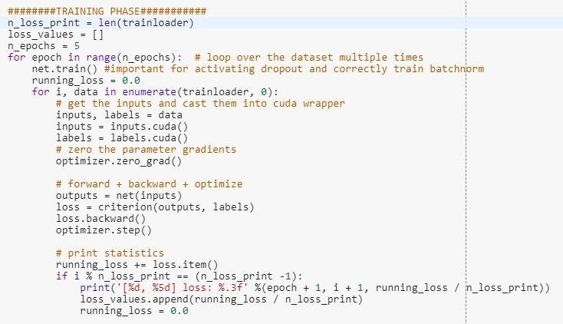
Each network is defined as:
Fare clic per inserire testo

Slide 14
This code is called at every time at the end of a cycle of the loop.
It is used to store the trained nets sequentially.
tree.append(net)
Tree is the vector with the trained nets
Testloader, is the test set
LabelsArray is the order of the leaves in the tree
test_accuracy(tree,testloader, labelsArray)

Slide 15
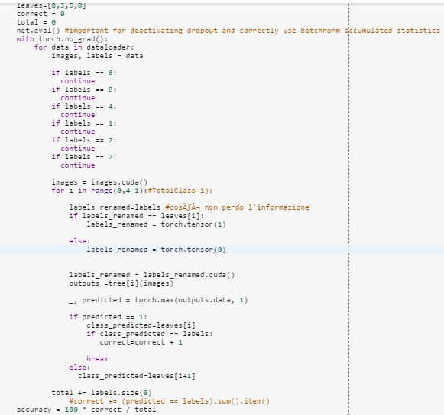
Each image passes in the tree.
The net gives its output. 0, if it decides that is other, 1 if it is equal to the leaf
The if statements drop the classes not used.
If it is not equal to the leaf of that branch, it is passed to the next level.
As for the training the label of the image to test is renamed in 0/1 if it is equal to the leaf of that branch.

Slide 16
The accuracy function is called again, updating the order of the leaves
Databalancing() is used again to balacing the union of the old dataset and the new class
A new net is trained to recognize the extra class from the old set
The trained net is inserted in the position zero of the vector tree
Afte the old tree is ready, the extra class stored before is added to the tree.
In this way at every time a new class is added, only the net that recognize the new class, must be trained. The other nets are only shifted inside the tree vector.

Slide 17
RESULTS of CIFAR10 TREE

Slide 18
Dimension of the filter and number of epochs have been changed multiple times to increase the accuracy and decrease the loss
EPOCHS
FILTER
5
20
32
64
128
256

Slide 19
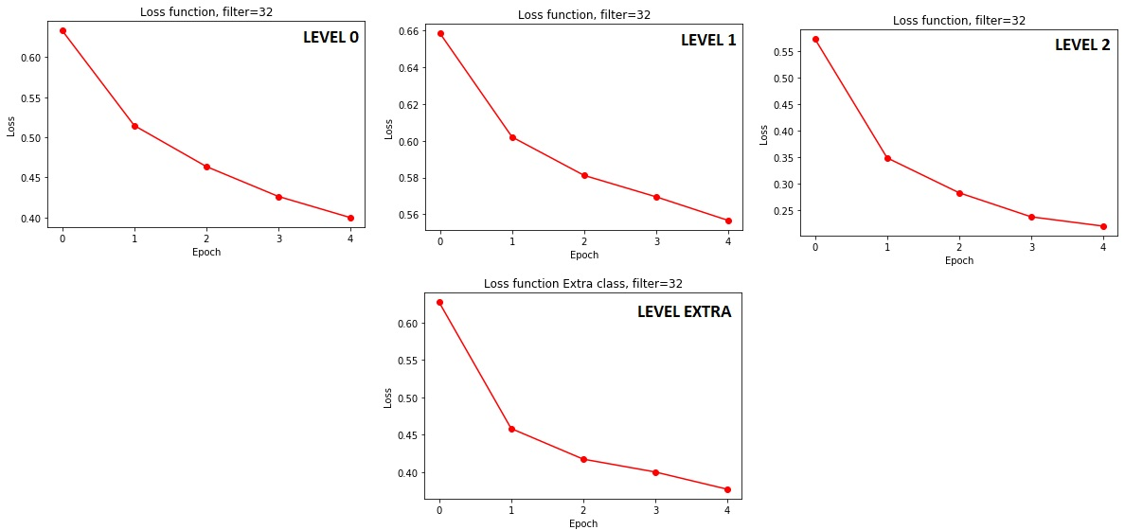

Slide 20
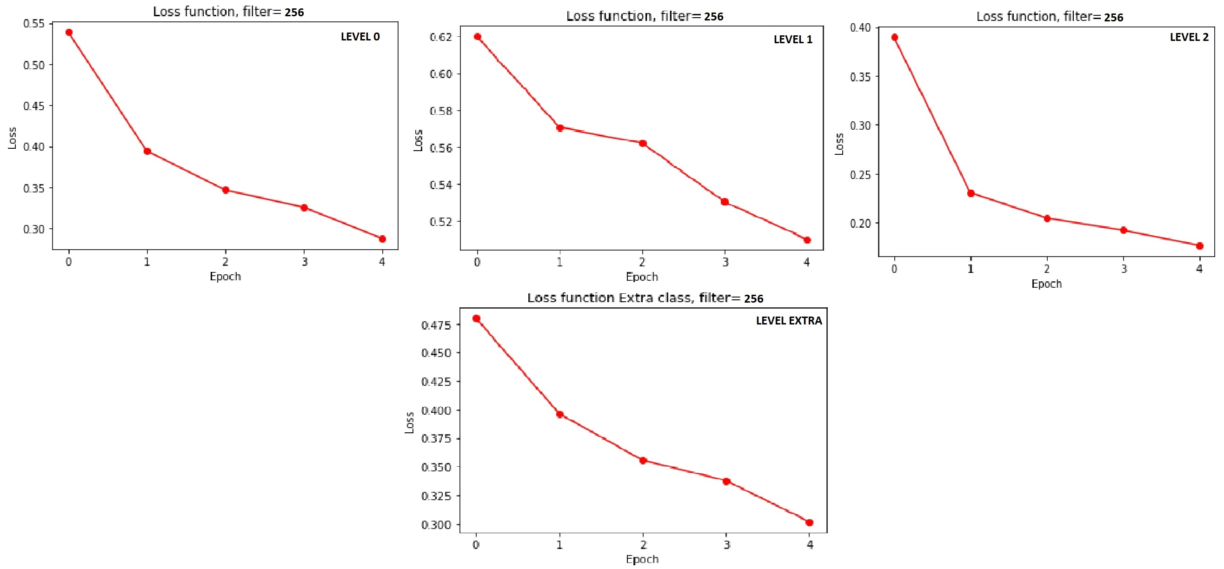

Slide 21
Increasing the dimension of the filters the loss decrease as expected, but the time of processing the image is increased
In the next slides the improvement of the loss to due the increase of the epochs is shown

Slide 22
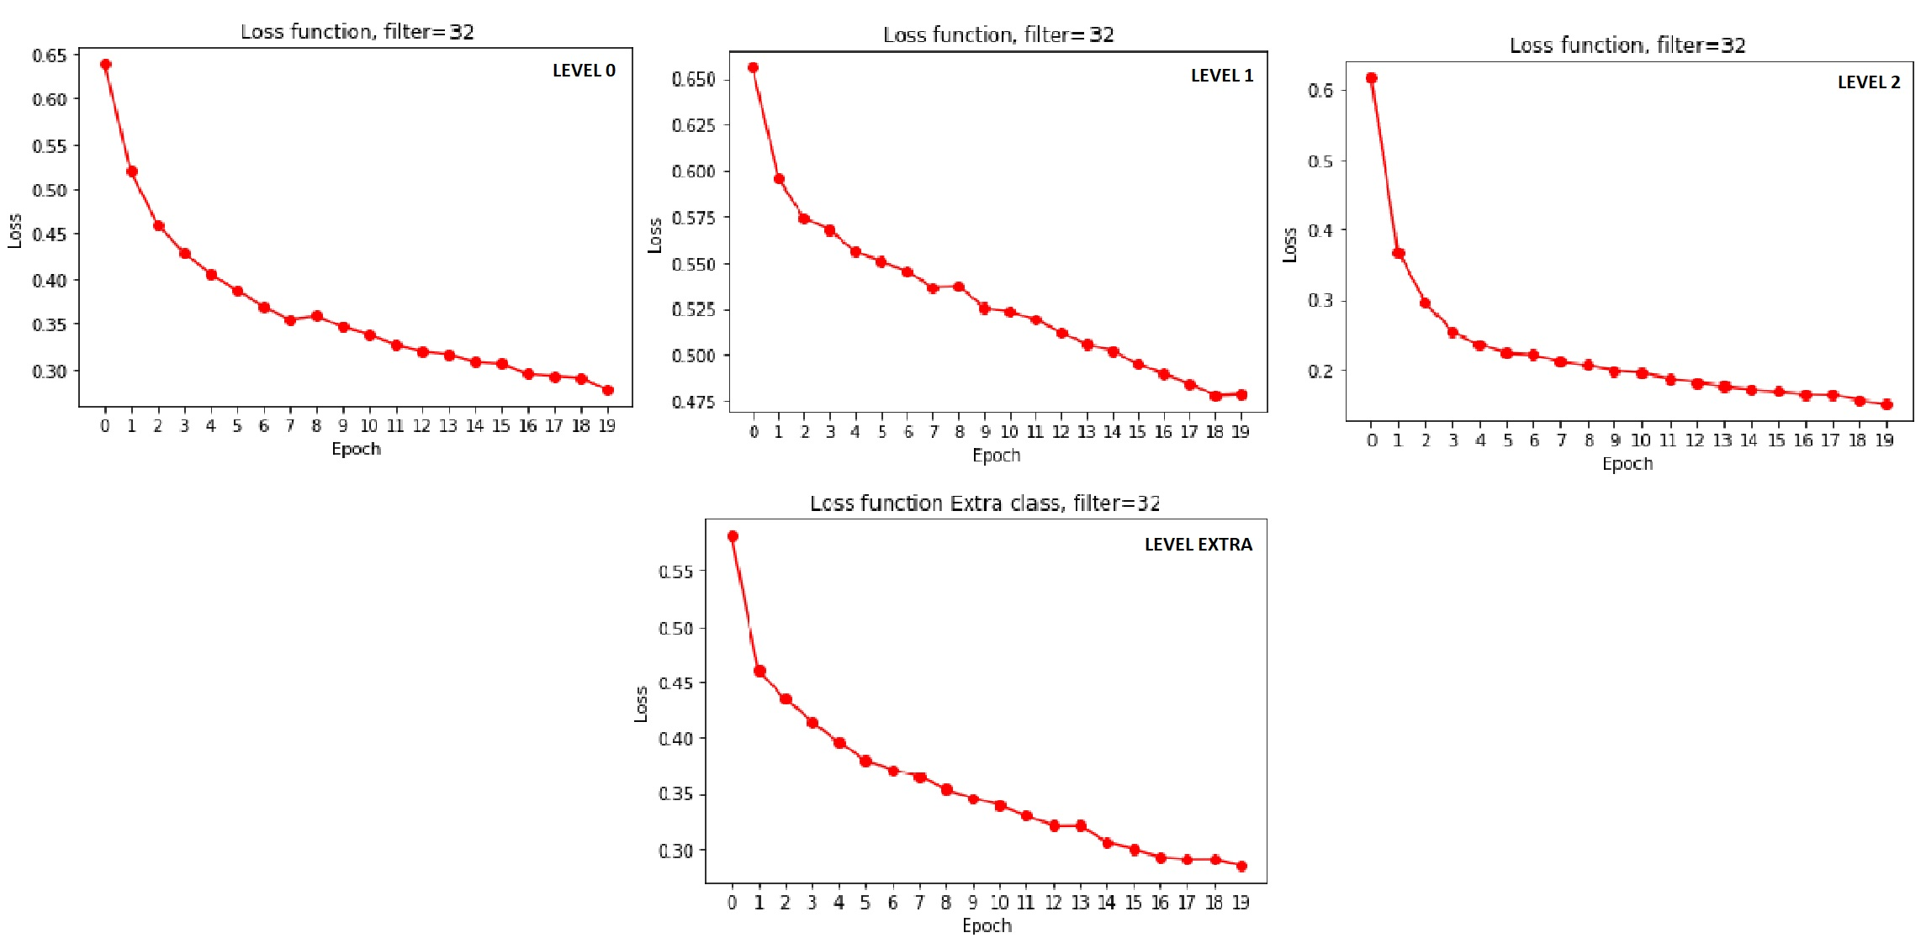

Slide 23
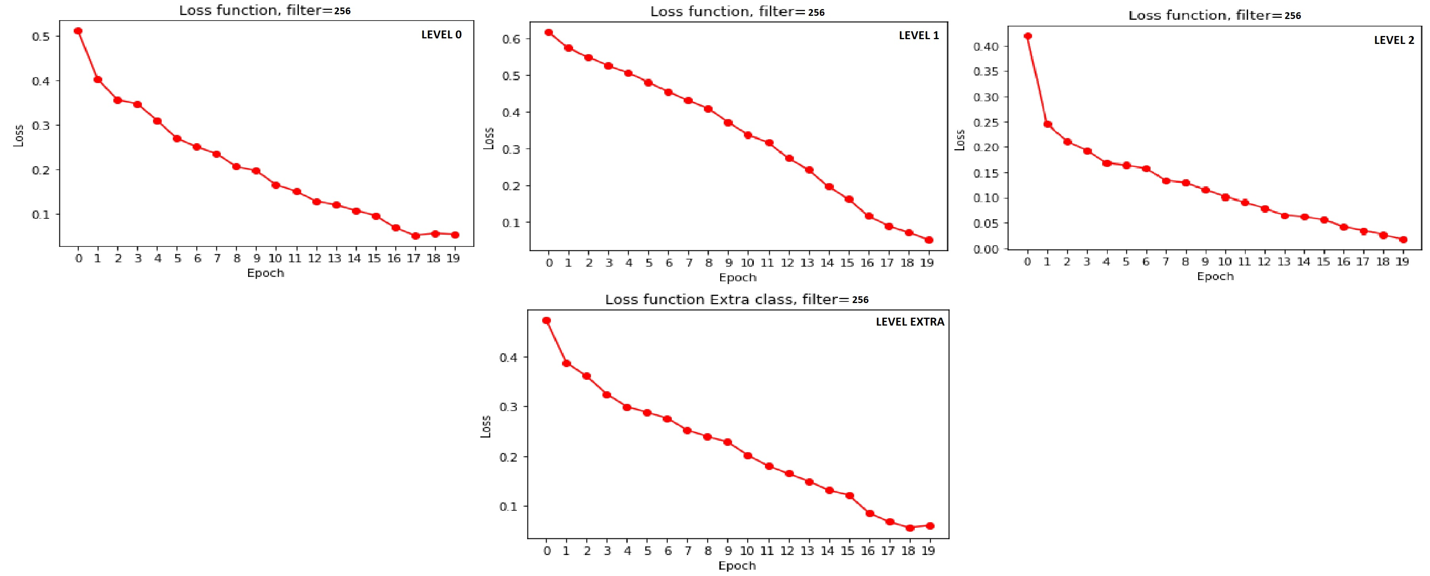

Slide 24
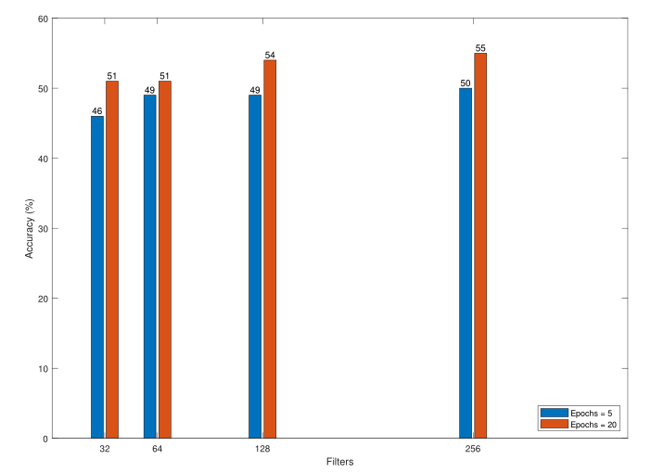
The increase of the accuracy is shown
FILTER using 5 epochs | ACCURACY (%) | ACCURACY EXTRA CLASS (%)
32 | 46 | 47
64 | 49 | 49
128 | 49 | 47
256 | 50 | 52

Slide 25
MEDICAL DATASET

Slide 26
The steps taken for the new dataset are similar to those made for the old one
Divide Training and Test sets
Import sets using ImageFolder
Transform the dataet into a readable one for the function
Create the tree

Slide 27
Balacing()
Similar to the function seen above, it takes the training set in input and divides "others" from the leaf. Creating a balanced set.
Furthermore, it gives as output a tuple vector with only two labels, 0/1
OUTPUT
[(imm,label), (imm,label), (imm,label), …..(imm,label)]

Slide 28
RESULT of MEDICAL DATASET TREE

Slide 29
Results are similar to that one of CIFAR10, but the time is doubled.
In the next slides the improvement of the loss to due the increase of the epochs is shown

Slide 30
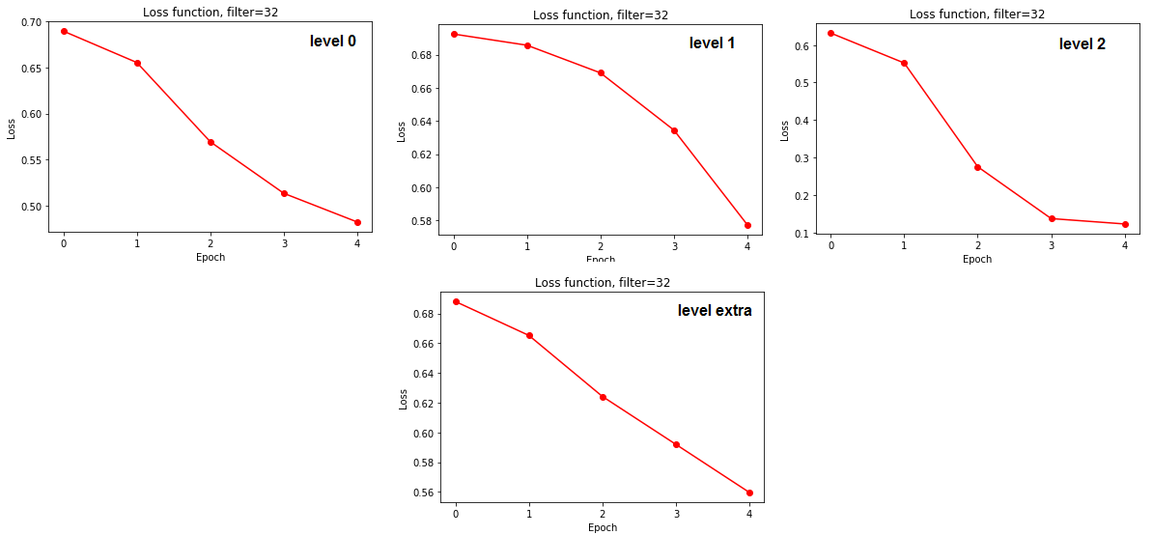

Slide 31
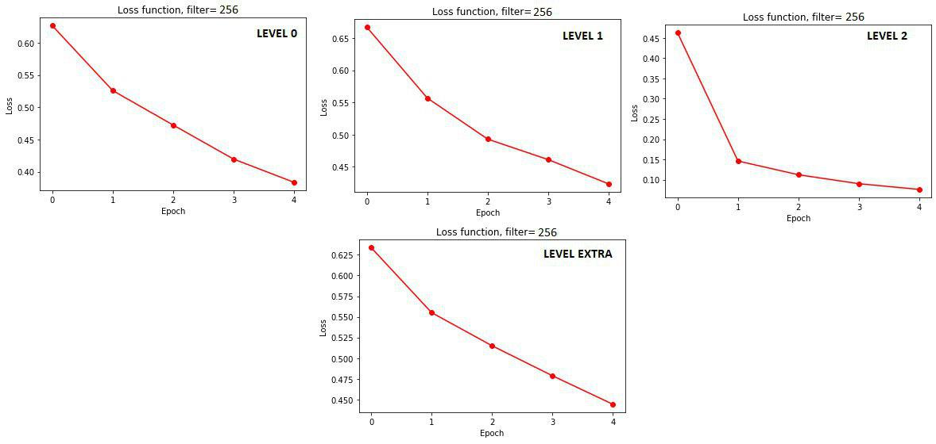

Slide 32
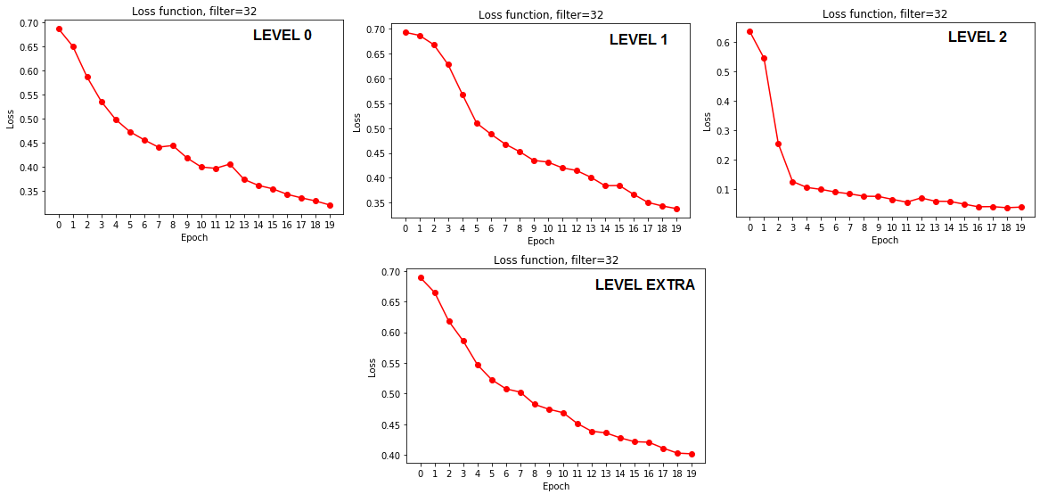

Slide 33
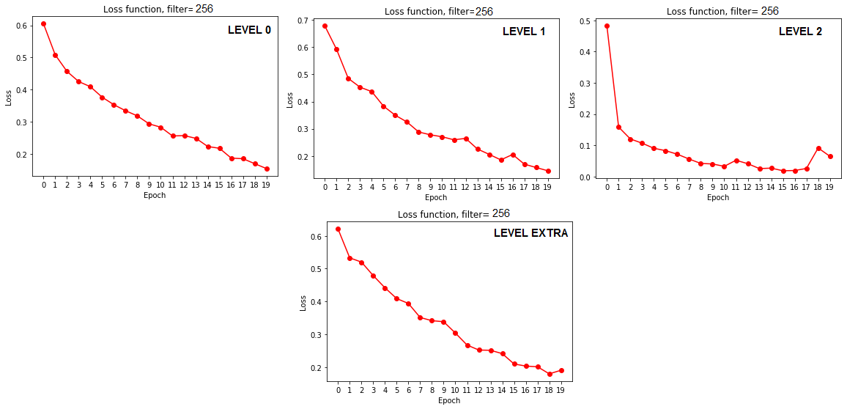

Slide 34
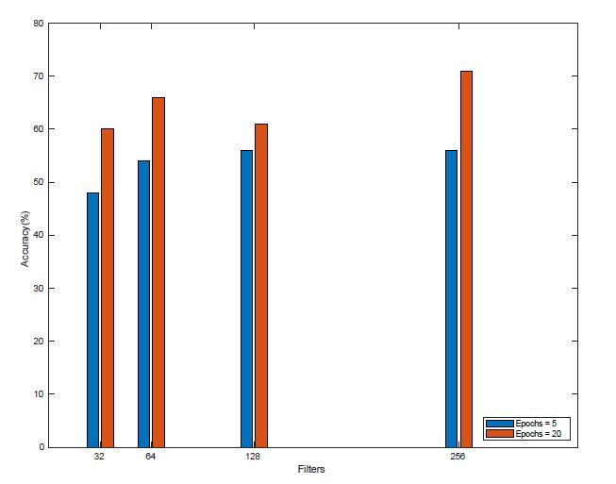
The variation of the accuracy is shown
FILTER using 5 epochs | ACCURACY (%) | ACCURACY EXTRA CLASS (%)
32 | 48 | 49
64 | 54 | 48
128 | 56 | 42
256 | 56 | 51

Slide 35
CONCLUSION

Slide 36
The accuracy of the two datasets using four classes is almost similar. When a fifth class is added, in the first dataset we don't see big differences, unlike the second one
Add Class
Increase time + Decrase Accuracy
Not training all tree again

Slide 37
Some subsequent improvements can be added to CNN to improve the accuracy.
1
Improve Learn Rate
2
Increase Filter dimension
3
Add other block to the CNN

Slide 38
WE THANK YOU FOR YOUR ATTENTION

