Slide 1
myTaxiService
Alberto Cibari: 852689
Magoni Monica
Politecnico di Milano, AY 2015-2016
Notes:
aaaaaaaaaaaaaaaaaaaaaaaaaaaaaaaaaaaaa

Slide 2
Content Table
Project Overview
  Introduction
  Actors
  Mockups
  System Functions (qui ci vanno i class diagram e sequance diagrams)
  Assumptions and Dependences
  Non Functional Requirements
  Alloy Model
Politecnico di Milano, AY 2015-2016
Notes:
aaaaaaaaaaaaaaaaaaaaaaaaaaaaaaaaaaaaa

Slide 3
Project Overview
Politecnico di Milano, AY 2015-2016

Slide 4
Introduction
The government of a large city wants to optimize its taxi service.
The aim of the project is to create a brand new taxi application that is used by both the taxi drivers and the passengers to access the taxi service.
Passengers can request or reserve a taxi through a web or a mobile application.
Taxi drivers can access the service only from mobile application. They can manage their availability and ride requests that they receive from the system.
The system has the city map divided into areas and holds a taxi queue in each area. It manages the taxis in queue based on their availability and what kind of answer they give to a given request.
Politecnico di Milano, AY 2015-2016

Slide 5
Actors
Guest
  Register
User
  Sign up into the system.
  Log into the system.
  Request a taxi.
  Reserve a taxi.
  Delete requests or reservations.
  Visualize information about requests or reservations.
  Manage their account.
Politecnico di Milano, AY 2015-2016

Slide 6
Actors
Taxi Driver
  Sign up into the system.
  Log into the system.
  Receive information from the system about the city's area they
  have to cover.
  Notify the system of their availability.
  Receive requests and reservations from the system.
  Accept or decline requests.
  Manage their account.
Politecnico di Milano, AY 2015-2016

Slide 7
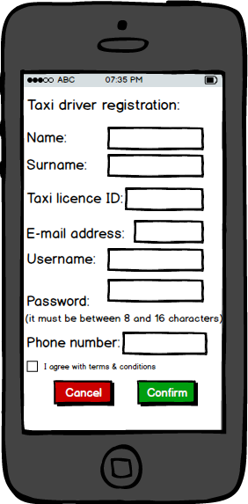
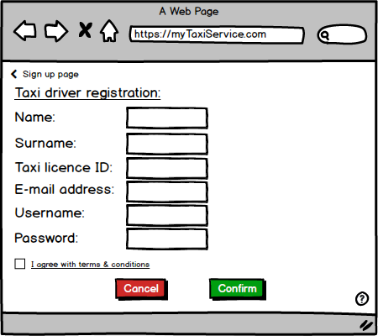
Mockups - Registration
Politecnico di Milano, AY 2015-2016

Slide 8
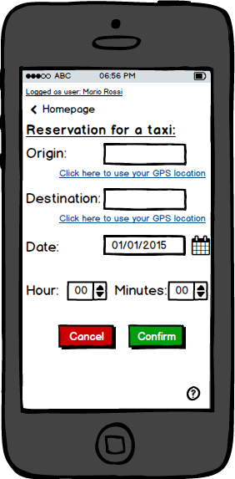
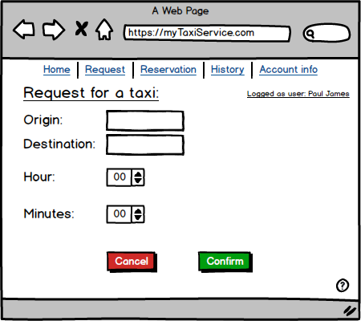
Mockups – Request and Reservation
Politecnico di Milano, AY 2015-2016

Slide 9
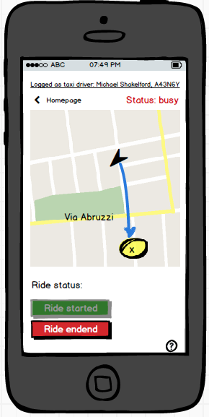
Mockups – Ride status
Politecnico di Milano, AY 2015-2016

Slide 10
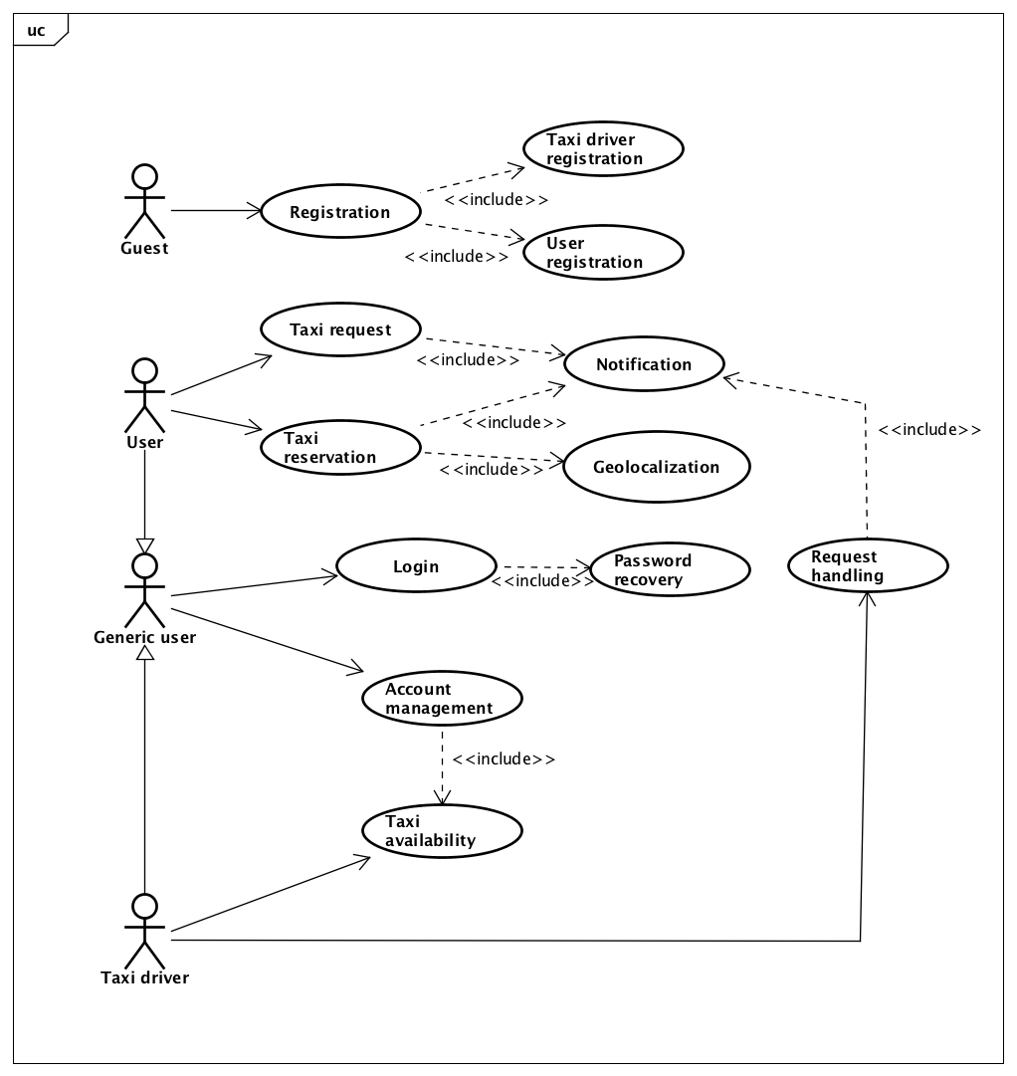
System Functions
Politecnico di Milano, AY 2015-2016

Slide 11
System Functions – Function Requirements
Guest Registration
User login/taxi driver login
User home page/taxi driver home page Activation/deactivation of the taxi services
Request making
Reservation making
Taxi driver notification handling
Zone queue handling
TO DO: ELENCARE FUNCTIONAL REQUIREMENTS GENERALE, NON SPECIFICO
Politecnico di Milano, AY 2015-2016

Slide 12
System Functions – Function Requirements
TO DO: ELENCARE FUNCTIONAL REQUIREMENTS GENERALE, NON SPECIFICO
Politecnico di Milano, AY 2015-2016

Slide 13
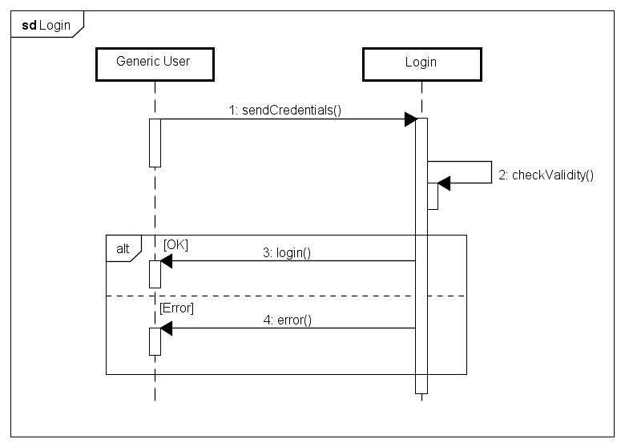
System Functions – Sequence Diagrams
Politecnico di Milano, AY 2015-2016

Slide 14
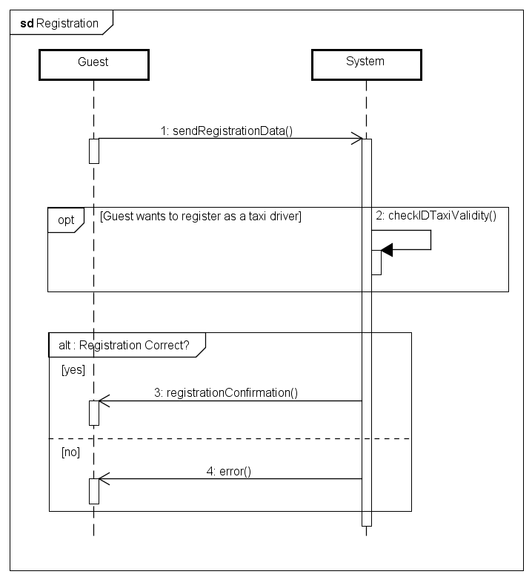
System Functions – Sequence Diagrams
Politecnico di Milano, AY 2015-2016

Slide 15
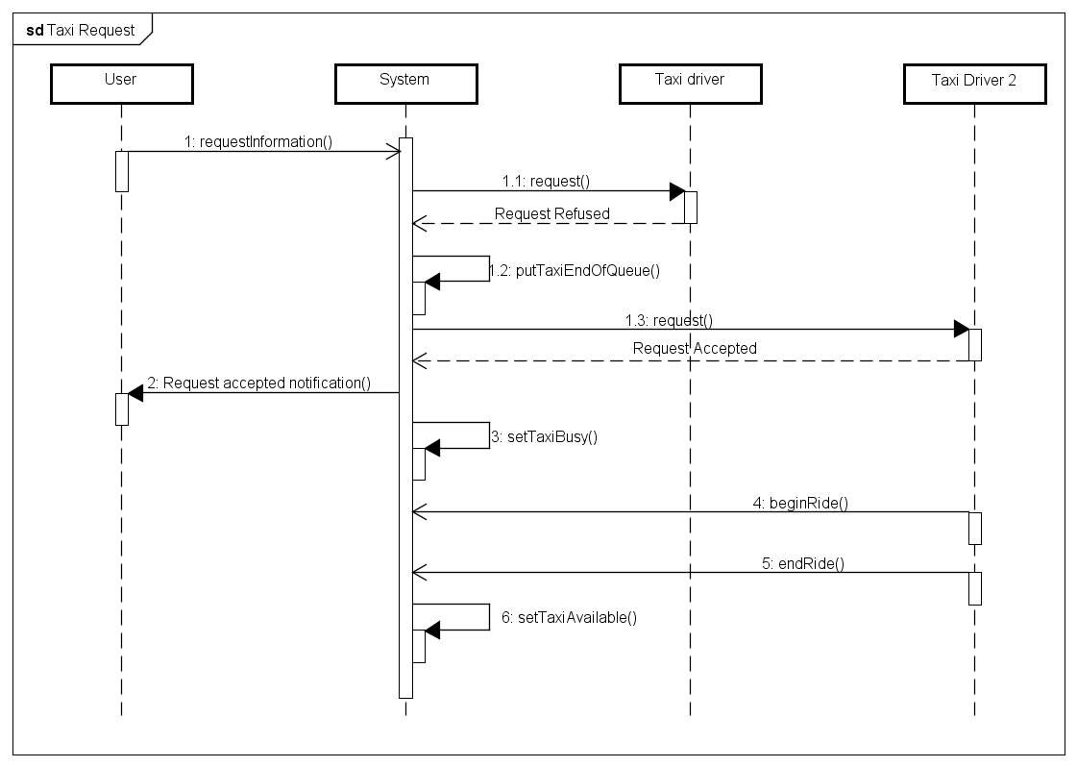
System Functions – Sequence Diagrams
Politecnico di Milano, AY 2015-2016

Slide 16
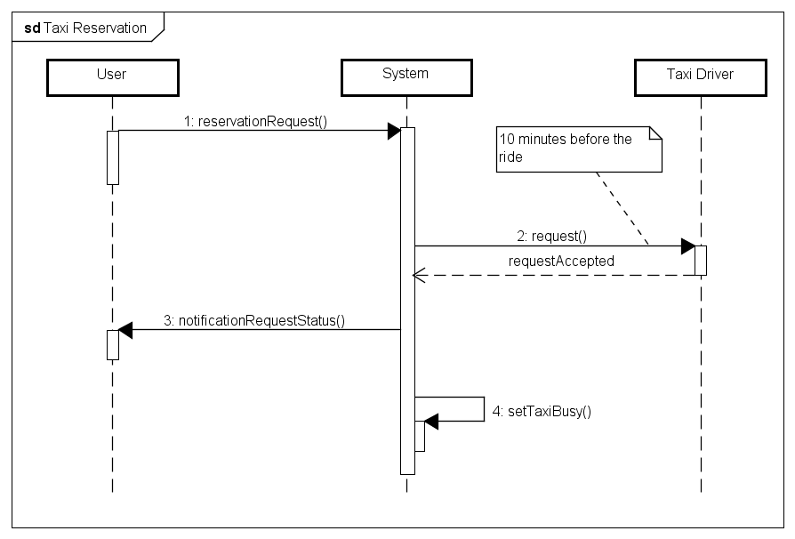
System Functions – Sequence Diagrams
Politecnico di Milano, AY 2015-2016

Slide 17
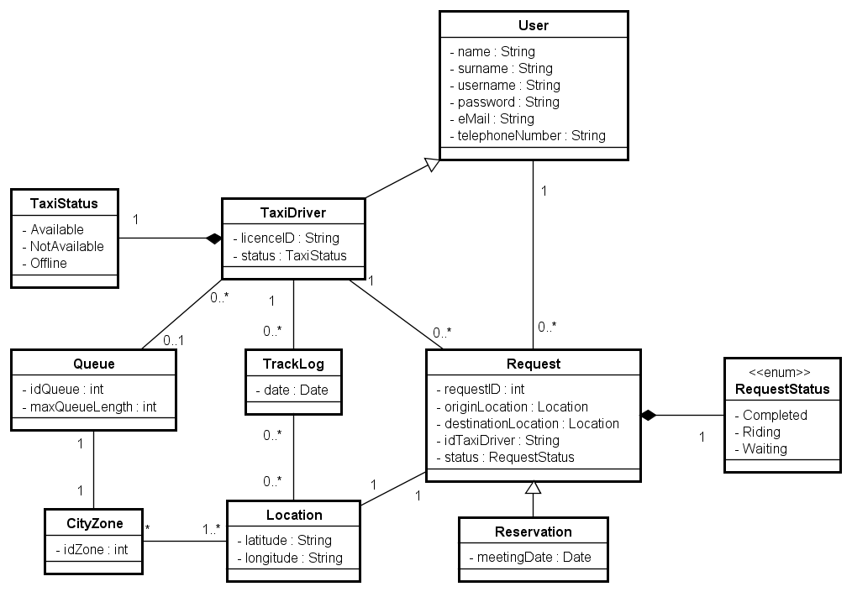
System Functions – Class Diagram
Politecnico di Milano, AY 2015-2016

Slide 18
Assumptions and Dependences
The taxi queue of each area has a maximum length.
If in a specific taxi queue there are too many taxi, the system must reschedule all the taxi's positions.
If in a specific taxi queue there are too few taxi, the system must reschedule all the taxi's positions.
Priority to reservations.
Users can delete reservations within 10 minutes from the appointment.
Taxi cars are provided of GPS and each of them is associated to a specific taxi identier.
Taxi drivers can delete accepted requests by contacting administrators, only if there is a problem to their car.
Politecnico di Milano, AY 2015-2016

Slide 19
Assumptions and Dependences
The origin of every reservation must be within the boundaries of the city.
The destination chosen by the passenger must be within 10Km from the city boundaries.
If there are no taxi in a city zone for more than 30 minutes, the system will do a reschedule of the taxi's positions.
Each time a user makes a reservation, he must specify the origin of the ride.
If a taxi driver doesn't accept/deny a request received by the system within 1 minute, the system forwards the request to the next taxi driver in the queue.
The taxi is able to reach the meeting location within 20 minutes from the request acceptance.
Politecnico di Milano, AY 2015-2016

Slide 20
  Non Functional Requirements
Availability
The system shall be available 24 hours per day, 365 days per year. It must have a minimum availability of 97%
Portability
The software product can be installed in any operating system that supports the java virtual machine and its dependent components.
Maintainability
The database must be backed up 2 times per day, so the logs of taxi services are not lost due to malfunction.
Security
The software product must provide secure storage of the passwords of its users. This can be achieved by using any cryptographic techniques.
Politecnico di Milano, AY 2015-2016

Slide 21
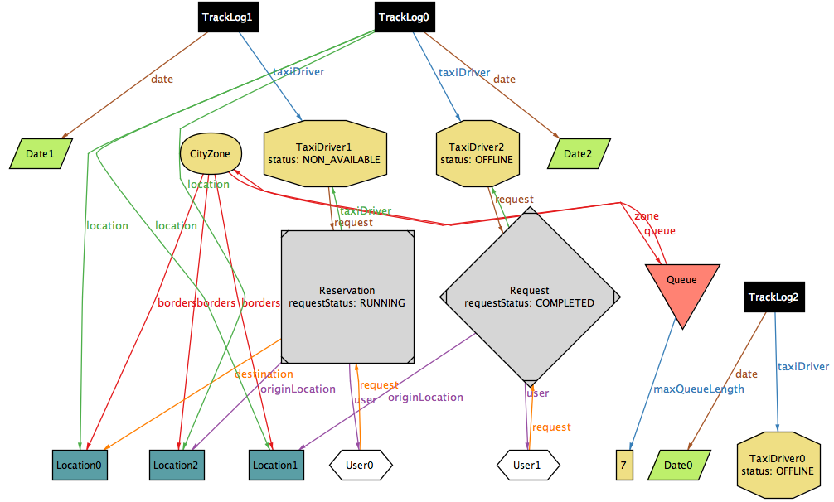
Alloy Model
Politecnico di Milano, AY 2015-2016

Slide 22
Politecnico di Milano, AY 2015-2016

Slide 23
Politecnico di Milano, AY 2015-2016

