Slide 1
Chapter 1: Introduction to Computer Networks
By Dr. Kejie Lu
Department of Electronic and Computer Engineering
Department of Electrical and Computer Engineering

Slide 2
Outline
Use of computer networks
Hardware
Software
Reference Model
Example networks
Standards
Characteristics
The Department of Electrical and Computer Engineering

Slide 3
Use of Computer Networks
History
Definition
Distributed system
Business application
Home application
Mobile user
Social issues
The Department of Electrical and Computer Engineering

Slide 4
History
A powerful computer with multiple terminals
  Centralized
A network of computers
  Computer and communication are combined
The Department of Electrical and Computer Engineering

Slide 5
Definition
A collection of autonomous computers interconnected by a single technology
The Department of Electrical and Computer Engineering

Slide 6
Distributed System
Distributed system is a software system or application built on top of a network
Key difference between the distributed system and the computer network
  The distributed system appears to users as if there is only one system
  The computer network does not appear as a coherent system
A middleware must be used, which is a layer above operating systems
The Department of Electrical and Computer Engineering

Slide 7
Example of Distributed System
World Wide Web
  Middleware: browser
Grid computing
  SETI @Home project (Search for Extraterrestrial Intelligence)
Cloud computing
The Department of Electrical and Computer Engineering

Slide 8
Business Application
Purpose
The client-server model
The Department of Electrical and Computer Engineering

Slide 9
Purpose of Business Application
Share resource
  Hardware
    Printer, scanner
  Information
    Data, database
Communication
  E-mail
  Video conference
Doing business electronically with other companies (B2B)
Doing business electronically with customer (B2C)
The Department of Electrical and Computer Engineering

Slide 10
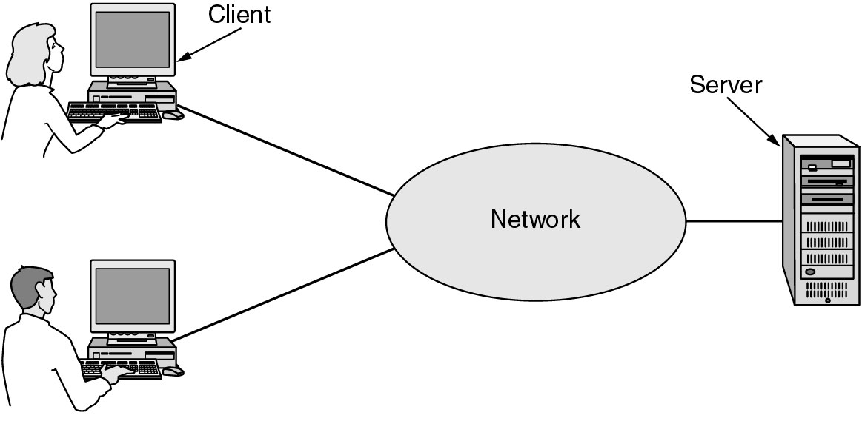
The Client-Server Model
A network with two clients and one server
The Department of Electrical and Computer Engineering

Slide 11
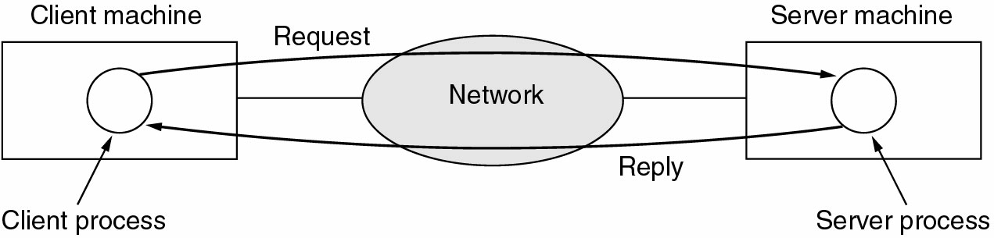
The Client-Server Model
The client-server model involves requests and replies
The Department of Electrical and Computer Engineering

Slide 12
Home Application
Purpose
Peer-to-peer model
The Department of Electrical and Computer Engineering

Slide 13
Purpose of Home Application
Access remote information
  Weather, news, library
Person-to-person communication
  Voice, video
Interactive entertainment
  Game
Business (C2C)
The Department of Electrical and Computer Engineering

Slide 14
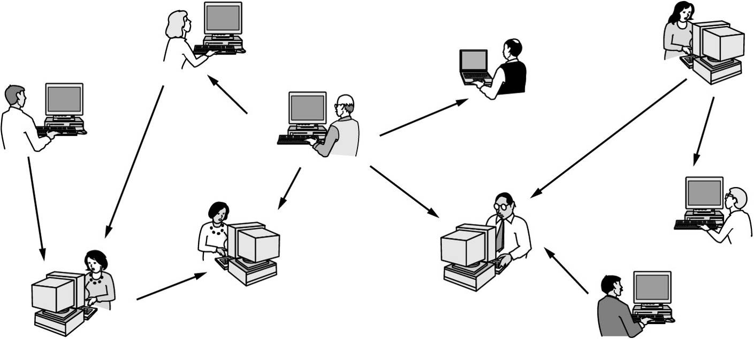
Peer-to-peer Model
In peer-to-peer system there are no fixed clients and servers
The Department of Electrical and Computer Engineering

Slide 15
P2P Application
P2P is a model, which can be applied to many applications
File sharing
  Song, video
  Legal risk
  Example: BT
Communication
  Voice call, text message
  Example: Skype
The Department of Electrical and Computer Engineering
Notes:
Here we shall note that P2P is a model. This means that it can be used not only for file sharing.

Slide 16
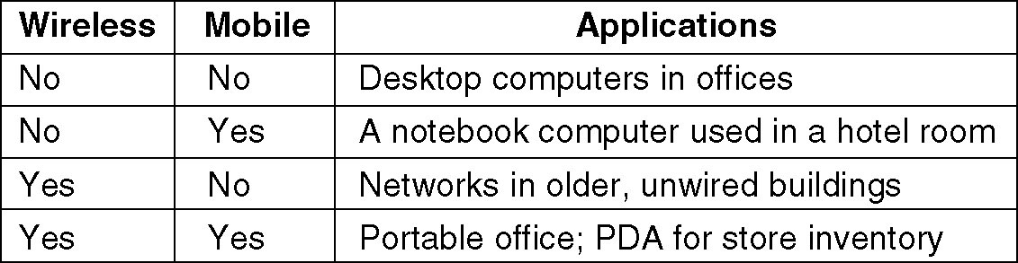
Mobile Users
Wireless != Mobile
M-commerce
The Department of Electrical and Computer Engineering

Slide 17
Hardware
Component
Size of network
  Personal area network (PAN)
  Local area network (LAN)
  Metropolitan area network (MAN)
  Wide area network (WAN)
The Department of Electrical and Computer Engineering

Slide 18
Component
Link
  Broadcast links
    Multicast
  Point-to-point links
    Unicast
Node
  PC
  Workstation
  Switch
  Router
The Department of Electrical and Computer Engineering

Slide 19
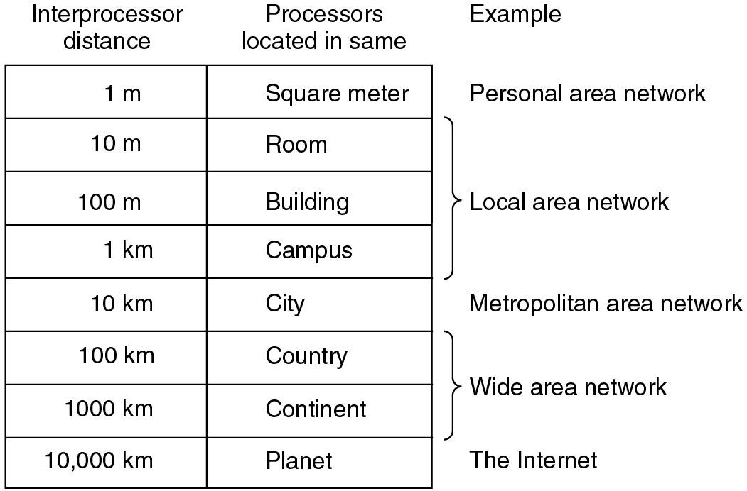
Size of Networks
The Department of Electrical and Computer Engineering

Slide 20
Personal Area Networks
Wireless PAN: IEEE 802.15
  Bluetooth
The Department of Electrical and Computer Engineering

Slide 21
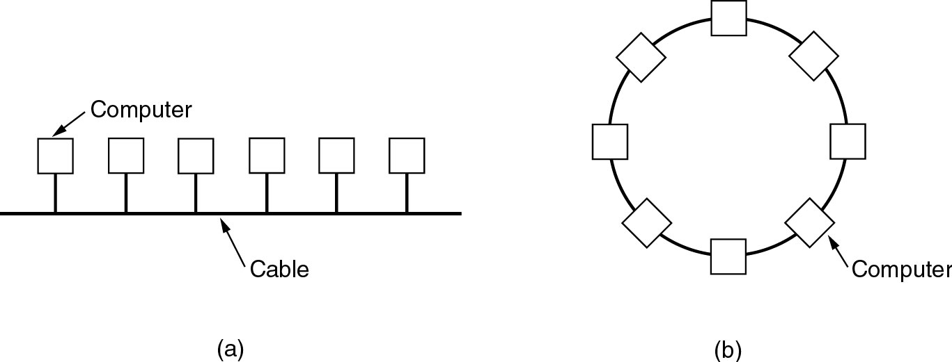
Local Area Networks
Ethernet
Wireless LAN: IEEE 802.11 (Wi-Fi)
Bus
Ring
The Department of Electrical and Computer Engineering

Slide 22
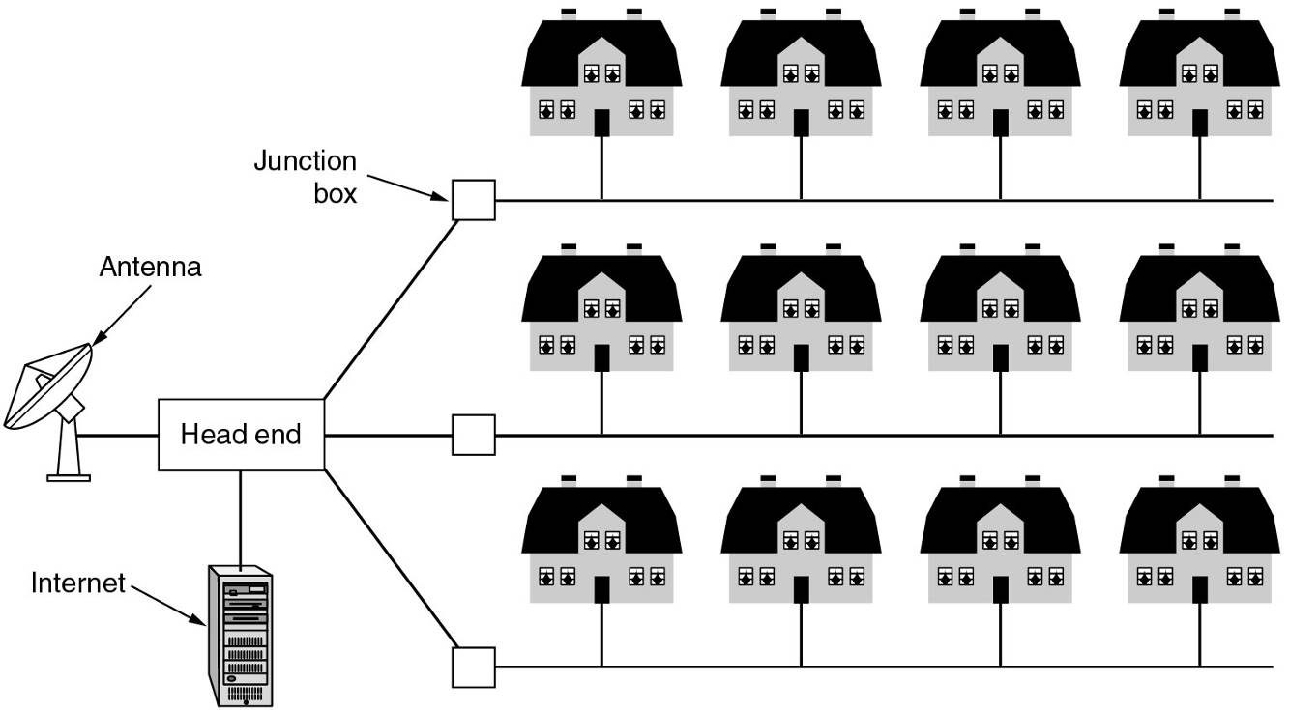
Metropolitan Area Networks
Cable TV based
Wireless MAN: IEEE 802.16 (WiMAX)
The Department of Electrical and Computer Engineering

Slide 23
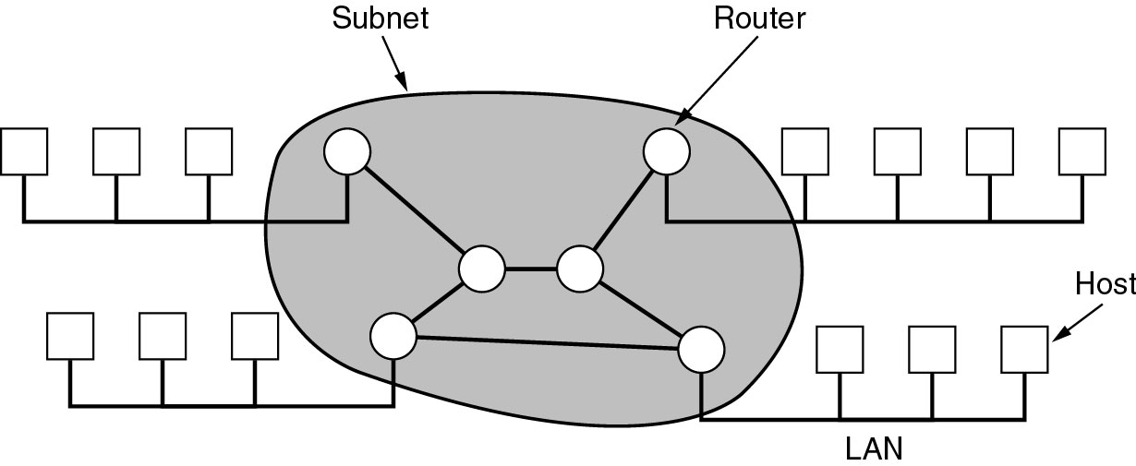
Wide Area Networks
Relation between hosts on LAN and the subnet
The Department of Electrical and Computer Engineering

Slide 24
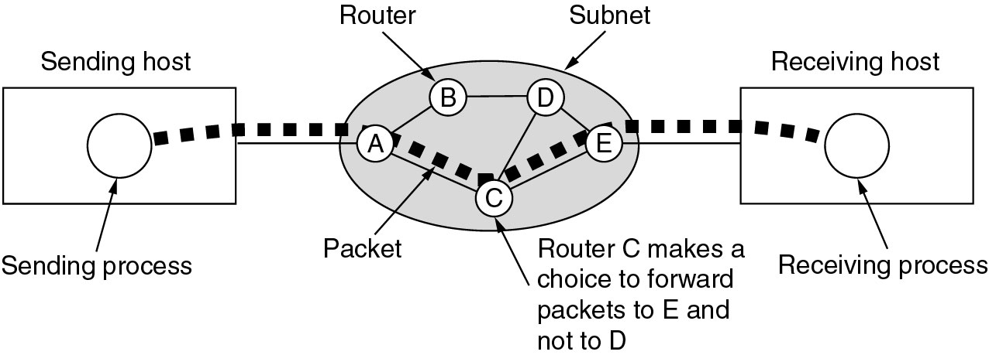
Wide Area Networks
A stream of packets from sender to receiver
Routing
The Department of Electrical and Computer Engineering

Slide 25
Home Network Categories
Computers (desktop PC, PDA, shared peripherals
Entertainment (TV, DVD, VCR, camera, stereo, MP3)
Telecomm (telephone, cell phone, intercom, fax)
Appliances (microwave, fridge, clock, furnace, airco)
Telemetry (utility meter, burglar alarm, baby cam).
The Department of Electrical and Computer Engineering

Slide 26
Software
Protocol hierarchy
Protocol
Interface
Service
Design issues
The Department of Electrical and Computer Engineering

Slide 27
Protocol Hierarchy
Purpose: reduce design complexity
  Each layer only perform a certain set of functions
  The details of internal states or algorithms will be hidden
Term
  Layer
  Protocol stack
The number of layers, the function and name of each layer differ from one network to another
The Department of Electrical and Computer Engineering

Slide 28
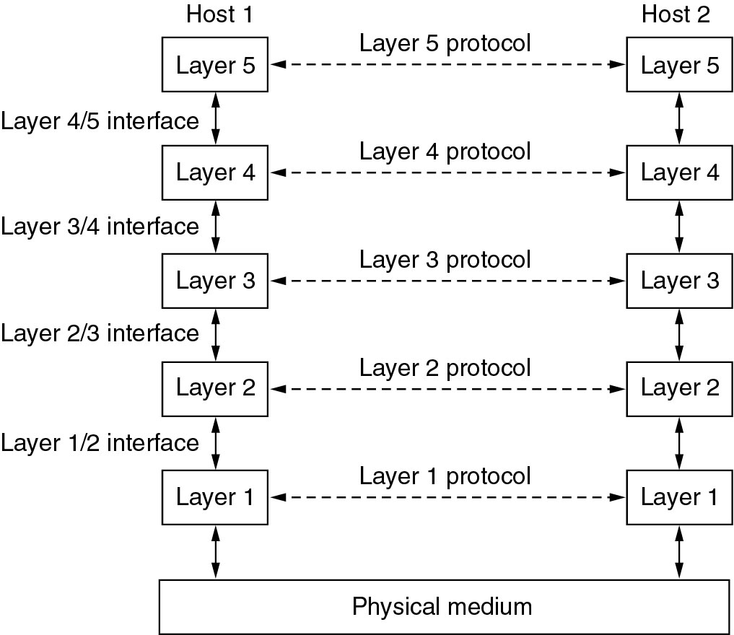
An Example Protocol Stack
The Department of Electrical and Computer Engineering

Slide 29
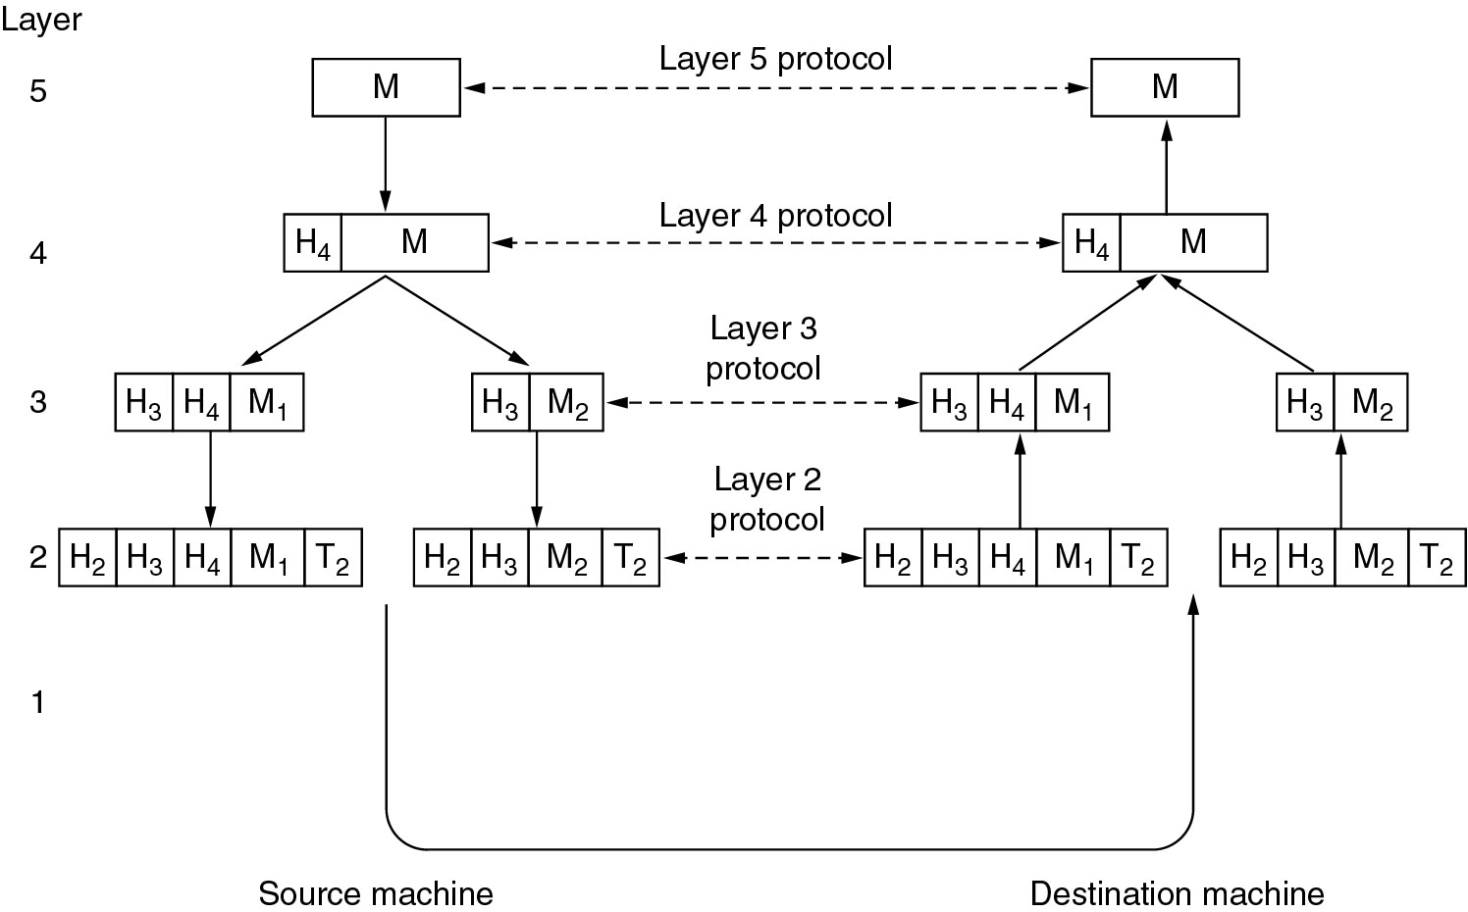
Information Flow in Layers
The Department of Electrical and Computer Engineering

Slide 30
Protocol
Protocol is an agreement between the communicating parties on how communication is to proceed
The Department of Electrical and Computer Engineering

Slide 31
Interface
Between each pair of adjacent layer, there is an interface
The Department of Electrical and Computer Engineering

Slide 32
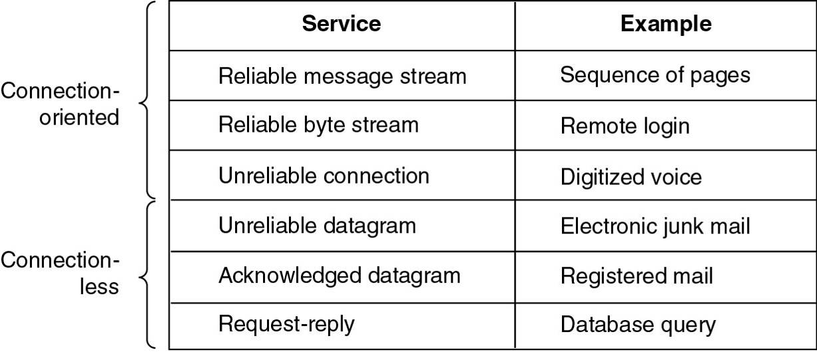
Service
Connection-oriented
  Telephone network
Connectionless
  Internet, best-effort packet forwarding
The Department of Electrical and Computer Engineering

Slide 33
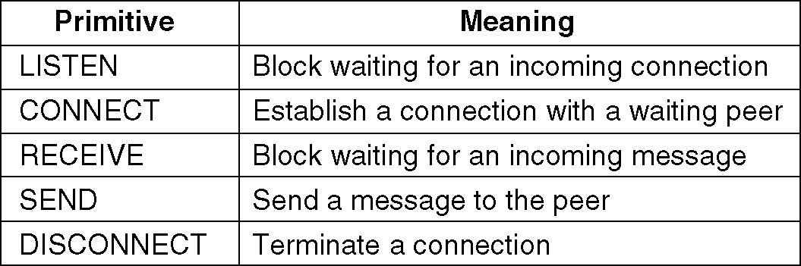
Service Primitive
Primitives are the set of services provided by the lower layer
Five service primitives for implementing a simple connection-oriented service
The Department of Electrical and Computer Engineering

Slide 34
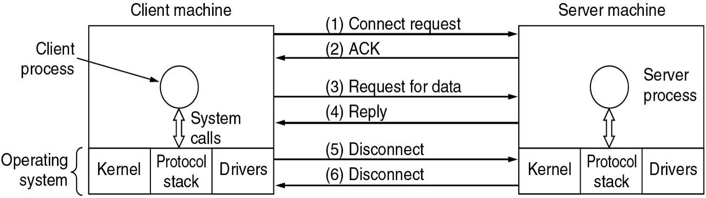
Service Primitive
The Department of Electrical and Computer Engineering

Slide 35
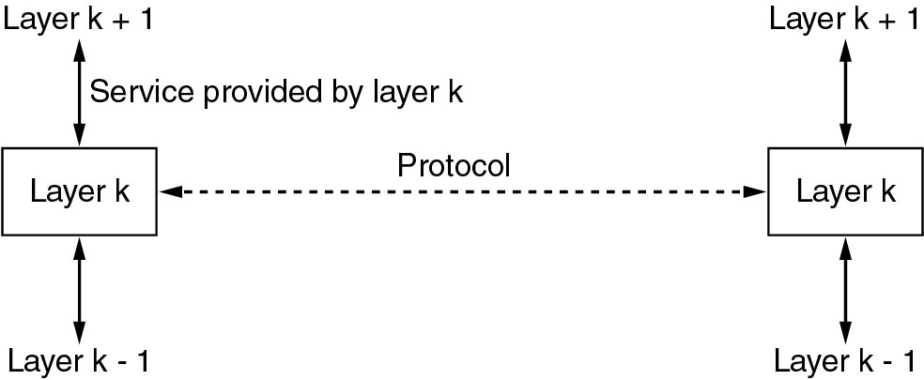
Relationship of Service and Protocol
The Department of Electrical and Computer Engineering

Slide 36
Design Issues
Error Control
Multiplexing
Addressing
Routing
Flow Control
The Department of Electrical and Computer Engineering

Slide 37
Reference Model
OSI reference model
TCP/IP reference model
Hybrid reference model
The Department of Electrical and Computer Engineering

Slide 38
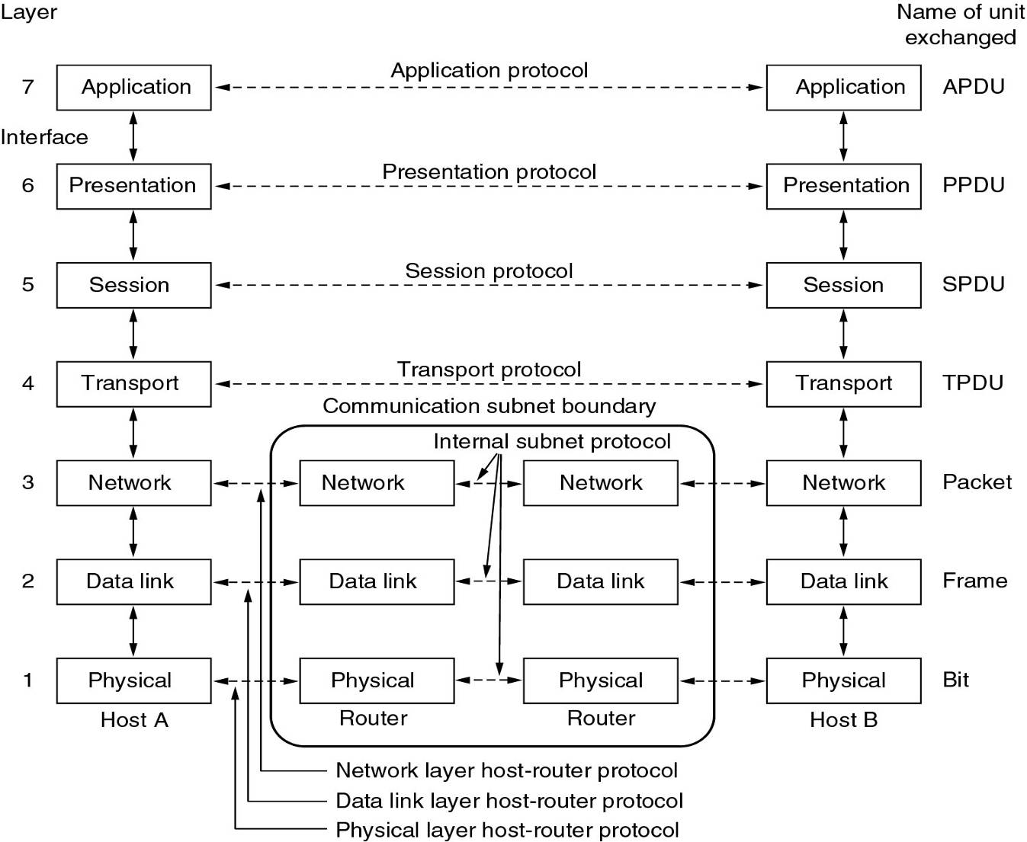
OSI Reference Model
The Department of Electrical and Computer Engineering

Slide 39
OSI Reference Model
Standard organization: ISO
OSI=Open Systems Interconnection
History
  First version 1983
  Revised 1995
7-layer protocol stack
The Department of Electrical and Computer Engineering

Slide 40
Layers
Physical: provide transmission channel
Data link: provide reliable communication (ACK)
Network: Control the operation of subnet
  Routing, congestion control, quality of service
Transport: accept upper packets, split if necessary, pass to network layer, ensure arrive correctly
Session
Presentation
Application
The Department of Electrical and Computer Engineering
Notes:
The DLL is built above the PHY, so the reliability here is for a physical link. On the other hand, for the transport layer, the reliability is for the whole route, from the source to the destination

Slide 41
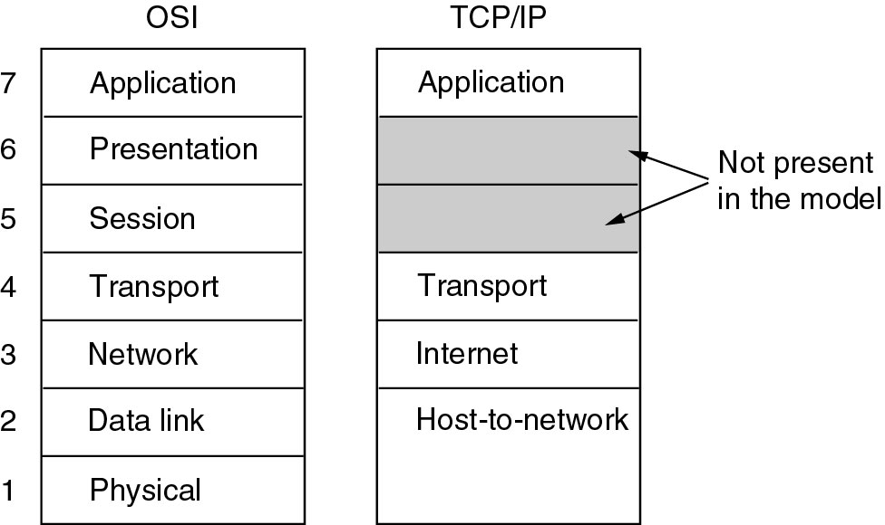
TCP/IP Reference Model
The Department of Electrical and Computer Engineering

Slide 42
TCP/IP Reference Model
Standard organization: IETF
The Department of Electrical and Computer Engineering

Slide 43
Layers
Internet
  Connectionless
  Interface: send, receive
Transport
  UDP: User datagram protocol
    Connectionless
    Unreliable, connectionless
  TCP: transmission control protocol
    Connection oriented
    Reliable, connection-oriented, with flow control
Application
  Telnet, FTP, SMTP, DNS, HTTP
The Department of Electrical and Computer Engineering

Slide 44
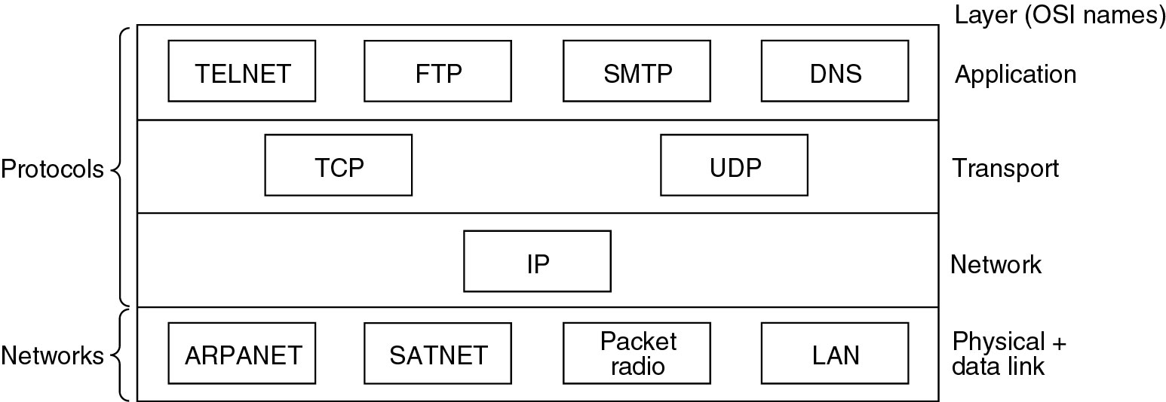
TCP/IP Reference Model
The Department of Electrical and Computer Engineering

Slide 45
Comparison
Similarity
Difference
The Department of Electrical and Computer Engineering

Slide 46
Similarity
Layer model
Functions of network and transport layer
The Department of Electrical and Computer Engineering

Slide 47
Difference
OSI
  Definition is more clear
    Protocol, service, interface
  More general
  The designer lack of the experience
    E.g.. The functionality of each layer
    Connection oriented and connectionless services in the network layer
    Only connection oriented services in the transport layer
      Not convenient to user
The Department of Electrical and Computer Engineering

Slide 48
Difference
TCP/IP
  Service, interface, and protocol not distinguished
  Not general
  Advantage: It has been widely used!
  Host-to-Network is not a real layer
    No physical and data link layer
  Only connectionless service in the network layer
  Connection oriented and connectionless service in the transport layer
    TCP
    UDP
The Department of Electrical and Computer Engineering

Slide 49
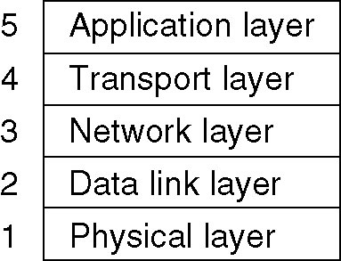
Hybrid Model
The hybrid reference model will be used in this text book
The Department of Electrical and Computer Engineering

Slide 50
Example Networks
The Internet
Connection-oriented (WAN)
  X.25
  Frame Relay
  ATM
Ethernet (LAN)
Wireless LAN: IEEE 802.11
The Department of Electrical and Computer Engineering

Slide 51
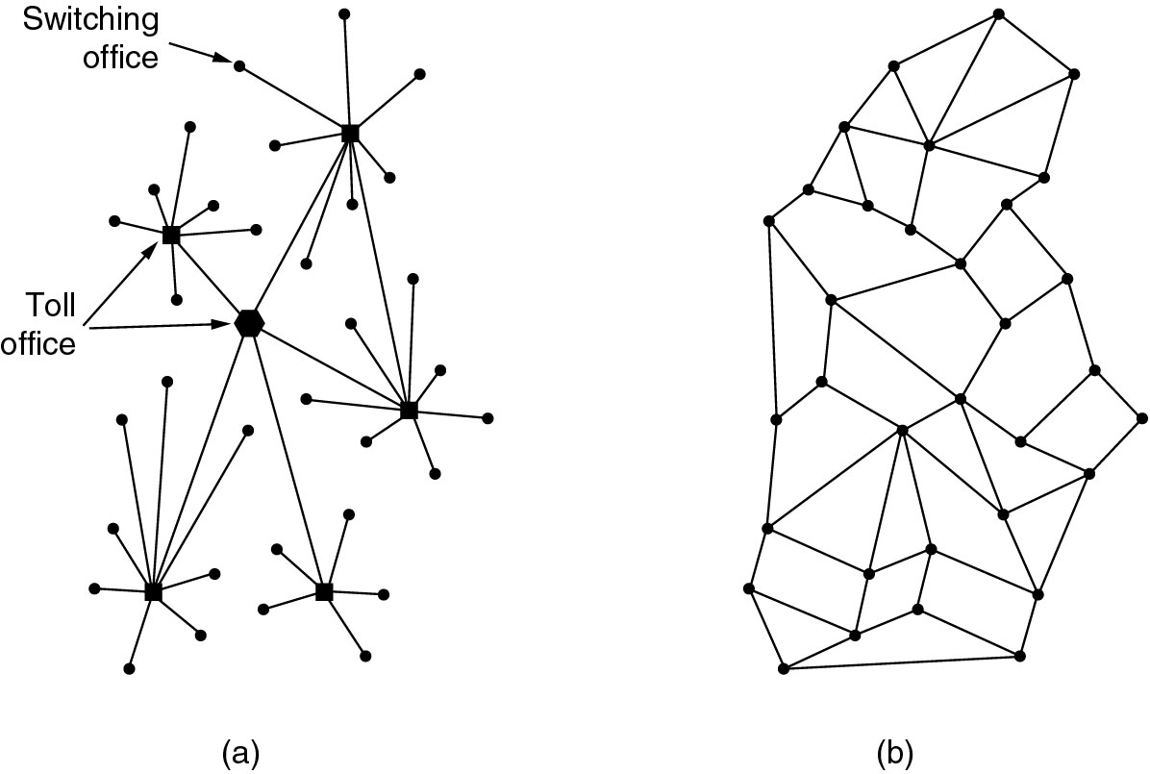
The Internet
Connect to thousands of telephone
(a) Structure of the original telephone system.
(b) Baran’s proposed distributed switching system. (60’s)
The Department of Electrical and Computer Engineering

Slide 52
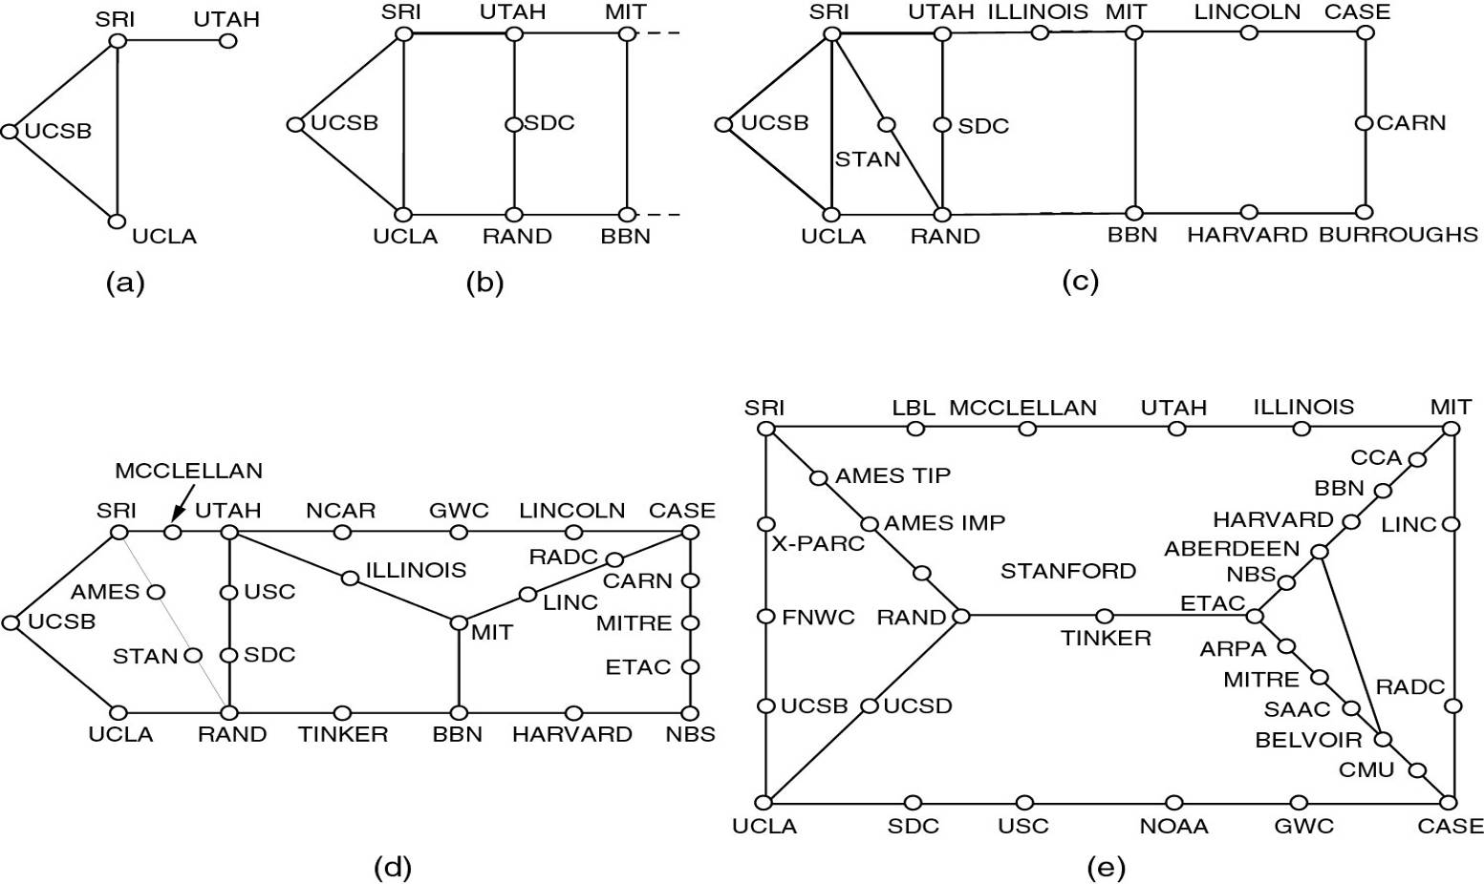
The ARPANET
Growth of the ARPANET (a) December 1969. (b) July 1970.
(c) March 1971. (d) April 1972. (e) September 1972.
The Department of Electrical and Computer Engineering

Slide 53
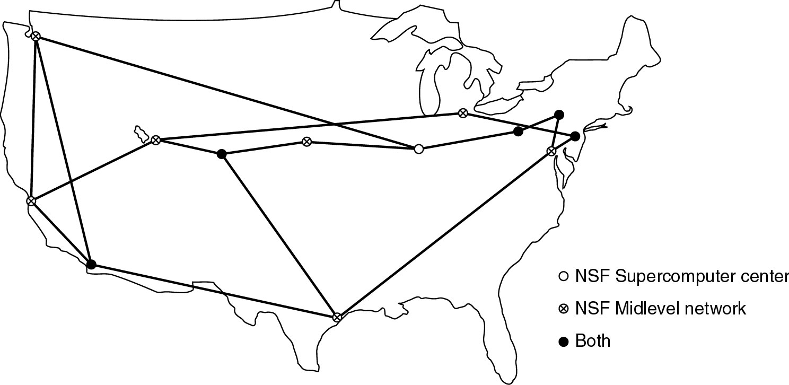
The NSFNET
The NSFNET backbone in 1988.
The Department of Electrical and Computer Engineering

Slide 54
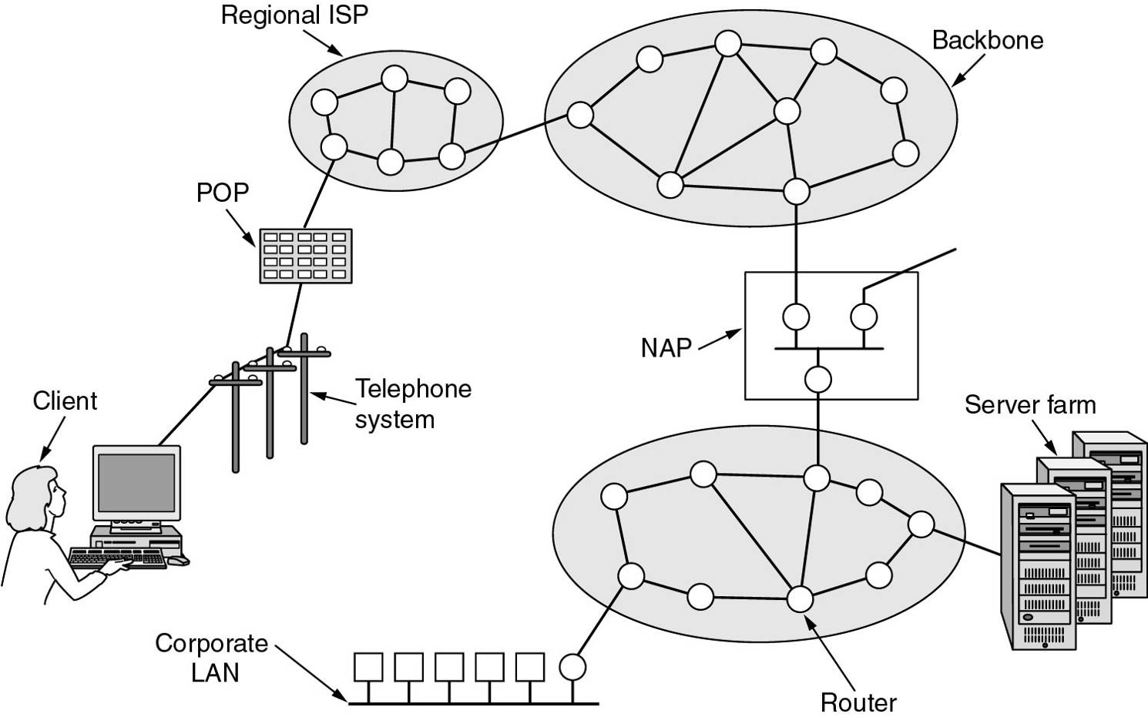
Architecture of the Internet
Internet Service Provider
Point of presence
Network Access Point
The Department of Electrical and Computer Engineering

Slide 55
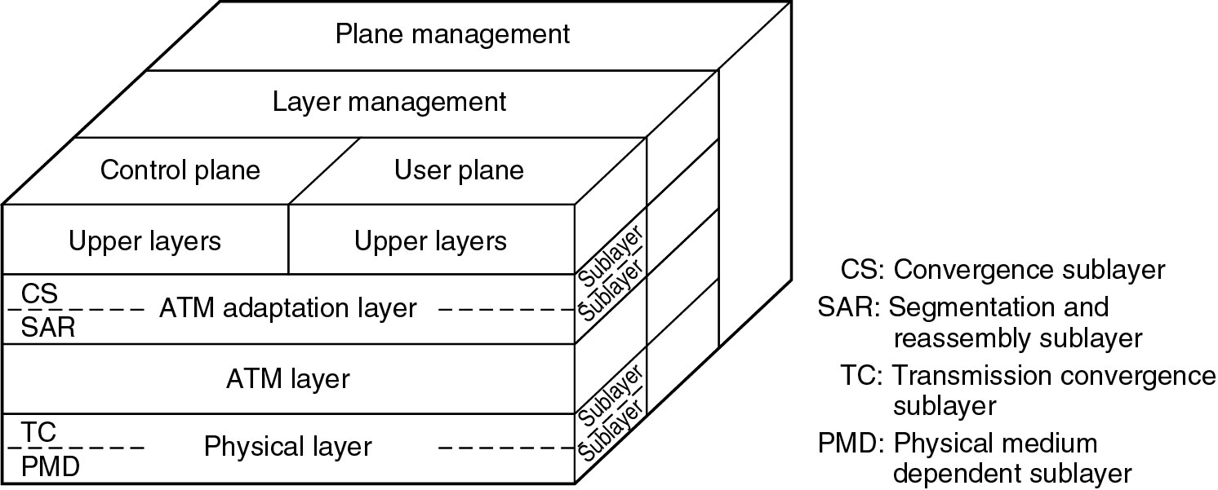
ATM
Asynchronous Transfer Mode
Reference model: 1-32 (layer and plan model)
The Department of Electrical and Computer Engineering

Slide 56
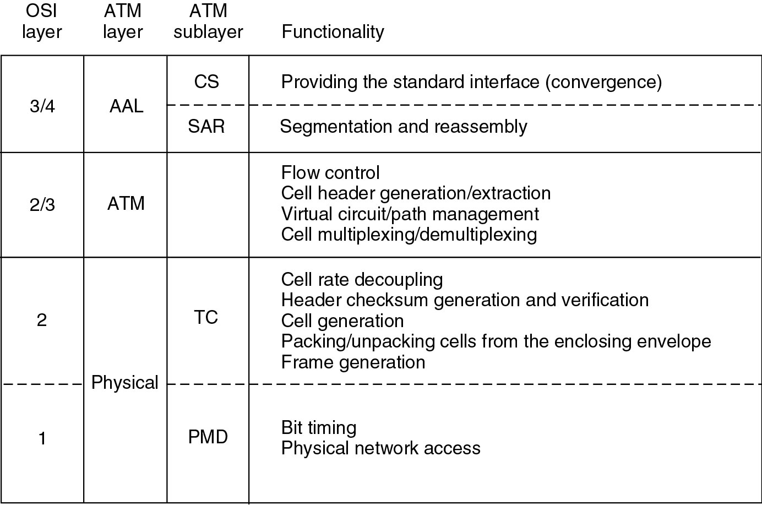
ATM Reference Model
The Department of Electrical and Computer Engineering

Slide 57
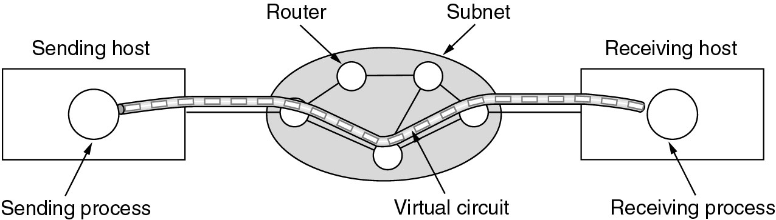
Connection in ATM
Connection oriented
  Two level Virtual circuits
    Virtual Path
    Virtual channel
The Department of Electrical and Computer Engineering

Slide 58
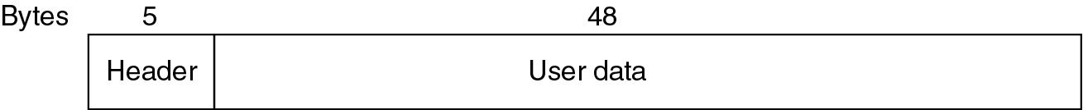
ATM
Basic transmission unit: cell
  The size of cell is fixed (5 Bytes header, 48 Bytes payload)
ATM can provide quality of service (QoS)
Many techniques are still used, but are unaware by most users
The Department of Electrical and Computer Engineering

Slide 59
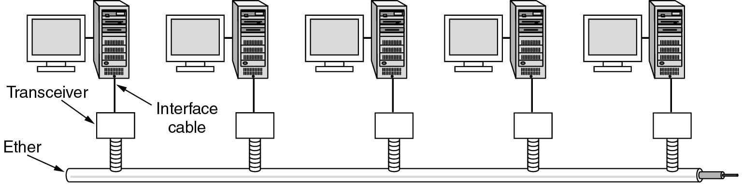
Ethernet (IEEE 802.3)
A standard for LAN
  Other standards (for political reasons)
    802.4 Token bus (by GM)
    802.5 Token ring (by IBM)
Link: Broadcast (shared medium)
Topology: Bus
The Department of Electrical and Computer Engineering

Slide 60
Ethernet
Access scheme (protocol)
  CSMA/CD
    Carrier sense multiple Access with collision detection
The Department of Electrical and Computer Engineering

Slide 61
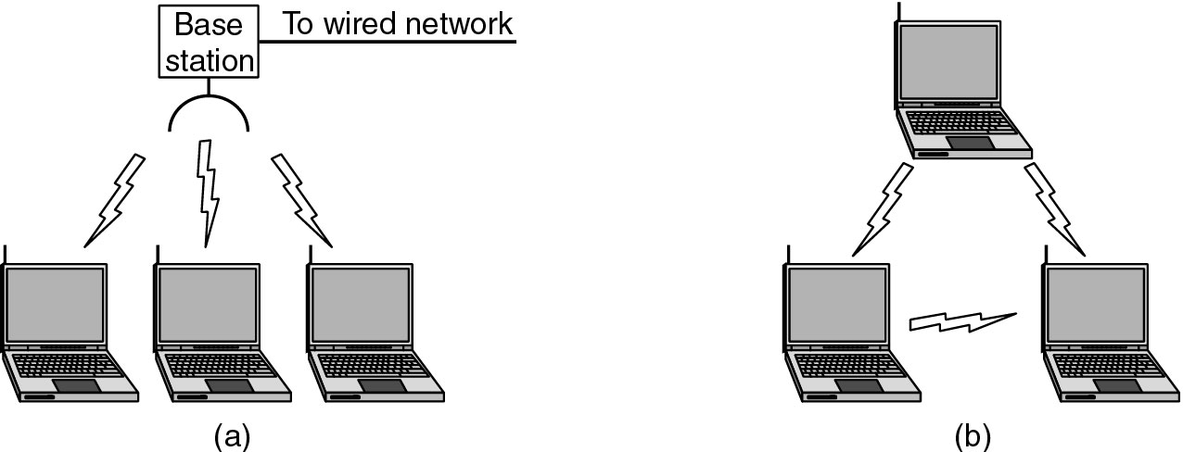
Wireless LAN
Standard: IEEE 802.11
Other name: Wi-Fi
Mode
  Infrastructure mode
    Base station (access point)
    All communication must pass the AP
  Ad hoc mode
Protocol: CSMA/CA
The Department of Electrical and Computer Engineering

Slide 62
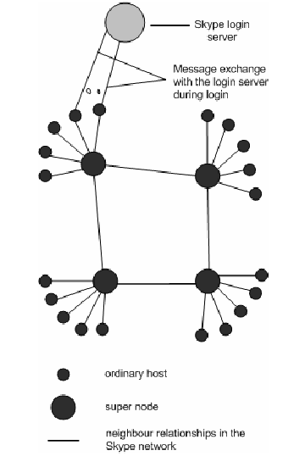
Skype Network (1)
Peer-to-peer model
Free
Better quality than MSN messenger and Yahoo messenger, which utilize the classic client-server model
The Department of Electrical and Computer Engineering

Slide 63
Skype Network (2)
Component
  Link
    Skype network is an overlay network
      Over the Internet
  Node
    Login server: Authentication
    Super node: store (update, propagate) user information
    Ordinary host
      Connect to a super node
      Each node store a set of reachable super nodes
Each client has a unique ID
  Address
  Routing
The Department of Electrical and Computer Engineering

Slide 64
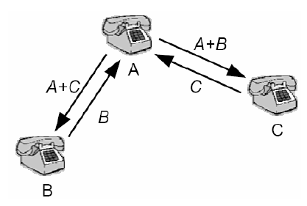
Skype Network (3)
Services
  Voice call
  Send text message
  Conference
  Interesting observation: user can login at multiple locations at the same time
The Department of Electrical and Computer Engineering

Slide 65
Skype Network (4)
Protocol stack
How can Skype pass firewall
  Use port 80, which is the port for HTTP
  Firewalls normally do not block HTTP requests!
Skype
Skype
TCP and UDP
TCP and UDP
IP
IP
The Department of Electrical and Computer Engineering

Slide 66
Network Standardization
Telecommunication world
International standard world
Internet standard world
The Department of Electrical and Computer Engineering

Slide 67
Telecommunication World
ITU: international telecommunication union
Sectors
  ITU-R: Radio communications
  ITU-T: Telecommunications Standardization
    Original name CCITT (before 1993)
  ITU-D: Development
Classes of members
  National governments
  Sector members
  Associate members
  Regulatory agencies
The Department of Electrical and Computer Engineering

Slide 68
International Standard World
ISO: international standards organization
  ANSI: US representative in ISO
    American national standards institute
IEEE: Institute of Electrical and Electronics Engineers
The Department of Electrical and Computer Engineering

Slide 69
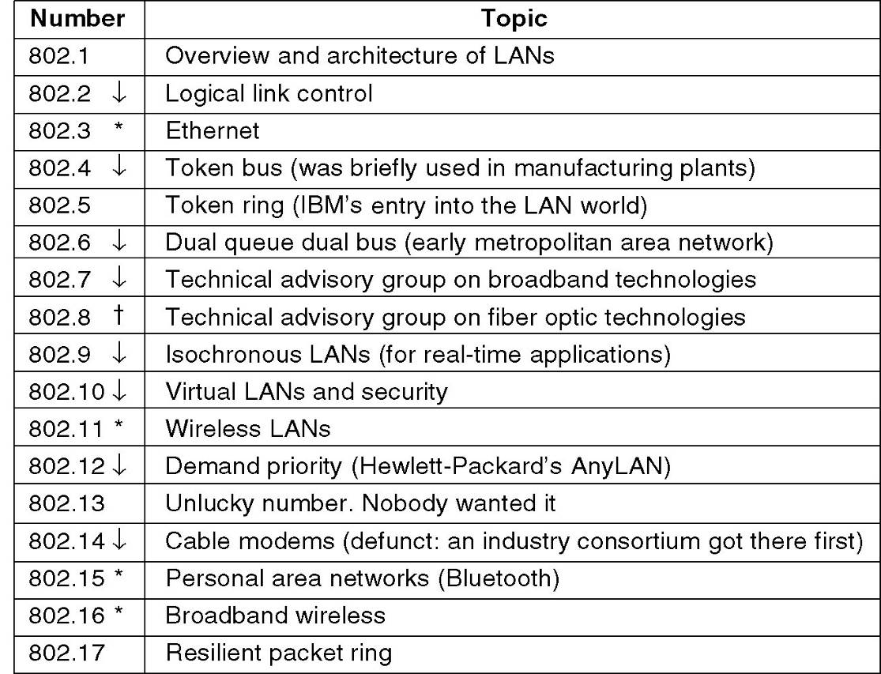
IEEE 802 Standards
The 802 working groups. The important ones are marked with *. The ones marked with ↓ are hibernating. The one marked with † gave up.
The Department of Electrical and Computer Engineering

Slide 70
Internet standard world
IETF: Internet Engineering task force
  RFC: request for comments
The Department of Electrical and Computer Engineering

Slide 71
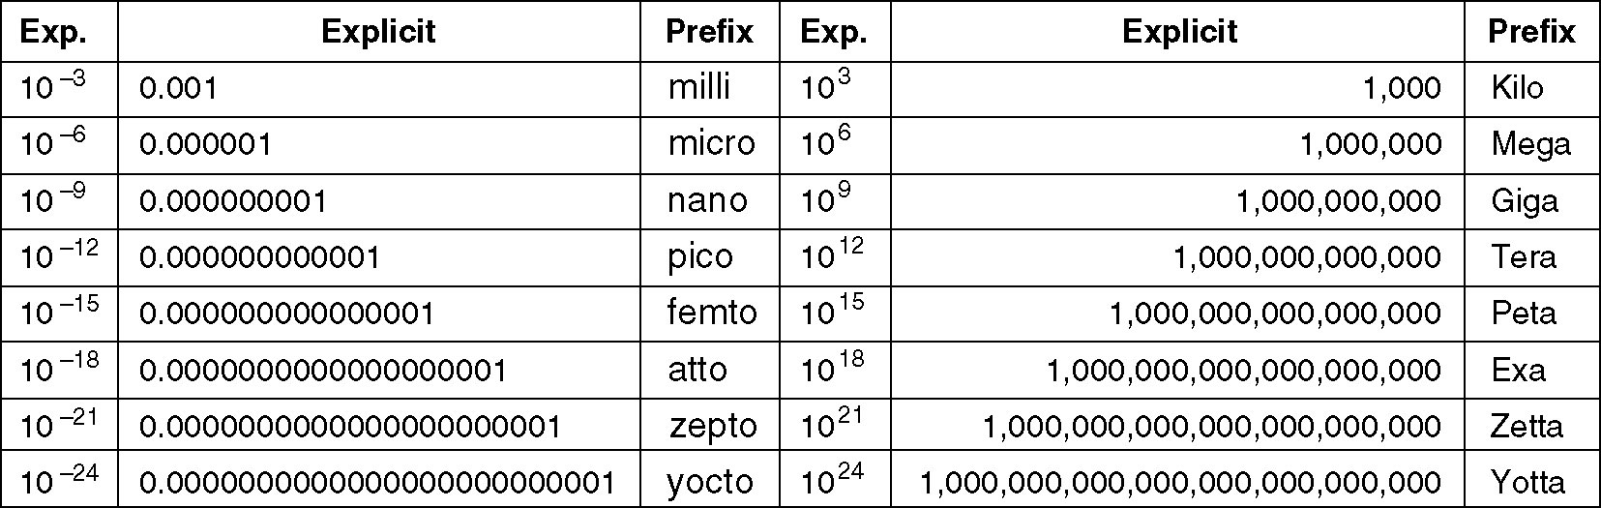
Metric Units
The Department of Electrical and Computer Engineering

Slide 72
Characteristics of Computer Networks – A Short Summary
Size
Connectivity
Reliability
Efficiency
Security
…
The Department of Electrical and Computer Engineering

Slide 73
Size
Personal area network
Local area network
Metropolitan area network
Wide area network
The Department of Electrical and Computer Engineering

Slide 74
Connectivity
Link
  Wire, wireless
  Direct links
    Point-to-point
    Broadcast medium
  Indirect links
    Telephone network
    Internet
    Addressing, routing
Node
  Switch, router, workstations
The Department of Electrical and Computer Engineering

Slide 75
Reliability
Bit errors may occur
  Error detection
  Error correction
Node failure
Link failure
  Routing
  Restoration
Packet-switched networks
  Dropped, Delay, Out-of-order, Duplicate
  Packet retransmission
  Packet sequence number
The Department of Electrical and Computer Engineering

Slide 76
Efficiency
Resource sharing
Multiplexing
The Department of Electrical and Computer Engineering

Slide 77
Security
Prevent eavesdropping
Verify sender
Against denial-of-service
The Department of Electrical and Computer Engineering

