Slide 1
ICOM 5016 – Introduction to
Database Systems
Lecture 5 – Joins
Dr. Manuel Rodriguez Martinez
Department of Electrical and Computer Engineering
University of Puerto Rico, Mayagüez
Slides are adapted from:

Slide 2
Joined Relations
Join operations take two relations and return as a result another relation.
A join operation is a Cartesian product which requires that tuples in the two relations match (under some condition). It also specifies the attributes that are present in the result of the join
The join operations are typically used as subquery expressions in the from clause

Slide 3
Natural-Join Operation
Notation: r s
Let r and s be relations on schemas R and S respectively.
Then, r s is a relation on schema R ∪ S obtained as follows:
  Consider each pair of tuples t_{r} from r and t_{s} from s.
  If t_{r} and t_{s} have the same value on each of the attributes in R ∩ S, add a tuple t to the result, where
    t has the same value as t_{r} on r
    t has the same value as t_{s} on s
Example:
  R = (A, B, C, D)
  S = (E, B, D)
  Result schema = (A, B, C, D, E)
  r s is defined as:
  ∏_{r.A, r.B, r.C, r.D, s.E} (σ_{r.B = s.B ∧ r.D = s.D} (r x s))

Slide 4

Natural Join Example
Relations r, s:
r s

Slide 5
Natural Join and Theta Join
Find the names of all instructors in the Comp. Sci. department together with the course titles of all the courses that the instructors teach
  ∏ _{name, title} (σ _{dept_name=“Comp. Sci.”} (instructor teaches course))
Natural join is associative
  (instructor teaches) course is equivalent to
  instructor (teaches course)
Natural join is commutative
  instruct teaches is equivalent to
  teaches instructor
The theta join operation r _{θ} s is defined as
  r _{θ} s = σ_{θ} (r x s)

Slide 6
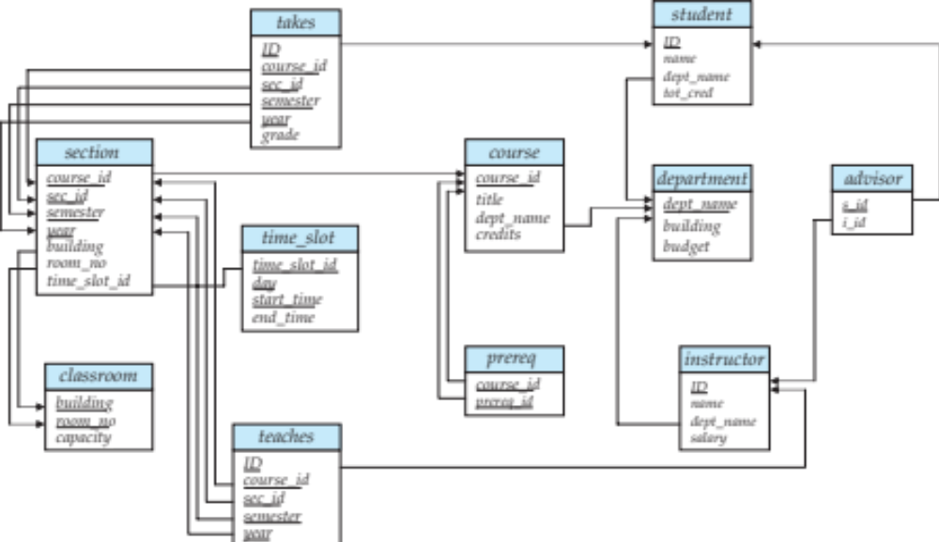
Joins in SQL
For all instructors who have taught some course, find their names and the course ID of the courses they taught.
select name, course_id
from instructor, teaches
where instructor.ID = teaches.ID
Find the course ID, semester, year and title of each course offered by the Comp. Sci. department
select section.course_id, semester, year, title
from section, course
where section.course_id = course.course_id and
dept_name = ‘Comp. Sci.'

Slide 7

Natural Join
Natural join matches tuples with the same values for all common attributes, and retains only one copy of each common column
select *
from instructor natural join teaches;

Slide 8
Natural Join Example
List the names of instructors along with the course ID of the courses that they taught.
  select name, course_id
  from instructor, teaches
  where instructor.ID = teaches.ID;
  select name, course_id
  from instructor natural join teaches;

Slide 9
Natural Join (Cont.)
Danger in natural join: beware of unrelated attributes with same name which get equated incorrectly
List the names of instructors along with the the titles of courses that they teach
  Incorrect version (makes course.dept_name = instructor.dept_name)
    select name, title
    from instructor natural join teaches natural join course;
  Correct version
    select name, title
    from instructor natural join teaches, course
    where teaches.course_id = course.course_id;
  Another correct version
    select name, title
    from (instructor natural join teaches)
    join course using(course_id);

Slide 10
Outer Join
An extension of the join operation that avoids loss of information.
Computes the join and then adds tuples form one relation that does not match tuples in the other relation to the result of the join.
Uses null values:
  null signifies that the value is unknown or does not exist
  All comparisons involving null are (roughly speaking) false by definition.
    We shall study precise meaning of comparisons with nulls later

Slide 11
Outer Join – Example
Relation instructor1
ID
name
dept_name
10101
12121
15151
Srinivasan
Wu
Mozart
Comp. Sci.
Finance
Music
Relation teaches1
ID
course_id
10101
12121
76766
CS-101
FIN-201
BIO-101

Slide 12
Outer Join – Example
Join
instructor teaches
ID
name
dept_name
course_id
10101
12121
Srinivasan
Wu
Comp. Sci.
Finance
CS-101
FIN-201
Left Outer Join
instructor teaches
ID
name
dept_name
course_id
10101
12121
15151
Srinivasan
Wu
Mozart
Comp. Sci.
Finance
Music
CS-101
FIN-201
null

Slide 13
Outer Join – Example
Right Outer Join
instructor teaches
ID
name
dept_name
course_id
10101
12121
76766
Srinivasan
Wu
null
Comp. Sci.
Finance
null
CS-101
FIN-201
BIO-101
Full Outer Join
instructor teaches
ID
name
dept_name
course_id
10101
12121
15151
76766
Srinivasan
Wu
Mozart
null
Comp. Sci.
Finance
Music
null
CS-101
FIN-201
null
BIO-101

Slide 14


Join operations – Example
Relation course
Relation prereq
Observe that
prereq information is missing for CS-315 and
course information is missing for CS-437

Slide 15
Outer Join
An extension of the join operation that avoids loss of information.
Computes the join and then adds tuples form one relation that does not match tuples in the other relation to the result of the join.
Uses null values.

Slide 16

Left Outer Join
  course natural left outer join prereq

Slide 17

Right Outer Join
course natural right outer join prereq

Slide 18

Joined Relations
Join operations take two relations and return as a result another relation.
These additional operations are typically used as subquery expressions in the from clause
Join condition – defines which tuples in the two relations match, and what attributes are present in the result of the join.
Join type – defines how tuples in each relation that do not match any tuple in the other relation (based on the join condition) are treated.

Slide 19

Full Outer Join
course natural full outer join prereq

Slide 20


Joined Relations – Examples
course inner join prereq on
course.course_id = prereq.course_id
What is the difference between the above, and a natural join?
course left outer join prereq on
course.course_id = prereq.course_id

Slide 21
Joined Relations – Examples
course natural right outer join prereq
course full outer join prereq using (course_id)

Slide 22

Questions?

