Slide 1
Database Systems
Manuel Rodriguez-Martinez, Ph.D.
Relational Algebra & SQL
(Selections & Projections)

Slide 2
Objectives
Introduction to relational algebra
Introduction to its implementation in the SQL language
Selections
Projections

Slide 3
Introduction
Relational model provides the way to model data for an enterprise
A collection of relation instances with their appropriate schemas
The tuples are the records, the data of the enterprise.
Questions that must be raised:
How do I access (“query”) the data?
How about modifying, adding, or erasing data?
Relational model provides:
Relational algebra – procedural method to access the tuples
Relational calculus - non-procedural (declarative) method

Slide 4
Relational Algebra
Provides a series of operations to access the data in one or more tables
These operations are mathematically based on set theory
Every operation has one or more tables as input
Produces one table as output
Closure property of relational algebra
Programmatically, relational algebra was implemented at IBM San Jose in the SEQUEL language
Donald D. Chamberlin and Raymond F. Boyce in the early 70’s
This was part of the IBM System R relational prototype project

Slide 5
SQL as a standard
Oracle and other commercial vendors adopt Sequel
Eventually renamed as Structured Query Language (SQL)
Standards: ANSI and ISO:
SQL-86
SQL-89
SQL-92 – this is the one that most systems follows
SQL-99
SQL-2003
SQL-2008
Vendors also add their own extensions

Slide 6
Data Definition Language (DDL)
Data Definition Language (DDL) provides the instructions to create the schema of table
Table Name
Attribute names
Domains
Keys
Primary, secondary and foreing keys
Storage organization
Constrains on the table
Indexing

Slide 7
Create Table
Create table is the instruction to create a table in the database
Format:
create table (column1 type1, column2 type2, …, columnN typeN)
Example (using PostgreSQL)
create table person(id integer, first_name char(10), last_name char(10))
Note: SQL is case insensitive
Add data with the following command (to be explained later)
Insert into person(<id>, <first_name>, <last_name>

Slide 8
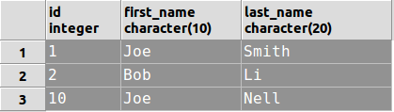
Create table
Result
insert into person values (1, 'Joe', 'Smith');
insert into person values (2, 'Bob', 'Li');
insert into person values (10, 'Joe', 'Nell');

Slide 9
Problem: No primary key
Most database systems work best with a primary key
Better way to define the table Person
create table person
(id serial primary key, first_name char(10), last_name char(20))
Serial – an auto increment integer
MySQL calls them auto increment (id integer auto_increment)
Primary key – keyword that indicates that the preceding column is the primary key of the table

Slide 10
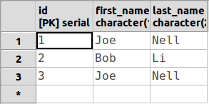
Improved version
With a serial value, you do not need to specify the id column
The system will automatically add those values
Now, use this format for the adding data:
insert into person(first_name, last_name) values ('Joe', 'Nell');
insert into person(first_name, last_name) values ('Bob', 'Li');
insert into person(first_name, last_name) values ('Joe', 'Nell');
Person

Slide 11
More tables
create table Employee(id serial primary key,
first_name varchar(10), last_name varchar(20), age integer,
phone char(10), gender char(1), service_years integer,
salary integer);
You can add has many tables as needed
NOTE: It is not a bad design to have a DB with dozens or hundreds of tables
Most real life systems are like that

Slide 12
Data Types
char(n). Fixed length character string, with user-specified length n.
varchar(n). Variable length character strings, with user-specified maximum length n.
integer - Integer (a finite subset of the integers that is machine-dependent).
smallint. Small integer (a machine-dependent subset of the integer domain type).
numeric(p,d). Fixed point number, with user-specified precision of p digits, with n digits to the right of decimal point.
real, double precision. Floating point and double-precision floating point numbers, with machine-dependent precision.
serial, bigserial. Auto increment integer and long

Slide 13
Data Manipulation Language (DML)
Provides the instructions to manipulate the data in the tables
Commands let you
Create new rows in tables
Read rows from tables
Update rows in tables
Delete data from tables
Called CRUD operations
They implement the Relational Algebra Operators
CRUD

Slide 14
Relational Algebra
Language to specify how to manage data
Procedural and base on set theory
Six basic operators
selection: σ
projection: ∏
union: ∪
set difference: –
Cartesian product: x
rename: ρ
For all operators:
Input: one or more tables
Output: one table
Every other operator can be derived from these ones

Slide 15



Projection Operation
Purpose: pick only a subset of the columns from the original table:
Given a table R = (A1, A2, ...,An) we can pick a subset of columns
Notation: We use the symbol
Read: projection of C₁, C₂, …, C_{k} over R

Slide 16

Projection Intuition
Projection: Preserves only a few columns and removes all others
Employee
ID | Name | Last Name | Salary
1234 | Joe | Diaz | $96,000
4833 | Ned | Li | $48,000
9348 | Ron | Peter | $67,000
2342 | Jil | Li | $57,094
4565 | Ken | Ortiz | $20,333
7876 | Pol | Paul | $90,000
4567 | Apu | Perez | $65,000
2233 | Ann | Kim | $100,000
2344 | Lu | Katz | $47,000
ID
1234
4833
9348
2342
4565
7876
4567
2233
2344

Slide 17

Another Example
Employee
ID | Name | Last Name | Salary
1234 | Joe | Diaz | $96,000
4833 | Ned | Li | $48,000
9348 | Ron | Peter | $67,000
2342 | Jil | Li | $57,094
4565 | Ken | Ortiz | $20,333
7876 | Pol | Paul | $90,000
4567 | Apu | Perez | $65,000
2233 | Ann | Kim | $100,000
2344 | Lu | Katz | $47,000
ID | Salary
1234 | $96,000
4833 | $48,000
9348 | $67,000
2342 | $57,094
4565 | $20,333
7876 | $90,000
4567 | $65,000
2233 | $100,000
2344 | $47,000

Slide 18
Projection and Duplicates
Consider the following table
Person
ID | Name | Last Name
1234 | Joe | Diaz
4833 | Ned | Li
9348 | Ann | Kim
2342 | Jil | Li
4565 | Ken | Ortiz
4567 | Apu | Perez
2233 | Ann | Kim
2344 | Joe | Diaz
Name | Last Name
Joe | Diaz
Ned | Li
Ann | Kim
Jil | Li
Ken | Ortiz
Apu | Perez
Ann | Kim
Joe | Diaz
Duplicates

Slide 19
Projection and Duplicates (2)
Relation is a set, so duplicates must be removed
Consider the following table
Person
ID | Name | Last Name
1234 | Joe | Diaz
4833 | Ned | Li
9348 | Ann | Kim
2342 | Jil | Li
4565 | Ken | Ortiz
4567 | Apu | Perez
2233 | Ann | Kim
2344 | Joe | Diaz
Name | Last Name
Joe | Diaz
Ned | Li
Ann | Kim
Jil | Li
Ken | Ortiz
Apu | Perez
No Duplicates

Slide 20
Projection in SQL
The instruction for a project operation is a select
Form:
Select C₁, C₂, …, C_{n}
From R
Select clause specifies the columns to take
From clause specifies the table to use
Note: Select * brings every column in the table

Slide 21
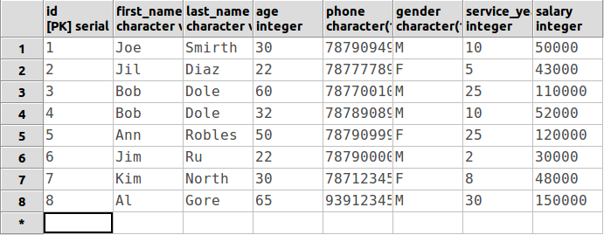
Example: Employees

Slide 22
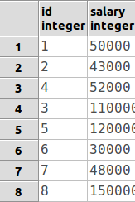
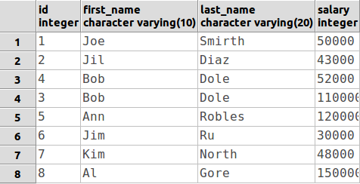
Examples: Employees
select id, salary
from employee
select id, first_name, last_name, salary
from employee

Slide 23
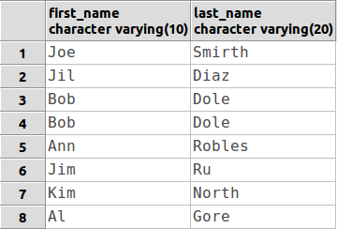
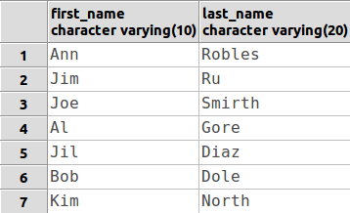
How about duplicates?
By default, SQL won’t remove duplicates
Computational expensive
Must force with distinct keyworkd
select first_name, last_name
from employee
select distinct first_name, last_name
from employee
Duplicates!

Slide 24


Selection Operation
Purpose: pick only those records that satisfy a Boolean condition
Intuition: Get tuples that return T when a predicate p is evaluated on them
Given a table R=(A₁, A₂, …, A_{n}) and a predicate p s.t.
Pick:

Slide 25

Selection Operation (2)
Notation: we used the symbol to denote selection
Read as “selection of R over p”
P is some concrete predicate.

Slide 26

Selection Example:
Employee
ID | Name | Last Name | Salary
1234 | Joe | Diaz | $96,000
4833 | Ned | Li | $48,000
9348 | Ron | Peter | $67,000
2342 | Jil | Li | $57,094
4565 | Ken | Ortiz | $20,333
7876 | Pol | Paul | $90,000
4567 | Apu | Perez | $65,000
2233 | Ann | Kim | $100,000
2344 | Lu | Katz | $47,000
ID | Name | Last Name | Salary
1234 | Joe | Diaz | $96,000
7876 | Pol | Paul | $90,000
2233 | Ann | Kim | $100,000
Predicate p:
Meaning: Get all the information about employees with a salary of at least $90000

Slide 27
Logical Connectors
Use connectors to form complex expressions
ID | Name | Last Name | Salary | city
1234 | Joe | Diaz | $96,000 | NY
4833 | Ned | Li | $48,000 | SJ
9348 | Ron | Peter | $67,000 | NY
2342 | Jil | Li | $57,094 | NY
4565 | Ken | Ortiz | $20,333 | CR
7876 | Pol | Paul | $90,000 | SF
4567 | Apu | Perez | $65,000 | SJ
2233 | Ann | Kim | $100,000 | LA
2344 | Lu | Katz | $47,000 | SJ
OR
AND
NOT

Slide 28
Logical Connectors (2)
Query: Get all the information about employees from NY who make at least $60000
ID | Name | Last Name | Salary | city
1234 | Joe | Diaz | $96,000 | NY
9348 | Ron | Peter | $67,000 | NY

Slide 29
Practice
Get all the information about employees from either NY or SJ.
Get all the information about employees that either come from SF or make at least $50,000.
Find all information about employee not living in SF.

Slide 30


Selection in SQL
The instruction for selection operation is a where clause
Form:
Select C1, C2, …, Cn
From R
Where p
P can be
A simple logical predicate using the operators
A complex expression formed by connecting simple predicated with the logical operators AND, OR, NOT
Note: On some systems not equal can be either one of:

Slide 31
Example of selection
Employee
ID | Name | Last Name | Salary
1234 | Joe | Diaz | $96,000
4833 | Ned | Li | $48,000
9348 | Ron | Peter | $67,000
2342 | Jil | Li | $57,094
4565 | Ken | Ortiz | $20,333
7876 | Pol | Paul | $90,000
4567 | Apu | Perez | $65,000
2233 | Ann | Kim | $100,000
2344 | Lu | Katz | $47,000
Select *
From Employee
Where salary >= 90000
ID | Name | Last Name | Salary
1234 | Joe | Diaz | $96,000
7876 | Pol | Paul | $90,000
2233 | Ann | Kim | $100,000

Slide 32
Example with logical connectors
Get all the information about employees from NY who make at least $60000
Employee
ID | Name | Last Name | Salary | city
1234 | Joe | Diaz | $96,000 | NY
4833 | Ned | Li | $48,000 | SJ
9348 | Ron | Peter | $67,000 | NY
2342 | Jil | Li | $57,094 | NY
4565 | Ken | Ortiz | $20,333 | CR
7876 | Pol | Paul | $90,000 | SF
4567 | Apu | Perez | $65,000 | SJ
2233 | Ann | Kim | $100,000 | LA
2344 | Lu | Katz | $47,000 | SJ
Select *
From Employee
Where salary >= 60000
And city = ‘NY’
ID | Name | Last Name | Salary | city
1234 | Joe | Diaz | $96,000 | NY
9348 | Ron | Peter | $67,000 | NY

Slide 33
Practice
Get all the information about employees from either NY or SJ.
Get all the information about employees that either come from SF or make at least $50,000.
Find all information about employee not living in SF.

Slide 34
Questions ?
Email:
manuel.rodriguez7@upr.edu

