Slide 1
ICOM 5016 – Introduction to
Database Systems
Lecture 2 – Sets and Relations
Dr. Manuel Rodriguez Martinez
Department of Electrical and Computer Engineering
University of Puerto Rico, Mayagüez
Slides are adapted from:

Slide 2
Objectives
Introduce Set Theory
Review of Set concepts
  Cardinality
  Set notation
  Empty set
  Subset
Set Operations
  Union
  Intersection
  Difference
Complex Sets
  Power Sets
  Partitions
Relations
  Cartesian products
  Binary relations
  N-ary relations

Slide 3
Part I: Definitions

Slide 4
On Sets and Relations
A set S is a collection of objects, where there are no duplicates
  Examples
    A = {a, b, c}
    B = {0, 2, 4, 6, 8}
    C = {Jose, Pedro, Ana, Luis}
The objects that are part of a set S are called the elements of the set.
  Notation:
    0 is an element of set B is written as 0 ∈ B.
    3 is not an element of set B is written as 3 ∉ B.

Slide 5
Cardinality of Sets
Sets might have
  0 elements – called the empty set ∅.
  1 elements – called a singleton
  N elements – a set of N elements (called a finite set)
    Ex: S = {car, plane, bike}
  ∞ elements – an infinite number of elements (called infinite set)
    Integers, Real,
    Even numbers: E = {0, 2, 4, 6, 8, 10, …}
      Dot notation means infinite number of elements

Slide 6
Cardinality of Sets (cont.)
The cardinality of a set is its number of elements
  Notation: cardinality of S is denoted by |S|
  Could be:
    an integer number
    infinity symbol ∞.
Countable Set - a set whose cardinality is:
  Finite
  Infinite but as big as the set of natural numbers (one-to-one correspondence)
Uncountable set – a set whose cardinality is larger than that of natural numbers. Ex: R - real numbers

Slide 7
Cardinality of Sets (cont.)
Some examples:
  A = {a,b,c}, |A| = 3
  N = {0,1,2,3,4,5,…}
    |N| = ∞
  R – set of real numbers
    |R| = ∞
  E = {0, 2, 3, 4, 6, 8, 10, …}
    |E| = ∞
  ∅ the empty set
    | ∅ | = 0

Slide 8
Set notations and equality of Sets
Enumeration of elements of set S
  A = {a,b c}
  E = {0, 2, 4, 6, 8, 10, …}
Enumeration of the properties of the elements in S
  E = {x : x is an even integer}
  E = {x: x ∈ I and x%2=0, where I is the integers.}
Two sets are said to be equal if and if only they both have the same elements
  A = {a, b, c}, B = {a, b, c}, then A = B
  if C = {a, b, c, d}, then A ≠C
    Because d ∉ A

Slide 9
Sets and Subsets
Let A and B be two sets. B is said to be a subset of A if and only if every member x of B is also a member of A
  Notation: B ⊆ A
  Examples:
    A = {1, 2, 3, 4, 5, 6}, B = {1, 2}, then B ⊆ A
    D = {a, e, i, o, u}, F = {a, e, i, o, u}, then F ⊆ D
  If B is a subset of A, and B ≠A, then we call B a proper subset
    Notation: B ⊂ A
    A = {1, 2, 3, 4, 5, 6}, B = {1, 2}, then B ⊂ A
  The empty set ∅ is a subset of every set, including itself
    ∅ ⊆ A, for every set A
  If B is not a subset of A, then we write B ⊄ A

Slide 10
Part II: Set Operations

Slide 11
Set Union
Let A and B be two sets. Then, the union of A and B, denoted by A ∪ B is the set of all elements x such that either x ∈ A or x ∈ B.
  A ∪ B = {x: x ∈A or x ∈ B}
Examples:
  A = {10, 20 , 30, 40, 100}, B = {1,2 , 10, 20} then A ∪ B = {1, 2, 10, 20, 30, 40, 100}
  C = {Tom, Bob, Pete}, then C ∪ ∅ = C
  For every set A, A ∪ A = A

Slide 12
Set Intersection
Let A and B be two sets. Then, the intersection of A and B, denoted by A ∩ B is the set of all elements x such that x ∈ A and x ∈ B.
  A ∩ B = {x: x ∈A and x ∈ B}
Examples:
  A = {10, 20 , 30, 40, 100}, B = {1,2 , 10, 20} then A ∩ B = {10, 20}
  Y = {red, blue, green, black}, X = {black, white}, then Y ∩ X = {black}
  E = {1, 2, 3}, M={a, b} then, E ∩ M = ∅
  C = {Tom, Bob, Pete}, then C ∩ ∅ = ∅
For every set A, A ∩ A = A
Sets A and B disjoint if and only if A ∩ B = ∅
  They have nothing in common

Slide 13
Set Difference
Let A and B be two sets. Then, the difference between A and B, denoted by A - B is the set of all elements x such that x ∈ A and x ∉ B.
  A - B = {x: x ∈A and x ∉ B}
Examples:
  A = {10, 20 , 30, 40, 100}, B = {1,2 , 10, 20} then A - B = {30, 40, 100}
  Y = {red, blue, green, black}, X = {black, white}, then Y - X = {red, blue, green}
  E = {1, 2, 3}, M={a, b} then, E - M = E
  C = {Tom, Bob, Pete}, then C - ∅ = C
  For every set A, A - A = ∅

Slide 14

Power Set and Partitions
Power Set: Given a set A, then the set of all possible subsets of A is called the power set of A.
  Notation:
  Example:
    A = {a, b, 1} then = {∅, {a}, {b}, {1}, {a,b}, {a,1}, {b,1}, {a,b,1}}
    Note: empty set is a subset of every set.
Partition: A partition ∏ of a nonempty set A is a subset of such that
  Each set element P ∈ ∏ is not empty
  For D, F ∈ ∏, D ≠ F, it holds that D ∩ F = ∅
  The union of all P ∈ ∏ is equal to A.
  Example: A = {a, b, c}, then ∏= {{a,b}, {c}}. Also ∏ = {{a}, {b}, {c}}. But this is not: M = {{a, b}, {b}, {c}}

Slide 15
Cartesian Products and Relations
Cartesian product: Given two sets A and B, the Cartesian product between and A and, denoted by A x B, is the set of all ordered pairs (a,b) such a ∈ A and b ∈ B.
  Formally: A x B = {(a,b): a ∈ A and b ∈ B}
  Example: A = {1, 2}, B = {a, b}, then A x B = {(1,a), (1,b), (2,a), (2,b)}.
A binary relation R on two sets A and B is a subset of A x B.
  Example: A = {1, 2}, B = {a, b}, then A x B = {(1,a), (1,b), (2,a), (2,b)}, and one possible R ⊆ A x B = {(1,a), (2,a)}

Slide 16
N-ary Relations
Let A1, A2, …, An be n sets, not necessarily distinct, then an n-ary relation R on A1, A2, …, An is a sub-set of A1 x A2 x … x An.
  Formally: R ⊆ A1 x A2 x … x An
  R = {(a1, a2, …,an) : a1 ∈ A1 and a2 ∈ A2 and … and an ∈ An}
  Example:
    R = set of all real numbers
    R x R x R = three-dimensional space
    P = {(x, y, z): x ∈R and x ≥ 0 and y ∈R and y ≥ 0 and y ∈R and y ≥ 0} = Set of all three-dimensional points that have positive coordinates

Slide 17

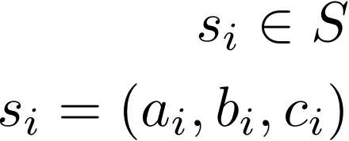
Multidimensional Spaces
A space is a set S of objects with some additional structure
A space can be created by taking Cartesian products
Example: Given sets A, B, and C we can create a space S :
Each set A, B, C represents a dimension
An element in the space can be identified by the coordinates along its dimensions
Often, the coordinates are integers used as indices in some data structure and the value can be any other thing
The value is often called a measurement

Slide 18
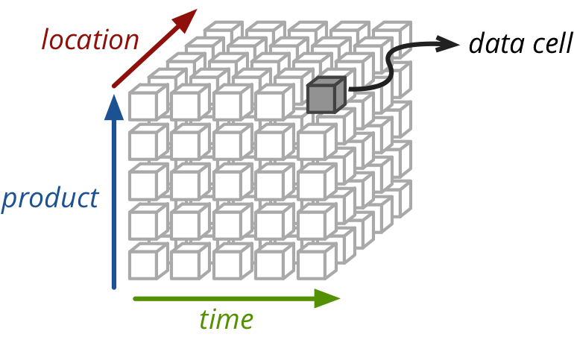
Multidimensional Data Cube
Image from: https://pythonhosted.org

Slide 19
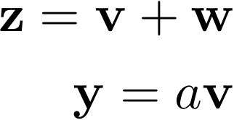
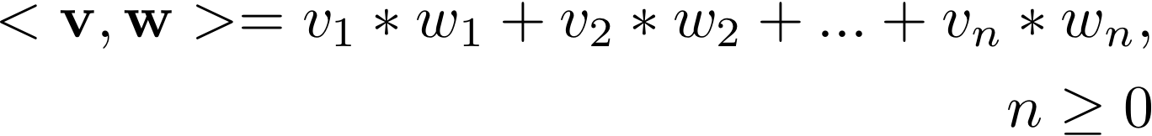
Some Spaces
Vector space: A vector space is a collection of objects v, w with two operations defined:
An inner product space is a vector space with an inner product defined between two vectors v,w

Slide 20
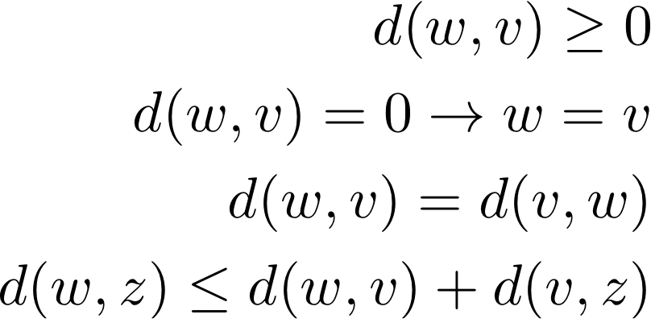
Some Space(2)
A metric space defines a metric d (distance) between elements , where d is a real-valued function.

