Slide 1
Database Systems
Manuel Rodriguez-Martinez, Ph.D.
Storage Organization

Slide 2
Objectives
Describe storage organization in DBMS
Memory Hierarchy
Disk Organization
Data Stripping and Disk Arrays

Slide 3
Storage in Modern Computers
Storage can be classified into two categories
Volatile
Non-Volatile
Volatile is fast, expensive, limited in size and lost if computer is turned off
CPU Cache
Main Memory
Non-volatile is cheaper, slower, with higher capacity and persistent
Solid State Disks
Magnetic Disks
Flash Disks
Optical Disks
Tape

Slide 4
Storage in Modern Computers
Alternative Nomenclature
Primary Storage
Secondary Storage
Tertiary Storage
Primary Storage
Cache, Main Memory
Secondary Storage
Flash Memory, SSD, Magnetic Disk
Tertiary Storage
Optical Disks, CDs, DVDs, Tape

Slide 5
Processing of Data by DBMS
CPU
CACHE
Request for
Data
Response
MAIN MEMORY
MAGNETIC DISK
TAPE
OPTICAL DISK

Slide 6
Memory Hierarchy
CACHE
Price &
Speed
increases
MAIN MEMORY
Reliability
increases
MAGNETIC DISK
OPTICAL DISK
TAPE

Slide 7
DBMS and Storage
DBMS will try to keep frequently used data in memory
Go to disk only when you have to
Primary vs Secondary Storage Performance
If you need to go to tape or optical disk, bring lots of data (e.g. a few dozen or hundred MBs)
Secondary vs Tertiary Storage Performance
Most DBMS use tertiary storage to bring dataset that are big and used on one or few seldom run queries
Ex: Satellite Images, old data from backups
Magnetic or SSD Disk (or simply Disk) is the predominant method for storage in DBMS

Slide 8
Performance in DBMS
The performance of a DBMS depends on:
CPU usage
I/O usage
Network usage
We shall concentrate on I/O
Disk I/O performance can be defined in terms of:
Resource usage time: time using the disk
Response time: wall-clock time to complete the query
Number of I/Os: number of times an I/O operation is performed
Parallel I/O – bringing data from various disk simultaneously
Response time <> Resource usage time
In this case usually Response time << Resource usage time

Slide 9
Sequential vs Parallel I/O
Suppose reading an objects X takes 10 secs
Let’s read 3 items X₁, X₂, and X₃
3x times faster
Sequential
I/O
Parallel
I/O
X₁ , X₂ , X₃
X₁
X₁, X₂
X₂, X₃
Disk 0
Disk 0
Disk 1
Disk 2
IO Sequence:
IO Sequence:
Read X1 from Disk 0
Read X2 from Disk 0
Read X3 from Disk 0
Read X1 from Disk 0, Read X2 from Disk, Read X3 from Disk 2
Resource Usage: 3x10secs = 30secs
Read simultaneously
Resource Usage: 3x10secs = 30secs
Wall-clock time : 3x10secs = 30secs
Wall-clock time : 10secs = 10secs

Slide 10
Single Disk Organization
System Bus
Controller
CPU
Memory
Disk
Controller Bus

Slide 11
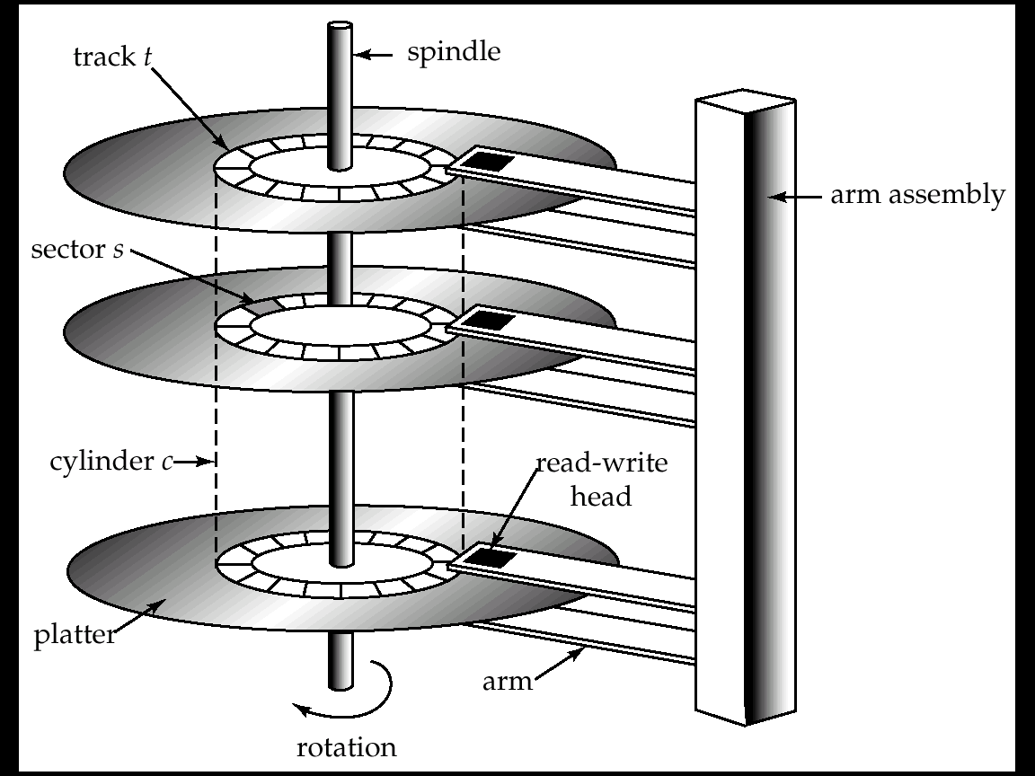
Disk Organization

Slide 12
Few Notes on Disks
Too expensive and inefficient to bring a few bytes from disk
You often bring one ore more disk blocks into RAM
1 block is the minimal amount of I/O done on disk
For a read or write operation (rw operation)
1 I/O = 1 block , for read and write
1 block consist of one or more disk sectors
Implementation of file system layer in DBMS defines this
Few magic numbers for block sizes
512 bytes
1KB
4KB

Slide 13
Units that we shall use
It would take approximately 1000 disks of 1 TB
to form 1 PB
1000 PCs/servers with 1 TB disk to get 1 PB
Only Big universities and IT companies can afford these
“data centers”
We will follow binary units
1 KB = 1024 bytes
1 MB = 1024 KB
1 GB = 1024 MB
1 TB = 1024 GB
1 PB = 1024 TB
1 EB = 1024 PB
Most single site DBs
Big Data System

Slide 14
Cost of performing I/O
To access a single block the cost if defined as
Cost = seek time + rotational delay + transfer time
Seek Time
Time for the arm to get into the right track (or cylinder)
Mechanical movement cost
Rotational Delay
Time before the target block gets underneath the reading head
½ of time for 1 disk rotation
Mechanical movement cost
Transfer time
Time to move the bytes from the disk into the RAM
Electronics cost

Slide 15
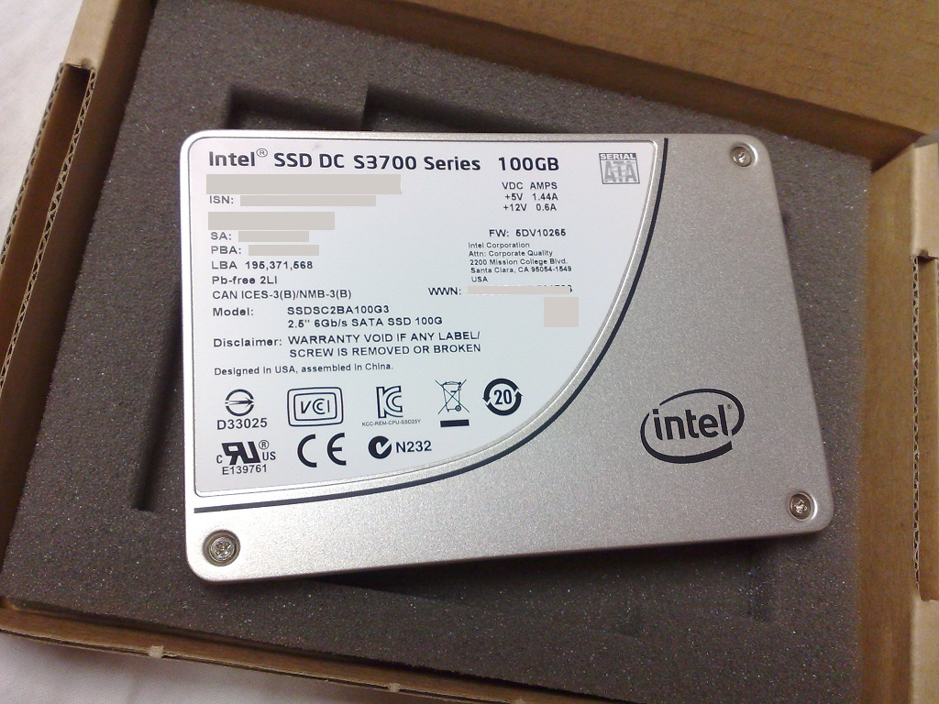
Solid State Drive
Next generation hard disks
No mechanical parts!
Asymmetric I/O
Reads are faster than writes
Tradeoff:
Faster
More expensive & Less space

Slide 16
Performance Comparison: HDD vs SDD
HDD
SDD
Seek : 4 ms – 15 ms
Rotational Delay :
5.56 ms on 5,400 rpm
4.17 ms on 7,200 rpm
3 ms on 10,000 rpm
Transfer time : 50 MB/s – 120 MB/s
Seek* : 0.08 – 0.16 ms
Rotational Delay : 0
Transfer time : 250 MB/s – 500 MB/s
*Not true seek, but electronics sync time to read data location

Slide 17
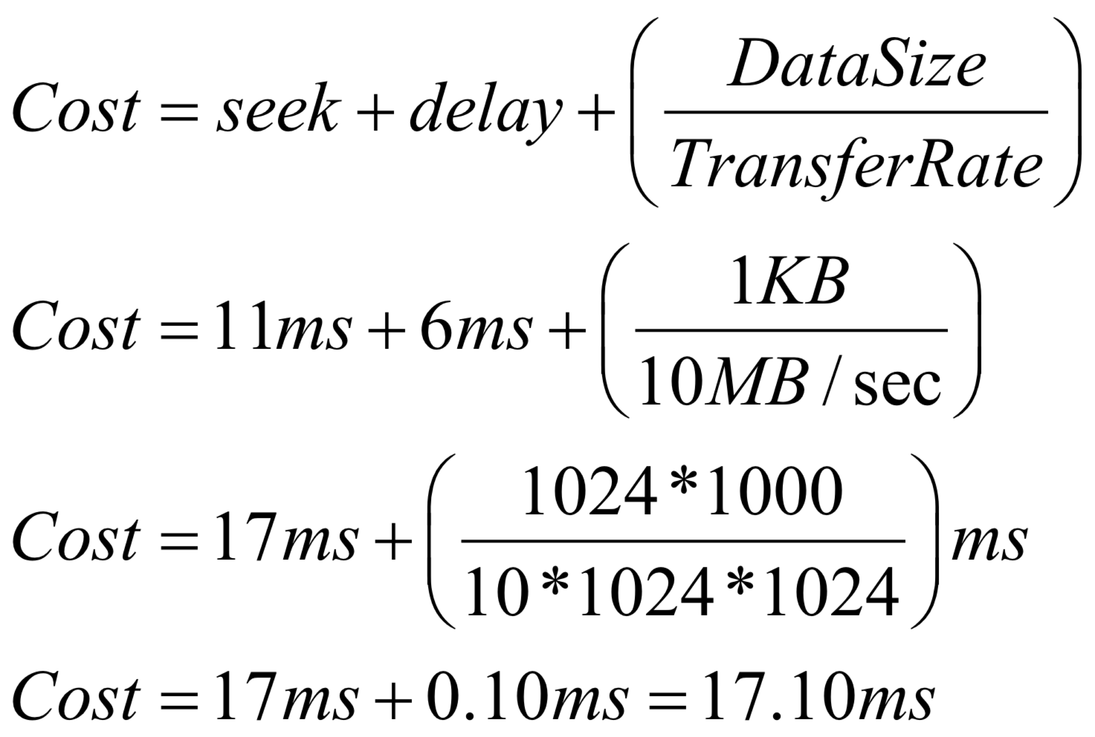
Example
Lets have a disk with:
Average seek time of 11 ms
Rotational delay of 6 ms
Transfer rate of 10MB/sec
Block size of 1 KB
How much is the cost for
one I/O?
Recall that
1KB = 1024 bytes

Slide 18
Random I/O vs Sequential I/O
Let B1, B2, …,Bn be a sequence of n blocks to be read/written from disk
Random I/O
Blocks are read/written from different regions on the disk
In worst case, you must do one seek and delay per block.
Cost = n * (seek + delay + transfer time)
Sequential I/O
Blocks are read/written one after the other from the same cylinder or adjacent cylinder (just a few seeks and delays)
In best case, after we reach B1, and then all others blocks show up next without incurring in additional seek / delay cost
Cost = seek + delay + n*(transfer time)
DBMS want to do Sequential I/O!!! – It is much faster

Slide 19
Disk Metrics Summary
Metric | Symbol
Seek | S
Rotational Delay | R
Transfer Rate | T
Block Size (I/O Size) | B
Number of Disks | D_{N}
Number of Plates per Disk | D_{P}
Number of Sides per Plate | D_{S}
Number of Tracks per Plate | D_{T}
Number of Sectors per Track | D_{B}
Sector Size (in bytes) | I

Slide 20
Example
A disk has seek time of 8 ms, rotational delay of 4ms, 100MB/sec transfer rate, 4 double-sized platter, 512 byte sector, block of 2 sectors, 500 sectors per track, and 2000 tracks per surface:
How much capacity this disk has?

Slide 21
Example (2)
How much space does a cylinder has?

Slide 22
Example (3)
How long would it take to read 200,000 blocks using random I/O?

Slide 23
Example (4)
How long would it take to read 200,000 blocks with ideal sequential I/O?

Slide 24
Notes on Disks
Yet another nomenclature
On-line storage: secondary storage
Off-line storage: tertiary storage
Many disk put memory buffer on the disk
Allows this buffers to control the rate at which data are exchanged with main memory
Idea is to minimize amount of time waiting for disk
But, this has implication in terms of transactions and recovery
What is power goes out when the data was on the buffers but before it was written to disk?

Slide 25
Disks as performance bottlenecks …
Microprocessor speed increase 50% per year.
Disk performance improvements
Access time decreases 10% per year
Transfer rate decreases 20% per year
Disk crash results in data loss.
Solution: Disk array
Have several disk behave as a single, large and very fast disk.
Parallel I/O
Put some redundancy to recover from a failure somewhere in the array

Slide 26
Disk Array Organization
Several disks are grouped into a single logical unit.
System Bus
Controller
CPU
Memory
Disk Array
Controller Bus

Slide 27
Disk Striping
Disk Striping is a mechanism to divide the data in a file into segments that are scattered over the disks of the disk array.
The minimum size of a segment is 1 bit, in which case each data block must be read from several disks to extract the appropriate bits.
The drawback of this approach is the overhead of managing data at the level of bits.
Better approach is to have a striping unit of 1 disk block!
Sequential I/O can be run parallel since block can be fetched in parallel from the disks.

Slide 28
Disk Striping – Block sized
Disk Striping can be used to partition the data in a file into equal-sized segments of a block size that are distributed over the disk array.
File
Disk
Blocks
Disk Array
Controller Bus

Slide 29
Data Allocation
Data is partitioned into equal sized segments
Striping unit
Each segment is stored on a different disk of the arrays
Typically, round-robin algorithm is used
If we have n disks, then block i is stored at disk
i mod n
Example: Array of 5 disks, and file of 1MB with a 4KB Striping unit
Disk 0: gets blocks: 0, 5, 10, 15, 20, …
Disk 1: gets blocks: 1, 6, 11, 16, 21, …
Disk 2: gets blocks: 2, 7, 12, 17, 22, …
Etc.

Slide 30
Benefits of Striping
With Striping we can access data blocks in parallel!
issue a request to the proper disks to get the blocks
For example, suppose we have a 5-disk array with 4KB striping and disk blocks. Let F be a 1MB file. If we need to access partition 0, 11, 22, 23, then we need to ask:
Disk 0 for partition 0 at time t0
Disk 1 for partition 11 at time t0
Disk 2 for partition 22 at time t0
Disk 3 for partition 23 at time t0
All these requests are issued by the DBMS and are serviced concurrently by the disk array!

Slide 31
Single Disk Time Line
Elapsed Clock Time
0
11
22
23
t0
Disk
Service
Time
t1
Read
Request Completed
Read
Request

Slide 32
Striping Time Line
Elapsed Clock Time
0
11
Parallel I/O
22
23
t0
t1
Disk
Service
Time
Read
Request
Read
Request Completed

Slide 33
Time access estimates
Access time:
seek time + rotational delay + transfer time
Disk used independently or in array: IBM Deskstar 14GPX 14.4 GB disk
Seek time: 9.1 milliseconds (msecs)
Rotational delay: 4.15 msecs
Tranfer rate: 13MB/sec
How does striping compares with a single disk?
Scenario: 1disk block(4KB) striping-unit, access to blocks 0, 11, 22, and 23. Disk array has 5 disks
Editorial Note: Looks like an exam problem!

Slide 34
Single Disk Access time
Total time = sum of time to read each partition
Time for partition 0:
9.1 msec + 4.15msec + 4KB/(13MB/1sec)*(1MB/1024KB)*(1000msec/1sec) =
9.1 msec + 4.15msec + 0.3 msecs = 13.55 msecs
Time for partition 11:
9.1 msec + 4.15msec + 4KB/(13MB/1sec)*(1MB/1024KB)*(1000msec/1sec) =
9.1 msec + 4.15msec + 0.3 msecs = 13.55 msecs
Time for partition 22:
9.1 msec + 4.15msec + 4KB/(13MB/1sec)*(1MB/1024KB)*(1000msec/1sec) =
9.1 msec + 4.15msec + 0.3 msecs = 13.55 msecs
Time for partition 23:
9.1 msec + 4.15msec + 4KB/(13MB/1sec)*(1MB/1024KB)*(1000msec/1sec) =
9.1 msec + 4.15msec + 0.3 msecs = 13.55 msecs
Total time: 4 * 13.55 msec = 54.20 msecs

Slide 35
Striping Access Time
Total time: maximum time to complete any read quest.
Following same calculation as in previous slide:
Time for partition 0: 13.55 msec
Time for partition 11: 13.55 msec
Time for partition 22: 13.55 msec
Time for partition 23: 13.55 msec
Total time:
max{13.55msec, 13.55msec 13.55msec 13.55msec} = 13.55 msec
In this case, Striping gives us a 4-1 better (4 times) performance because of parallel I/O.

Slide 36
The problem with Striping
Striping has the advantage of speeding up disk access time.
But the use of a disk array decrease the reliability of the storage system because more disks mean more possible points of failure.
Mean-time-to-failure (MTTF)
Mean time to have the disk fail and lose its data
MTTF is inversely proportional to the number of components in used by the system.
The more we have the more likely they will fall apart!

Slide 37
MTTF in disk array
Suppose we have a single disk with a MTTF of 50,000 hrs (5.7 years).
Then, if we build an array with 50 disks, then the have a MTTF for the array of 50,000/50 = 1000 hrs, or 42 days!, because any disk can fail at any given time with equal probability.
Disk failures are more common when disks are new (bad disk from factory) or old (wear due to usage).
Morale of the story: More does not necessarily means better!

Slide 38
Increasing MTTF with redundancy
We can increase the MTTF in a disk array by storing some redundant information in the disk array.
This information can be used to recover from a disk failure.
This information should be carefully selected so it can be used to reconstruct original data after a failure.
What to store as redundant information?
full data block?
Parity bit for a set of bit locations across the disks

Slide 39
Questions ?
Email:
manuel.rodriguez7@upr.edu

