Slide 1
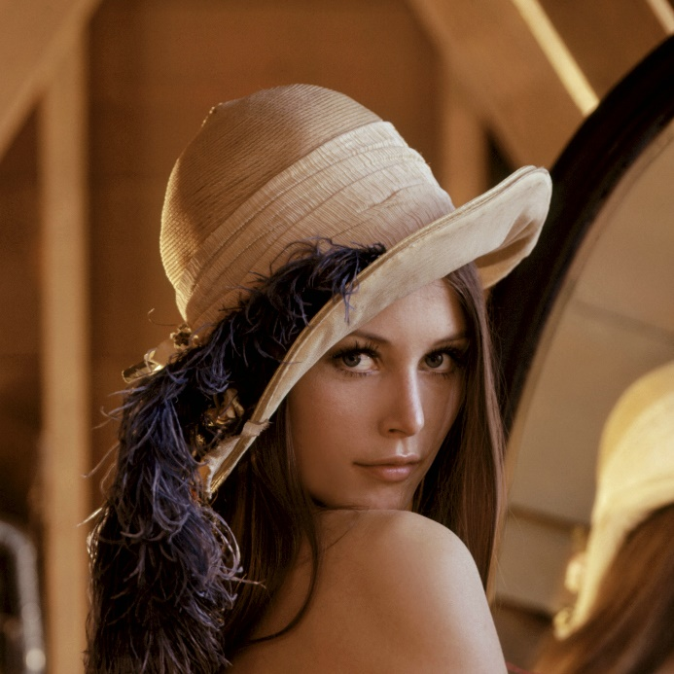
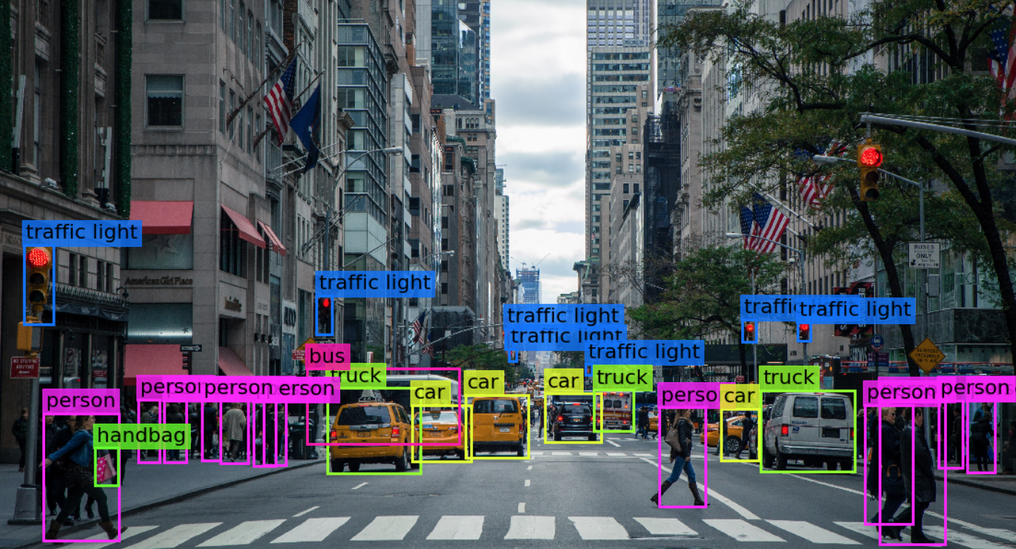

Visión por computador en la nueva era de la Inteligencia Artificial y el Deep Learning
Computer vision in the new era of Artificial Intelligence and Deep Learning
Rubén Usamentiaga*, Alberto Fernándezº
* University of Oviedo
º TSK
Gijón (Spain)
5 – 16 April 2021
https://github.com/albertofernandezvillan/computer-vision-and-deep-learning-course

Slide 2

OpenCV
Understanding BGR color format in OpenCV
Notebook: bgr_color_format_opencv.ipynb
bgr_color_format_opencv.ipynb
bgr_color_format_opencv.ipynb
https://github.com/albertofernandezvillan/computer-vision-and-deep-learning-course
Notes:
Empezar con el ejemplo del tren en la pizarra

Slide 3
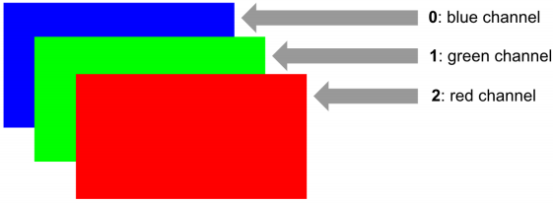
BGR color format in OpenCV
OpenCV uses BGR color format, while other libraries and packages (e.g. PIL, Matplotlib uses RGB color format). In BGR color format:
Blue channel is the first channel (channel 0)
Green channel is the second channel (channel 1)
Red channel is the third channel (channel 2)

Slide 4
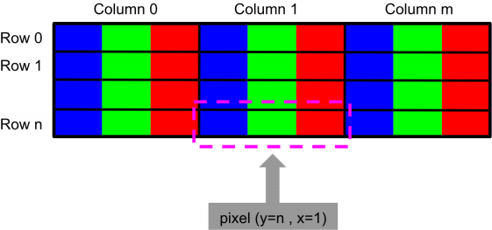
BGR color format in OpenCV
Accessing one pixel in OpenCV give us three values corresponding to the blue, green and red channels

Slide 5
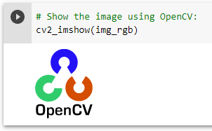
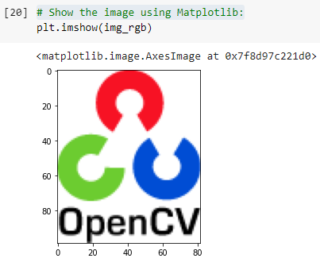
BGR to RGB in OpenCV
We have several options to convert from BGR to RGB and viceversa
Using cv2.cvtColor() method included in OpenCV
List slicing to change (reverse) the channels of the image
# Converting the loaded image (BGR format) to RGB:
img_rgb = cv2.cvtColor(img, cv2.COLOR_BGR2RGB)
This will show the image in wrong color

Slide 6
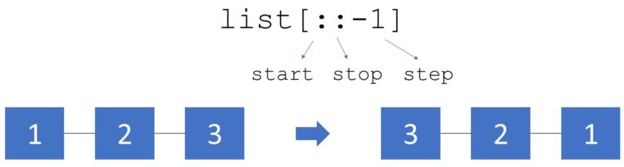
BGR to RGB in OpenCV
List slicing to change (reverse) the channels of the image
# Swap B and R channels in the BGR image to get a RGB color image:
img_rgb = img[:, :, ::-1]

Slide 7
img[:, :, ::-1] explanation
List slicing to change (reverse) the channels of the image
[[[ 48 204 108]
[255 255 255]
[212 77 0]
[212 77 0]]]
# Load the image in BGR format
img = cv2.resize(cv2.imread("opencv_logo.png"), (4,1))
# Swap B and R channels in the BGR image to get a RGB color image:
img_rgb = img[:, :, ::-1]
print(img_rgb)
[[[108 204 48]
[255 255 255]
[ 0 77 212]
[ 0 77 212]]]

Slide 8
OpenCV
Understanding BGR color format in OpenCV
https://github.com/albertofernandezvillan/computer-vision-and-deep-learning-course
Notes:
Empezar con el ejemplo del tren en la pizarra

