Slide 1
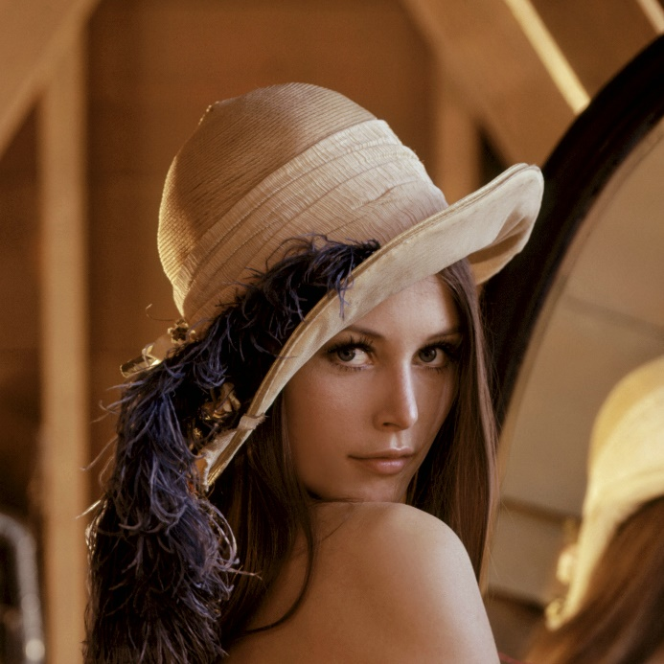
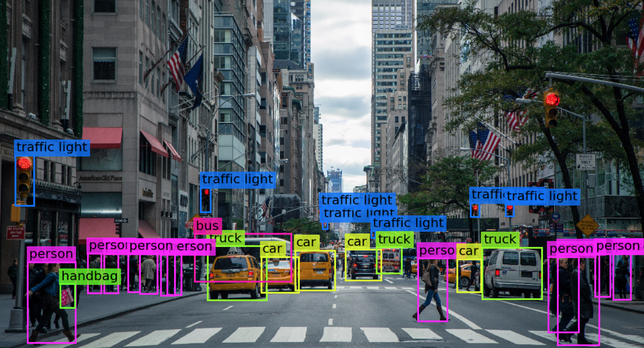

Visión por computador en la nueva era de la Inteligencia Artificial y el Deep Learning
Computer vision in the new era of Artificial Intelligence and Deep Learning
Rubén Usamentiaga*, Alberto Fernándezº
* University of Oviedo
º TSK
Gijón (Spain)
5 – 16 April 2021
https://github.com/albertofernandezvillan/computer-vision-and-deep-learning-course

Slide 2

Python
Notebook: python_introduction.ipynb
computer-vision-and-deep-learning-course/python_introduction.ipynb at main · albertofernandezvillan/computer-vision-and-deep-learning-course (github.com)
python_introduction.ipynb - Colaboratory (google.com)
https://github.com/albertofernandezvillan/computer-vision-and-deep-learning-course
Notes:
Empezar con el ejemplo del tren en la pizarra

Slide 3
Python introduction
Python is an interpreted, high-level and general-purpose programming language
Python can be used for scientific computing:
Libraries such as NumPy, SciPy and Matplotlib allow the effective use of Python in scientific computing
OpenCV has python bindings with a rich set of features for computer vision and image processing
Python is commonly used in artificial intelligence projects and machine learning projects with the help of libraries like TensorFlow, Keras, Pytorch and Scikit-learn

Slide 4
Programming examples
Python is a high-level, dynamically typed multiparadigm programming language. As an example, see a Python function to calculate the factorial of a number (a non-negative integer)
def factorial(n):
if n == 0:
return 1
else:
return n * factorial(n-1)
n=int(input("Input a number to compute the factorial : "))
print(factorial(n))

Slide 5
Variables
Variables are containers for holding data and they're defined by a name and value
# This is a integer variable
x = 10
# This is a float variable
x = 10.0
# This is a string variable
x = '10.0'
# This is a boolean variable
x = True
We can also do operations with variables
x = 1
y = 2
z = (x + y) / 2
x = 4
print(x + 1) # Addition
print(x - 1) # Subtraction
print(x * 2) # Multiplication
print(x ** 2) # Exponentiation
print(x % 3) # Modulo
a = "this is "
b = "an example"
c = a + b

Slide 6
Importing modules
In python, we can import modules, which provide specific functions. For example, we can import math module, which provides access to the mathematical function
# Import the math module
import math
x = 4
print(math.sqrt(4)) # Square root
# Import only the method to be used
from math import factorial
print(factorial(4)) # Factorial

Slide 7
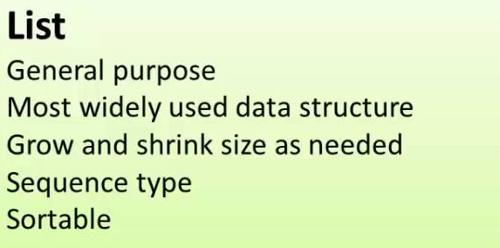
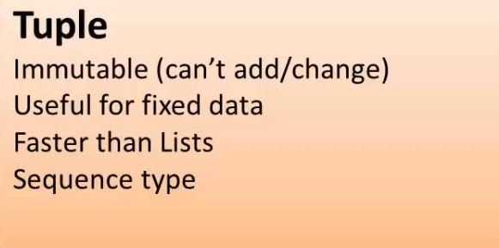
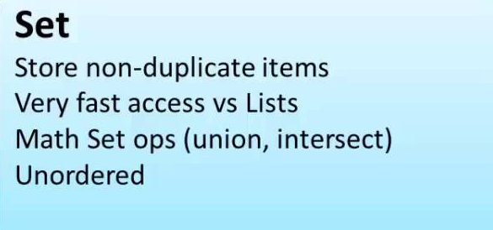
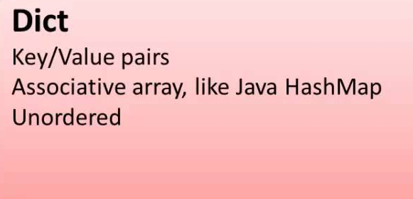
Data types
Python provides 4 built-in data types in used to store collections of data

Slide 8
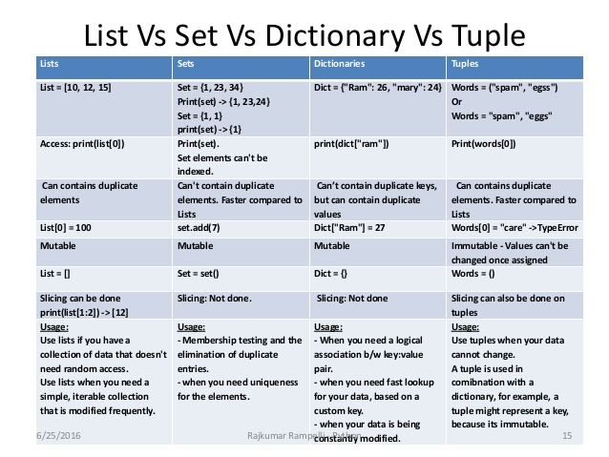
Data types to store collections of data

Slide 9
Data types
<class 'list'>
<class 'tuple'>
# Creating a list:
my_list = [1,2,3,4,5]
# Creating empty lists:
my_empty_list = []
my_empty_list_2 = list()
# Creating a tuple:
my_tuple = (1,2,3,2,2)
# Creating empty tuples:
my_empty_tuple = ()
my_empty_tuple_2 = tuple()
<class 'dict'>
<class 'set'>
# Creating a dictionary:
my_dict = {'key_1': 10,
'key_2': 20}
# Creating empty dicts
my_empty_dict = {}
my_empty_dict_2 = dict()
# Creating a set:
my_set = {1,2,3,4,5,6}
# Creating an empty set:
my_empty_set = set()
Use type(my_object) to get the class type (e.g. type(my_list))

Slide 10
List Comprehensions
List comprehensions provide a concise way to create lists
# Calculates the squares
# of 1, 2, ... 9
squares = []
for x in range(10):
squares.append(x**2)
squares = [x**2 for x in range(10)]
# Calculates the squares
# of 1, 3, ... 9
squares_odd = []
for x in range(10):
if x % 2:
squares_odd.append(x**2)
squares_od = [x**2 for x in range(10) if x % 2 ]

Slide 11
Creating dictionaries
Dictionaries are used to store data values in key:value pairs
# This creates a dictionary:
my_dict = {'key_1': 10, 'key_2': 20}
The dict() constructor builds dictionaries directly from sequences of key-value pairs:
list_pairs = [("a", 1),("b", 2),("c", 3)]
my_dict = dict(list_pairs)
In connection with this previous example, a common way of creating dictionaries in Python is by using the zip() method
letters = ['a', 'b']
nums = [0, 1]
my_dict = dict(zip(letters, nums))
{'a': 0, 'b': 1}

Slide 12
If statements
We can use if statements to conditionally do something.
The conditions are defined by the words if, elif and else
if mark_slider > 8:
print("Your mark is: {}".format(mark_slider))
print("Congratulations you have a high mark!")
elif mark_slider >= 5:
print("Your mark is: {}".format(mark_slider))
print("Congratulations you have passed the exam!")
else:
print("Your mark is: {}".format(mark_slider))
print("Better luck next time. Keep trying!")

Slide 13
Loops
Python provides following types of loops to handle looping requirements
For loops
numbers = [10, 20, 30]
for number in numbers:
print(number)
10 20 30
numbers = [10, 20, 30]
for number in numbers:
if number == 20:
break
print(number)
10
numbers = [10, 20, 30]
for number in numbers:
if number == 20:
continue
print(number)
10 30

Slide 14
Loops
While loops: A while loop can perform repeatedly as long as a condition is True. We can use continue and break commands in while loops as well
x = 10
times = 0
while True:
if x > 15:
break
print("Value of x is: {}".format(x))
x = x + 2
times = times + 1
print("Times = {}".format(times))
Value of x is: 10 Value of x is: 12 Value of x is: 14 Times = 3

Slide 15
Functions
Functions are a way to modularize reusable pieces of code. They are defined by the keyword def
def my_function(): print("Hello from a function") my_function()
Hello from a function
def my_function(food): for x in food: print(x) fruits = ["apple", "banana", "cherry"] my_function(fruits)
apple banana cherry

Slide 16
Classes
Classes provide a means of bundling data and functionality together. Creating a new class creates a new type of object, allowing new instances of that type to be made
tim = Dog("Tim", 5)
tim.change_age(7)
tim.speak()
class Dog():
def __init__(self, name, age):
self.name = name
self.age = age
def speak(self):
print("I am", self.name,
"and I am", self.age, "years old")
def change_age(self, age):
self.age = age
I am Tim and I am 7 years old

Slide 17
Python
Recommended lectures
The Python Tutorial:
https://docs.python.org/3/tutorial/
Learn the Basics:
https://www.learnpython.org/en/
(Spanish: Aprenda las bases):
https://www.learnpython.org/es/
https://github.com/albertofernandezvillan/computer-vision-and-deep-learning-course
Notes:
Empezar con el ejemplo del tren en la pizarra

