Slide 1
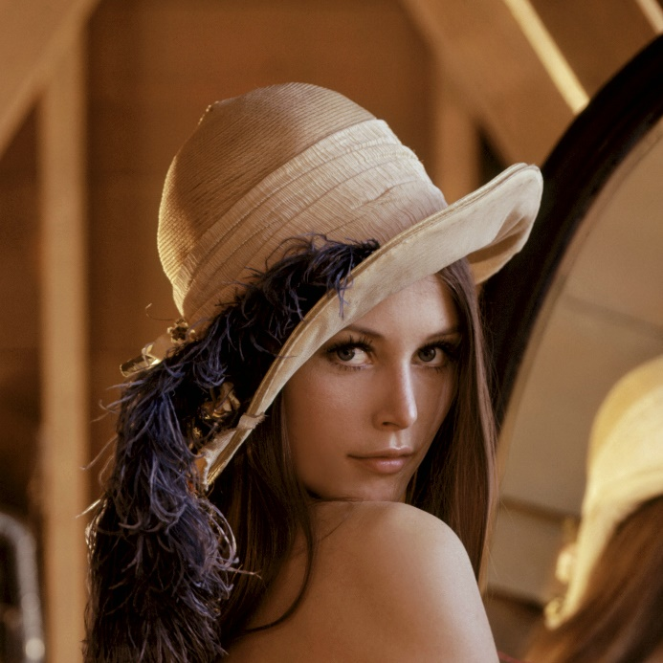
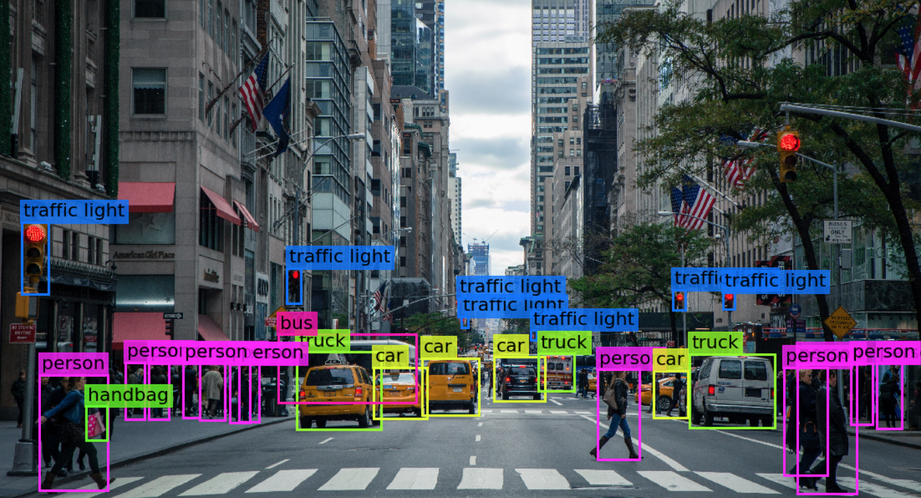

Visión por computador en la nueva era de la Inteligencia Artificial y el Deep Learning
Computer vision in the new era of Artificial Intelligence and Deep Learning
Rubén Usamentiaga*, Alberto Fernándezº
* University of Oviedo
º TSK
Gijón (Spain)
5 – 16 April 2021
https://github.com/albertofernandezvillan/computer-vision-and-deep-learning-course

Slide 2

Pillow
Notebook: pil_introduction_python.ipynb
computer-vision-and-deep-learning-course/pil_introduction_python.ipynb at main · albertofernandezvillan/computer-vision-and-deep-learning-course (github.com)
pil_introduction_python.ipynb - Colaboratory (google.com)
https://github.com/albertofernandezvillan/computer-vision-and-deep-learning-course
Notes:
Empezar con el ejemplo del tren en la pizarra

Slide 3
Pillow introduction
Pillow is the friendly PIL fork by Alex Clark and Contributors. PIL is the Python Imaging Library by Fredrik Lundh and Contributors. As of 2019, Pillow development is supported by Tidelift.
Use the following import convention
import PIL

Slide 4
Pillow main features
To load an image use Image.open()
Note that PIL uses RGB mode
from PIL import Image
img = Image.open("/content/face_test.png")
print(img)
print("Format: '{}', size: '{}', mode: '{}'".format(img.format, img.size, img.mode))
<PIL.PngImagePlugin.PngImageFile image mode=RGB size=482x504 at 0x7F3A5722DC50> Format: 'PNG', size: '(482, 504)', mode: 'RGB'

Slide 5
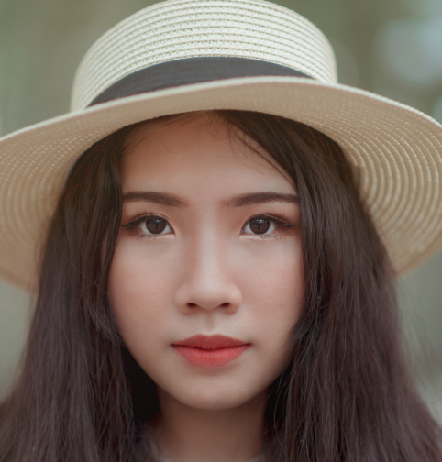
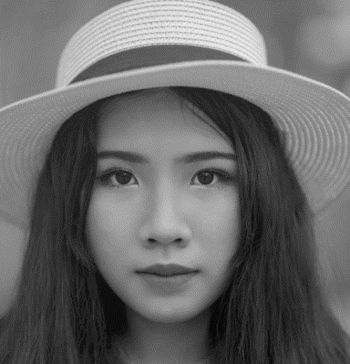
Pillow main features
To convert images between different pixel representations use img.convert().
from PIL import Image
# This converts RGB image to grayscale img = Image.open("/content/face_test.png")
img_l = img.convert("L")
from PIL import Image, ImageOps
# For this purpose, we can also use ImageOps module
img_2 = ImageOps.grayscale(img)

Slide 6
Pillow main features
To save an image on disk: img.save()
You can specify a different extension from its original, and the saved image will be converted to the specified format.
from PIL import Image
# Load image:
img = Image.open("/content/face_test.png")
# Save it on disk:
img.save("face_test.jpg", quality=95)

Slide 7
Pillow main features
Convert PIL Image to OpenCV format
import cv2
from PIL import Image
import numpy as np
img = Image.open("/content/face_test.png")
img_bgr = cv2.cvtColor(np.asarray(img), cv2.COLOR_RGB2BGR)
Convert OpenCV format to PIL Image
from PIL import Image
pil_image = Image.fromarray(img_rgb)

Slide 8
Pillow modules
Reference — Pillow (PIL Fork) 3.0.0 documentation
Image Module
ImageChops
ImageDraw Module
ImageEnhance Module
ImageFont Module
ImageMorph Module
ImagePalette Module
ImageStat Module
ImageCms Module
ImageOps Module
ImageColor Module
ExifTags Module
ImageFile Module
ImageFilter Module

Slide 9

Pillow modules
Reference — Pillow (PIL Fork) 3.0.0 documentation
ImageFilter Module
img.filter(ImageFilter.UnsharpMask)

Slide 10
Pillow
Recommended lectures
PIL Modules:
https://pillow.readthedocs.io/en/3.0.x/reference/index.html
https://github.com/albertofernandezvillan/computer-vision-and-deep-learning-course
Notes:
Empezar con el ejemplo del tren en la pizarra

