Slide 1
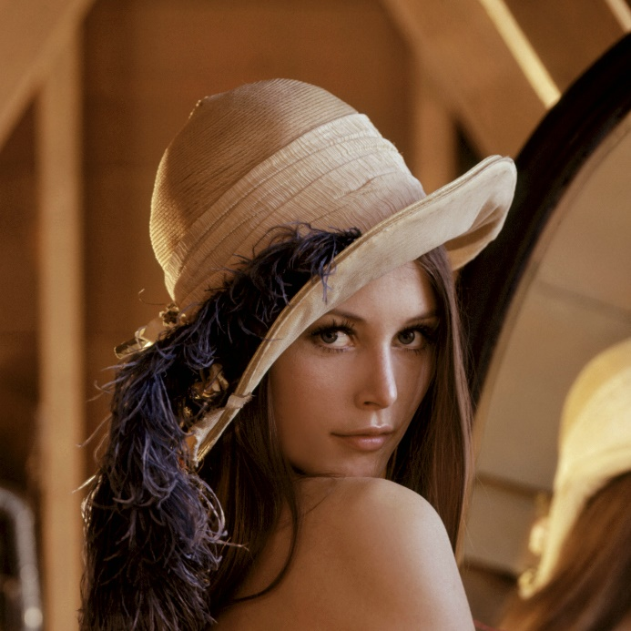
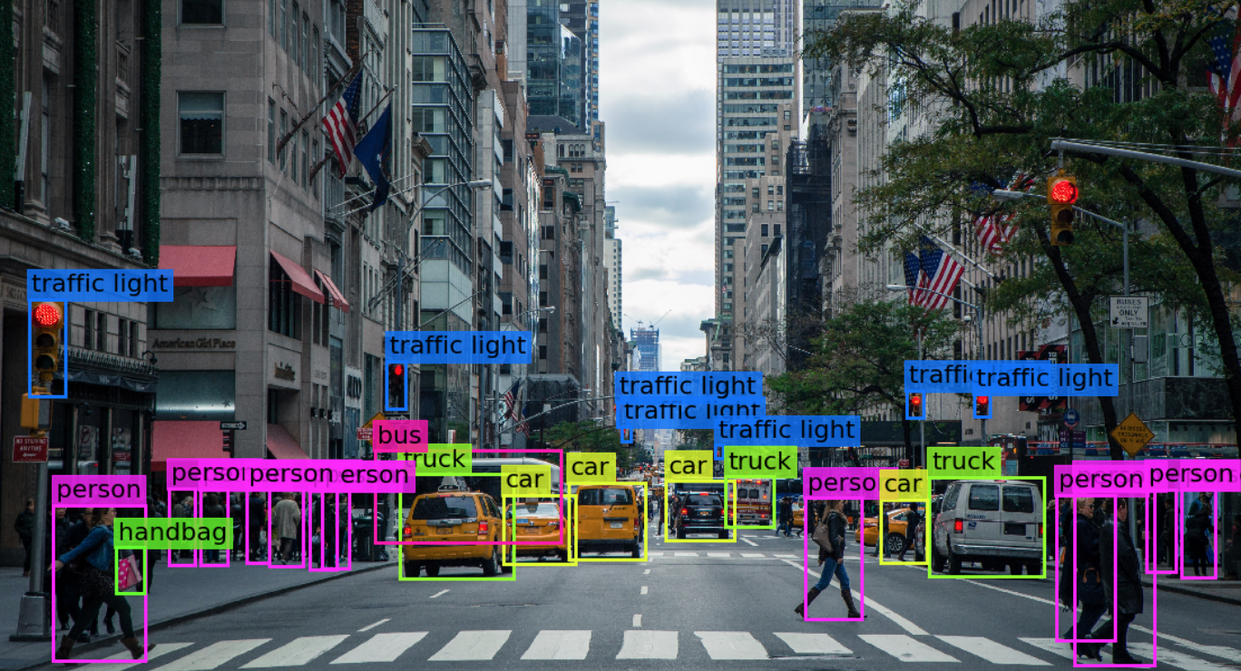

Visión por computador en la nueva era de la Inteligencia Artificial y el Deep Learning
Computer vision in the new era of Artificial Intelligence and Deep Learning
Rubén Usamentiaga*, Alberto Fernándezº
* University of Oviedo
º TSK
Gijón (Spain)
5 – 16 April 2021
https://github.com/albertofernandezvillan/computer-vision-and-deep-learning-course

Slide 2

Scikit-learn
Introducing scikit-learn for classification, regression and clustering
scikit_learn_introduction_classification.ipynb
scikit_learn_introduction_regression.ipynb
k_means_clustering_sklearn.ipynb
scikit_learn_introduction_classification.ipynb
scikit_learn_introduction_regression.ipynb
k_means_clustering_sklearn.ipynb
https://github.com/albertofernandezvillan/computer-vision-and-deep-learning-course
Notes:
Empezar con el ejemplo del tren en la pizarra

Slide 3
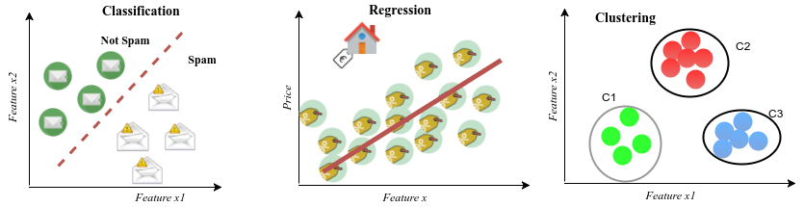
supervised vs unsupervised learning
Supervised
Unsupervised
Spam filtering
House price estimation
Customers clustering
Classification: predicting a label
Classification uses supervised learning techniques to find the relationship between the features and the assigned label (e.g. spam/no spam)
Regression: predicting a quantity
Regression uses supervised learning techniques to learn a mapping function from the features to a continuous output variable. A regression problem requires the prediction of a quantity. All houses have a price.
Clustering: assigning a cluster
Customers are grouped into different categories based on their purchasing behaviour, but the unsupervised learning algorithm has no information about the labels (or classes) associated with each sample

Slide 4
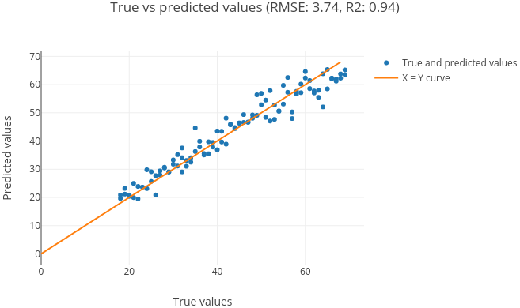
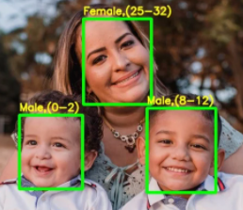
Classification vs regression
In some cases, it is possible to convert a regression problem to a classification problem. For example, the age to be predicted could be converted into discrete buckets. Age in a continuous range between [0 and 100] could be converted into:
Class 0: 0 - 2
Class 1: 3 - 8
Class 2: 8 – 12
….

Slide 5
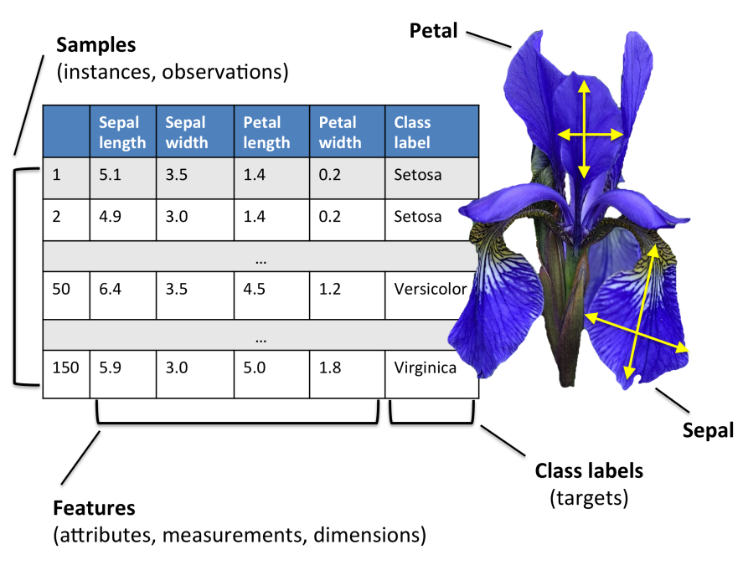
Scikit-learn for classification: dataset
from sklearn.datasets import load_iris
iris = load_iris()
x = iris.data
y = iris.target
feature_names = iris.feature_names
target_names = iris.target_names
x.shape: (150,4)
y.shape: (150,1)
Feature names: '['sepal length (cm)', 'sepal width (cm)', 'petal length (cm)', 'petal width (cm)']'
Target names: '['setosa' 'versicolor' 'virginica']'
As we have three classes, this is a three-class classification problem, because our task here is to classify each sample in one of the three classes (the species of Iris).

Slide 6
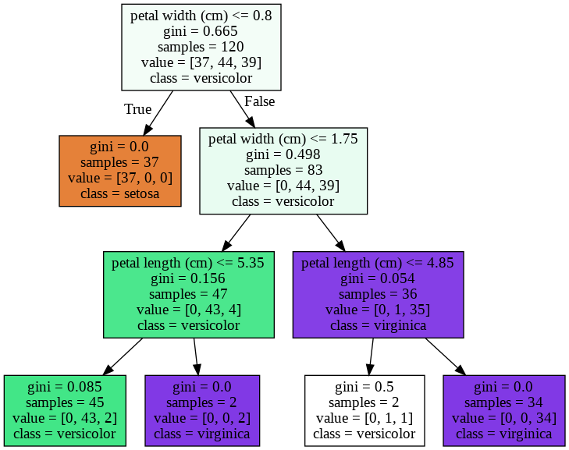
Scikit-learn for classification: training
Split training and test sets
from sklearn.model_selection import train_test_split
# Split the dataset for training and testing:
x_train, x_test, y_train, y_test = train_test_split(x, y, test_size=0.2, random_state=123)
x train shape: '(120, 4)'
x test shape: '(30, 4)'
Training (fit)
from sklearn import tree
# Create the decision tree classifier
tree_classifier=tree.DecisionTreeClassifier(random_state=0, max_depth=3)
# We can train the model with fit function:
tree_classifier.fit(x_train,y_train)

Slide 7
Making predictions using the trained model
sepal length of 5 cm
sepal width of 5 cm
petal length of 5 cm
petal width of 0.7999 cm.
new_sample = np.array([[5, 5, 5, 0.7999]])
# Predict the class for this new sample:
predicted_class = tree_classifier.predict(new_sample)
pred_class = predicted_class[0]
class_name = iris.target_names[pred_class]
Model persistence
from joblib import dump
dump(tree_classifier, 'iris_tree_classifier.joblib')
from joblib import load
tree_classifier_iris = load('iris_tree_classifier.joblib')

Slide 8
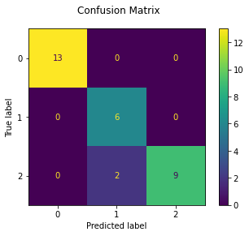
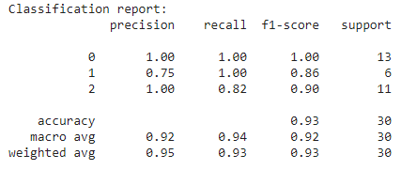
Measuring the accuracy of the trained model
# 1. After training, the model is ready to make predictions:
tree_predictions = tree_classifier.predict(x_test)
# 2. Get the comparisons (True/False) for each one:
comparisons = (tree_predictions == y_test)
print("comparisons array: \n '{}'".format(comparisons))
# 3. Calculate the accuracy using np.mean():
my_accuracy = np.mean(comparisons)
print("The accuracy of the model is: '{}'".format(my_accuracy))
import sklearn.metrics as metrics
metrics.accuracy_score(y_test, tree_predictions)
metrics.classification_report(y_test, tree_predictions)
metrics.plot_confusion_matrix(tree_classifier, x_test, y_test)

Slide 9
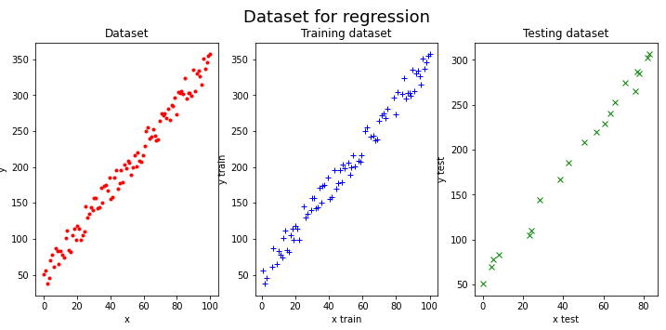
Scikit-learn for regression: dataset

Slide 10
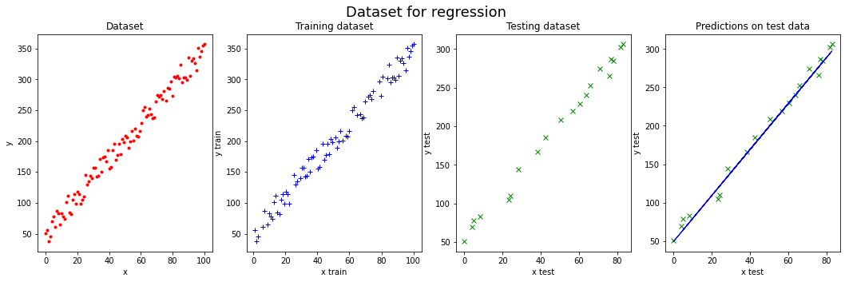
Scikit-learn for regression: training and testing
from sklearn import linear_model
# Create linear regression object:
model = linear_model.LinearRegression()
# Train the model using the training sets:
model.fit(x_train, y_train)
# The coefficients and the intercept factor:
print("Coefficients: {}".format(model.coef_))
print("Intercept: {}".format(model.intercept_))
from sklearn.metrics import mean_squared_error, r2_score
# Make predictions using the testing set
y_preds = model.predict(x_test)
# Model score:
model.score(x_test, y_test))
# The mean squared error (mse):
mean_squared_error(y_test, y_preds)
r2_score(y_test, y_preds)
Coefficients: [[2.99811861]]
Intercept: [49.14094108]

Slide 11
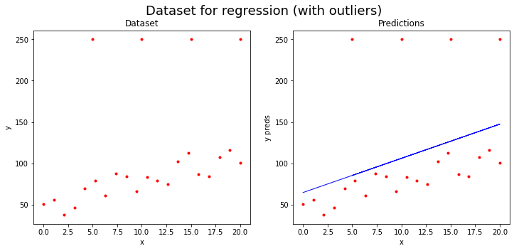
Scikit-learn for regression: dataset with outliers
linear_model.LinearRegression estimator is heavily influenced by the outliers

Slide 12
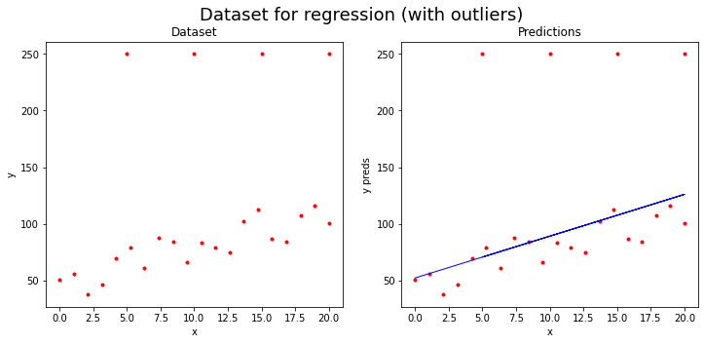
Scikit-learn for regression: dataset with outliers
linear_model.HuberRegressor is robust to outliers
The parameter epsilon controls the number of samples that should be classified as outliers. The smaller the epsilon, the more robust it is to outliers. greater than 1.0, default=1.35
HuberRegressor(epsilon=2.0)

Slide 13
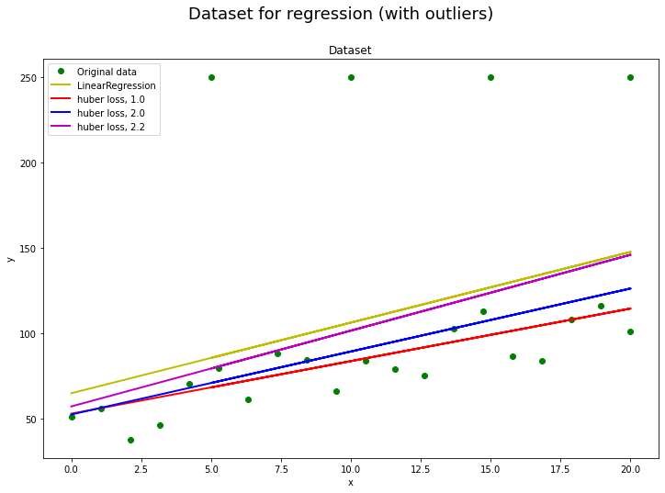
Scikit-learn for regression: dataset with outliers
HuberRegressor estimator is less influenced by the outliers. Moreover, as the parameter epsilon is increased for the HuberRegressor estimator, the obtained results get closer to the results obtained with the LinearRegression estimator.

Slide 14
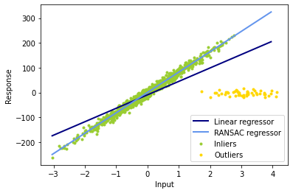
Scikit-learn for regression: dataset with outliers
Robust linear model estimation using RANSAC
# Robustly fit linear model with RANSAC algorithm
ransac = linear_model.RANSACRegressor()
ransac.fit(X, y)
inlier_mask = ransac.inlier_mask_
outlier_mask = np.logical_not(inlier_mask)
Boolean mask of inliers classified as True.
plt.scatter(X[inlier_mask], y[inlier_mask], color='yellowgreen', marker='.', label='Inliers')
plt.scatter(X[outlier_mask], y[outlier_mask], color='gold', marker='.', label='Outliers')

Slide 15
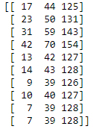

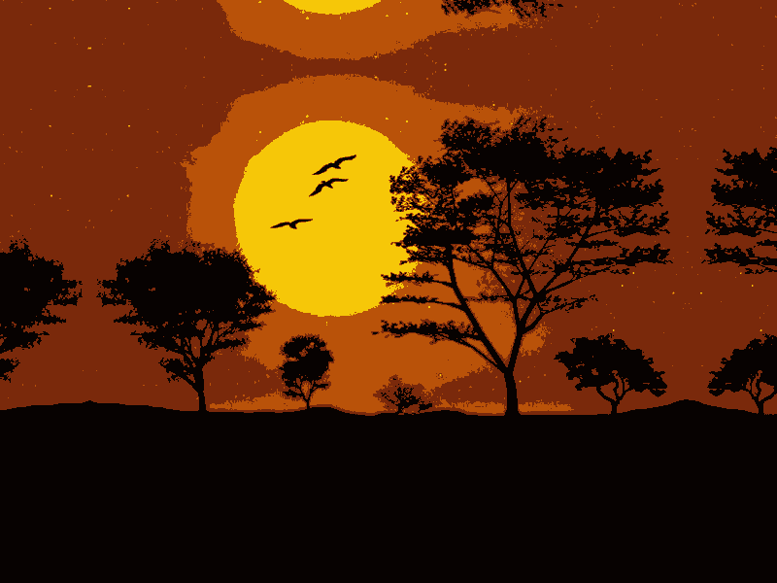
K-Means clustering for color quantization in scikit-learn
img = cv2.imread("landscape.jpg")
img = img.reshape((img.shape[1]*img.shape[0], 3))
kmeans = KMeans(n_clusters=NUMBER_CLUSTERS)
kmeans.fit(img)
centroids = kmeans.cluster_centers_
centroids = np.uint8(centroids)
labels = kmeans.labels_
result = centroids[labels]
result = result.reshape(img_shape)
[1 2 7]
[ 8 199 246]
0 0 0 3 0 0 0 0 0 0 0 0 0 0 0 0 0 0 0 0 0 0 0 0 0 0 0 0
0 0 0 0 0 0 0 0 0 0 0 0 0 0 0 0 0 0 0 0 0 0 0 0 0 0 0 0 3 3 0 0 0 0 0 0 0 0 0 0 0 0 0 0 0 0 0 0 0 0 0 0 0 0 0 0
[ 11 41 122]
[ 9 82 185]
Centroids are in the form of BGR triplets

Slide 16
Scikit-learn
Introducing scikit-learn for classification, regression and clustering
https://github.com/albertofernandezvillan/computer-vision-and-deep-learning-course
Notes:
Empezar con el ejemplo del tren en la pizarra

