Slide 1

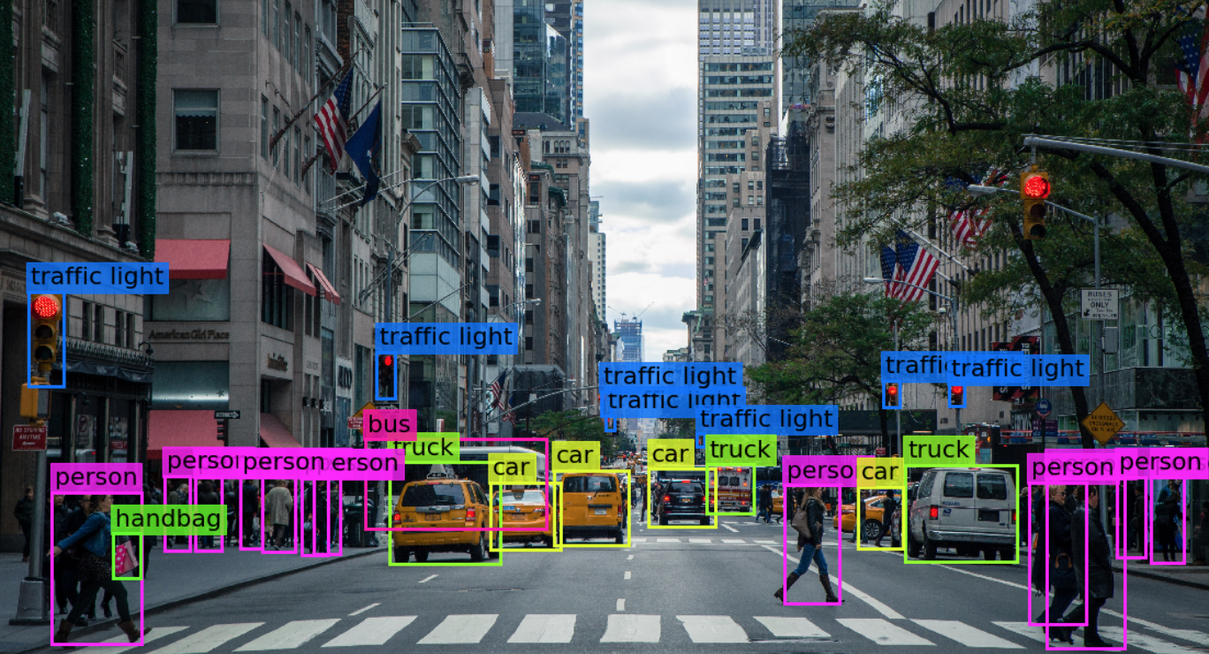

Visión por computador en la nueva era de la Inteligencia Artificial y el Deep Learning
Computer vision in the new era of Artificial Intelligence and Deep Learning
Rubén Usamentiaga*, Alberto Fernándezº
* University of Oviedo
º TSK
Gijón (Spain)
5 – 16 April 2021
https://github.com/albertofernandezvillan/computer-vision-and-deep-learning-course

Slide 2

Google Colab
Notebook: notebooks_and_colab_introduction.ipynb
computer-vision-and-deep-learning-course/notebooks_and_colab_introduction.ipynb at main · albertofernandezvillan/computer-vision-and-deep-learning-course (github.com)
notebooks_and_colab_introduction.ipynb - Colaboratory (google.com)
https://github.com/albertofernandezvillan/computer-vision-and-deep-learning-course
Notes:
Empezar con el ejemplo del tren en la pizarra

Slide 3
What is Colaboratory
Google cloud-based service that replicates Jupyter Notebook in the cloud
Colab allows you to run and code in Python in your browser with the following advantages:
No configuration required
Gives free access to GPUs
Allows content sharing easily
Colab allows anybody to write and execute arbitrary Python code through the browser, and is especially well suited to machine learning, data analysis and education

Slide 4
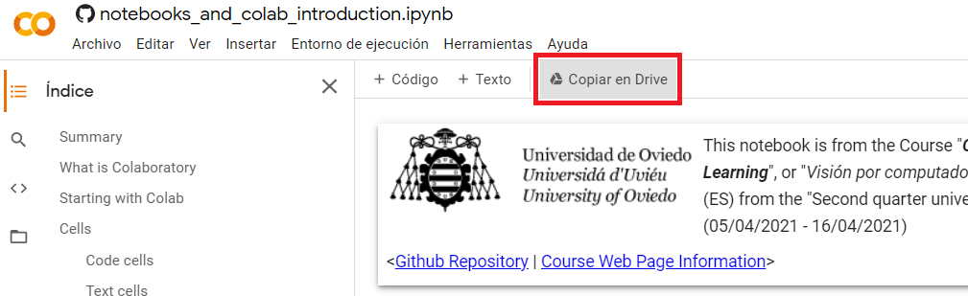
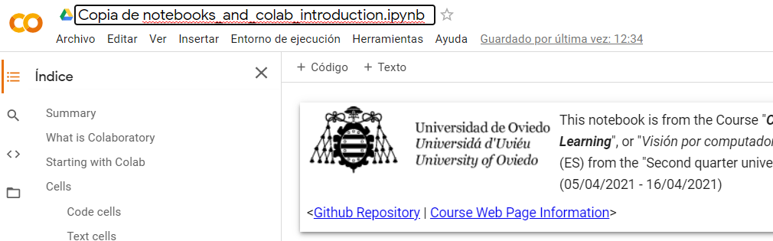
Setting up Colab
First step is to sign into your Google account to start using notebooks. If you do want to save your work, click the “Copy to Drive” button on the toolbar. This will open a new notebook in a new tab. You can rename this new notebook

Slide 5
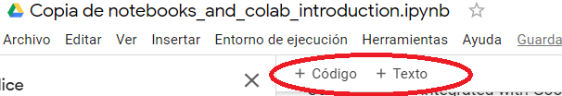
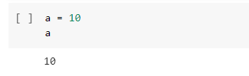
Cells
Notebooks are composed of cells. There are two types of cells: code cells and text cells.
Code cells are used for both writting and executing code.
Text cells are used for writing text, HTML or including Figures among others
Code cell
Text cell

Slide 6
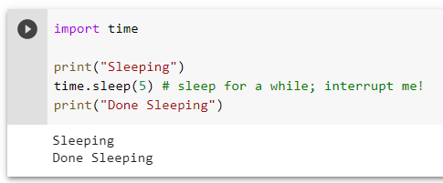
Working with python
You can include Python code in code cells.

Slide 7
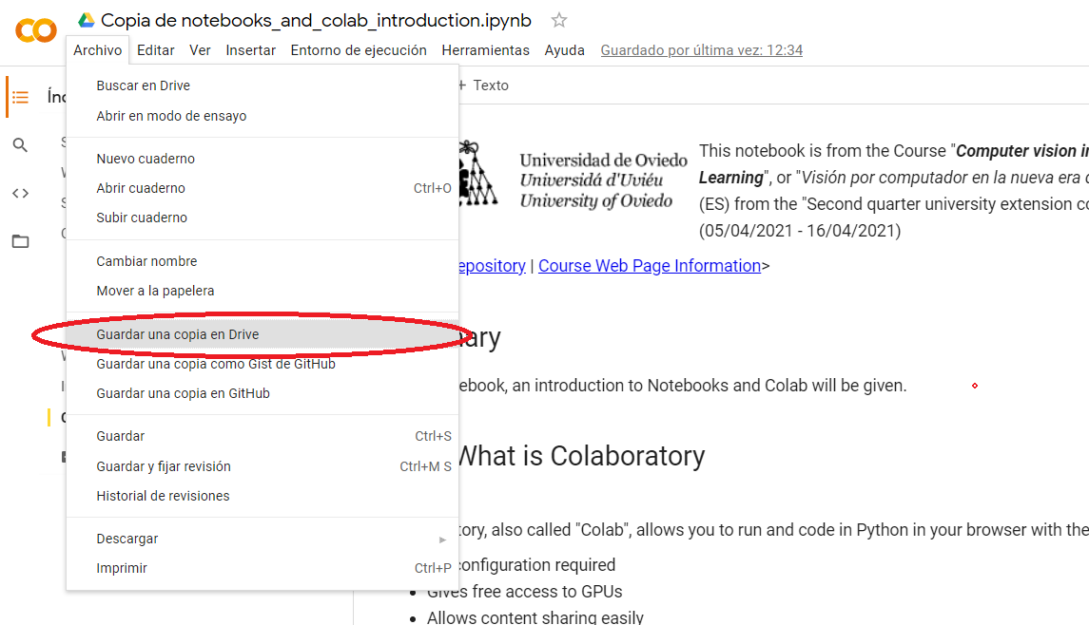
Integration with Drive

Slide 8
Google Colab
https://github.com/albertofernandezvillan/computer-vision-and-deep-learning-course
Notes:
Empezar con el ejemplo del tren en la pizarra

