Slide 1
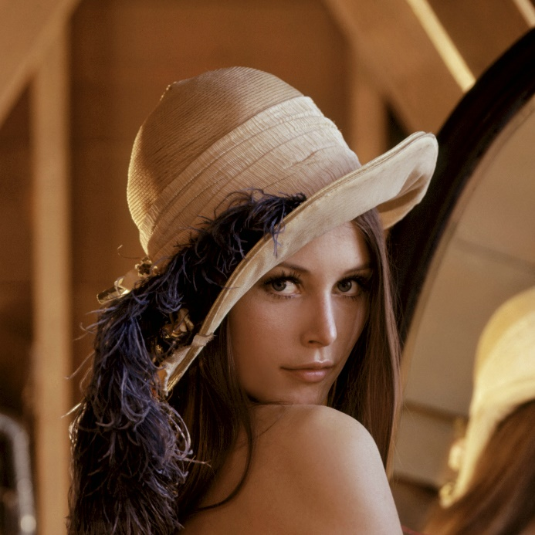
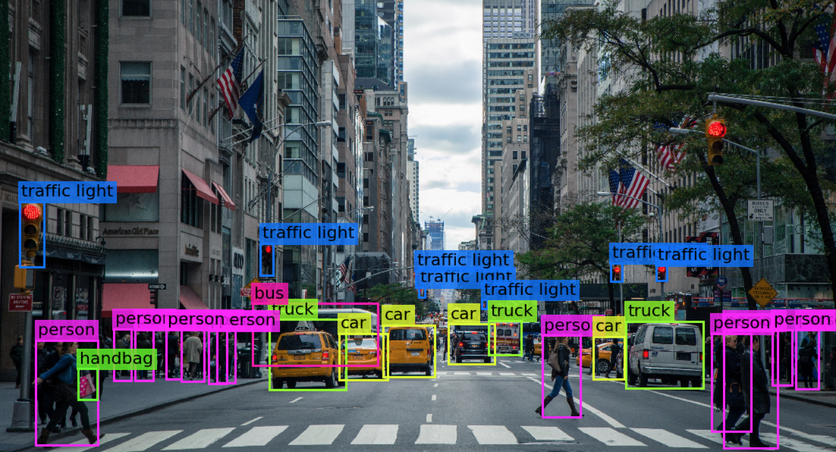

Visión por computador en la nueva era de la Inteligencia Artificial y el Deep Learning
Computer vision in the new era of Artificial Intelligence and Deep Learning
Rubén Usamentiaga*, Alberto Fernándezº
* University of Oviedo
º TSK
Gijón (Spain)
5 – 16 April 2021
https://github.com/albertofernandezvillan/computer-vision-and-deep-learning-course

Slide 2

Google Colab
Explore, execute and see the output of external Python scripts
Notebooks: explore_and_execute_external_scripts_in_colab.ipynb
explore_and_execute_external_scripts_in_colab.ipynb
explore_and_execute_external_scripts_in_colab.ipynb
https://github.com/albertofernandezvillan/computer-vision-and-deep-learning-course
Notes:
Empezar con el ejemplo del tren en la pizarra

Slide 3
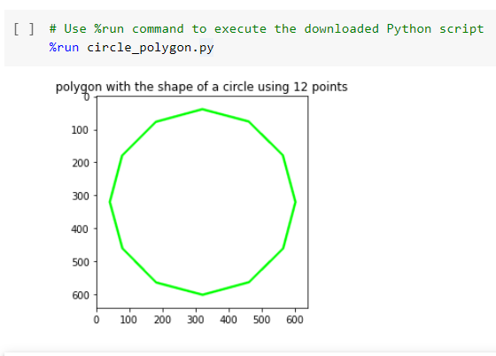
%run IPython Magic Command
Python Magic Command %run can be used to execute other Python scripts
!wget https://raw.githubusercontent.com/PacktPublishing/Mastering-OpenCV-4-with-Python/master/Chapter04/02-exercices/circle_polygon.py
# Use %run command to execute the downloaded Python script
%run circle_polygon.py

Slide 4
Download and execute scripts (programmatically)
import requests
def download_and_execute_file(fname, url, params="", execute=True, show_content=False):
# Download and write the file:
r = requests.get(url)
open(fname , 'wb').write(r.content)
# Show the content of the script if required:
if show_content:
print("\n")
with open(fname,'r') as testwritefile:
print(testwritefile.read())
print("\n")
# Execute the script if required:
if execute:
execution = "run " + fname + " " + params
ipy = get_ipython()
ipy.magic(execution)

Slide 5
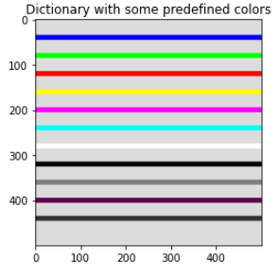
Download and execute scripts (programmatically)
fname = 'constant.py'
url = "https://raw.githubusercontent.com/PacktPublishing/Mastering-OpenCV-4-with-Python/master/Chapter04/01-chapter-content/constant.py"
download_and_execute_file(fname, url, params="", execute=False, show_content=False)
fname = 'testing_colors.py'
url = "https://raw.githubusercontent.com/PacktPublishing/Mastering-OpenCV-4-with-Python/master/Chapter04/01-chapter-content/testing_colors.py"
download_and_execute_file(fname, url, params="", execute=True, show_content=True)
testing_colors.py requires constant.py file. Therefore:
Download the file constants.py
Download and execute testing_colors.py
For more examples see the accompanying notebook

Slide 6
Google Colab
Explore, execute and see the output of external Python scripts
https://github.com/albertofernandezvillan/computer-vision-and-deep-learning-course
Notes:
Empezar con el ejemplo del tren en la pizarra

