Slide 1
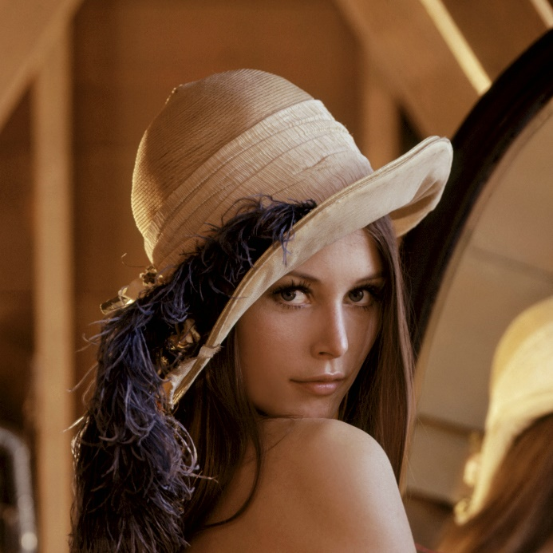
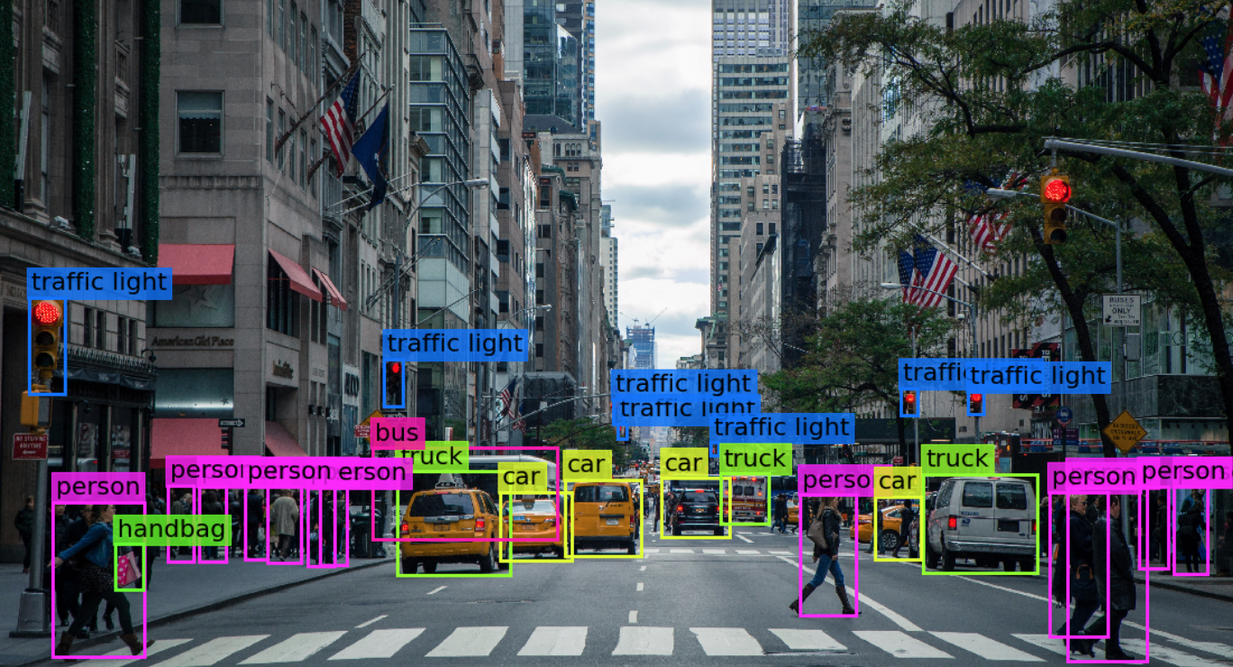

Visión por computador en la nueva era de la Inteligencia Artificial y el Deep Learning
Computer vision in the new era of Artificial Intelligence and Deep Learning
Rubén Usamentiaga*, Alberto Fernándezº
* University of Oviedo
º TSK
Gijón (Spain)
5 – 16 April 2021
https://github.com/albertofernandezvillan/computer-vision-and-deep-learning-course

Slide 2

Google Colab
Installing and using Colab utilities
Notebooks: colaboratory_utils.ipynb
colaboratory_utils.ipynb
colaboratory_utils.ipynb
https://github.com/albertofernandezvillan/computer-vision-and-deep-learning-course
Notes:
Empezar con el ejemplo del tren en la pizarra

Slide 3
Introduction
colaboratory-utils repository contains Python stuff for Google Colab notebooks. Most of this stuff is taken from this repository
This repository provides the following functionality:
Showing multiple image figures
Downloading and execute a file
Taking image from webcam
Taking a video from webcam
Showing an image

Slide 4
Main functionality
import colaboratory_utils as colab_utils
# 1. Show multiple image figures:
# Create the dimensions of the figure and set title:
plt.figure(figsize=(12, 7))
plt.suptitle("Testing visualization", fontsize=14, fontweight='bold')
colab_utils.show_img_plt(img_bgr_flip_ud, title='sample', n_rows=2, n_cols=3, pos=1)
# .....
# Show the created image:
plt.show()
# 2. Download an execute a file
colab_utils.download_and_execute_file(fname, url, params= "", execute=True, show_content=True)
# 3. Take image from webcam:
img = colab_utils.webcam2numpy()
# 4. Take video from webcam:
vid = colab_utils.videoGrabber(showVideo=False)
image_np = np.array(vid(0))
# 5. Show image (simple):
colab_utils.imshow(img)

Slide 5
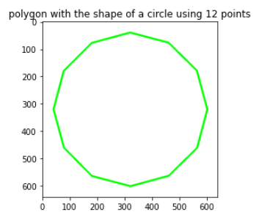
Installing and using colaboratory-utils
!pip install git+git://github.com/albertofernandezvillan/colaboratory-utils.git
import colaboratory_utils as colab_utils
fname = 'circle_polygon.py'
url = 'https://raw.githubusercontent.com/PacktPublishing/Mastering-OpenCV-4-with-Python/master/Chapter04/02-exercices/circle_polygon.py'
colab_utils.download_and_execute_file(fname, url, params= "", execute=True, show_content=True)
Executing an external Python script

Slide 6
Installing and using colaboratory-utils
Taking image from webcam
img = colab_utils.webcam2numpy()
print("Shape of the acquired image: '{}'".format(img.shape))
Shape of the acquired image: '(600, 800, 3)'
Showing an image
colab_utils.imshow(img)
Taking video from webcam
total_iter = 10
vid = colab_utils.videoGrabber(showVideo=False)
try:
n_iter = 0
while n_iter <= total_iter:
n_iter += 1
image_np = np.array(vid(0))
colab_utils.imshow(image_np)
finally:
vid(stop=True)

Slide 7
Google Colab
Installing and using Colab utilities
https://github.com/albertofernandezvillan/computer-vision-and-deep-learning-course
Notes:
Empezar con el ejemplo del tren en la pizarra

