Slide 1
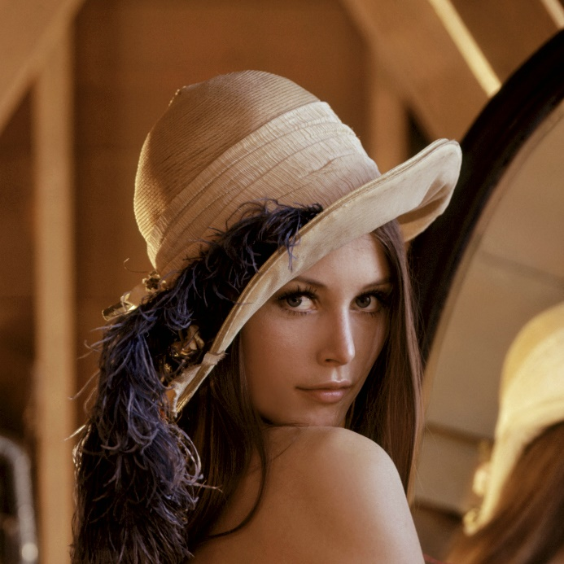
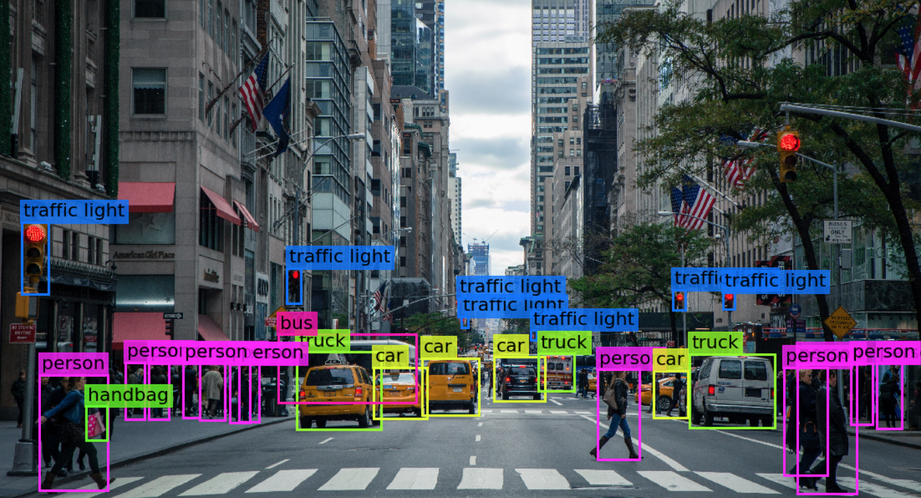

Visión por computador en la nueva era de la Inteligencia Artificial y el Deep Learning
Computer vision in the new era of Artificial Intelligence and Deep Learning
Rubén Usamentiaga*, Alberto Fernándezº
* University of Oviedo
º TSK
Gijón (Spain)
5 – 16 April 2021
https://github.com/albertofernandezvillan/computer-vision-and-deep-learning-course

Slide 2

OpenCV
Basic image treatment in OpenCV
Notebook: basic_image_treatment_with_opencv.ipynb
basic_image_treatment_with_opencv.ipynb
basic_image_treatment_with_opencv.ipynb
https://github.com/albertofernandezvillan/computer-vision-and-deep-learning-course
Notes:
Empezar con el ejemplo del tren en la pizarra

Slide 3
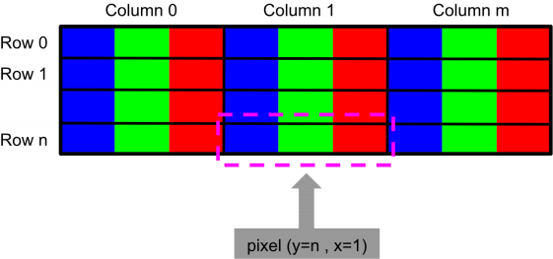
BGR color format in OpenCV
Accessing one pixel in OpenCV give us three values corresponding to the blue, green and red channels

Slide 4

Sample color image (using NumPy)
import numpy as np
def build_sample_image_color(colors):
"""Builds a sample image with 50x50 regions of different colors"""
# Initialize result with the first 50x50 region with black color
result = np.zeros((50, 50, 3), dtype="uint8")
# Build the image concatenating horizontally the regions:
for color in colors:
img = np.ones((50, 50, 3), dtype="uint8") * color
result = np.concatenate((result, img), axis=1)
return result
colors = np.array([(255,0,255),(255,0,0),(255,255,255),(0,255,0),(0,0,255),(255,255,0),(0,255,255)], dtype="uint8")
color_img = build_sample_image_color(colors)

Slide 5
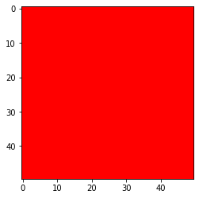

Working with color images
# Get the dimensions (shape):
color_img.shape: (50, 400, 3)
# Get total number of elements:
color_img.size: 60000
# Type of the elements:
color_img.dtype: uint8
# Get the pixel value at y=10,x=60
color_img[10, 60]: (255,0,255)
# Get only green value at y=10,x=310
color_img[10, 310, 1]: 255
# Set value to the pixel y=10,x=20
color_img[10, 20] = (255, 255, 0)
# Get ROI of the image:
roi_red = color_img[0:50, 250:300]
# Check the shape:
roi_red.shape: (50, 50, 3)
# Set ROI of the image
color_img[0:50, 50:100] = roi_red

Slide 6

Sample gray image (using NumPy)
import numpy as np
def build_sample_image_grayscale():
"""Builds a sample image with 50x50 regions of different tones of gray"""
# Define the different tones.
# The end of interval is not included
tones = np.arange(start=50, stop=300, step=50)
# print(tones)
# Initialize result with the first 50x50 region with 0-intensity level
result = np.zeros((50, 50), dtype="uint8")
# Build the image concatenating horizontally the regions:
for tone in tones:
img = np.ones((50, 50), dtype="uint8") * tone
result = np.concatenate((result, img), axis=1)
return result
# Create the gray image using the function defined above:
gray_img = build_sample_image_grayscale()

Slide 7
Working with gray images
# Get the dimensions (shape):
gray_img.shape: (50, 300)
# Get total number of elements
gray_img.size: 15000
# Type of the elements:
gray_img.dtype: uint8
# Get the pixel value at y=10,x=60
gray_img[10, 60]: 50
# Set value to the pixel y=10,x=20
gray_img[10, 20] = 65

Slide 8
OpenCV
Basic image treatment in OpenCV
https://github.com/albertofernandezvillan/computer-vision-and-deep-learning-course
Notes:
Empezar con el ejemplo del tren en la pizarra

