Slide 1
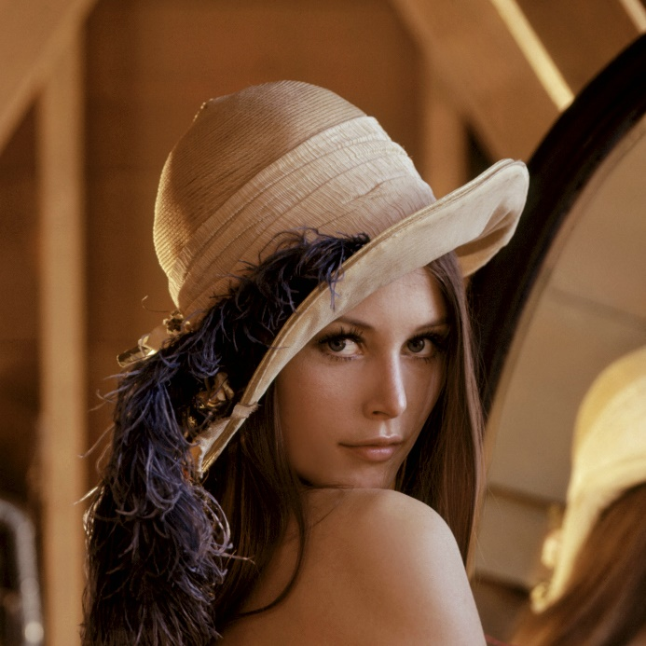
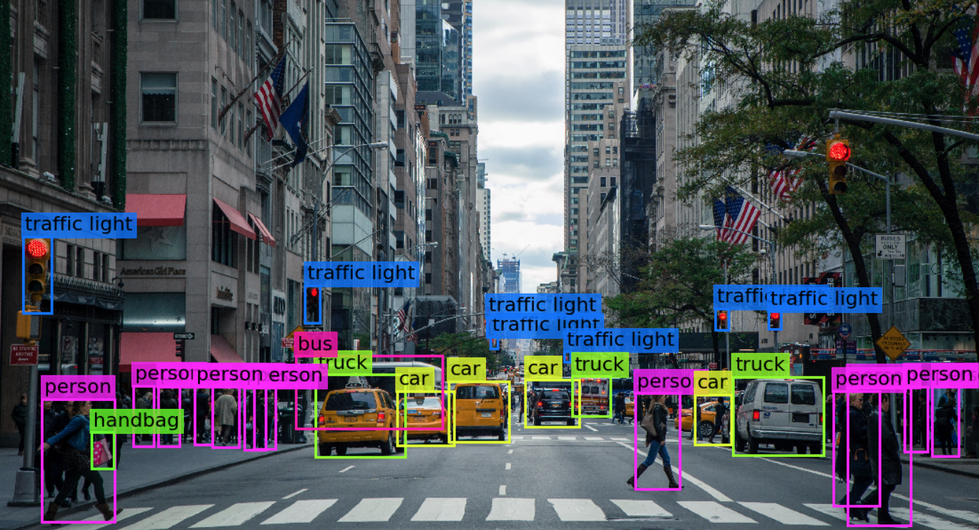

Visión por computador en la nueva era de la Inteligencia Artificial y el Deep Learning
Computer vision in the new era of Artificial Intelligence and Deep Learning
Rubén Usamentiaga*, Alberto Fernándezº
* University of Oviedo
º TSK
Gijón (Spain)
5 – 16 April 2021
https://github.com/albertofernandezvillan/computer-vision-and-deep-learning-course

Slide 2

OpenCV
Drawing in OpenCV
Notebooks: basic_drawing_opencv.ipynb
drawing_text_and_symbols_in_opencv.ipynb
basic_drawing_opencv.ipynb
drawing_text_and_symbols_in_opencv.ipynb
basic_drawing_opencv.ipynb
drawing_text_and_symbols_in_opencv.ipynb
https://github.com/albertofernandezvillan/computer-vision-and-deep-learning-course
Notes:
Empezar con el ejemplo del tren en la pizarra

Slide 3
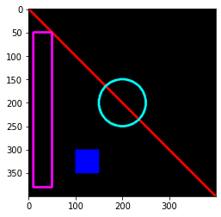
Basic drawing with OpenCV
import cv2
from matplotlib import pyplot as plt
image = create_canvas()
cv2.line(image, (0, 0), (400, 400), (0, 0, 255), 3)
cv2.rectangle(image, (10, 50), (50, 380), (255, 0, 255), 3)
cv2.rectangle(image, (100, 300), (150, 350), (255, 0, 0), -1)
cv2.circle(image, (200, 200), 50, (255, 255), 3)
plt.imshow(image[:, :, ::-1])
import numpy as np
def create_canvas():
canvas = np.zeros((400, 400, 3), dtype="uint8")
return canvas

Slide 4
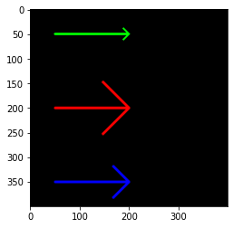
Basic drawing with OpenCV
import cv2
from matplotlib import pyplot as plt
image = create_canvas()
cv2.arrowedLine(image, (50, 50), (200, 50), (0, 255, 0) , 3)
cv2.arrowedLine(image, (50, 200), (200, 200), (0, 0, 255) , 3, cv2.LINE_AA, 0, 0.5)
cv2.arrowedLine(image, (50, 350), (200, 350), (255, 0, 0) , 3, cv2.LINE_AA, 0, 0.3)
plt.imshow(image[:, :, ::-1])

Slide 5
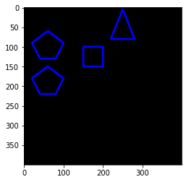
Basic drawing with OpenCV
import cv2
from matplotlib import pyplot as plt
image = create_canvas()
pts = np.array([[20, 90], [60, 60], [100, 90], [80, 130], [40, 130]], np.int32)
pts2 = np.array([[20, 180], [60, 150], [100, 180], [80, 220], [40, 220]], np.int32)
pts3 = np.array([[150, 100], [200, 100], [200, 150], [150, 150]], np.int32)
pts4 = np.array([[250, 5], [220, 80], [280, 80]], np.int32)
cv2.polylines(image, [pts, pts2, pts3, pts4], True, (255,0,0), 3)
plt.imshow(image[:, :, ::-1])

Slide 6
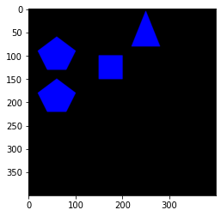
Basic drawing with OpenCV
import cv2
from matplotlib import pyplot as plt
image = create_canvas()
pts = np.array([[20, 90], [60, 60], [100, 90], [80, 130], [40, 130]], np.int32)
pts2 = np.array([[20, 180], [60, 150], [100, 180], [80, 220], [40, 220]], np.int32)
pts3 = np.array([[150, 100], [200, 100], [200, 150], [150, 150]], np.int32)
pts4 = np.array([[250, 5], [220, 80], [280, 80]], np.int32)
cv2.fillPoly(image, [pts, pts2, pts3, pts4], (255,0,0), cv2.LINE_AA)
plt.imshow(image[:, :, ::-1])

Slide 7
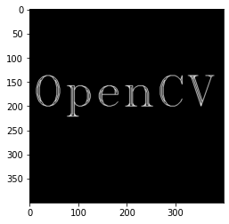
Drawing text with OpenCV
import cv2
from matplotlib import pyplot as plt
image = create_canvas()
font = cv2.FONT_HERSHEY_TRIPLEX
cv2.putText(image, 'OpenCV', (5, 200), font, 3, (255,255,255), 1, cv2.LINE_AA)
plt.imshow(image[:, :, ::-1])

Slide 8
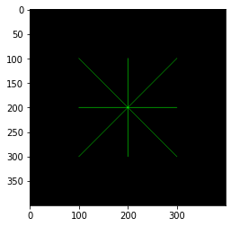
Drawing marker with OpenCV
import cv2
from matplotlib import pyplot as plt
image = create_canvas()
marker = cv2.MARKER_STAR
print("Marker MARKER_STAR is equals to '{}'".format(marker))
cv2.drawMarker(image, (200,200), (0,255,0), marker, 200)
plt.imshow(image[:, :, ::-1])

Slide 9
OpenCV
Drawing in OpenCV
https://github.com/albertofernandezvillan/computer-vision-and-deep-learning-course
Notes:
Empezar con el ejemplo del tren en la pizarra

