Slide 1
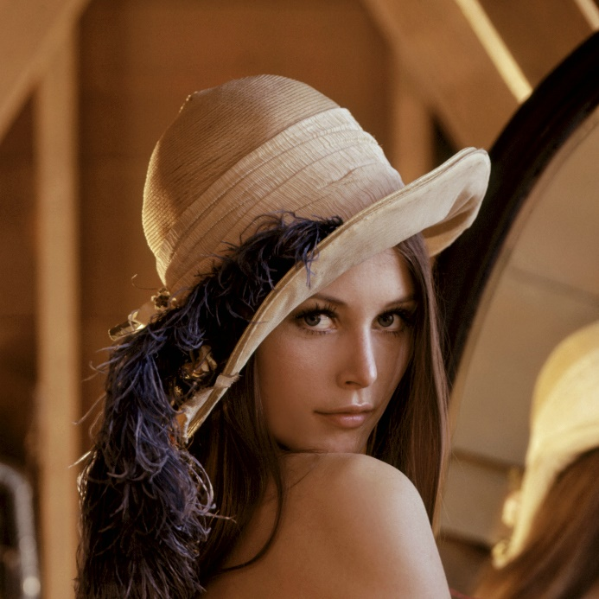
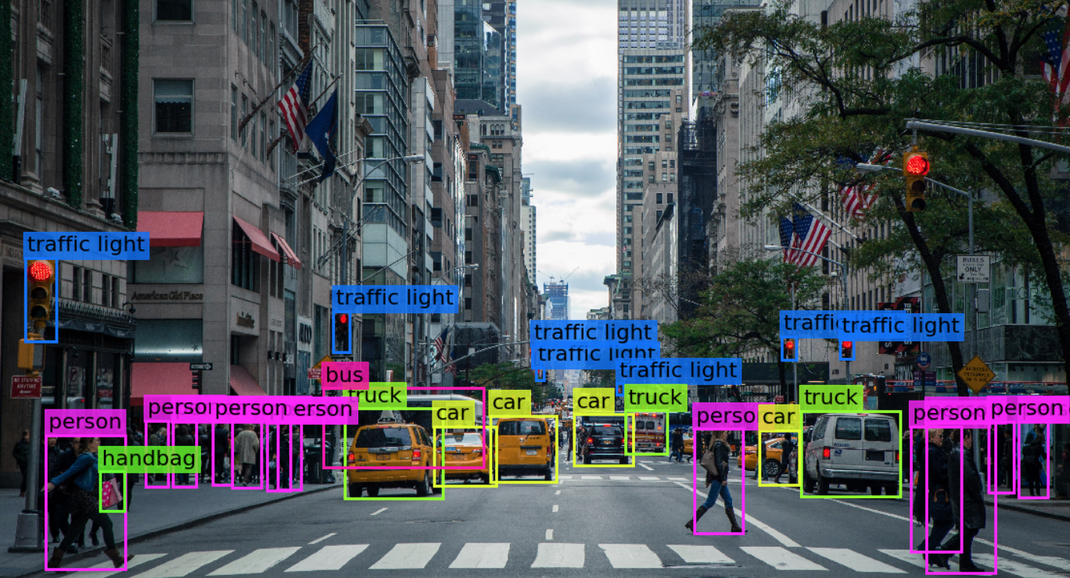

Visión por computador en la nueva era de la Inteligencia Artificial y el Deep Learning
Computer vision in the new era of Artificial Intelligence and Deep Learning
Rubén Usamentiaga*, Alberto Fernándezº
* University of Oviedo
º TSK
Gijón (Spain)
5 – 16 April 2021
https://github.com/albertofernandezvillan/computer-vision-and-deep-learning-course

Slide 2

Google Colab
Collection of features, utilities and tricks on Colab and/or Python
Notebook: collection_of_some_features_utilities_and_tricks.ipynb
computer-vision-and-deep-learning-course/collection_of_some_features_utilities_and_tricks.ipynb at main · albertofernandezvillan/computer-vision-and-deep-learning-course (github.com)
collection_of_some_features_utilities_and_tricks.ipynb - Colaboratory (google.com)
https://github.com/albertofernandezvillan/computer-vision-and-deep-learning-course
Notes:
Empezar con el ejemplo del tren en la pizarra

Slide 3
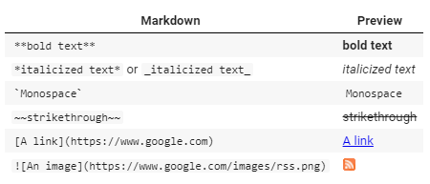
Markdown
Markdown | Preview
--- | ---
`**bold text**` | **bold text**
`*italicized text*` or `_italicized text_` | *italicized text*
`` `Monospace` `` | `Monospace`
`~~strikethrough~~` | ~~strikethrough~~
`[A link](https://www.google.com)` | [A link](https://www.google.com)
`![An image](https://www.google.com/images/rss.png)` | ![An image](https://www.google.com/images/rss.png)

Slide 4




Markdown
* One
* Two
* Three
First column name | Second column name
-------------------|------------------
Row 1, Col 1 | Row 1, Col 2
Row 2, Col 1 | Row 2, Col 2
# Run Commands
To run commands in cells, we can simply prefix an exclamation mark before the command.
<img align="left" style="padding-right:10px;" src ="https://raw.githubusercontent.com/albertofernandezvillan/computer-vision-and-deep-learning-course/main/assets/university_oviedo_logo.png" width=300 px>

Slide 5
Run commands
To run commands in cells, we can simply prefix an exclamation mark before the command. For example, we can use pip command to install/uninstall a package
!pip install python-dotenv==0.15.0
One common issue associated with running commands is how we interact with prompts, such as installation confirmation (yes or no). The trick is to append the yes flag (-y) to the command.
!pip uninstall python-dotenv==0.15.0 -y

Slide 6


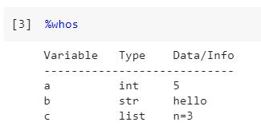
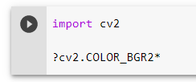
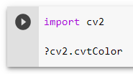
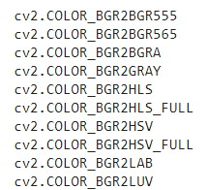
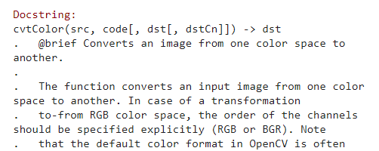
Active variables and API Lookups
To see the current variables, we can use the magic method %who or %whos
We can make use of ? to explore the API we are working with.

Slide 7
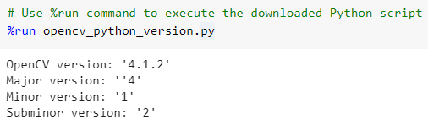
Magic commands
IPython Magic Commands are added on top of the normal Python syntax and are prefixed by the % character:
line magics (%) operate on a single line of input
cell magics (%%) operate on multiple lines of input

Slide 8
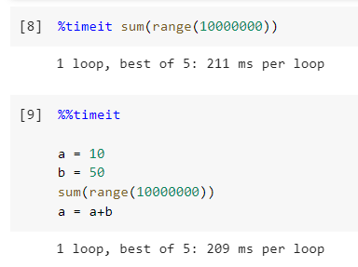
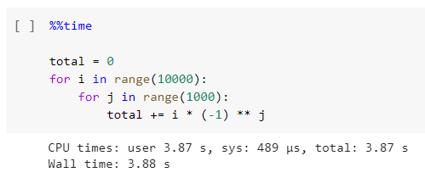
Timing Code Execution: %time and %timeit
%time: Time the execution of a single statement
%timeit: Time repeated execution of a single statement for more accuracy

Slide 9
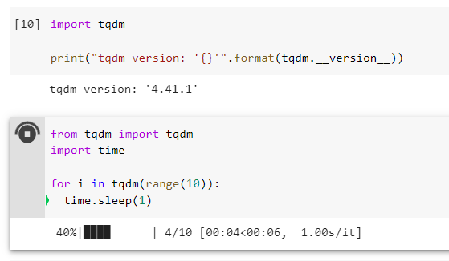
Progress bar
We can make use of tqdm to show the progress bar in a loop. With tqdm, we can instantly make our loops show a smart progress meter: just wrap any iterable with tqdm(iterable)

Slide 10
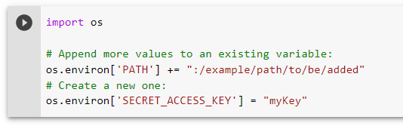

Environment Variables
It is not recommended to upload private information to Github or other platforms (even if your repository is private). We can set and get the environment variables in Colab like this:
/usr/local/nvidia/bin:/usr/local/cuda/bin:/usr/local/sbin:/usr/local/bin:/usr/sbin:/usr/bin:/sbin:/bin:/tools/node/bin:/tools/google-cloud-sdk/bin:/opt/bin:/example/path/to/be/added
Wen can access the value of these environment variables using os.getenv()
myKey

Slide 11
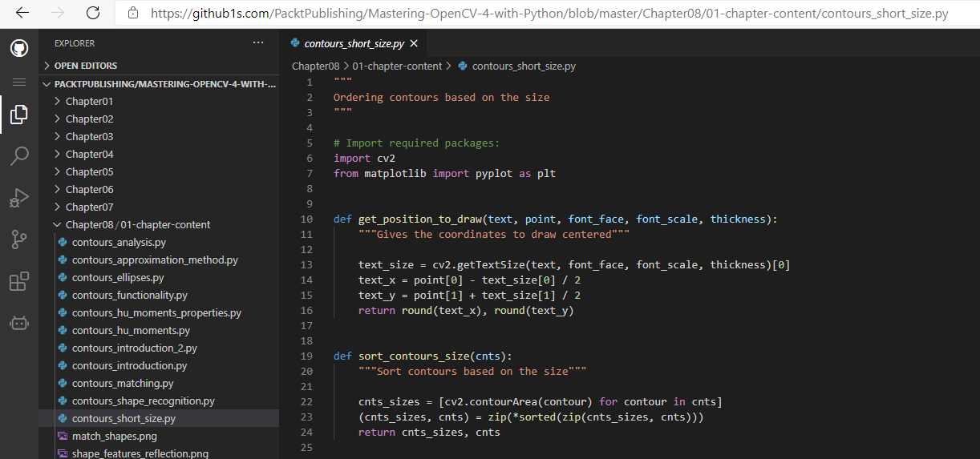
Github1s - Browse Projects on VSCode in Your Browser
https://github.com/PacktPublishing/Mastering-OpenCV-4-with-Python/blob/master/Chapter08/01-chapter-content/contours_short_size.py
https://github1s.com/PacktPublishing/Mastering-OpenCV-4-with-Python/blob/master/Chapter08/01-chapter-content/contours_short_size.py

Slide 12
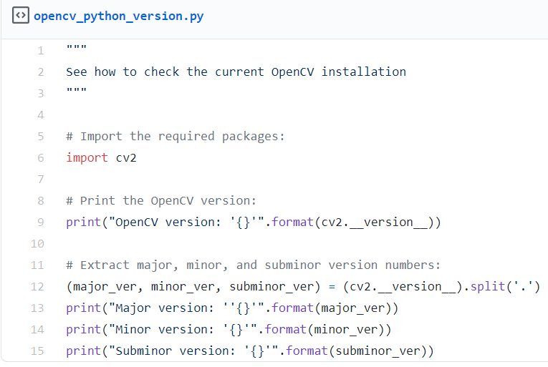
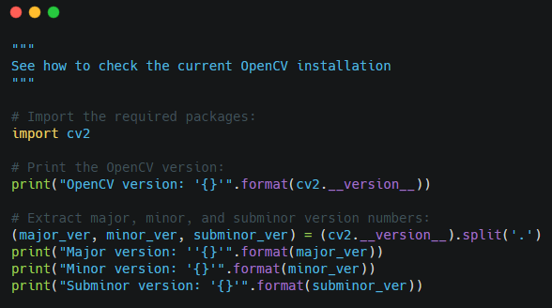
Create and share beautiful images of your source code
We are going to make use of Carbon. There are a few different ways to import code into Carbon (see accompanying notebook)
https://gist.github.com/albertofernandezvillan/050687ee7f3b01aacd2277a5e7b2f125
https://carbon.now.sh/050687ee7f3b01aacd2277a5e7b2f125

Slide 13
Google Colab
Collection of features, utilities and tricks on Colab and/or Python
https://github.com/albertofernandezvillan/computer-vision-and-deep-learning-course
Notes:
Empezar con el ejemplo del tren en la pizarra

