Slide 1

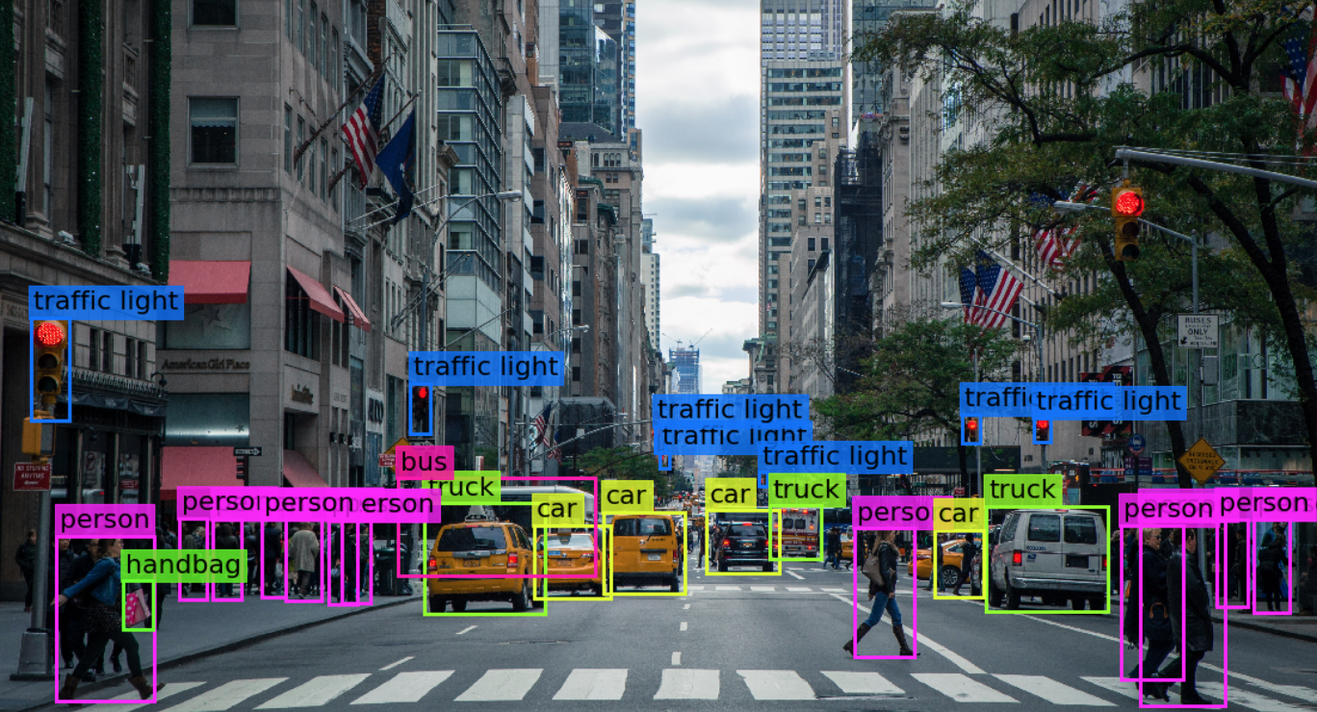

Visión por computador en la nueva era de la Inteligencia Artificial y el Deep Learning
Computer vision in the new era of Artificial Intelligence and Deep Learning
Rubén Usamentiaga*, Alberto Fernándezº
* University of Oviedo
º TSK
Gijón (Spain)
5 – 16 April 2021
https://github.com/albertofernandezvillan/computer-vision-and-deep-learning-course

Slide 2

Scikit-learn
Introduction to metrics in scikit-learn
metrics_for_classification_with_scikit_learn.ipynb
metrics_for_classification_with_scikit_learn.ipynb
https://github.com/albertofernandezvillan/computer-vision-and-deep-learning-course
Notes:
Empezar con el ejemplo del tren en la pizarra

Slide 3
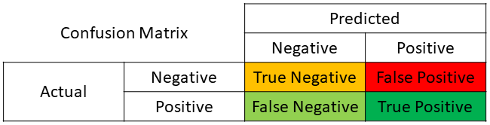
Metrics for classification
Study evaluating a test that screens people for a disease. The test outcome can be:
Positive: classifying the person as having the disease
Negative: classifying the person as not having the disease
True positive (TP): Sick people (actual = 1) correctly identified as sick (predicted = 1)
False positive (FP): Healthy people (actual = 0) incorrectly identified as sick (predicted = 1)
True negative (TN): Healthy people (actual = 0) correctly identified as healthy (predicted = 0)
False negative (FN): Sick people (actual = 1) incorrectly identified as healthy (predicted = 0)

Slide 4
Metrics for classification
Study evaluating a test that screens people for a disease. The test outcome can be:
Positive: classifying the person as having the disease
Negative: classifying the person as not having the disease
True positive (TP): Sick people (actual = 1) correctly identified as sick (predicted = 1)
False positive (FP): Healthy people (actual = 0) incorrectly identified as sick (predicted = 1)
True negative (TN): Healthy people (actual = 0) correctly identified as healthy (predicted = 0)
False negative (FN): Sick people (actual = 1) incorrectly identified as healthy (predicted = 0)
All the samples that are negative
All the samples that are positive
All the samples predicted as negative
All the samples predicted as positive

Slide 5
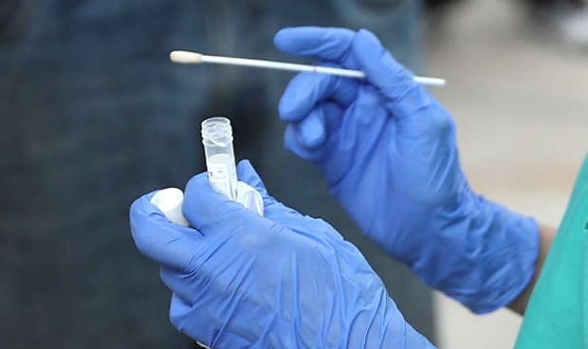
Metrics for classification
Using TP, FP, FN and TN, we can calculate some metrics: sensitivity (or recall), specificity, and precision.
Sensitivity (recall) is a measure of how well a test can identify true positives
Specificity is a measure of how well a test can identify true negatives.
Precision (positive predictive values (PPV)). It is the proportions of positive results that are true positive
Specificity
how sure you are of your true positives
Precision
Sensitivity (recall)

Slide 6
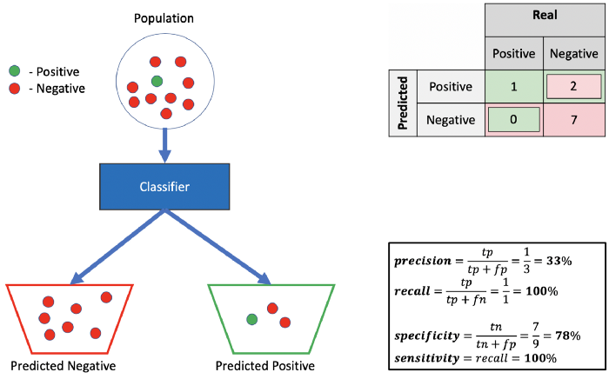
Metrics for classification
Sensitivity (recall) is a measure of how well a test can identify true positives
Specificity is a measure of how well a test can identify true negatives.
Precision (positive predictive values (PPV)). It is the proportions of positive results that are true positive (how sure you are of your true positives).
Accuracy: 80.00% (8/10)
F1 score (2 * (precision * recall) / (precision + recall)): 50.00%:

Slide 7
Metrics for classification in scikit-learn
from sklearn.metrics import accuracy_score
from sklearn.metrics import balanced_accuracy_score
from sklearn.metrics import confusion_matrix
from sklearn.metrics import precision_score
from sklearn.metrics import recall_score
from sklearn.metrics import f1_score
from sklearn.metrics import classification_report

Slide 8
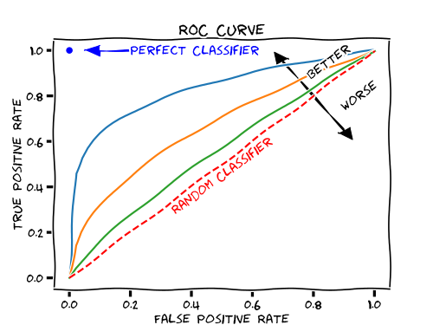
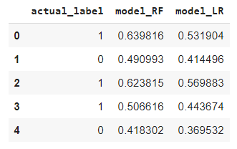
Metrics for classification in scikit-learn
Receiver Operating Characteristic (ROC) curve
from sklearn.metrics import roc_curve
Compute Area Under the Receiver Operating Characteristic Curve (ROC AUC)
from sklearn.metrics import roc_auc_score
Trade-offs between true positive (benefits) and false positive (costs)
100% sensitivity
(no false negatives)
100% specificity
(no false positives)
sensitivity
As you decrease the threshold you get higher TPR at the cost of a higher FPR
1 - specificity

Slide 9
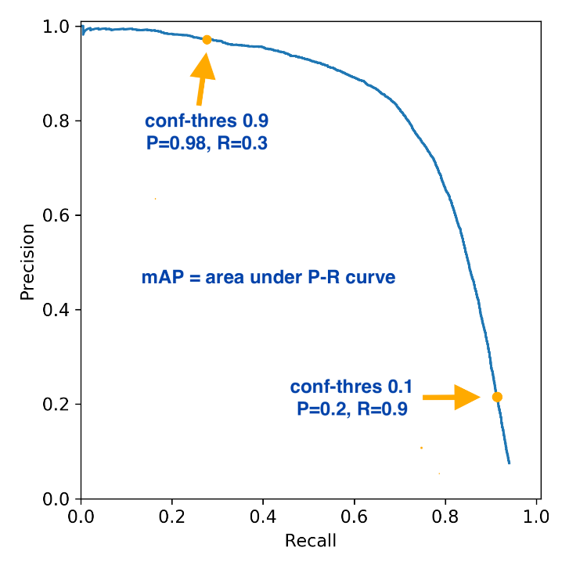
Metrics for classification in scikit-learn
from sklearn.metrics import precision_recall_curve
How sure you are about your positives
As you decrease the threshold you get higher recall at the cost of a lower precision (I will be not sure about my positives)
Recall = Sensitivity
how well we can identify true positives

Slide 10
Scikit-learn
Introduction to metrics in scikit-learn
https://github.com/albertofernandezvillan/computer-vision-and-deep-learning-course
Notes:
Empezar con el ejemplo del tren en la pizarra

