Slide 1
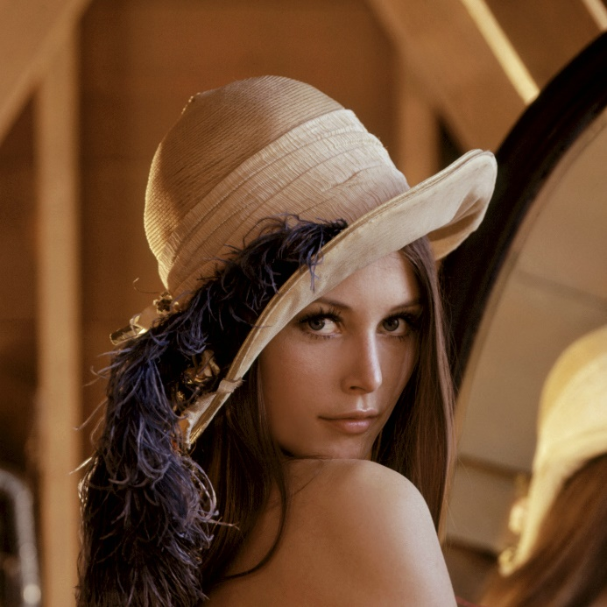
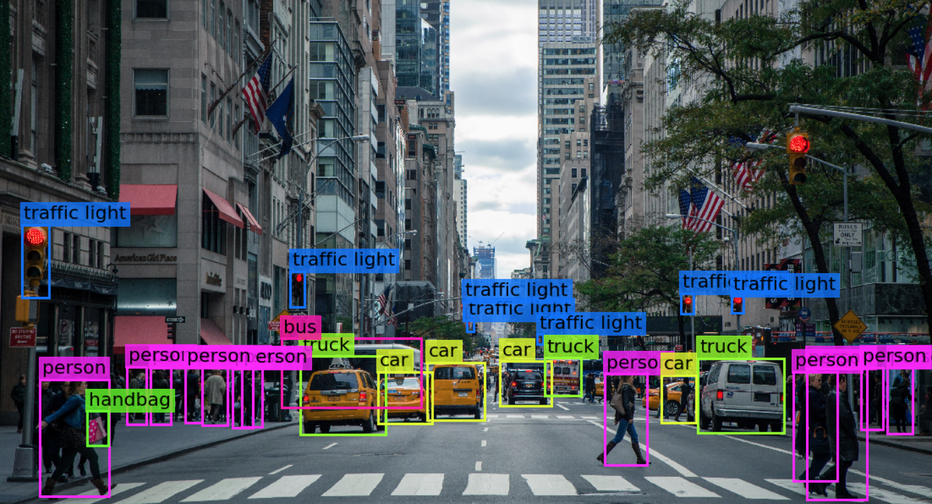

Visión por computador en la nueva era de la Inteligencia Artificial y el Deep Learning
Computer vision in the new era of Artificial Intelligence and Deep Learning
Rubén Usamentiaga*, Alberto Fernándezº
* University of Oviedo
º TSK
Gijón (Spain)
5 – 16 April 2021
https://github.com/albertofernandezvillan/computer-vision-and-deep-learning-course

Slide 2

OpenCV
Configure OpenCV with GPU on Colab
and benchmarking inference speed
configure_opencv_with_gpu_on_colab.ipynb
benchmarking_inference_speed_gpu_vs_cpu_opencv_on_colab.ipynb
yolo_v4_opencv_dnn.ipynb
configure_opencv_with_gpu_on_colab.ipynb
benchmarking_inference_speed_gpu_vs_cpu_opencv_on_colab.ipynb
yolo_v4_opencv_dnn.ipynb
https://github.com/albertofernandezvillan/computer-vision-and-deep-learning-course
Notes:
Empezar con el ejemplo del tren en la pizarra

Slide 3
Configure OpenCV with GPU on Colab
Ref 1describes how to install and compile OpenCV with GPU support. Installing OpenCV for GPU support is easier in Colab because this environment has many dependencies onboard.
I have followed the instructions given here: “how-to-make-opencv-use-gpu-on-google-colab”
%cd /content
!git clone https://github.com/opencv/opencv
!git clone https://github.com/opencv/opencv_contrib
!mkdir /content/build
%cd /content/build
!cmake -DOPENCV_EXTRA_MODULES_PATH=/content/opencv_contrib/modules -DBUILD_SHARED_LIBS=OFF -DBUILD_TESTS=OFF -DBUILD_PERF_TESTS=OFF -DBUILD_EXAMPLES=OFF -DWITH_OPENEXR=OFF -DWITH_CUDA=ON -DWITH_CUBLAS=ON -DWITH_CUDNN=ON -DOPENCV_DNN_CUDA=ON /content/opencv
!make -j8 install
Ref 1: How to use OpenCV’s “dnn” module with NVIDIA GPUs, CUDA, and cuDNN

Slide 4
Configure OpenCV with GPU on Colab
cv2.getBuildInformation(): To check how the current installation of OpenCV was built
import cv2
import re
cv_info = [re.sub('\s+', ' ', ci.strip()) for ci in cv2.getBuildInformation().strip().split('\n')
if len(ci) > 0 and re.search(r'(nvidia*:?)|(cuda*:)|(cudnn*:)', ci.lower()) is not None]
print(cv_info)
['NVIDIA CUDA: YES (ver 10.1, CUFFT CUBLAS)', 'NVIDIA GPU arch: 30 35 37 50 52 60 61 70 75', 'NVIDIA PTX archs:', 'cuDNN: YES (ver 7.6.5)']
You can also download the OpenCV 4.5.1 library compiled with GPU support from this link, or using the following command:
!gdown --id 1-Ze3zkdzA_kDsakY_hGAZRh3aK3p5lHk

Slide 5
Configure OpenCV with GPU on Colab
# Test everything:
import cv2
import re
cv_info = [re.sub('\s+', ' ', ci.strip()) for ci in cv2.getBuildInformation().strip().split('\n')
if len(ci) > 0 and re.search(r'(nvidia*:?)|(cuda*:)|(cudnn*:)', ci.lower()) is not None]
print(cv_info)
print('You need OpenCV 4.2 or above to use DNN_BACKEND_CUDA & DNN_TARGET_CUDA')
print('Lets check it')
print("Current OpenCV installation: '{}'".format(cv2.__version__))
try:
print("cv2.dnn.DNN_BACKEND_CUDA: '{}'".format(cv2.dnn.DNN_BACKEND_CUDA))
print("cv2.dnn.DNN_TARGET_CUDA: '{}'".format(cv2.dnn.DNN_TARGET_CUDA))
except AttributeError:
print("It seems like your current OpenCV version is < 4.2 with no GPU support")
['NVIDIA CUDA: YES (ver 10.1, CUFFT CUBLAS)', 'NVIDIA GPU arch: 30 35 37 50 52 60 61 70 75', 'NVIDIA PTX archs:', 'cuDNN: YES (ver 7.6.5)']
You need OpenCV 4.2 or above to use DNN_BACKEND_CUDA & DNN_TARGET_CUDA
Lets check it
Current OpenCV installation: '4.5.1-dev'
cv2.dnn.DNN_BACKEND_CUDA: '5'
cv2.dnn.DNN_TARGET_CUDA: '6'

Slide 6
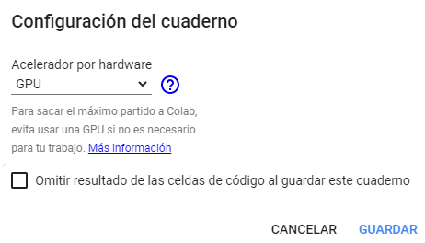
Benchmarking gpu vs cpu Opencv on Colab
Check that the GPU is activated (and check it in your notebook)
!nvidia-smi -L
GPU 0: Tesla T4 (UUID: GPU-ec920886-668d-ad63-e0df-cc77e5673b16)

Slide 7
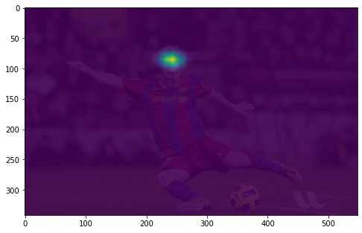
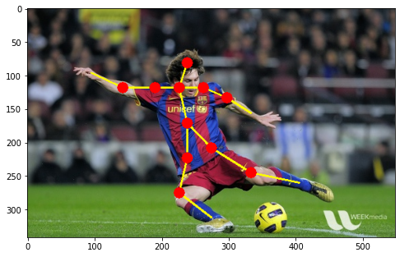
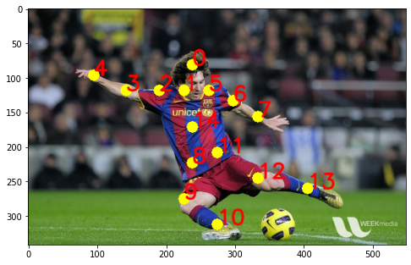
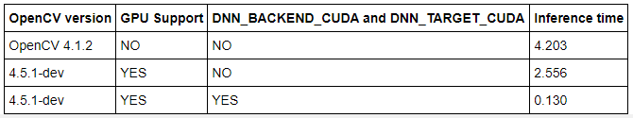
pre-trained model for human pose estimation

Slide 8
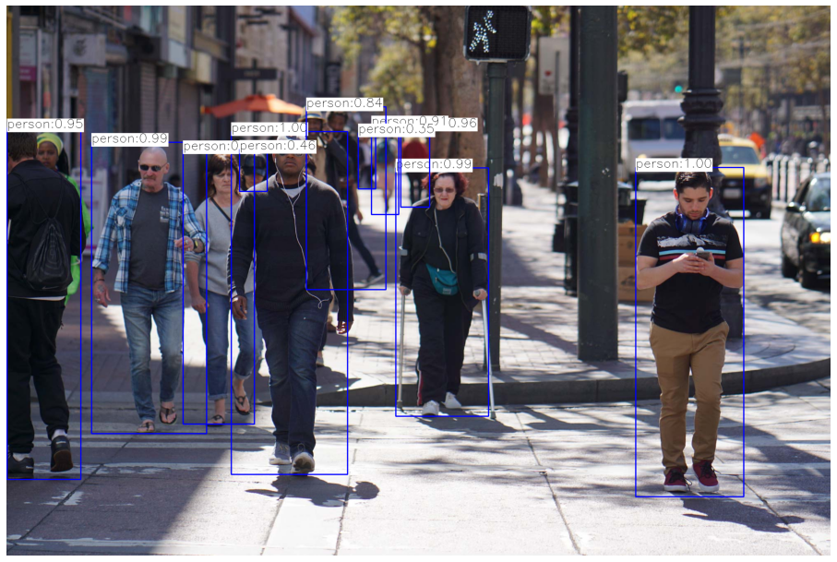
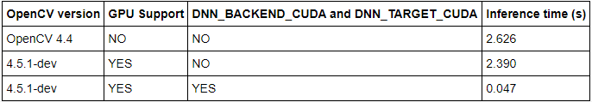
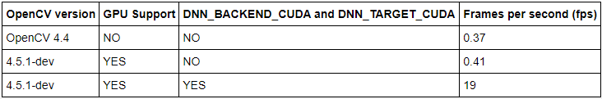
pre-trained model for object detection (YOLO V4)

Slide 9
OpenCV
Configure OpenCV with GPU on Colab
and benchmarking inference speed
https://github.com/albertofernandezvillan/computer-vision-and-deep-learning-course
Notes:
Empezar con el ejemplo del tren en la pizarra

