Slide 1
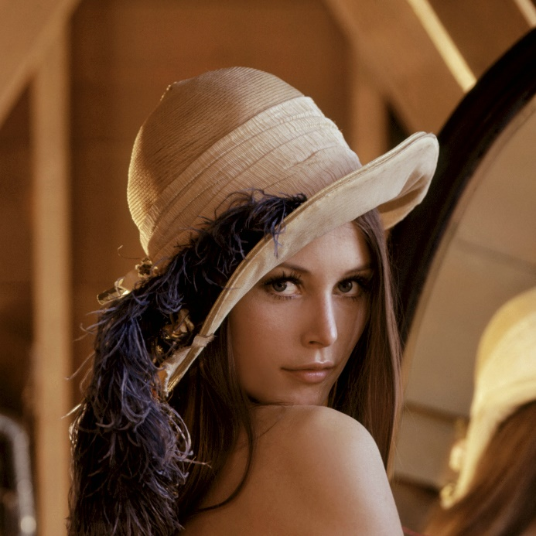
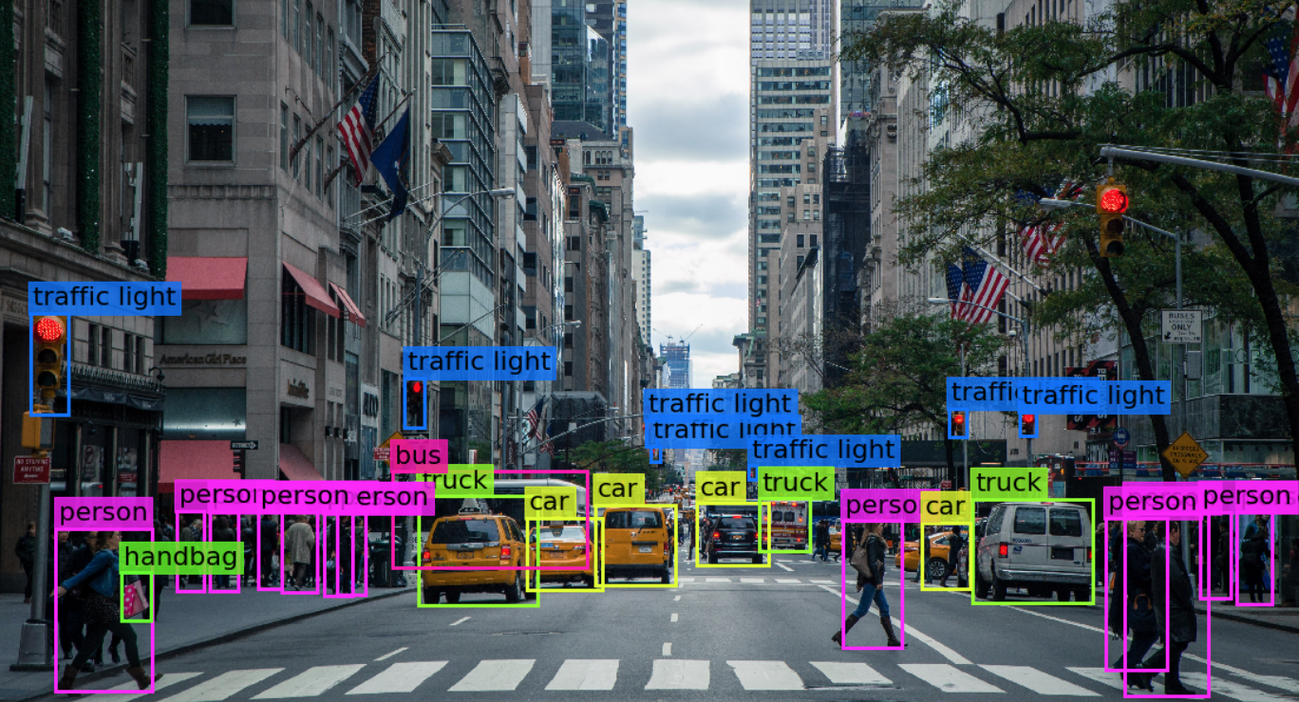

Visión por computador en la nueva era de la Inteligencia Artificial y el Deep Learning
Computer vision in the new era of Artificial Intelligence and Deep Learning
Rubén Usamentiaga*, Alberto Fernándezº
* University of Oviedo
º TSK
Gijón (Spain)
5 – 16 April 2021
https://github.com/albertofernandezvillan/computer-vision-and-deep-learning-course

Slide 2

Google Colab
Take both images and videos from webcam in Colab
Notebooks: take_image_from_webcam_as_numpy_array.ipynb
take_video_from_webcam_in_colab.ipynb
take_image_from_webcam_as_numpy_array.ipynb
take_video_from_webcam_in_colab.ipynb
take_image_from_webcam_as_numpy_array.ipynb
take_video_from_webcam_in_colab.ipynb
https://github.com/albertofernandezvillan/computer-vision-and-deep-learning-course
Notes:
Empezar con el ejemplo del tren en la pizarra

Slide 3
Taking images/videos from webcam in Colab
OpenCV provides cv2.VideoCapture() object to capture live stream with camera. See this script to see how to use cv2.VideoCapture().
However, cv2.VideoCapture() does not work in Colab, because the previous method can only access hardware (e.g. webcam) connected locally.
The solution is to code our own methods. For similar approaches you can check the following links:
“VideoCapture in Colab: How do i use cv2.VideoCapture(0) in google colab”
“Camera Capture”: This function does not return the image. It takes the image from the webcam and saves the file on disk
“Direct access to your webcam inside Colab”

Slide 4
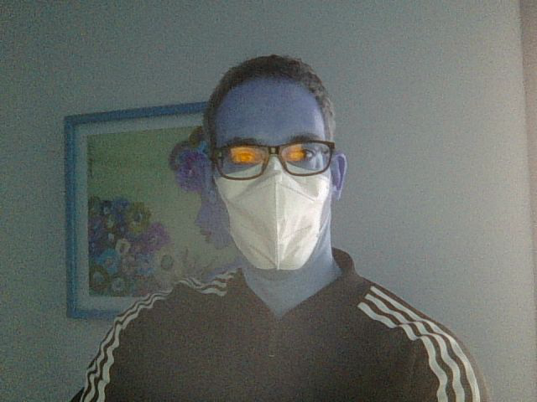
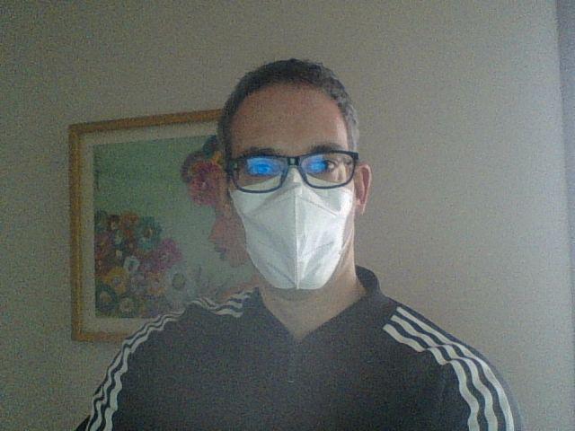
Taking images from webcam in Colab
See the accompanying notebook “take_image_from_webcam_as_numpy_array.ipynb”
to see the implementation of the method take_photo(), which returns a numpy array.
img = take_photo(quality=0.8)
# Printing the shape of the image
# This returns, for example: (480, 640, 3)
print(img.shape)
from google.colab.patches import cv2_imshow
cv2_imshow(img)
img_bgr = img[:, :, ::-1]
cv2_imshow(img_bgr)
the returned image is in RGB format
OpenCV works in BGR format

Slide 5
Taking video from webcam in Colab
This repository provides the required functionality to take video from webcam. To install it, we make use of download_and_execute_file() function (see accompanying notebook take_video_from_webcam_in_colab.ipynb). The file that is going to be executed is located here and contains the implementation.
fname = 'colab_utils.py'
url = 'https://raw.githubusercontent.com/albertofernandezvillan/computer-vision-and-deep-learning-course/main/assets/colab_utils/colab_utils.py'
download_and_execute_file(fname, url, params= "", execute=True, show_content=False)
Once installed, we can use our own
videoGrabber, and use it as follows:
total_iter=20
vid = videoGrabber(showVideo=False)
try:
n_iter = 0
while n_iter <= total_iter:
n_iter += 1
image_np = np.array(vid(0))
imshow(image_np)
finally:
vid(stop=True)

Slide 6
Google Colab
Take both images and videos from webcam in Colab
https://github.com/albertofernandezvillan/computer-vision-and-deep-learning-course
Notes:
Empezar con el ejemplo del tren en la pizarra

