Slide 1

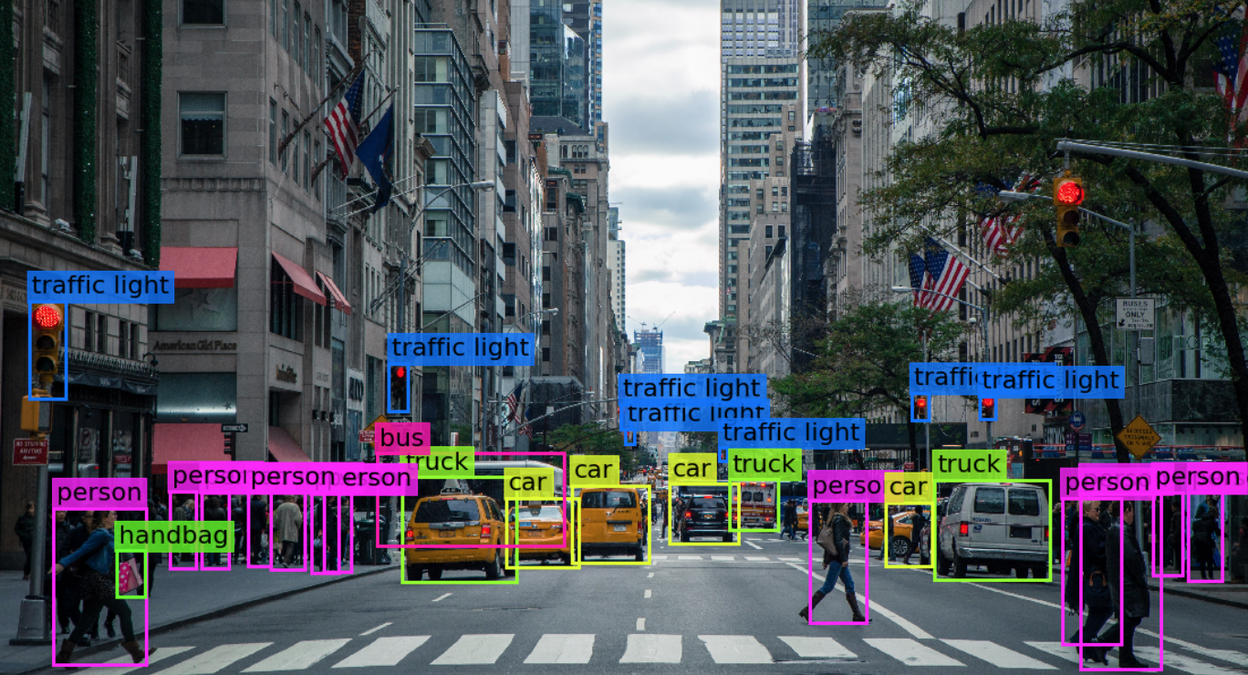

Visión por computador en la nueva era de la Inteligencia Artificial y el Deep Learning
Computer vision in the new era of Artificial Intelligence and Deep Learning
Rubén Usamentiaga*, Alberto Fernándezº
* University of Oviedo
º TSK
Gijón (Spain)
5 – 16 April 2021
https://github.com/albertofernandezvillan/computer-vision-and-deep-learning-course

Slide 2

Pandas
Introduction to pandas
pandas_introduction.ipynb
pandas_introduction.ipynb
https://github.com/albertofernandezvillan/computer-vision-and-deep-learning-course
Notes:
Empezar con el ejemplo del tren en la pizarra

Slide 3
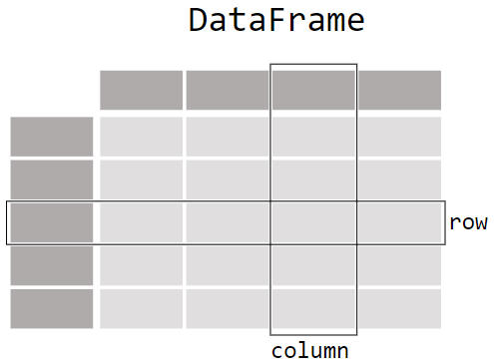
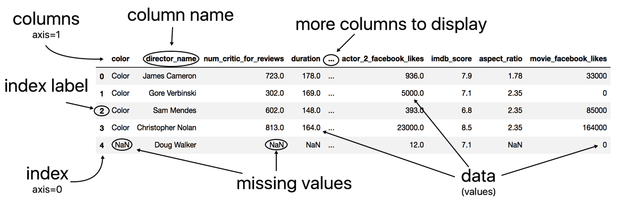
Anatomy of a DataFrame
The Pandas DataFrame is a structure that contains two-dimensional data and its corresponding labels.
It is composed of three different components, the index, columns, and the data.

Slide 4
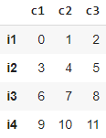



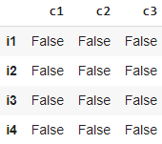
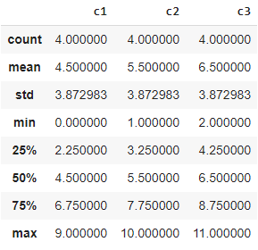
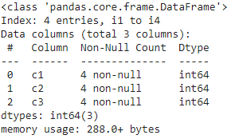

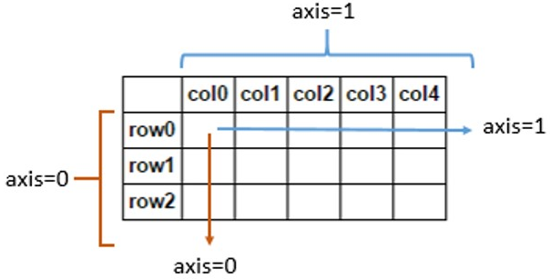
Exploring a DataFrame
df.columns
df.head(2)
data = np.array([np.arange(3),
np.arange(3,6),
np.arange(6,9),
np.arange(9,12)])
df = pd.DataFrame(data=data,
index=["i1", "i2", "i3", "i4"],
columns=["c1", "c2", "c3"])
df.tail(1)
df.dtypes
df.shape
df.empty
df.size
c1 int64
c2 int64
c3 int64
(4, 3)
False
12
df.index
df.values
df.isnull().sum(axis=0)
df.isnull()
(rows: axis=0,cols: axis=1)
df.describe()
df.info()
df.isnull().sum(axis=1)

Slide 5
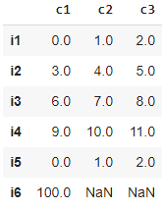
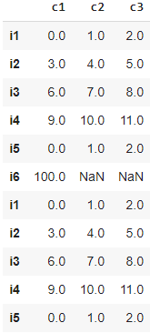
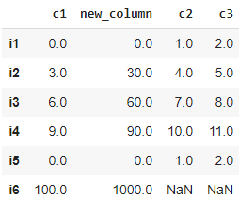
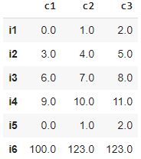

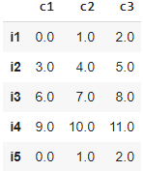
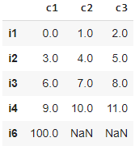
Working with a DataFrame
All the operations are referred to the initial DataFrame
data = np.array([np.arange(3), np.arange(3,6), np.arange(6,9), np.arange(9,12),np.arange(3),[100, np.nan, np.nan]])
df = pd.DataFrame(data=data,index=["i1", "i2", "i3", "i4", "i5", "i6"],columns=["c1", "c2", "c3"])
df2 = df.append(df)
df.insert(1, 'new_column', df['c1'] * 10)
df.fillna(123.0, inplace = True)
df.rename(columns={"c1": "C1"})
df.rename(index={"i1": "I1"})
df.dropna(axis=0, inplace = True)
df.drop_duplicates(inplace=True)
All rows with nan values will be deleted
‘first’ by default

Slide 6
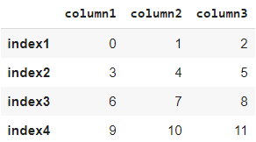
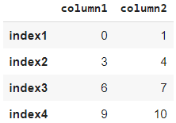

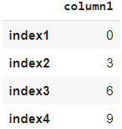
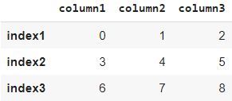

Selecting subsets of data in pandas DataFrame
numpy_data = np.array([np.arange(3), np.arange(3,6), np.arange(6,9), np.arange(9,12)])
df = pd.DataFrame(data=numpy_data, index=["index1", "index2", "index3", "index4"], columns=["column1", "column2", "column3"])
Selecting multiple columns returns a DataFrame
df[["column1","column2"]]
Selecting a single column returns a Series
df["column1"]
df.loc["index2","column1"]
df.loc[:,["column1"]]
df.loc["index1":"index3",:]
df.iloc[1, 0]
df.iloc[:, [0]]
df.iloc[0:3, :]
3
df.loc[["index2"],["column1"]]
df.iloc[[1], [0]]

Slide 7
Pandas
Introduction to pandas
https://github.com/albertofernandezvillan/computer-vision-and-deep-learning-course
Notes:
Empezar con el ejemplo del tren en la pizarra

