Slide 1

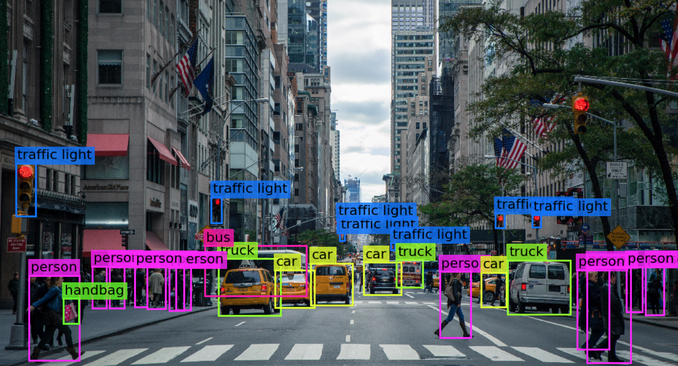

Visión por computador en la nueva era de la Inteligencia Artificial y el Deep Learning
Computer vision in the new era of Artificial Intelligence and Deep Learning
Rubén Usamentiaga*, Alberto Fernándezº
* University of Oviedo
º TSK
Gijón (Spain)
5 – 16 April 2021
https://github.com/albertofernandezvillan/computer-vision-and-deep-learning-course

Slide 2


Pandas
Introduction to pandas
Minimal example with pandas and scikit-learn
pandas_introduction.ipynb
pandas_and_scikit_learn_introduction.ipynb
pandas_introduction.ipynb
pandas_and_scikit_learn_introduction.ipynb
https://github.com/albertofernandezvillan/computer-vision-and-deep-learning-course
Notes:
Empezar con el ejemplo del tren en la pizarra

Slide 3
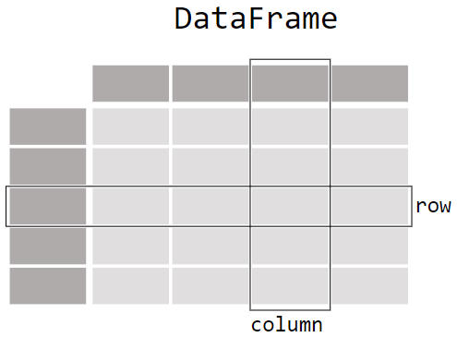
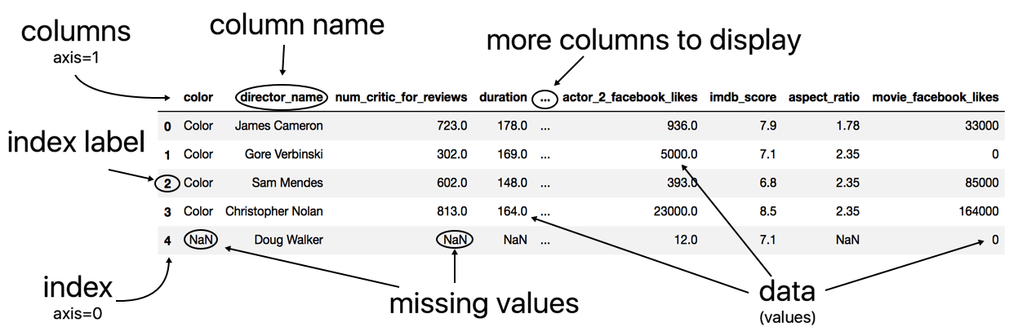
Anatomy of a DataFrame
The Pandas DataFrame is a structure that contains two-dimensional data and its corresponding labels.
It is composed of three different components, the index, columns, and the data.

Slide 4
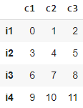



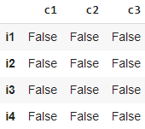
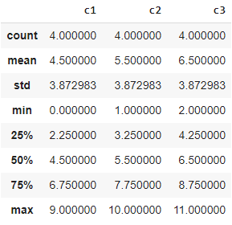
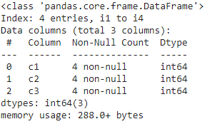

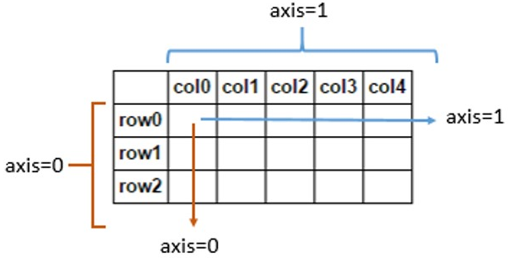
Exploring a DataFrame
df.columns
df.head(2)
data = np.array([np.arange(3),
np.arange(3,6),
np.arange(6,9),
np.arange(9,12)])
df = pd.DataFrame(data=data,
index=["i1", "i2", "i3", "i4"],
columns=["c1", "c2", "c3"])
df.tail(1)
df.dtypes
df.shape
df.empty
df.size
c1 int64
c2 int64
c3 int64
(4, 3)
False
12
df.index
df.values
df.isnull().sum(axis=0)
df.isnull()
(rows: axis=0,cols: axis=1)
df.describe()
df.info()
df.isnull().sum(axis=1)

Slide 5
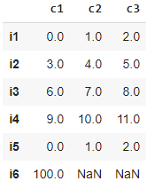
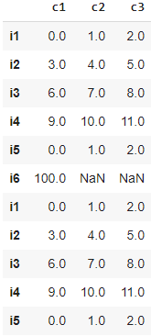
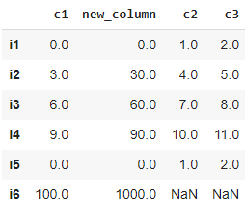
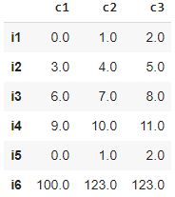

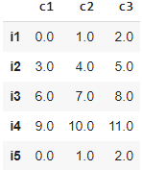
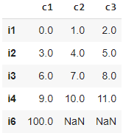
Working with a DataFrame
All the operations are referred to the initial DataFrame
data = np.array([np.arange(3), np.arange(3,6), np.arange(6,9), np.arange(9,12),np.arange(3),[100, np.nan, np.nan]])
df = pd.DataFrame(data=data,index=["i1", "i2", "i3", "i4", "i5", "i6"],columns=["c1", "c2", "c3"])
df2 = df.append(df)
df.insert(1, 'new_column', df['c1'] * 10)
df.fillna(123.0, inplace = True)
df.rename(columns={"c1": "C1"})
df.rename(index={"i1": "I1"})
df.dropna(axis=0, inplace = True)
df.drop_duplicates(inplace=True)
All rows with nan values will be deleted
‘first’ by default

Slide 6
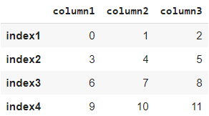
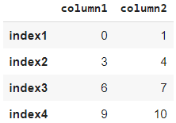

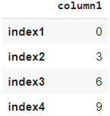
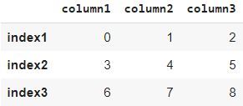

Selecting subsets of data in pandas DataFrame
numpy_data = np.array([np.arange(3), np.arange(3,6), np.arange(6,9), np.arange(9,12)])
df = pd.DataFrame(data=numpy_data, index=["index1", "index2", "index3", "index4"], columns=["column1", "column2", "column3"])
Selecting multiple columns returns a DataFrame
df[["column1","column2"]]
Selecting a single column returns a Series
df["column1"]
df.loc["index2","column1"]
df.loc[:,["column1"]]
df.loc["index1":"index3",:]
df.iloc[1, 0]
df.iloc[:, [0]]
df.iloc[0:3, :]
3
df.loc[["index2"],["column1"]]
df.iloc[[1], [0]]

Slide 7

Minimal example using both scikit-learn and pandas for classification
Import the dataset into a DataFrame
Explore the DataFrame (e.g. duplicates, null values, number of instances per class, ..)
Train the classifier
In this example, we have performed a minimal example using both pandas and scikit-learn to tackle a classification problem.
Note also that we have only trained the classifier but other points are missing (e.g. making predictions using the trained model, measuring the performance, model persistence,...). See this notebook, where aforementioned topics are covered using also this dataset.

Slide 8
Pandas
Introduction to pandas
Minimal example with pandas and scikit-learn
https://github.com/albertofernandezvillan/computer-vision-and-deep-learning-course
Notes:
Empezar con el ejemplo del tren en la pizarra

