Slide 1
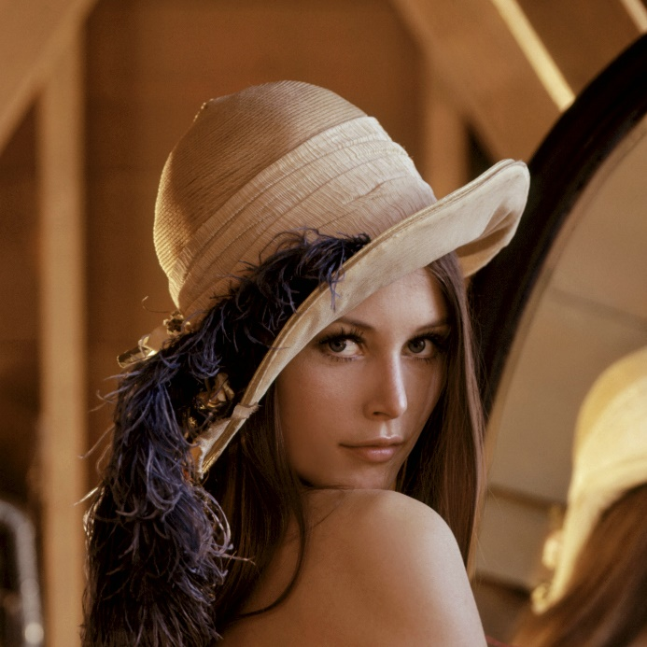
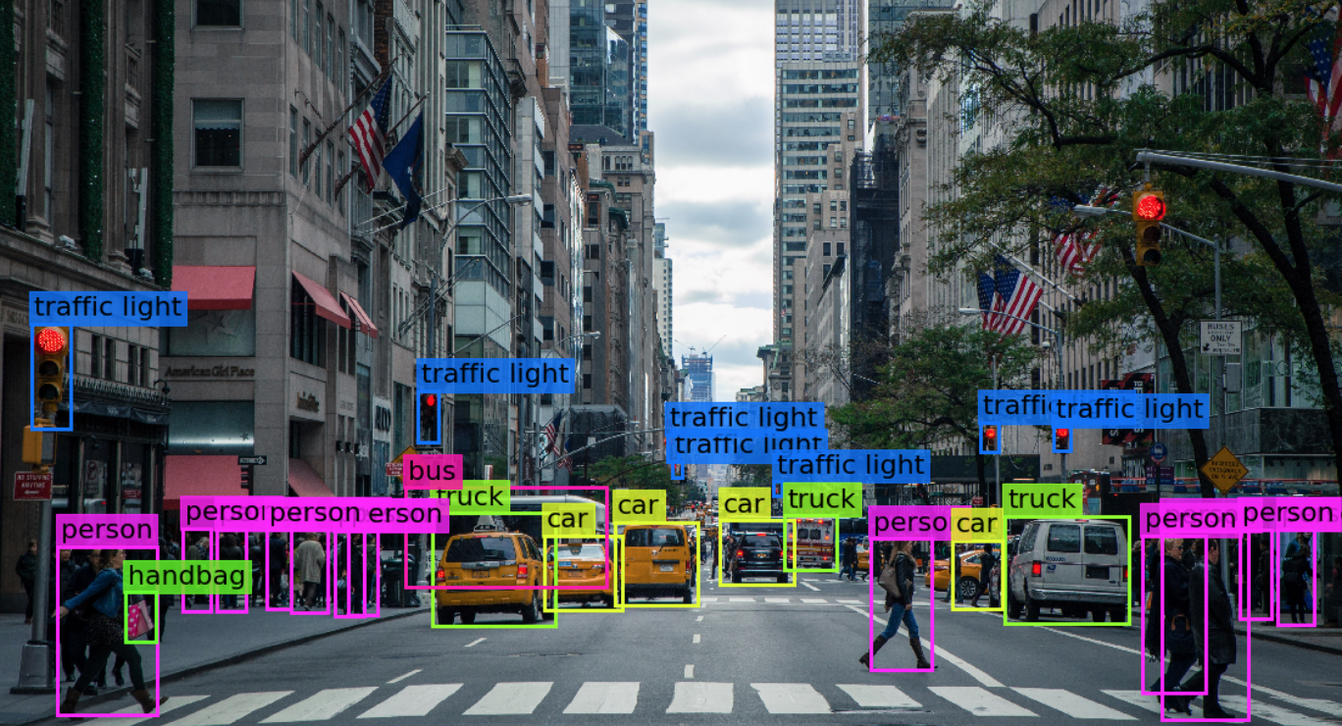

Visión por computador en la nueva era de la Inteligencia Artificial y el Deep Learning
Computer vision in the new era of Artificial Intelligence and Deep Learning
Rubén Usamentiaga*, Alberto Fernándezº
* University of Oviedo
º TSK
Gijón (Spain)
5 – 16 April 2021
https://github.com/albertofernandezvillan/computer-vision-and-deep-learning-course

Slide 2

Google Colab
Create and show multiple images in the same figure with matplotlib
Notebooks: show_multiple_images_same_figure_plt.ipynb
show_multiple_images_same_figure_plt.ipynb
show_multiple_images_same_figure_plt.ipynb
https://github.com/albertofernandezvillan/computer-vision-and-deep-learning-course
Notes:
Empezar con el ejemplo del tren en la pizarra

Slide 3
Coding the function show_img_plt()
from matplotlib import pyplot as plt
import cv2
def show_img_plt(img, is_color=True, title="", show_axis=True, n_rows=1, n_cols=1, pos=1):
"""Shows an image using matplotlib capabilities"""
if is_color:
# Convert BGR image to RGB
img_rgb = img[:, :, ::-1]
else:
# We convert the image from gray to BGR
img_rgb = cv2.cvtColor(img, cv2.COLOR_GRAY2BGR)
ax = plt.subplot(n_rows, n_cols, pos)
plt.imshow(img_rgb)
plt.title(title)
if show_axis is False:
plt.axis('off')

Slide 4
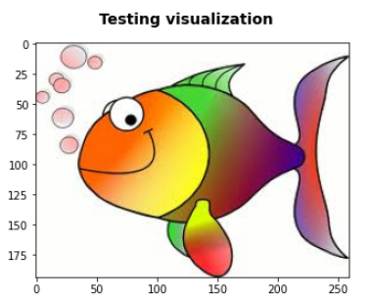
Testing the function show_img_plt()
img_bgr = cv2.imread("/content/HappyFish.jpg")
print("Loaded image with shape: '{}'".format(img_bgr.shape))
# Create the dimensions of the figure and set title:
plt.figure(figsize=(6, 4))
plt.suptitle("Testing visualization", fontsize=14, fontweight='bold')
show_img_plt(img_bgr)
# Show the created image:
plt.show()

Slide 5
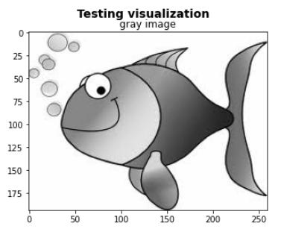
Testing the function show_img_plt()
img_gray = cv2.imread("/content/HappyFish.jpg", cv2.IMREAD_GRAYSCALE)
print("Loaded image with shape: '{}'".format(img_gray.shape))
# Create the dimensions of the figure and set title:
plt.figure(figsize=(6, 4))
plt.suptitle("Testing visualization", fontsize=14, fontweight='bold')
show_img_plt(img_gray, is_color=False, title='gray image')
# Show the created image:
plt.show()

Slide 6
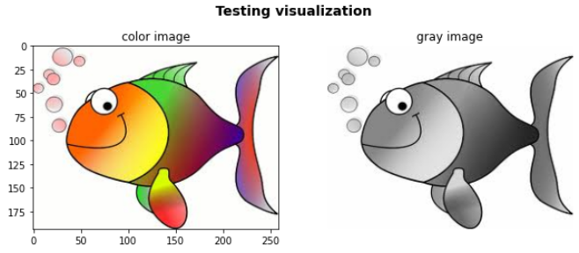
Testing the function show_img_plt()
# Create the dimensions of the figure and set title:
plt.figure(figsize=(10, 4))
plt.suptitle("Testing visualization", fontsize=14, fontweight='bold')
show_img_plt(img_bgr, is_color=True, title='color image', show_axis=True, n_rows=1, n_cols=2, pos=1)
show_img_plt(img_gray, is_color=False, title='gray image', show_axis=False, n_rows=1, n_cols=2, pos=2)
# Show the created image:
plt.show()

Slide 7
Google Colab
Create and show multiple images in the same figure with matplotlib
https://github.com/albertofernandezvillan/computer-vision-and-deep-learning-course
Notes:
Empezar con el ejemplo del tren en la pizarra

