Slide 1

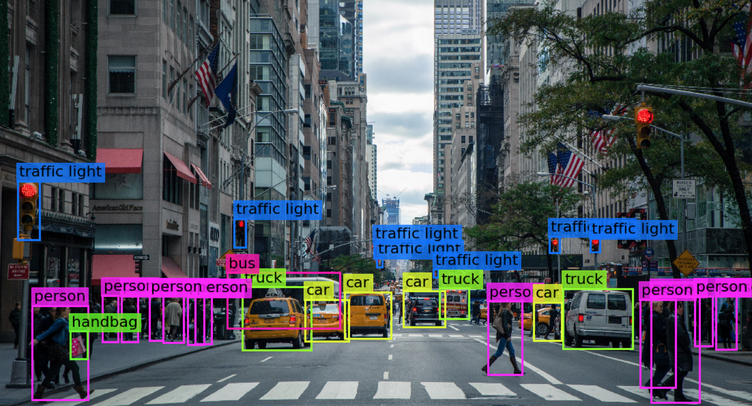

Visión por computador en la nueva era de la Inteligencia Artificial y el Deep Learning
Computer vision in the new era of Artificial Intelligence and Deep Learning
Rubén Usamentiaga*, Alberto Fernándezº
* University of Oviedo
º TSK
Gijón (Spain)
5 – 16 April 2021
https://github.com/albertofernandezvillan/computer-vision-and-deep-learning-course

Slide 2

Numpy
Notebook: numpy_introduction.ipynb
computer-vision-and-deep-learning-course/numpy_introduction.ipynb at main · albertofernandezvillan/computer-vision-and-deep-learning-course (github.com)
numpy_introduction.ipynb - Colaboratory (google.com)
https://github.com/albertofernandezvillan/computer-vision-and-deep-learning-course
Notes:
Empezar con el ejemplo del tren en la pizarra

Slide 3
Numpy introduction
Numpy is the core library for scientific computing in Python. It provides:
A high-performance multidimensional array object
Tools for working with these arrays
The core functionality of NumPy is its "ndarray", for n-dimensional array, data structure
These arrays are homogeneously typed (all elements of a single array must be of the same type)
Use the following import convention
import numpy as np

Slide 4
Numpy introduction
Most of the popular Machine Learning, Deep Learning, and Data Science libraries use NumPy under the hood:
Scikit-learn, Matplotlib, Pandas, OpenCV
NumPy arrays are stored at one continuous place in memory unlike lists
Processes can access and manipulate them very efficiently
This behavior is called “locality of reference” in computer science.

Slide 5
numpy.ndarray
The core functionality of NumPy is its "ndarray", for n-dimensional array, data structure
It is also known by the alias array
numpy.array() is just a method which returns an array object of the type ndarray
The more important attributes of an ndarray object are:
a.shape: tuple of integers indicating the size of the array in each dimensions
a.ndim: the number of axes (dimensions) of the array (also called as rank)
a.size: the total number of elements of the array
a.dtype: an object describing the type of the elements in the array
a.data: the buffer containing the actual elements of the array

Slide 6
Array creation and arithmetic with arrays
np.array([1, 2, 3]): This creates an array from a list of values
np.zeros((3,4)): This creates an array of zeros with the specified shape
np.ones((3,4)): This creates an array of ones with the specified shape
np.eye(2): This creates a diagonal 2x2 array
np.random.random((2,2)): This creates a random array with the specified shape
np.linspace(0,10,21): This creates an array with 21 elements from 0 to 10
np.arange(0,10.5,0.5): This creates an array from 0 to 10 (the upper interval 10.5 is not included) with a step of 0.5
array_a + array_b
array_b - array_a
# Example of broadcasting:
array_a + 5
# Element-wise multiplications:
array_a * array_b
np.multiply(array_a, array_b)
# Dot product:
array_a.dot(array_b)
array_a = np.arange(1, 10, 1)
array_b = np.arange(1, 10, 1)
my_matrix_1 = np.ones((3, 2))
my_matrix_2 = np.ones((2, 4))
# Matrix multiplication:
np.matmul(my_matrix_1, my_matrix_2)

Slide 7
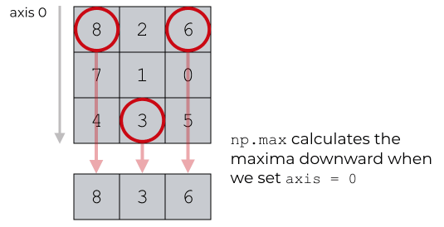
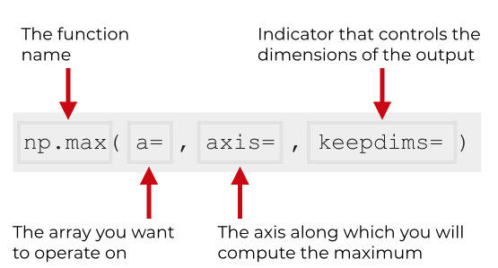
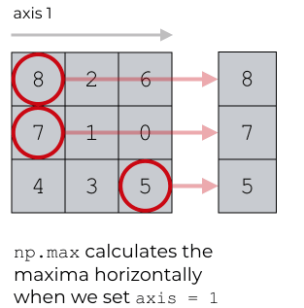
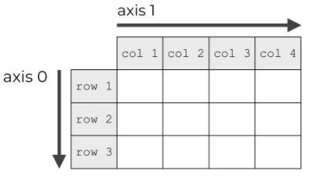
Axis operations
Example with np.max()
np.max(axis = 0)
np.max(axis = 1)

Slide 8
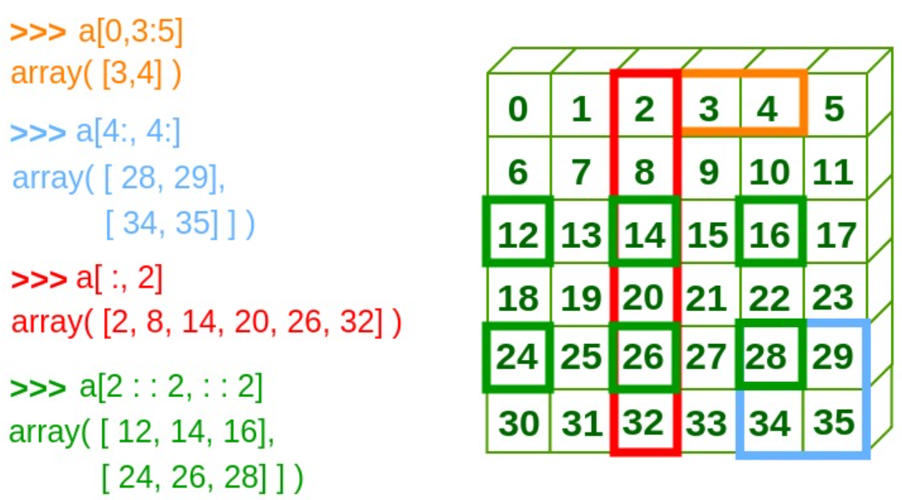
Indexing and slicing
Indexing: Accessing elements of an array by using their indices.
For one-dimensional Numpy arrays, you only need to specify one index value, which is the position of the element in the Numpy array (e.g. arrayname[index]).
For two-dimensional Numpy arrays, you need to specify both a row index and a column index for the element (e.g. arrayname[indexrow,indexcol]).
Slicing: Slicing means taking elements from one given index to another given index:
We pass slice instead of index like this: [start:end]
We can also define the step, like this: [start:end:step]
If we don't pass start its considered 0. If we don't pass end its considered length of array in that dimension. If we don't pass step its considered 1

Slide 9
Numpy
Recommended lectures
NumPy: the absolute basics for beginners:
https://numpy.org/doc/stable/user/absolute_beginners.html
NumPy quickstart:
https://numpy.org/doc/stable/user/quickstart.html
NumPy basics:
https://numpy.org/doc/stable/user/basics.html
https://github.com/albertofernandezvillan/computer-vision-and-deep-learning-course
Notes:
Empezar con el ejemplo del tren en la pizarra

