Slide 1
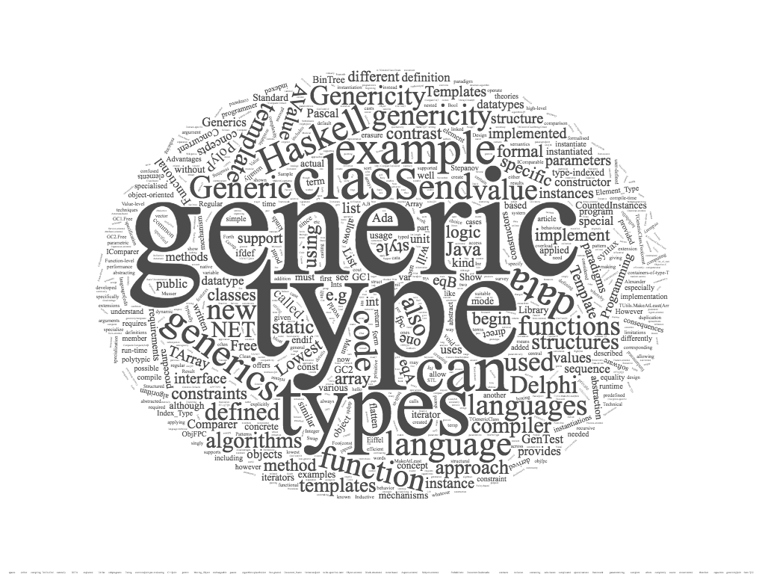
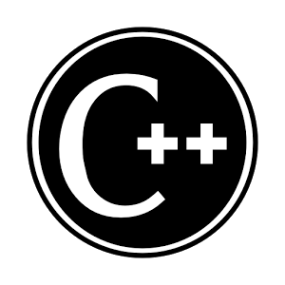
generic programming – c++

Slide 2
contents
generic programming in C++
function
overloading
void pointers
templates
class templates
variable templates
concepts

Slide 3

generic programming in c++
generic function
performs the same operation on different data types
how to implement a generic function in C++
overloading
void pointers
templates
example: swap the value of two variables

Slide 4
generic function - overloading
void my_swap (int &f, int &s ) {
int tmp = f; f=s; s=tmp;
}
void my_swap (string &f, string &s ) {
string tmp = f; f=s; s=tmp;
}
int main() {
string a, b; a = "hello"; b = "world";
cout << "before a = " << a << " b = " << b << endl;
my_swap (a,b);
cout << "after a = " << a << " b = " << b << endl;
int x, y; x = 33; y = 44;
cout << "before x = " << x << " y = " << y << endl;
my_swap(x,y);
cout << "after x = " << x << " by = " << y << endl;
double d1, d2; d1 = 3.3; d2 = 4.4;
cout << "before d1 = " << d1 << " d1 = " << d2 << endl;
// my_swap(d1,d2); // compile time error
// no know conversion from double to &int ...
cout << "after d1 = " << d1 << " d2 = " << d2 << endl;
return 0;
}
overloading: set of methods all having
the same name
different arguments list (signature)

Slide 5
generic function – void pointers
we can write a function that takes a void pointer as an argument, and then use that method with any pointer
this method is more general and can be used in more places
we need cast from void pointer to a specific pointer

Slide 6
gneric function – void pointers
void my_swap (void* &f, void* &s ) {
void* tmp = f;
f=s;
s=tmp;
}
int main() {
void* a; void* b;
a = new std::string("hello"); b = new std::string("world");
cout << *((string*) a) << *((string*) b) << endl;
my_swap (a,b);
cout << *((string*) a) << *((string*) b) << endl;
void* x; void* y;
x = new int(33); y = new int(44);
cout << *((int*) x) << *((int*) y) << endl;
my_swap(x,y);
cout << *((int*) x) << *((int*) y) << endl;
cout << "a = " << *((int*) a) << endl;
// no compile time error, no runtime error
// output a = 1919907594 :(
return 0;
}

Slide 7
generic function - templates
template <class T>
void my_swap(T& f, T& s) {
T tmp = f;
f = s;
s = tmp;
}
int main()
{
int a = 3; int b = 4;
cout << "before a = " << a << " b = " << b << endl;
my_swap<int> (a,b);
cout << "after a = " << a << " b = " << b << endl;
string s1 = "hello";
string s2 = "world";
cout << "before s1 = " << s1 << " s2 = " << s2 << endl;
my_swap<string> (s1,s2);
cout << "after s1 = " << s1 << " s2 = " << s2 << endl;
return 0;
}
we add a type parameter to the function

Slide 8
template
templates allows functions and classes to operate with generic types
with templates a function or a class can work on many different data types without being rewritten for each one
the C++ Standard Library provides many useful functions within a framework of connected templates
kinds of templates:
function templates
class templates
variable templates _{(C++14)}

Slide 9

function template
a function template defines a family of functions
template <class identifier> function_declaration;
template <typename identifier> function_declaration;

Slide 10
template: array central element
primitive type
T must be a type
template <typename T>
T centralElement(T data[], int cont)
{
return data[cont/2];
}
class
int i[] = {10,20,30,40,50};
int ci = centralElement(i,5);
string s[] = {"alpha","beta","gamma"};
string cs = centralElement(s,3);
float f[] = {2.2,3.3,4.4};
float cf = centralElement<float>(f,3);
type parameters are inferred from the values
in a function invocation
or explicitly passed as type parameter

Slide 11
argument deduction
template <typename T> T min (T a, T b) { return a < b ? a : b; } int main() { std::cout << min(3,4); // OK (output 3) 'int', 'int' inferred std::cout << min(3.3,4); // compile time error // template argument deduction/substitution failed: // deduced conflicting types for parameter ‘T’ (‘double’ and ‘int’) std::cout << min(3.3,(double)(4)); // OK (output 3.3) 'double', 'double' inferred std::cout << min(3.3,static_cast<double>(4)); // OK (output 3.3) 'double', 'double' inferred std::cout << min<double>(3.3,4); // OK (output 3.3) 'double' explicitly passed }

Slide 12
multiple type parameters
template <typename T1, typename T2> T1 min (T1 a, T2 b) { return a < b ? a : b; } int main() { std::cout << min(3,4) << std::endl; // output 3 : 'int', 'int' -> 'int' std::cout << min(3.3,4) << std::endl; // output 3.3 'double', 'int' -> 'double' std::cout << min(4, 3.3) << std::endl; // output 3 'int', 'double' -> 'int' }

Slide 13
return type parameter
template <typename T1, typename T2, typename RT> RT min (T1 a, T2 b) { return static_cast<RT>(a < b ? a : b); } int main() { std::cout << min<int,int,int>(3,4); // output 3 : 'int', 'int' -> 'int' std::cout << min<double,int,double>(3.3,4); // output 3.3 'double', 'int' -> 'double' std::cout << min<int,double,double>(4, 3.3); // output 3.3 'int', 'double' -> 'double' }

Slide 14

under the hood

Slide 15
C++ function template
in c++, templates are a pure compile-time feature
template is a factory that can be used to produce functions
c++ provide substitutions of types during compile time
in c# ﻿substitutions are performed at runtime
each set of different template parameters may cause the generation at compile time of a different internal function definition
the resulting program is bigger in size due to the boilerplate code created during compilation

Slide 16
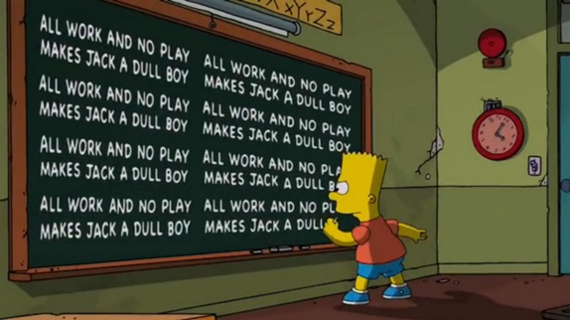
boilerplate code
sections of code included in many places with little or no alteration

Slide 17
more on function templates
a generic function is also called template function
when the compiler creates a specific version of a generic function, it is said to have created a generated function
the act of generation is said instantiation
a generated function is a specific instance of a template function
no code is generated from a source file that contains only template definitions
in order for any code to appear, a template must be instantiated → the template arguments must be determined so that the compiler can generate an actual function

Slide 18
generic function & overloading
we can define the explicit overloading of a generic function
the modified version overloaded, hide the generic function
template<class T> T square(T b) { return b * b; } template<> string square(string b) { return b + b; } int main( ) { int i = 5; cout << "square "<< i << " = " << square(i) << endl; //square 5 = 25 double j = 5.5; cout << "square "<< j << " = " << square(j) << endl; //square 5.5 = 30.25 string s = "hello"; cout << "square "<< s << " = " << square(s) << endl; //square hello = hellohello char c = 'h'; cout << "square "<< c << " = " << square(c) << endl; //square h = @ }

Slide 19
class template
template class can work with many different types of values

Slide 20
class template
a class template provides a specification for generating classes based on parameters
class templates are generally used to implement containers
a class template is instantiated by passing a given set of types to it as template arguments
template < parameter-list > class-declaration

Slide 21

template <typename F, typename S> class Pair { public: Pair(const F& f, const S& s); F get_first() const; S get_second() const; private: F first; S second; };
template <typename F, typename S> Pair<F,S>::Pair(const F& f, const S& s) { first = f; second = s; }; template <typename F, typename S> F Pair<F,S>::get_first() const { return first; }; template <typename F, typename S> S Pair<F,S>::get_second() const { return second; };

Slide 22
class templates unlike function templates
when we declare a variable of a template class you must specify the parameters type
types are not inferred
Pair<int,double> p1(2,3.4);
int p1_first = p1.get_first();
double p1_second = p1.get_second();
Pair<string,int> p2("alpha",5);
string p2_first = p2.get_first();
int p2_second = p2.get_second();

Slide 23


templates & compiler
template<typename T>
class Foo
{
public:
T& bar()
{
return subject;
}
private:
T subject;
};
class FooInt
{
public:
int& bar()
{
return subject;
}
private:
int subject;
}
class FooDouble
{
public:
double& bar()
{
return subject;
}
private:
double subject;
}
Foo<int> fooInt;
Foo<double> fooDouble;
the compiler generates the code for the specific types given in the template class instantiation
left side and right side will generate the same compiled code
FooInt fooInt;
FooDouble fooDouble;

Slide 24
inheritance vs template
inheritance
template
run time polymorphism
requires run time mechanism for binding
late binding
compile time polymorphism
each set of different template parameters may cause the generation of a different internal function definition
no run time cost

Slide 25
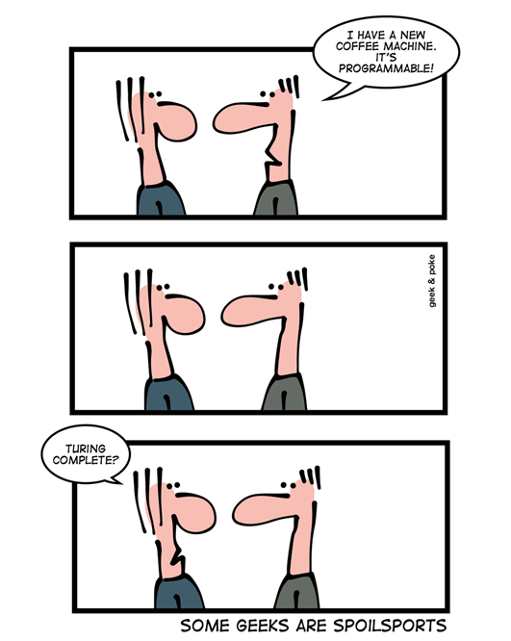
template → Turing complete
templates are a compile time mechanism that is Turing-complete
any computation expressible by a computer program can be computed, in some form, by a template metaprogram prior to runtime
is this fact useful in practice?

Slide 26

c++ templates with invalid parameters
compiler error messages are often misleading and obscure

Slide 27
class Point { public: Point(); Point(int, int); ~Point(); void setX(int); int getX(); void setY(int); int getY(); void display(); private: int x; int y; };
Point::Point () { x = 0; y = 0; } Point::Point (int x, int y) { this->x = x; this->y = y; } Point::~Point(){ } void Point::setX (int x){ this->x=x; } int Point::getX() { return x; } void Point::setY (int y){ this->y=y; } int Point::getY() { return y; } void Point::display() { cout<<"("<<x<<","<<y<<")"<<endl; }

Slide 28
invalid type parameter
the properties that a type parameter must satisfy are characterized only implicitly by the way instances of the type are used in the body of the template function
int mi = minValue(3,6); //(int int) OK
float mf1 = minValue(9.2,6.1); // (float float) OK
float mf2 = minValue(9.2,6);
// (float int) error:
template argument deduction/substitution failed
float mf3 = minValue<float>(9.2,6);
//explicit provide type parameter OK
Point p1(3.2,4.7);
Point p2(2.9,1.1);
Point p3 = minValue(p1,p2);
// error: no match for 'operator<‘
(operand types are 'Point' and 'Point')
template <typename T>
T minValue(T v1, T v2)
{
if (v1<v2)
return v1;
return v2;
}
Compiler error messages are often
misleading and obscure

Slide 29
problems
the error message we get from minValue(p1,p2) is verbose and nowhere near as precise and helpful
to use minValue we need to provide its definition, rather than just its declaration
the requirements of minValue on its argument type are implicit (“hidden”) in its function body
the error message for minValue will appear only when the template is instantiated, and that may be long after the point of call
proposed solution:
using a concept we can get to the root of the problem by properly specifying a template’s requirements on its arguments

Slide 30

c++ concepts

Slide 31
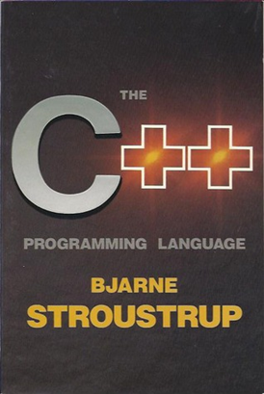
concepts
Bjarne Stroustrup
The Future of Generic Programming and
how to design good concepts and use them well

Slide 32
once upon a time ...
In about 1987, I (Bjarne Stroustrup) tried to design templates with proper interfaces. I failed. I wanted three properties for templates:
Full generality/expressiveness
Zero overhead compared to hand coding
Well-specified interfaces
Then, nobody could figure out how to get all three, so we got
:) Turing completeness
:) Better than hand-coding performance
:( Lousy interfaces (basically compile-time duck typing)
The lack of well-specified interfaces led to the spectacularly bad error messages we saw over the years. The other two properties made templates a run-away success.
The solution to the interface specification problem was named “concepts” by Alex Stepanov

Slide 33
timeline – traditional code
double sqrt(double d); // C++84: accept any d that is a double double d = 7; double d2 = sqrt(d); // fine: d is a double vector<string> vs = { "Good", "old", "templates" }; double d3 = sqrt(vs); // error: vs is not a double
we have a function sqrt specified to require a double
if we give it a double (as in sqrt(d)) all is well
if we give it something that is not a double (as in sqrt(vs)) we promptly get a helpful error message, such as “a vector<string> is not a double.”

Slide 34
timeline – 1990s style generic code
template<class T> void sort(T& c) // C++98: accept a c of any type T { // code for sorting (depending on various properties of T, // such as having [] and a value type with < } vector<string> vs = { "Good", "old", "templates" }; sort(vs); // fine: vs happens to have all the syntactic properties required by sort double d = 7; sort(d); // error: d doesn’t have a [] operator
the error message we get from sort(d) is verbose and nowhere near as precise and helpful
will appear only when the template is instantiated, and that may be long after the point of call
to use sort, we need to provide its definition, rather than just its declaration, this differs from ordinary code and changes the model of how we organize code
the requirements of sort on its argument type are implicit (“hidden”) in its function body

Slide 35
timeline – cpp20 with concepts
// Generic code using a concept (Sortable): void sort(Sortable& c); // Concepts: accept any c that is Sortable vector<string> vs = { "Hello", "new", "World" }; sort(vs); // fine: vs is a Sortable container double d = 7; sort(d); // error: d is not Sortable (double does not provide [], etc.)
this code is analogous to the sqrt example
the only real difference is that for double, a language designer (Dennis Ritchie) built it into the compiler as a specific type with its meaning specified in documentation
for Sortable, a user specified what it means in code
a type is Sortable if it has begin() and end() providing random access to a sequence with elements that can be compared using <
we get an error message much as indicated in the comment
the message is generated immediately at the point where the compiler sees the erroneous call (sort(d))

Slide 36
concepts as constraints
templates may be associated with a constraint
it specifies the requirements on template arguments
constraints may also be used to limit automatic type deduction in variable declarations and function return types to only the types that satisfy specified requirements
named sets of such requirements are called concepts
each concept is a predicate, evaluated at compile time, and becomes a part of the interface of a template where it is used as a constraint
violations of constraints are detected at compile time, early in the template instantiation process, which leads to easy to follow error messages

Slide 37
e.g. EqualityComparable
template <typename T> concept bool Equality_comparable() { return requires(T a, T b) { {a == b} -> bool; {a != b} -> bool; }; }
template <Equality_comparable T> bool twoEquals(T v1, T v2, T v3) { if (v1==v2 || v1==v3 || v2==v3) return true; return false; }
Equality_comparable is proposed as a standard-library concept
like many concepts it takes more than one argument: concepts describe not just types but relationships among types
a require expression is never actually executed → the compiler looks at the requirements and compiles only if all are true

Slide 38
compiler errors
cout<<twoEquals(2,3,2)<<endl; //(int int int) OK cout<<twoEquals(9.2,6.1,5.8)<<endl; //(float float float) OK cout<<twoEquals(2,3.1,2)<<endl; //(int float int) ERROR cout<<twoEquals<float>(9.2,6,6)<<endl; //explicit provide type parameter OK cout<<twoEquals("alpha","beta","beta")<<endl; //(string string string) OK Point p1(3,4); Point p2(5,2); Point p3(3,4); cout<<twoEquals(p1,p2,p3)<<endl; // error: cannot call function ‘bool twoEquals(T, T, T) [with T = Point]’ // error no match for 'operator<' (operand types are 'Point' and 'Point') // note: constraints not satisfied // bool twoEquals(T v1, T v2, T v3) // ^~~~~~~~~~~~~ // note:within 'template<class T> concept bool Equality_Comparable() [with T = Point]' // concept bool Equality_Comparable() // ^~~~~~~~~~~~~~~~~~~ // note: with ‘Point a’ // note: with ‘Point b’ // note: the required expression ‘(a == b)’ would be ill-formed // note: the required expression ‘(a != b)’ would be ill-formed

Slide 39
example
#include <iostream> #include <concepts> template<typename T> concept Addable = requires (T x) { x + x; }; // requires-expression template<typename T> requires Addable<T> // requires-clause, not requires-expression T mySum(T a, T b) { return a + b; } int main() { std::cout << mySum(3,4) << std::endl; return 0; }
https://en.cppreference.com/w/cpp/language/constraints
https://coliru.stacked-crooked.com/

Slide 40
concept summary
concepts are named boolean predicates on template parameters, evaluated at compile time
a concept may be associated with a template, it serves as a constraint (limits the set of arguments that are accepted as template parameters)
concepts simplify compiler diagnostics for failed template instantiations
if a programmer attempts to use a template argument that does not satisfy the requirements of the template, the compiler will generate an error

Slide 41
concepts as semantic categories
the intent of concepts is to model semantic categories rather than syntactic restrictions
the ability to specify a meaningful semantics is a defining characteristic of a true concept, as opposed to a syntactic constraint
“Concepts are meant to express semantic notions, such as ‘a number’, ‘a range’ of elements, and ‘totally ordered.’ Simple constraints, such as ‘has a + operator’ and ‘has a > operator’ cannot be meaningfully specified in isolation and should be used only as building blocks for meaningful concepts, rather than in user code.”
Avoid "concepts" without meaningful semantics
(ISO C++ core guideline T.20)
Bjarne Stroustrup - Herb Sutter

Slide 42
e.g. Number
template<typename T> concept Number = requires (T x) { x + x; x - x; x * x; x / x; -x; x += x;
… }; template<typename T> requires Number<T> T mySum(T a, T b) { return a + b; }
this is extremely unlikely
to be matched unintentionally

Slide 43
concepts library (c++20)
the concepts library provides definitions of fundamental library concepts that can be used to perform compile-time validation of template arguments
most concepts in the standard library impose both syntactic and semantic requirements
a standard concept is satisfied if its syntactic requirements are met and its semantic requirements (if any) are also met
only the syntactic requirements can be checked by the compiler

Slide 44
concepts library (c++20)
core language concepts
comparison concepts
object concepts
callable concepts
additional concepts can be found in the iterators library, the the algorithms library, and the ranges library

Slide 45
The concept convertible_to<From, To> specifies that an expression of the same type and value category as those of std::declval<From>() can be implicitly and explicitly converted to the type To, and the two forms of conversion are equivalent.
template <class From, class To>
concept convertible_to =
std::is_convertible_v<From, To> &&
requires(std::add_rvalue_reference_t<From> (&f)()) {
static_cast<To>(f());
};
The concept totally_ordered<T> specifies that the comparison operators ==,!=,<,>,<=,>= on T yield results consistent with a strict total order on T.
template <class T>
concept totally_ordered =
std::equality_comparable<T> && __PartiallyOrderedWith<T, T>;
template <class T>
concept copyable =
std::copy_constructible<T> &&
std::movable<T> &&
std::assignable_from<T&, T&> &&
std::assignable_from<T&, const T&> &&
std::assignable_from<T&, const T>;
The concept copyable<T> specifies that T is an movable object type that can also copied (that is, it supports copy construction and copy assignment).

Slide 46
references
Dehnert, James & Stepanov, Alexander. (1998). Fundamentals of Generic Programming. LNCS. 1766. 1-11. 10.1007/3-540-39953-4_1.
B. Stroustrup: Concepts: The Future of Generic Programming (or "How to design good concepts and use them well)". January 2017.
https://en.cppreference.com/w/cpp/concepts

