Slide 1
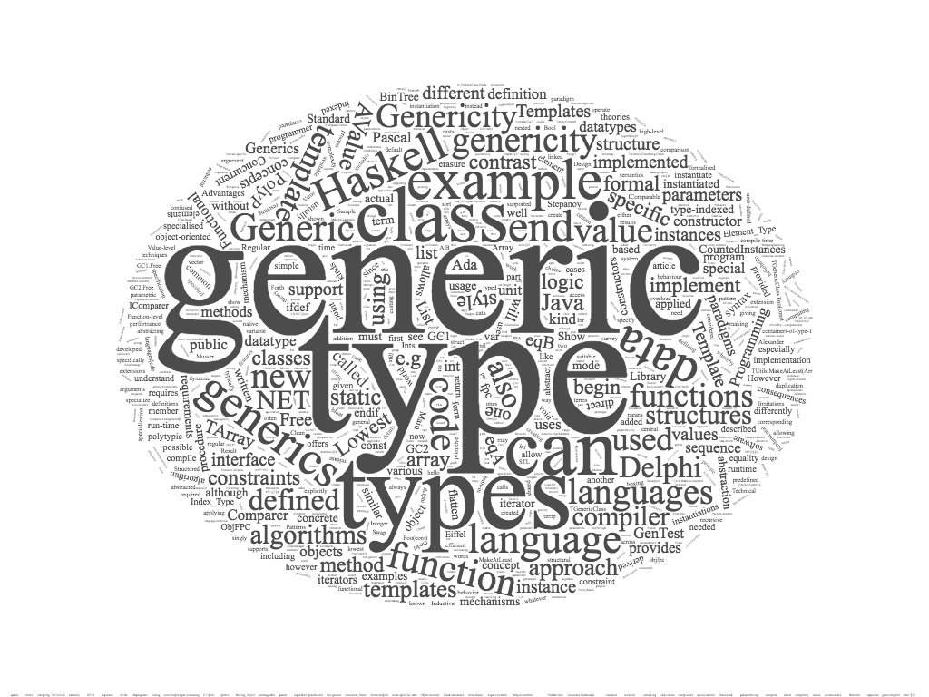
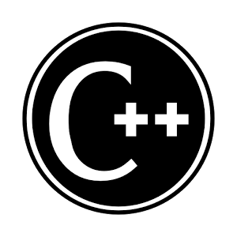
generic programming
alberto ferrari – university of parma

Slide 2
contents
generic programming in C++
  function
    overloading
    void pointers
    templates
  class templates
  variable templates
concepts

Slide 3

generic programming in C++
generic function
  performs the same operation on different data types
how to implement a generic function in C++
  overloading
  void pointers
  templates
example: swap the value of two variables

Slide 4
generic function – overloading
void my_swap (int &f, int &s ) {
int tmp = f; f=s; s=tmp;
}
void my_swap (string &f, string &s ) {
string tmp = f; f=s; s=tmp;
}
int main() {
string a, b; a = "hello"; b = "world";
cout << "before a = " << a << " b = " << b << endl;
my_swap (a,b);
cout << "after a = " << a << " b = " << b << endl;
int x, y; x = 33; y = 44;
cout << "before x = " << x << " y = " << y << endl;
my_swap(x,y);
cout << "after x = " << x << " by = " << y << endl;
double d1, d2; d1 = 3.3; d2 = 4.4;
cout << "before d1 = " << d1 << " d1 = " << d2 << endl;
// my_swap(d1,d2); // compile time error
// no know conversion from double to &int ...
cout << "after d1 = " << d1 << " d2 = " << d2 << endl;
return 0;
}
overloading: set of methods all having
the same name
different arguments list (signature)

Slide 5
generic function – void pointers
void my_swap (void* &f, void* &s ) {
void* tmp = f;
f=s;
s=tmp;
}
int main() {
void* a; void* b;
a = new std::string("hello"); b = new std::string("world");
cout << *((string*) a) << *((string*) b) << endl;
my_swap (a,b);
cout << *((string*) a) << *((string*) b) << endl;
void* x; void* y;
x = new int(33); y = new int(44);
cout << *((int*) x) << *((int*) y) << endl;
my_swap(x,y);
cout << *((int*) x) << *((int*) y) << endl;
cout << "a = " << *((int*) a) << endl;
// no compile time error, no runtime error
// output a = 1919907594 :(
return 0;
}
we can write a method that takes a void pointer as an argument, and then use that method with any pointer
this method is more general and can be used in more places
we need cast from void pointer to a specific pointer

Slide 6
generic function – void pointers – static cast
void my_swap (void* &f, void* &s ) {
void* tmp = f;
f=s;
s=tmp;
}
int main() {
void* a; void* b;
a = new string("hello"); b = new string("world");
cout << *(static_cast<string*>(a)) << *(static_cast<string*>(b)) << endl;
swap (a,b);
cout << *(static_cast<string*>(a)) << *(static_cast<string*>(b)) << endl;
int* x; int* y;
x = new int(33); y = new int(44);
cout << *(static_cast<int*>(x)) << *(static_cast<int*>(y)) << endl;
my_swap(x,y);
cout << *(static_cast<int*>(x)) << *(static_cast<int*>(y)) << endl;
cout << "a = " << *(static_cast<int*>(a)) << endl;
// no compile time error, no runtime error
// output a = 1919907594 :(
return 0;
}
the static cast performs conversions between compatible types
it is similar to the C-style cast, but is more restrictive
  for example: the C-style cast would allow an integer pointer to point to a char

Slide 7
generic function – templates
template <class T>
void my_swap(T& f, T& s) {
T tmp = f;
f = s;
s = tmp;
}
int main()
{
int a = 3; int b = 4;
cout << "before a = " << a << " b = " << b << endl;
my_swap<int> (a,b);
cout << "after a = " << a << " b = " << b << endl;
string s1 = "hello";
string s2 = "world";
cout << "before s1 = " << s1 << " s2 = " << s2 << endl;
my_swap<string> (s1,s2);
cout << "after s1 = " << s1 << " s2 = " << s2 << endl;
return 0;
}
we add a type parameter to the function

Slide 8
template
templates allows functions and classes to operate with generic types
with templates a function or a class can work on many different data types without being rewritten for each one
the C++ Standard Library provides many useful functions within a framework of connected templates
kinds of templates:
  function templates
  class templates
  variable templates _{(C++14)}

Slide 9

function template
A function template
defines a family of functions
template <class identifier> function_declaration;
template <typename identifier> function_declaration;

Slide 10
template: array central element
primitive type
T must be a type
template <typename T>
T centralElement(T data[], int cont)
{
return data[cont/2];
}
class
int i[] = {10,20,30,40,50};
int ci = centralElement(i,5);
string s[] = {"alpha","beta","gamma"};
string cs = centralElement(s,3);
float f[] = {2.2,3.3,4.4};
float cf = centralElement<float>(f,3);
Type parameters are inferred from the values in a function invocation
Or explicitly passed as type parameter

Slide 11
argument deduction
Type parameters are
  inferred from the values in a function invocation
  or explicitly passed as type parameter
template <typename T>
T min (T a, T b) {
return a < b ? a : b;
}
int main() {
std::cout << min(3,4); // OK (output 3) 'int', 'int' inferred
std::cout << min(3.3,4); // compile time error
// template argument deduction/substitution failed:
// deduced conflicting types for parameter ‘T’ (‘double’ and ‘int’)
std::cout << min(3.3,(double)(4)); // OK (output 3.3) 'double', 'double' inferred
std::cout << min(3.3,static_cast<double>(4)); // OK (output 3.3) 'double', 'double' inferred
std::cout << min<double>(3.3,4); // OK (output 3.3) 'double' explicitly passed
}

Slide 12
multiple type parameters
template <typename T1, typename T2>
T1 min (T1 a, T2 b) {
return a < b ? a : b;
}
int main() {
std::cout << min(3,4) << std::endl; // output 3 : 'int', 'int' -> 'int'
std::cout << min(3.3,4) << std::endl; // output 3.3 'double', 'int' -> 'double'
std::cout << min(4, 3.3) << std::endl; // output 3 'int', 'double' -> 'int'
}

Slide 13
return type parameter
template <typename T1, typename T2, typename RT>
RT min (T1 a, T2 b) {
return static_cast<RT>(a < b ? a : b);
}
int main() {
std::cout << min<int,int,int>(3,4);
// output 3 : 'int', 'int' -> 'int'
std::cout << min<double,int,double>(3.3,4);
// output 3.3 'double', 'int' -> 'double'
std::cout << min<int,double,double>(4, 3.3);
// output 3.3 'int', 'double' -> 'double'
}
template <typename RT, typename T1, typename T2>
RT min (T1 a, T2 b) {
return static_cast<RT>(a < b ? a : b);
}
int main() {
std::cout << min<int>(3,4);
// output 3 : 'int', 'int' -> 'int'
std::cout << min<double>(3.3,4);
// output 3.3 'double', 'int' -> 'double'
std::cout << min<double>(4, 3.3);
// output 3.3 'int', 'double' -> 'double'
}

Slide 14

under the hood

Slide 15
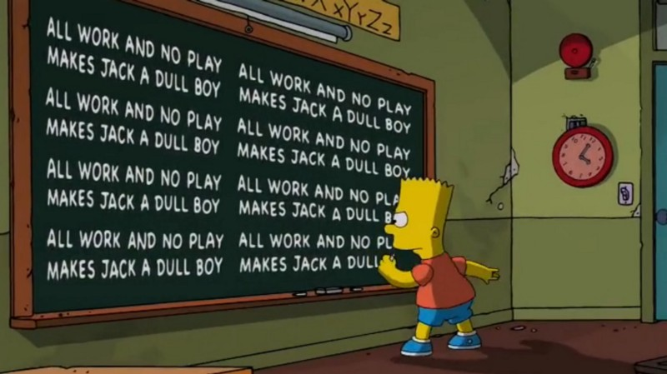
C++ & function template
in C++, templates are a pure compile-time feature
template is a factory that can be used to produce functions
C++ provide substitutions of types during compile time
  in C# ﻿substitutions are performed at runtime
each set of different template parameters may cause the generation at compile time of a different internal function definition
the resulting program is bigger in size due to the boilerplate code created during compilation
boilerplate code = sections of code included
in many places with little or no alteration

Slide 16
more on template functions
a generic function is also called template function
when the compiler creates a specific version of a generic function, it is said to have created a generated function
  the act of generation is said instantiation
a generated function is a specific instance of a template function
no code is generated from a source file that contains only template definitions
in order for any code to appear, a template must be instantiated → the template arguments must be determined so that the compiler can generate an actual function

Slide 17
generic functions & overloading
we can define the explicit overloading of a generic function
the modified version overloaded, hide the generic function
compile-time cases were performed by pattern matching over the template arguments
template<class T>
T square(T b) { return b * b; }
template<>
string square(string b) { return b + b; }
int main( ) {
int i = 5; cout << "square "<< i << " = " << square(i) << endl; //square 5 = 25
double j = 5.5; cout << "square "<< j << " = " << square(j) << endl; //square 5.5 = 30.25
string s = "hello";
cout << "square "<< s << " = " << square(s) << endl; //square hello = hellohello
char c = 'h';
cout << "square "<< c << " = " << square(c) << endl; //square h = @
}

Slide 18
variable template (c++14)
a variable template defines a family of variables or static data members
syntax: template < parameter-list > variable-declaration
example:
template<class T>
constexpr T pi = T(3.1415926535897932385); // variable template
template<class T>
T circular_area(T r) { // function template
return pi<T> * r * r; // pi<T> is a variable template instantiation
}
int main() {
double r1 = 10.0;
cout << circular_area<double>(r1) << endl; // 314.159
int r2 = 10;
cout<< circular_area<int>(r2) << endl; // 300
return 0;
}

Slide 19
explicit overloading of a variable template
template <int N> // Recursive template for general case
struct factorial {
const static int value = n * factorial<n - 1>::value;
};
template <> // Template specialization for base case
struct factorial<0> {
const static int value = 1;
};
int main() {
cout << "4! = " << factorial<4>::value << endl;
}

Slide 20
class template
class template
template class can work with many different types of values

Slide 21
class template
a class template provides a specification for generating classes based on parameters
class templates are generally used to implement containers
a class template is instantiated by passing a given set of types to it as template arguments
template < parameter-list > class-declaration

Slide 22

class Pair
template <typename F, typename S>
class Pair
{
public:
Pair(const F& f, const S& s);
F get_first() const;
S get_second() const;
private:
F first;
S second;
};
template <typename F, typename S>
Pair<F,S>::Pair(const F& f, const S& s)
{
first = f;
second = s;
};
template <typename F, typename S>
F Pair<F,S>::get_first() const
{
return first;
};
template <typename F, typename S>
S Pair<F,S>::get_second() const
{
return second;
};

Slide 23
class templates unlike function templates
When we declare a variable of a template class you must specify the parameters type. Types are not inferred.
Pair<int,double> p1(2,3.4);
int p1_first = p1.get_first();
double p1_second = p1.get_second();
Pair<string,int> p2("alpha",5);
string p2_first = p2.get_first();
int p2_second = p2.get_second();
(C++17 has template deduction of constructors)

Slide 24


templates & compiler
template<typename T>
class Foo
{
public:
T& bar()
{
return subject;
}
private:
T subject;
};
class FooInt
{
public:
int& bar()
{
return subject;
}
private:
int subject;
}
class FooDouble
{
public:
double& bar()
{
return subject;
}
private:
double subject;
}
Foo<int> fooInt;
Foo<double> fooDouble;
The compiler generates the code for the specific types given in the template class instantiation.
Left side and right side will generate the same compiled code
FooInt fooInt;
FooDouble fooDouble;

Slide 25
inheritance Vs templates
inheritance
  run time polymorphism
  requires run time mechanism for binding
  late binding
templates
  compile time polymorphism
  each set of different template parameters may cause the generation of a different internal function definition
  no run time cost

Slide 26
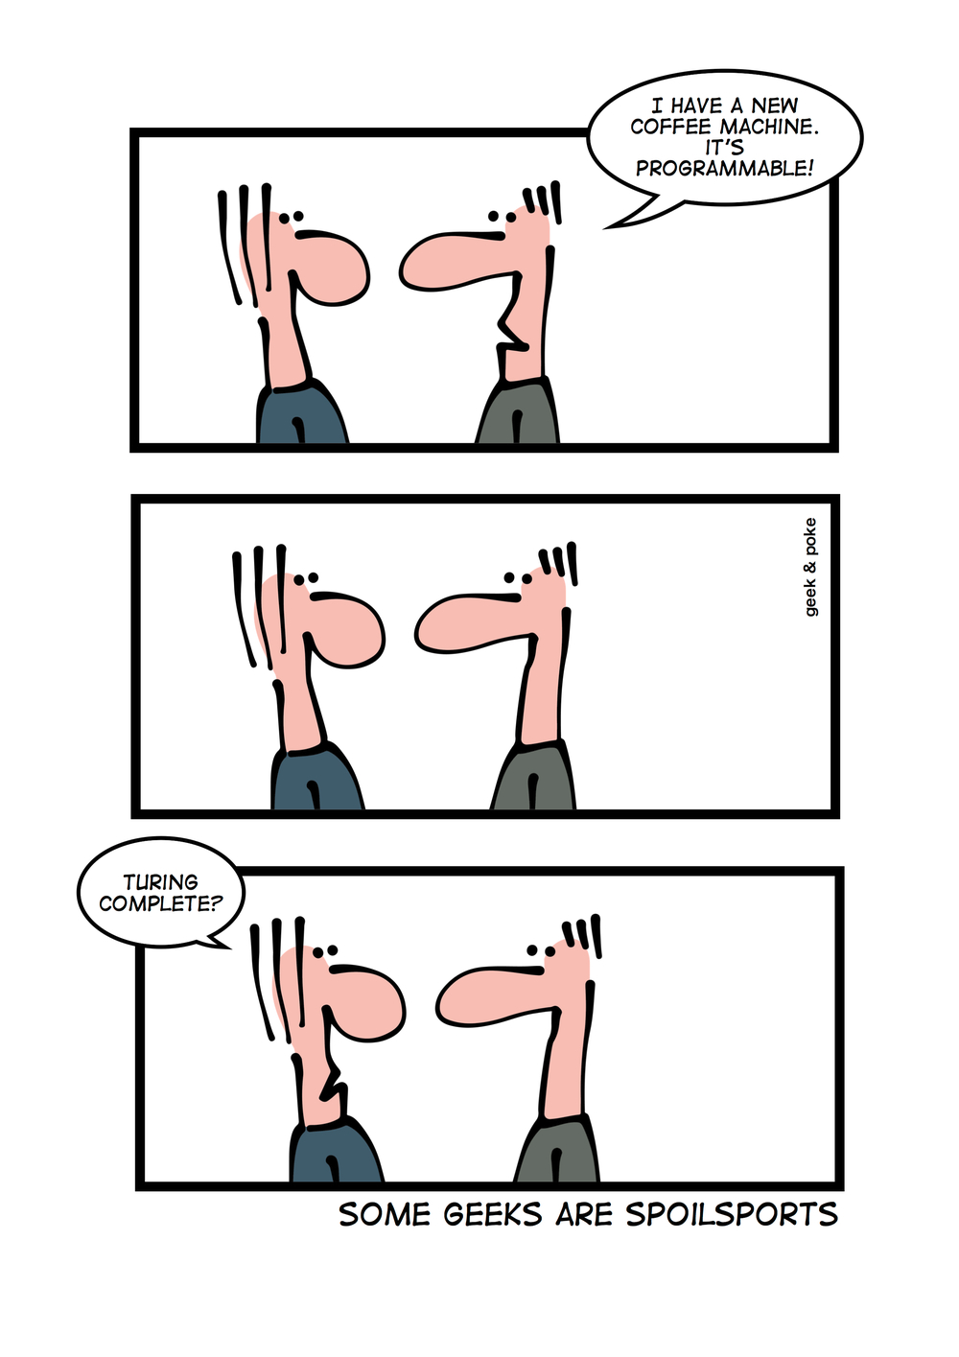
template → Turing-complete
templates are a compile time mechanism in C++ that is Turing-complete
  any computation expressible by a computer program can be computed, in some form, by a template metaprogram prior to runtime
is this fact useful in practice?

Slide 27

C++ templates with invalid parameters
compiler error messages
are often misleading and obscure

Slide 28
class Point
class Point {
public:
Point();
Point(int, int);
~Point();
void setX(int);
int getX();
void setY(int);
int getY();
void display();
private:
int x;
int y;
};
Point::Point () {
x = 0; y = 0;
}
Point::Point (int x, int y) {
this->x = x; this->y = y;
}
Point::~Point(){ }
void Point::setX (int x){
this->x=x; }
int Point::getX() {
return x; }
void Point::setY (int y){
this->y=y; }
int Point::getY() {
return y;
}
void Point::display() {
cout<<"("<<x<<","<<y<<")"<<endl;
}

Slide 29
invalid type parameters
the properties that a type parameter must satisfy are characterized only implicitly by the way instances of the type are used in the body of the template function
template <typename T>
T minValue(T v1, T v2)
{
if (v1<v2)
return v1;
return v2;
}
int mi = minValue(3,6); //(int int) OK
float mf1 = minValue(9.2,6.1); // (float float) OK
float mf2 = minValue(9.2,6);
// (float int) error: template argument deduction/substitution failed
float mf3 = minValue<float>(9.2,6); //explicit provide type parameter OK
Point p1(3.2,4.7);
Point p2(2.9,1.1);
Point p3 = minValue(p1,p2);
// error: no match for 'operator<' (operand types are 'Point' and 'Point')
Compiler error messages are often misleading and obscure

Slide 30
problems
the error message we get from minValue(p1,p2) is verbose and nowhere near as precise and helpful
to use minValue we need to provide its definition, rather than just its declaration, this differs from ordinary code and changes the model of how we organize code
the requirements of minValue on its argument type are implicit (“hidden”) in its function body
the error message for minValue will appear only when the template is instantiated, and that may be long after the point of call
proposed solution:
  using a concept we can get to the root of the problem by properly specifying a template’s requirements on its arguments

Slide 31

C++ concepts

Slide 32
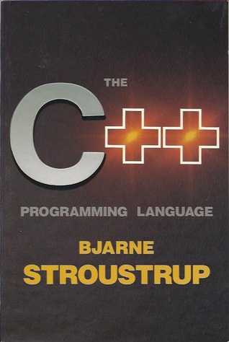
Concepts
Bjarne Stroustrup
The Future of Generic Programming and
how to design good concepts and use them well

Slide 33
once upon a time ...
In about 1987, I (Bjarne Stroustrup) tried to design templates with proper interfaces. I failed. I wanted three properties for templates:
Full generality/expressiveness
Zero overhead compared to hand coding
Well-specified interfaces
Then, nobody could figure out how to get all three, so we got
:) Turing completeness
:) Better than hand-coding performance
:( Lousy interfaces (basically compile-time duck typing)
The lack of well-specified interfaces led to the spectacularly bad error messages we saw over the years. The other two properties made templates a run-away success.
The solution to the interface specification problem was named “concepts” by Alex Stepanov.
http://www.stroustrup.com/good_concepts.pdf

Slide 34
duck typing
duck typing is an application of the duck test in type safety
  “if it looks like a duck, swims like a duck, and quacks like a duck, then it probably is a duck”
type checking is deferred to runtime
normal typing
  suitability is assumed to be determined by an object's type only
duck typing
  suitability is determined by the presence of certain methods and properties (with appropriate meaning), rather than the actual type of the object

Slide 35
timeline – traditional code
double sqrt(double d){...}; // C++84: accept any d that is a double
double d = 7;
double d2 = sqrt(d); // fine: d is a double
vector<string> vs = { "Good", "old", “templates" };
double d3 = sqrt(vs); // error: vs is not a double
we have a function sqrt specified to require a double
if we give it a double (as in sqrt(d)) all is well
if we give it something that is not a double (as in sqrt(vs)) we promptly get a helpful error message, such as “a vector<string> is not a double.”

Slide 36
timeline – 1990s style generic code
template<class T> void sort(T& c) // C++98: accept a c of any type T
{
// code for sorting (depending on various properties of T,
// such as having [] and a value type with <
}
vector<string> vs = { "Good", "old", “templates" };
sort(vs); // fine: vs happens to have all the syntactic properties required by sort
double d = 7;
sort(d); // error: d doesn’t have a [] operator
the error message we get from sort(d) is verbose and nowhere near as precise and helpful
  will appear only when the template is instantiated, and that may be long after the point of call
to use sort, we need to provide its definition, rather than just its declaration, this differs from ordinary code and changes the model of how we organize code
  the requirements of sort on its argument type are implicit (“hidden”) in its function body

Slide 37
timeline – 2017(?)
// Generic code using a concept (Sortable):
void sort(Sortable& c); // Concepts: accept any c that is Sortable
vector<string> vs = { "Hello", "new", "World" };
sort(vs); // fine: vs is a Sortable container
double d = 7;
sort(d); // error: d is not Sortable (double does not provide [], etc.)
this code is analogous to the sqrt example
the only real difference is that
  for double, a language designer (Dennis Ritchie) built it into the compiler as a specific type with its meaning specified in documentation
  for Sortable, a user specified what it means in code
    a type is Sortable if it has begin() and end() providing random access to a sequence with elements that can be compared using <
we get an error message much as indicated in the comment
  the message is generated immediately at the point where the compiler sees the erroneous call (sort(d))

Slide 38
concepts as constraints
templates may be associated with a constraint, which specifies the requirements on template arguments, which can be used to select the most appropriate function overloads and template specializations
constraints may also be used to limit automatic type deduction in variable declarations and function return types to only the types that satisfy specified requirements
named sets of such requirements are called concepts
each concept is a predicate, evaluated at compile time, and becomes a part of the interface of a template where it is used as a constraint
violations of constraints are detected at compile time, early in the template instantiation process, which leads to easy to follow error messages

Slide 39
e.g. EqualityComparable
template <typename T>
concept bool Equality_comparable()
{
return requires(T a, T b) {
{a == b} -> bool;
{a != b} -> bool;
};
}
template <Equality_comparable T>
bool twoEquals(T v1, T v2, T v3)
{
if (v1==v2 || v1==v3 || v2==v3)
return true;
return false;
}
Equality_comparable is proposed as a standard-library concept
like many concepts it takes more than one argument: concepts describe not just types but relationships among types
a require expression is never actually executed → the compiler looks at the requirements and compiles only if all are true

Slide 40
compiler errors
cout<<twoEquals(2,3,2)<<endl; //(int int int) OK
cout<<twoEquals(9.2,6.1,5.8)<<endl; //(float float float) OK
cout<<twoEquals(2,3.1,2)<<endl; //(int float int) ERROR
cout<<twoEquals<float>(9.2,6,6)<<endl; //explicit provide type parameter OK
cout<<twoEquals("alpha","beta","beta")<<endl; //(string string string) OK
Point p1(3,4); Point p2(5,2); Point p3(3,4);
cout<<twoEquals(p1,p2,p3)<<endl;
// error: cannot call function ‘bool twoEquals(T, T, T) [with T = Point]’
// error no match for 'operator<' (operand types are 'Point' and 'Point')
// note: constraints not satisfied
// bool twoEquals(T v1, T v2, T v3)
// ^~~~~~~~~~~~~
// note: within ‘template<class T> concept bool Equality_Comparable() [with T = Point]’
// concept bool Equality_Comparable()
// ^~~~~~~~~~~~~~~~~~~
// note: with ‘Point a’
// note: with ‘Point b’
// note: the required expression ‘(a == b)’ would be ill-formed
// note: the required expression ‘(a != b)’ would be ill-formed

Slide 41
shorthand notation
standard notation example:
template <typename Seq>
requires Sequence<Seq>
void algo(Seq& s) …
…
shorthand notation:
template <Sequence Seq>
void algo(Seq& s) …
…
template<C T>
means
template<typename T>
requires C<T>
we need the long form expressing complex requirements

Slide 42
concepts summary
concepts are named boolean predicates on template parameters, evaluated at compile time
a concept may be associated with a template (class template, function template, or member function of a class template); it serves as a constraint (limits the set of arguments that are accepted as template parameters)
concepts = constraints + axioms
constraints are predicates on static properties of a type
axioms state semantic requirements on types that should not be statically evaluated. An axiom is an invariant that is assumed to hold (as opposed required to be checked) for types that meet a concept
concepts are predicates that represent general, abstract, and stable requirements of generic algorithms on their argument. They are defined in terms of constraints and axioms
concepts simplify compiler diagnostics for failed template instantiations
  if a programmer attempts to use a template argument that does not satisfy the requirements of the template, the compiler will generate an error. When concepts are not used, such errors are often difficult to understand because the error is not reported in the context of the call, but rather in an internal, often deeply nested, implementation context where the type was used

Slide 43
concept in 2017
during the C++11 standards development cycle, much work was done on a feature called “concepts” which aimed at providing systematic constraints on templates. Concepts was deferred from C++11 for lack of time to complete it, but work has continued
the non C++17 features (think Concepts) will be available as addons in upcoming compiler releases
now we have
  a ISO TS (“Technical Specification”) for concepts
    “… This Technical Specification describes extensions to the C++ Programming Language that enable the specification and checking of constraints on template arguments, and the ability to overload functions and specialize class templates based on those constraints. These extensions include new syntactic forms and modifications to existing language semantics.”
  concepts implementation is shipping as part of GCC 6
    https://gcc.gnu.org/gcc-6/
ISO Technical Specification
A Technical Specification addresses work still under technical development, or where it is believed that there will be a future, but not immediate, possibility of agreement on an International Standard. A Technical Specification is published for immediate use, but it also provides a means to obtain feedback. The aim is that it will eventually be transformed and republished as an International Standard.

Slide 44

GCC 6
GCC 6 (GNU Compiler Collection) is the first compiler with concept support
C++ Concepts are now supported when compiling with
--std=c++1z -fconcepts
g++ --std=c++1z concepts.cpp -o concepts
Online: http://en.cppreference.com/w/cpp/language/constraints

Slide 45
GCC 6
GCC 6 (GNU Compiler Collection) is the first compiler with concept support
C++ Concepts are now supported when compiling with
--std=c++1z -fconcepts
g++ --std=c++1z concepts.cpp -o concepts
Online: http://en.cppreference.com/w/cpp/language/constraints

Slide 46
concepts as semantic categories
the intent of concepts is to model semantic categories rather than syntactic restrictions
the ability to specify a meaningful semantics is a defining characteristic of a true concept, as opposed to a syntactic constraint
“Concepts are meant to express semantic notions, such as ‘a number’, ‘a range’ of elements, and ‘totally ordered.’ Simple constraints, such as ‘has a + operator’ and ‘has a > operator’ cannot be meaningfully specified in isolation and should be used only as building blocks for meaningful concepts, rather than in user code.”
Avoid "concepts" without meaningful semantics
(ISO C++ core guideline T.20)
Bjarne Stroustrup - Herb Sutter

Slide 47
e.g. AdmitsSum
template <typename T>
concept bool AdmitsSum() {
return requires(T a, T b) {
{a + b} -> T;
};
}
template <AdmitsSum T>
T mySum(T v1, T v2) {
return v1+v2;
}
int main() {
int mi = mySum(3,3); // OK
cout<<mi<<endl;
string s1 = mySum("alpha","beta"); // error?
cout<<s1<<endl;
}

Slide 48
e.g. Number
template<typename T>
concept bool Number = requires(T a, T b) {
{ a+b } -> T;
{ a-b } -> T;
{ a*b } -> T;
{ a/b } -> T;
{ -a } -> T;
{ a+=b } -> T&;
{ a-=b } -> T&;
{ a*=b } -> T&;
{ a/=b } -> T&;
{ T{0} }; // can construct a T from a zero
// …
} ;
this is extremely unlikely to be matched unintentionally

Slide 49
e.g. isIntegral
Trait class that identifies whether T is an integral type.
It inherits from integral_constant as being either true_type or false_type, depending on whether T is an integral type:
// is_integral example
#include <iostream>
#include <type_traits>
int main() {
std::cout << std::boolalpha;
std::cout << "is_integral:" << std::endl;
std::cout << "char: " << std::is_integral<char>::value << std::endl;
std::cout << "int: " << std::is_integral<int>::value << std::endl;
std::cout << "float: " << std::is_integral<float>::value << std::endl;
return 0;
}
see also
  is_floating_point
  is_arithmetic
  is_fundamental
  is_signed
  is_unsigned

Slide 50
concept overloading
concepts allows us to select among functions based of properties of the arguments given
Example: simple advance algorithm for iterator
void advance(Forward_iterator p, int n) {
while(n--)
++p;
}
void advance(Random_access_iterator p, int n) {
p+=n;
}
void use(vector<string>& vs, list<string>& ls) {
auto pvs = find(vs,”foo”);
advance(pvs,2); // use fast advance
auto pls = find(ls,”foo”);
advance(pls,2); // use slow advance
}

Slide 51
compiler overload resolution
compiler overload resolution based on concepts:
  if a function matches the requirements of one concept only, call it
  if a function matches the requirements of no concept, the call is an error
  if the function matches the requirements of two concepts, see if the requirements of one of those concepts is a subset of the requirements of the other
    if so, call the function with the most requirements (the strictest requirements)
    if not, the call is an error (ambiguous)

Slide 52
“A Concept Design for the STL”
Bjarne Stroustrup, Andrew Sutton, et al., “A Concept Design for the STL” (ISO/IEC JTC1/SC22/WG21 N3351, January 2012)
… We define seven concepts relating directly to language features: four that describe relationships between types and three that classify fundamental types. We imagine that these concepts will be intrinsic (i.e. , built into the compiler)
Type relations:
  concept Same<typename T, typename U>
    T and U denote exactly the same type after elimination of aliases
  concept Derived<typename T, typename U>
    T is derived from U
  concept Convertible<typename T, typename U>
    A value of T can be implicitly converted to a value of U
  concept Common<typename T, typename U>
    T and U can both be unambiguously converted to a third type C
Type classification
  concept Integral<typename T>
  concept SignedIntegral<typename T>
  concept UnsignedIntegral<typename T>

